Slide 1
NAS Enterprise Architecture
Infrastructure Roadmaps-
Surveillance v17.0
Baseline
February 2023

Slide 2
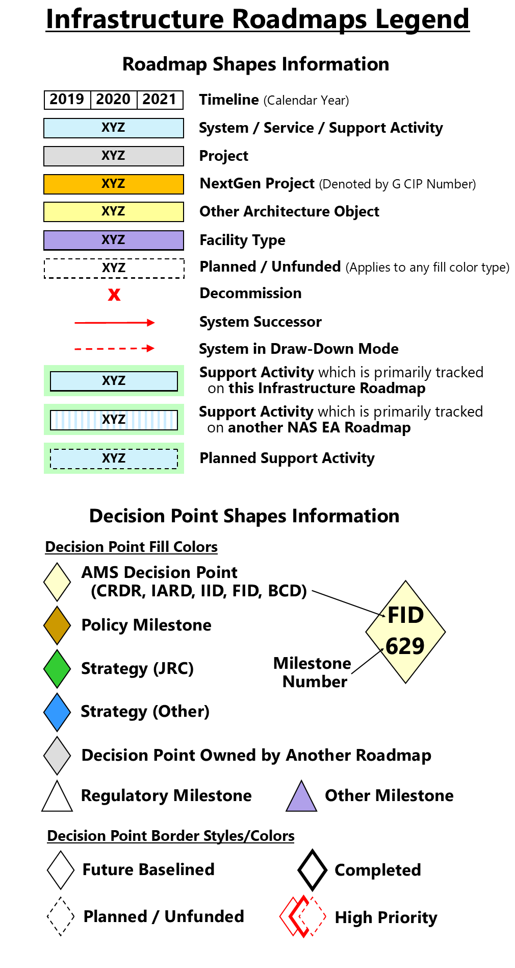
Infrastructure Roadmap Overview
What are the Infrastructure Roadmaps?
The FAA Infrastructure Roadmaps show the progression of system deployments, investments, and key decision points for major NAS acquisitions. They depict the acquisition strategy to evolve the NAS from the As-Is to the To-Be environment.
The Infrastructure Roadmaps show all Capital Investment Plan (CIP) investment projects and systems identified in the NSIP that will deliver the necessary functionality to enable OIs and BTIs.
Guidelines for Understanding the Roadmaps
The Infrastructure Roadmaps are organized by Domain (Automation, Communication, etc.) and depict projects, systems, services, decision points, and support activities.
The timeline is in calendar years and shows a 15-year outlook.
The roadmaps have swim lanes for infrastructure (white) and Support Activities (green).
The DP diamonds represent the quarter in which a decision will occur.
The Support Activity bars represent the dates that work is being performed on the activity.
The Project bars represent the dates that CIP funding is allocated to a project.
The System and Service bars represent the dates that a system or service is operational, with red lines indicating sustainment, drawdown, or convergence.
What’s new in Version 17.0?
See Appendix B: Change History for domain-specific changes.

Slide 3
Surveillance
Objective: The Surveillance roadmap depicts the sustainment of legacy surveillance systems and the evolution towards the NextGen environment.

Slide 4
Surveillance Roadmap (1 of 4)
Cooperative Surveillance - Broadcast Services
ADS-B
ADS-R
TIS-B
FIS-B
SBS Monitor
ADS-B Baseline Services Future Segments
ADS-B Services & Baselines
IARD
1323
FID
1327
FID
1390
FID
1327
ADS-B Baseline Services Future Segments Phase 2
IARD
1391
FID
1392
ADS-B Baseline Services Future Segments Phase 3
ADS-B Out
Avionics
1213
ADS-B In
Avionics
1213
ADS-B In Appl - Interval Management Planning
ADS-B In Applications
ADS-B In Capability Indicators
ADS-B Interval Management
IARD
1393
FID
1232
ADS-B Interval Management Phase 1A
FID
1240
ADS-B Enhancement
IARD
1348
Includes Space-Based ADS-B
ADS-C
Advanced Surveillance Enhanced Procedural Separation (ASEPS)

Slide 5
Surveillance Roadmap (2 of 4)
Cooperative Surveillance Systems
ADS-B Baseline Services Future Segments
WAM
FID
1327
ADS-B Baseline Services Future Segments Phase 2
Mode S Beacon Replacement System Phase 1A
FID 1321
Mode S Beacon Replacement System Phase 1B
FID 1343
Mode S Beacon Replacement System Phase 2
Select # (~40) of Mode S, ATCBI-5, and ATCBI-6 systems replaced by MSBRS Phase 1A/1B
[300+ legacy cooperative systems remaining]
MSBRS
Terminal and En Route Surveillance Technical Refresh Portfolio
MODE S
Mode S Sustainment 4
ATCBI-6
ATCBI-6M
ATCBI-6 Sustainment
ATCBI-5
ATCBI-5 Sustainment 1
ATCBI-5 Sustainment 2
ASR-11
ASR-11 Sustainment 4
FID 806
ASR-11 Sustainment 3
Interfaces
CD-2
Cooperative Avionics
Mode 3/A/C
Transponder
Mode S
Transponder
TCAS
ACAS X
1165
ACAS-X
ACAS-X Segment 2

Slide 6
Surveillance Roadmap (3 of 4)
Non-Cooperative Surveillance
Common ARSR
DoD/DHS funded/FAA maintained
ARSR-4
DoD/DHS funded/FAA maintained
FID 806
ASR-11 Sustainment 3
Terminal and En Route Surveillance Technical Refresh Portfolio
ASR-11
ASR-11 Sustainment 4
ASR-8/CTD
ASR-8 Sustainment 1
ASR-9
ASR-9 Sustainment 4
ASR-9 Sustainment 3
ANSR to evaluate alternatives for sustaining Non-Cooperative radar service provided by ASR-8, ASR-9 and ASR-11
IARD
1236
IID
1237
FID
1238
Airspace Non-Cooperative Surveillance Radar (ANSR)
Interfaces
TDX-2000
X
CV-4400

Slide 7
Surveillance Roadmap (4 of 4)
Surface and Approach
Surface Surveillance Portfolio Sustainment
RWSL
Runway Status Lights (RWSL) Sustainment
FID 1319
ASDE Surface Movement Radar Replacement
Airport Surface Detection Equipment (ASDE) Sustainment
ASDE-X
ASDE-3
ASSC
Support
Activities
IARD
1236
Evaluate Impact of Wind Turbine
Interference on Radar Systems
Evaluate Impact of Wind Turbine
Interference on Radar Systems
IARD
1236
Surveillance Portfolio Analysis
Surveillance Portfolio Analysis
IARD
1323
FID 1321
FID
1327

Slide 8
Surveillance Roadmap: Assumptions
Identifier | Description
SURV-01 | Backup to mitigate loss of on-board GPS positioning source for ADS-B is required: a) Retain all en route beacons (~150 monopulse systems) b) Retain limited set of terminal beacons (or WAM) based on need (Core 30 airports for resiliency, other airports based on economic analysis and ADS-B equipage rates) c) All terminal non-cooperative surveillance coverage areas are retained for safety purposes d) Selected terminal surveillance systems that will no longer be required will be divested starting in CY2020
SURV-02 | The Mode-S Beacon Replacement System (MSBRS) will replace all remaining beacon systems that are not replaced by WAM
SURV-03 | The ANSR program will determine the long-term upgrade strategy of the ASR-8, ASR-9, and ASR-11 (PSR portion) systems

Slide 9
Surveillance Roadmap: Decision Points (1 of 1)

