Slide 1
REDAC / Human Factors
Review of FY 2018 Proposed Portfolio
Air Traffic Control / Technical Operations Human Factors
BLI Number: 8BA000 (Core Program)
Dan Herschler, ANG-C1
March 29, 2016

Slide 2
ATC / Tech Ops Human Factors –
Core Program Overview
Purpose:
  To provide technical sponsors with timely and appropriate R&D products and consultation services that improve safety and efficiency of complex ATC systems
Methods used:
  Measuring individual and team performance of air traffic controllers and technical operations specialists.
  Recommending and testing improvements to design, procedures, training, selection and placement; and mitigations to address human performance shortfalls.

Slide 3
ATC / Tech Ops Human Factors Benefits
What are the benefits to the FAA:
Improving the safety and efficiency of complex ATC systems by application of R&D to address factors affecting human performance in air traffic control operations and ATC system maintenance.
Recommending and testing improvements to design, procedures, training, selection and placement; and mitigations to address human performance shortfalls.
What determines program success
R&D Sponsors and Stakeholders in the ATO are able to make important workforce policy and acquisition decisions based on the results of thorough, timely, and focused R&D efforts.
When programs embrace human factors processes and requirements during system acquisition, they reduce human factors risks. This increases the likelihood for successful system implementation and operation, while reducing the likelihood for system design and engineering rework.

Slide 4
ATC / Tech Ops Human Factors –
Core Program Team
  ATO Sponsors:
    AJG – Management Services
    AJI – Safety and Technical Training
    AJM – Program Management Office
  ANG-C1 Program Management:
    PM - Dan Herschler
    Human Factors Integration Lead - Bill Kaliardos
  FAA Research Performers:
    FAA Civil Aerospace Medical Institute (CAMI)
      Aerospace Human Factors Research Division (AAM-500)
        AAM-520 – Carol Manning, Manager
    FAA William J. Hughes Technical Center
      Aviation Research Division (ANG-E2), Human Factors Branch
        ANG-E25 – Kenneth Allendoerfer, Manager

Slide 5
ATC / Tech Ops Human Factors
Focus Areas
The program addresses R&D needs within
five focus areas:
  Human Factors Standards
  Workforce Optimization – Human Factors Efforts
  Improved Safety – Human Factors Efforts
  Human Factors in NAS Technology Integration
  Human Performance Enhancement
The program also supports Human Factors efforts for FAA acquisition programs through ISR Checklist human factors approval responsibility, and AMS Policy updates

Slide 6
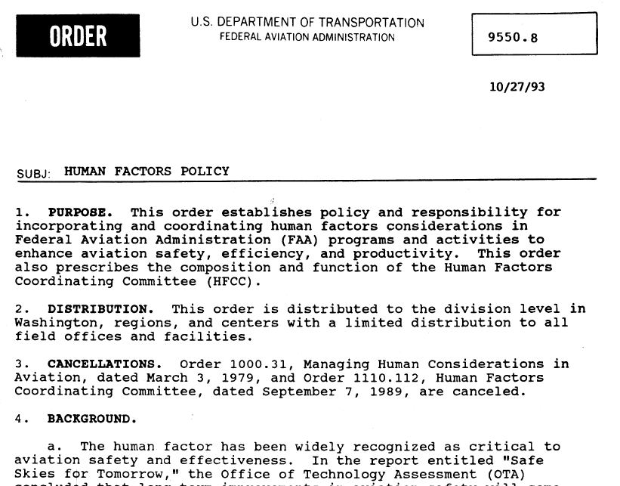
Provide Human Factors Support to
FAA Acquisition
Research Requirement
Outputs/Outcomes
Promote human factors engagement in acquisition program planning and execution
Provide advice and guidance to support incorporation of human factors principles and requirements, and the identification and mitigation of human factors issues throughout the AMS Lifecycle.
Serve as human factors subject matter expert with signature authority on in-service review (ISR) checklist prior to the In-Service Decision milestone.
Stakeholders: ATO Project Management Office (PMO)
Coordination on AMS HF across Lines of Business
Consensus-driven HF updates to draft AMS documents
Through ISR Checklist process: confirm human factors program adequacy and facilitate identification, tracking, mitigation, and resolution of human factors issues on acquisition programs.
FY 14/15 Accomplishment / Issues
Out Year Funding Requirements
Convened Human Factors Acquisition Working Group (Kaliardos) to discuss planned improvements to integrate human factors into 1) AMS guidance for the early phases, and 2) the Safety Risk Management Guidance for System Acquisitions (SRMGSA) document.
Conducted semi-annual Human Factors Reviews to communicate the accomplishments, activities, and challenges for human factors R&D and F&E activities as they support ATO and AVS initiatives and research needs.
Updated FAA Human Factors Division website https://www.hf.faa.gov to facilitate access to key information.
FY14 | FY15 | FY16 | FY17 | FY18
$0 | $0 | $0 | $0 | $0
ANG-C1 in-house resources:
Bill Kaliardos, Dan Herschler
6

Slide 7
HF.1 Human Factors Standards
Develop and update human factors standards that convey:
  Human factors design requirements for new and modified air traffic control systems.
  Human factors practices and requirements for contractors who plan and execute human factors efforts to meet air traffic control acquisition program requirements.
Update AMS Policy and Guidance that PMO human factors specialists will reference and apply on FAA acquisition programs.

Slide 8

1.07 Update “Requirements for a Human Factors Program” (FAA-HF-STD-004)
Research Requirement
Outputs/Outcomes
The purpose of this effort is to update HF-STD-004 “Requirements for a Human Factors Program” that was published in June 2009. The current standard is based on MIL-STD-46855A and as such is more aligned to military procurement than with human factors acquisition contracting in the FAA.
Updated material addresses lessons learned and best practices from acquisition programs’ human factors efforts. The updated standard will guide the PMO in defining SOW requirements for the system acquisition contractors’ human factors program activities and deliverables.
Sponsor: Human Factors Division (ANG-C1)
Stakeholders: AJM (Acquisition Program offices); HFAWG (Bill Kaliardos)
POC: Dan Herschler, ATC/TO HF BLI Program Manager, ANG-C1
Product:
Revision A to FAA-HF-STD-004 (6/2016)
Note: This effort will help the PMO to define SOW requirements for the contractor’s human factors program activities and data for FAA system acquisition programs
FY 14/15 Accomplishment / Issues
Out Year Funding Requirements
Develop new data item descriptions for human factors activities that are required during system development (e.g., Early User Involvement Events [EUIEs] and Heuristic Evaluations)
Develop a new section on HF support for system fielding and deployment that addresses HF in site adaptation, system acceptance testing, coordination, in-service support, and post implementation review.
Add text to clarify responsibilities FAA and acquisition contractor team human factors personnel regarding acquisition program human factors tasks and program support activities.
FY14 | FY15 | FY16 | FY17 | FY18
$0 | $78K | $0 | $0 | $0
Research Performer:
  WJHTC Aviation Research Division,
  Human Factors Branch, ANG-E25
8

Slide 9
HF.2 Human Factors in Workforce Optimization
Develop recommendations and guidance for ATO and FAA Academy sponsors who are responsible for policies affecting controller and technician recruitment, training, placement, staffing, and performance evaluation.
Maintain reliable and valid job/task analysis data that support application of FAA policies, and that will withstand potential legal challenges.
Upon sponsor request, conduct research to identify and recommend alternative approaches where current policies and methods result in adverse impact for employee selection, as required by EEOC Uniform Guidelines in 29 Code of Federal Regulations.

Slide 10
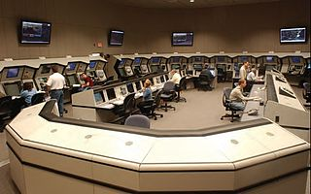
2.04 Training Certification Standards
Research Requirement
Outputs/Outcomes
Assess a method for improving air traffic controller training certification rates for roll out across the NAS
Sponsor: Arlenne Gonzalez (ENE-N90)
POC: Stephanie Kreseen, Program Manager, ANG-C1
Nick Lento, Manager (A), ANG-C1
Product:
A complete and vetted collection of training standards
Research report providing data on the effectiveness of the training standards
Outcomes:
Increased certification rates
Reduced time to certification
FY 14/15 Accomplishment / Issues
Out Year Funding Requirements
Completed initial development of training standards with TRACON SMEs
Developed and delivered Phase 1 training workshops
  OJTIs and FLMs received skill enhancement and best practices training
  Developmentals received learning styles and study skills training
FY14 | FY15 | FY16 | FY17 | FY18
$0 | $310K | $61K | $0 | $0
Research Performer:
  National Institute of Aerospace, Evans Inc.
10

Slide 11
HF.3 Human Factors in Improved Safety
Identify and characterize safety-related aspects of human capabilities and limitations that impact performance of air traffic control and technical operations personnel in the NAS
Through analysis and research, support major FAA safety initiatives such as the Runway Safety Call to Action, by developing human factors recommendations and guidance that will improve procedures and training in operational domains where air traffic controllers and pilots interact

Slide 12
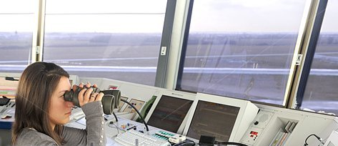
3.02 Tower Controller Visual Scanning
Research Requirement
Outputs/Outcomes
Numerous safety incidents have led ATO to declare Tower Controller Visual Scanning as a Top 5 Safety issues for FY2016.
CAMI will review existing information to identify best practices based on what is currently known about visual scanning and what has proven effective for monitoring the airport environment from the air traffic control tower. These best practices will be confirmed in discussion with FAA SMEs.
Additional human performance data will be obtained in a low-fidelity laboratory simulation study of controller visual scanning patterns.
The results of these efforts will be combined to produce recommendations and guidance by September 2016 to ATO Safety (AJI-1) for tower controller visual scanning best practices.
Sponsor: ATO Safety (AJI-155)
POC: Dan Herschler, ATC/TO HF BLI Program Manager, ANG-C1
Product:
Develop a research plan in conjunction with AJI-155 based on a workshop with field personnel, a review of existing ATC handbook policy, field practices, incident/accident observations and lessons learned.
Conduct low-fidelity research to test some identified techniques and provide recommendations that AJI-155 can offer to the field for improved scanning
FY 14/15 Accomplishment / Issues
Out Year Funding Requirements
Tower Scanning was included on AJI’s list of the Top 5 ATC Safety Hazards.
AJI-155 (Jason Demagalski) identified a list of activities on visual scanning in the tower environment that he asked AAM-520 to support.
This is a new task in FY16.
FY14 | FY15 | FY16 | FY17 | FY18
$0 | $0 | $70K | $0 | $0
Research Performer:
  CAMI Aerospace Human Factors Research Division AAM-520
12

Slide 13
HF.4 Human Factors in NAS Technology Integration
Develop methods and tools to support air traffic control system acquisition program efforts to address human factors during concept development, including prototyping and scenario evaluations.
Improve human factors laboratory capabilities using state-of-the-art human performance and human factors measurement techniques, to support studies that more robustly evaluate and predict human performance with future NAS technologies and procedures.

Slide 14
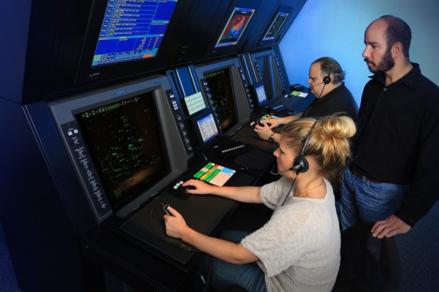
4.01 Standardized Scenario Development and Performance Metrics
Research Requirement
Outputs/Outcomes
ATO Project Management Office (AJM) requested assistance in developing methods to allow acquisition programs to identify and mitigate human factors concerns before fielding of new and upgraded NAS capabilities.
ATC technologies and procedures should be subjected to HF evaluations using standardized human performance metrics prior to deployment. New systems should be evaluated against situations as close as possible to those likely to be encountered in the field and should include off-nominal events.
To meet this need, CAMI is developing and obtaining SME concurrence on operational scenarios that will be used in human factors testing of new NAS technologies and procedures; they also are developing recommended measures of human performance that can be used in evaluations of new ATC capabilities.
Sponsor: ATO Program Management Office (AJM-352)
POC: Dan Herschler, ATC/TO HF BLI Program Manager, ANG-C1
Products:
Scenario requirements database
Validated performance measures
Technical report and briefing to sponsor
FY 14/15 Accomplishment / Issues
Out Year Funding Requirements
Completed sector analysis
Developed 9 example scenarios
Associated scenario elements with an existing ATC task analysis.
FY14 | FY15 | FY16 | FY17 | FY18
$5K | $31K | $0 | $0 | $0
Research Performer:
  CAMI Aerospace Human Factors Research Division AAM-520
14

Slide 15
HF.5 Human Performance Enhancement
Develop methods of measurement and assessment criteria supporting evaluation of air traffic controller and technician performance and application in workforce improvement policies.
Conduct focused research to identify minimum qualifications for specific air traffic control and technical operations jobs and performance in initial training.

Slide 16
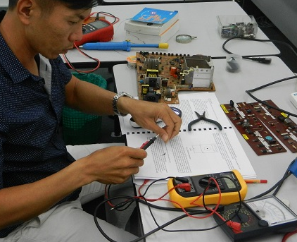
5.10 Content Validation of ATSS Common Principles Course to Support Employment Decisions
Research Requirement
Outputs/Outcomes
The Vice President of Technical Operations (AJW) would like to implement methods to identify trainees who are likely to be successful in training and certification as an ATSS.
To meet the AJW requirement under this task, CAMI will determine whether attachment of job jeopardy to ATSS performance in the Technical Operations Common Principles course is supported by content validation.
If there is a reasonable correspondence between course content and job knowledge and skill requirements, then attachment of job jeopardy to student performance is justified. If there is little correspondence between course content and job requirements, then job jeopardy would not be justified.
Sponsors: ATO Management Services (AJG-R42)
POC: Dan Herschler, ATC/TO HF BLI Program Manager, ANG-C1
Products:
Recommendation to AJW on whether to attach job jeopardy to Common Principles (April 2016)
Common Principles content validation technical report (June 2016)
FY 14/15 Accomplishment / Issues
Out Year Funding Requirements
American Institutes for Research previously completed subject matter expert (SME) panels and a joint management/labor review panel to identify technician job tasks, knowledge, skills, abilities, and other personal characteristics (KSAOs), and tools and equipment.
Prepared a Job analysis survey data to identify: (a) the most critical or important job duties/tasks, and (b) the most important KSAOs needed on Day 1 at an SSC.
FY14 | FY15 | FY16 | FY17 | FY18
$160K | $0 | $0 | $0 | $0
Research Performer:
  CAMI Aerospace Human Factors Research Division AAM-520, American Institutes for Research (AIR)
16

Slide 17
Anticipated Research in FY16 and FY17
Planned Research Activities (with anticipated completion dates)
Human Factors Standards:
  Develop a standard for the use of color on ATC displays using a defined palette of colors which are recognizable, legible, and discriminable by controllers (FY2017)
  Develop and implement an air traffic control information display and control management design strategy that incorporates best practices and lessons learned from prior and current air traffic user team activities (2019)
  Expand the work on the air traffic control information display and control management design strategy to achieve agile design characteristics (2020)
Workforce Optimization:
  Conduct research to provide data and targeted analyses to support data-driven decision-making at the FAA Academy Air Traffic Division, including documenting and improving the reliability of the raters who evaluate ATC student performance at the end of their initial courses (FY2017)
  Assess the Radar Vectoring Aptitude Test (RVAT) as a measure of vectoring aptitude and assist in determining its predictive validity, utility, and fairness use in the placement of newly hired air traffic developmental controllers (FY2017).

Slide 18
Anticipated Research in FY16 and FY17
Planned Research Activities (with anticipated completion dates)
Improved Safety:
  Evaluate factors related to controller recognition of hazards in the airport traffic area (e.g., via visual scanning) and develop recommendations to improve safety in the airport environment (FY2017).
  Conduct an ATO fatigue mitigation effectiveness study to determine the extent to which fatigue associated with insufficient sleep remains an issue in ATC/TO work force and whether particular work schedules are associated with greater fatigue (FY2017).
Human Factors in NAS Technology Integration:
  Develop a systematic analysis method for evaluating how well the user community is adopting and taking advantage of Air Traffic automation systems' capabilities (FY2017).
Human Performance Enhancement:
  Deliver prototype training standards and training performance measures to decrease the attrition rate at large and complex ATC facilities (FY2017).
  Develop recommendations for increasing the likelihood that controller trainees will succeed in field training to ensure that trainees are not lost due to factors other than their ability to control air traffic (FY2017).

Slide 19
Emerging FY18 Focal Areas
Human Factors Standards:
  Complete development of an empirically-validated color palette for ATC displays to ensure that displayed information is recognizable, discriminable, and legible for personnel with normal color vision and color-vision deficient personnel
Workforce Optimization:
  Develop and evaluate the suitability of objective assessments of electronics knowledge and skill levels of newly hired technical operations personnel and applicants (AJW funding)
Improved Safety:
  Assess the effects of shift work on personnel fatigue and develop recommended mitigations for fatigue effects on performance
Human Factors in NAS Technology Integration:
  Develop recommendations for a design strategy to optimize presentation of air traffic control information on controller workstation displays, to allow the controller to quickly and accurately process the information.
Human Performance Enhancement:
  Develop training performance measures and standards to reduce attrition of controllers-in-training at ATC facilities.

Slide 20
BACKUP SLIDES
QUAD CHARTS FOR EACH PROJECT
SORTED BY YEAR OF
EXPECTED COMPLETION

Slide 21
PROJECTS ENDING IN FY2016

Slide 22
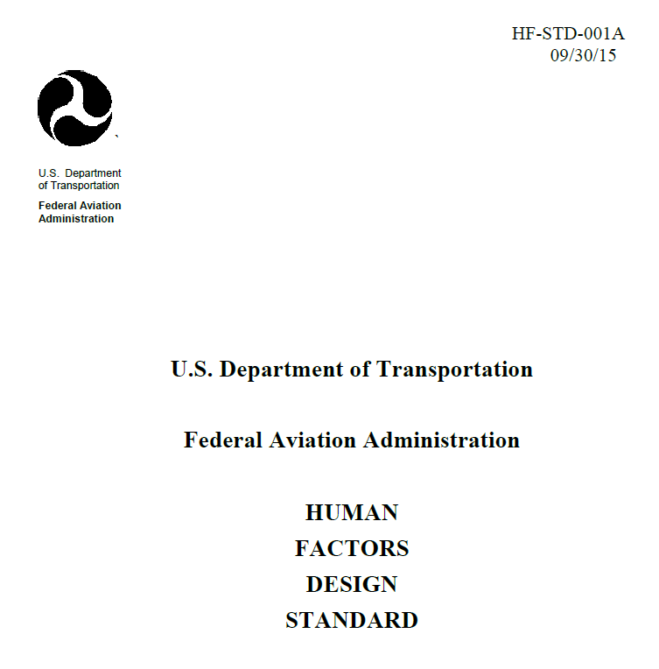
1.06 Update Human Factors Design Standard
(FAA-HF-STD-001A)
Research Requirement
Outputs/Outcomes
The purpose of this effort is to produce revision B to the Human Factors Design Standard (FAA HF-STD-001A). The original standard was released in 2003 and needs to be revised so that its requirements address the current landscape of technologies that are likely to be used in air traffic control systems. This document is the main source of human engineering design requirements for new and modified systems that are developed or purchased COTS products.
The updated standard will guide the PMO in defining SOW design requirements for air traffic control system acquisitions.
Sponsor: Human Factors Division (ANG-C1)
Stakeholders: AJM (Acquisition Program offices); HFAWG (Bill Kaliardos)
POC: Dan Herschler, ATC/TO HF BLI Program Manager, ANG-C1
Product:
Revision B to HFDS (6/2016)
Note: This document is the main source of human engineering design requirements for new and modified systems that are developed or purchased COTS products.
FY 14/15 Accomplishment / Issues
Out Year Funding Requirements
Published interim update FAA HF-STD-001A on the FAA Technical Center Library website
Identified references that were outdated or superseded by new material
Compared automation, controls and visual indicators, and displays and printers chapters from HFDS-001 (2003) to HF-STD-001A and identified new material
FY14 | FY15 | FY16 | FY17 | FY18
$0 | $208K | $0 | $0 | $0
Research Performer:
  WJHTC Aviation Research Division,
  Human Factors Branch, ANG-E25
22

Slide 23
1.07 Update “Requirements for a Human Factors Program” (FAA-HF-STD-004)
Research Requirement
Outputs/Outcomes
The purpose of this effort is to update HF-STD-004 “Requirements for a Human Factors Program” that was published in June 2009. The current standard is based on MIL-STD-46855A and as such is more aligned to military procurement than with human factors acquisition contracting in the FAA.
Updated material addresses lessons learned and best practices from acquisition programs’ human factors efforts. The updated standard will guide the PMO in defining SOW requirements for the system acquisition contractors’ human factors program activities and deliverables.
Sponsor: Human Factors Division (ANG-C1)
Stakeholders: AJM (Acquisition Program offices); HFAWG (Bill Kaliardos)
POC: Dan Herschler, ATC/TO HF BLI Program Manager, ANG-C1
Product:
Revision A to FAA-HF-STD-004 (6/2016)
Note: This effort will help the PMO to define SOW requirements for the contractor’s human factors program activities and data for FAA system acquisition programs
FY 14/15 Accomplishment / Issues
Out Year Funding Requirements
Develop new data item descriptions for human factors activities that are required during system development (e.g., Early User Involvement Events [EUIEs] and Heuristic Evaluations)
Develop a new section on HF support for system fielding and deployment that addresses HF in site adaptation, system acceptance testing, coordination, in-service support, and post implementation review.
Add text to clarify responsibilities FAA and acquisition contractor team human factors personnel regarding acquisition program human factors tasks and program support activities.
FY14 | FY15 | FY16 | FY17 | FY18
$0 | $78K | $0 | $0 | $0
Research Performer:
  WJHTC Aviation Research Division,
  Human Factors Branch, ANG-E25
23

Slide 24

2.02 OJTI Training Support
Research Requirement
Outputs/Outcomes
ATO Safety and Technical Training (AJI-1 and AJI-2) are concerned about the efficacy of controller on-the-job training at field facilities. CAMI will evaluate two Academy courses: Initial On the Job Instructor (OJTI) training (course 55049) and Cadre Training (course 50331).
CAMI will develop course improvements and a supplemental resource, The Air Traffic Instructor’s Handbook, for use in all OJTI courses and for use by OJTIs and FLMs at ATC field facilities. Then, CAMI will evaluate the improvements and make recommendations to AJI sponsors concerning demonstrated improvements in CPC and OJTI training.
Initial OJTI training helps Certified Professional Controllers (CPCs) learn skills for effectively conducting OJT, with emphasis on safety standards.
Sponsors: ATO Technical Training (AJI-231, 212),
ATO Safety (AJI-155)
POC: Dan Herschler, ATC/TO HF BLI Program Manager, ANG-C1
Product:
Deliver course improvements and a supplemental resource, The Air Traffic Instructor’s Handbook, for use in all OJTI courses and for use by OJTIs and FLMs at ATC field facilities.
FY 14/15 Accomplishment / Issues
Out Year Funding Requirements
Developed and administered surveys to OJTIs and FLMs about topics they thought should be added to the initial OJTI training course. Reported results to sponsors.
Collected and analyzed evaluative data from participants of OJTI Training Operational Tryout.
The evaluation will help to determine whether the courses meet the stated objectives and demonstrate improvements in OJTI training.
Management/NATCA disagreements may delay implementation of OJTI and OJTI Cadre training.
FY14 | FY15 | FY16 | FY17 | FY18
$0 | $56K | $0 | $0 | $0
Research Performer:
  CAMI Aerospace Human Factors Research Division AAM-520
24

Slide 25
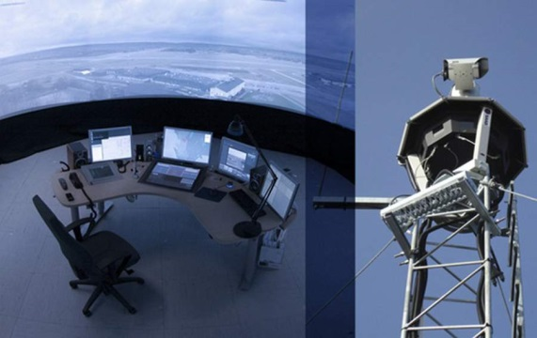
3.03 Human Factors and Safety Considerations in ATC Operations
Research Requirement
Outputs/Outcomes
AJI – Safety has identified several areas in which human factors R&D and engineering support are needed to address urgent safety needs, including defining human factors taxonomies and providing training in their application as part of formalized risk analysis processes, and identification of visual performance requirements for air traffic control operations in the airport environment.
Specific tasks will support FAA efforts including :
  Service Integrity and Air Traffic Control Airborne Risk Analysis Processes (SIRAP and Airborne RAP) taxonomy development, harmonization, and analyst training.
  Provide guidance based on human factors analyses for virtual ATC towers, facility operations, and RNAV/RNP operations.
Sponsor: ATO Safety (AJI-121, AJI-155, AJI-1112, ANG-C5)
POC: Dan Herschler, ATC/TO HF BLI Program Manager, ANG-C1
Products:
Report on 2014 and 2015 SI-RAP to-date analysis
Report summarizing ATCT Scenarios for remote tower requirements development
Report on Human Performance Assessment for Remote Towers
FY 14/15 Accomplishment / Issues
Out Year Funding Requirements
Completed delivery of SI-RAP training materials and course delivery to AJI and AJW personnel
Developed reporting template for SI-RAP annual aggregate analysis report
Developed scenarios based on FAA Order JO7110.65 to support development of performance requirements for remote (virtual) towers.
FY14 | FY15 | FY16 | FY17 | FY18
$668K | $626K | $0 | $0 | $0
Research Performer:
  Fort Hill Group, LLC
25

Slide 26
4.01 Standardized Scenario Development and Performance Metrics
Research Requirement
Outputs/Outcomes
ATO Project Management Office (AJM) requested assistance in developing methods to allow acquisition programs to identify and mitigate human factors concerns before fielding of new and upgraded NAS capabilities.
ATC technologies and procedures should be subjected to HF evaluations using standardized human performance metrics prior to deployment. New systems should be evaluated against situations as close as possible to those likely to be encountered in the field and should include off-nominal events.
To meet this need, CAMI is developing and obtaining SME concurrence on operational scenarios that will be used in human factors testing of new NAS technologies and procedures; they also are developing recommended measures of human performance that can be used in evaluations of new ATC capabilities.
Sponsor: ATO Program Management Office (AJM-352)
POC: Dan Herschler, ATC/TO HF BLI Program Manager, ANG-C1
Products:
Scenario requirements database
Validated performance measures
Technical report and briefing to sponsor
FY 14/15 Accomplishment / Issues
Out Year Funding Requirements
Completed sector analysis
Developed 9 example scenarios
Associated scenario elements with an existing ATC task analysis.
FY14 | FY15 | FY16 | FY17 | FY18
$5K | $31K | $0 | $0 | $0
Research Performer:
  CAMI Aerospace Human Factors Research Division AAM-520
26

Slide 27
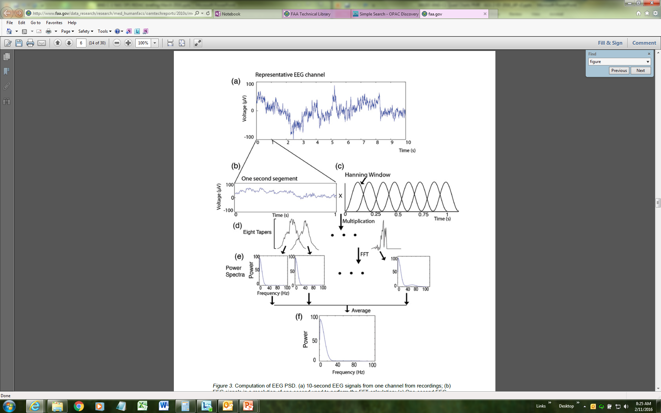
4.03 Applied and Translational Human Factors Research: EEG for Controller Workload Measurement
Research Requirement
Outputs/Outcomes
Controller workload measurement has been a perennial challenge for the human factors community. It is important because it has potential safety implications as well as potential impacts on airspace design, procedures, and controller scheduling and staffing.
The project is intended to improve our ability to measure workload when conducting human factors studies of new ATC technologies and procedures. Researchers are developing and testing software to efficiently screen, process, and analyze electroencephalograph (EEG) data. If the data reliably correlate with and predict controller workload and performance, such data could be used to support improvements in controller training and staffing.
The project will culminate in a demonstration and transition to the ANG-E25 Human Factors Laboratory at the WJHTC in April 2016.
Sponsor: to be determined
POC: Dan Herschler, ATC/TO HF BLI Program Manager, ANG-C1
Products:
EEG processing software tool
Tutorial
Demonstration using actual study data
FY 14/15 Accomplishment / Issues
Out Year Funding Requirements
$269K in FY13
Issue:
Looking to ANG-E25 for a plan for implementation and maintenance of the EEG analysis tool as part of the laboratory infrastructure.
FY14 | FY15 | FY16 | FY17 | FY18
$0 | $0 | $0 | $0 | $0
Research Performers:
  CAMI Aerospace Human Factors Research Division AAM-520, Drexel University, University of Oklahoma
27

Slide 28
5.10 Content Validation of ATSS Common Principles Course to Support Employment Decisions
Research Requirement
Outputs/Outcomes
The Vice President of Technical Operations (AJW) would like to implement methods to identify trainees who are likely to be successful in training and certification as an ATSS.
To meet the AJW requirement under this task, CAMI will determine whether attachment of job jeopardy to ATSS performance in the Technical Operations Common Principles course is supported by content validation.
If there is a reasonable correspondence between course content and job knowledge and skill requirements, then attachment of job jeopardy to student performance is justified. If there is little correspondence between course content and job requirements, then job jeopardy would not be justified.
Sponsors: ATO Management Services (AJG-R42)
POC: Dan Herschler, ATC/TO HF BLI Program Manager, ANG-C1
Products:
Recommendation to AJW on whether to attach job jeopardy to Common Principles (April 2016)
Common Principles content validation technical report (June 2016)
FY 14/15 Accomplishment / Issues
Out Year Funding Requirements
American Institutes for Research previously completed subject matter expert (SME) panels and a joint management/labor review panel to identify technician job tasks, knowledge, skills, abilities, and other personal characteristics (KSAOs), and tools and equipment.
Prepared a Job analysis survey data to identify: (a) the most critical or important job duties/tasks, and (b) the most important KSAOs needed on Day 1 at an SSC.
FY14 | FY15 | FY16 | FY17 | FY18
$160K | $0 | $0 | $0 | $0
Research Performer:
  CAMI Aerospace Human Factors Research Division AAM-520, American Institutes for Research (AIR)
28

Slide 29
PROJECTS ENDING IN FY2017

Slide 30
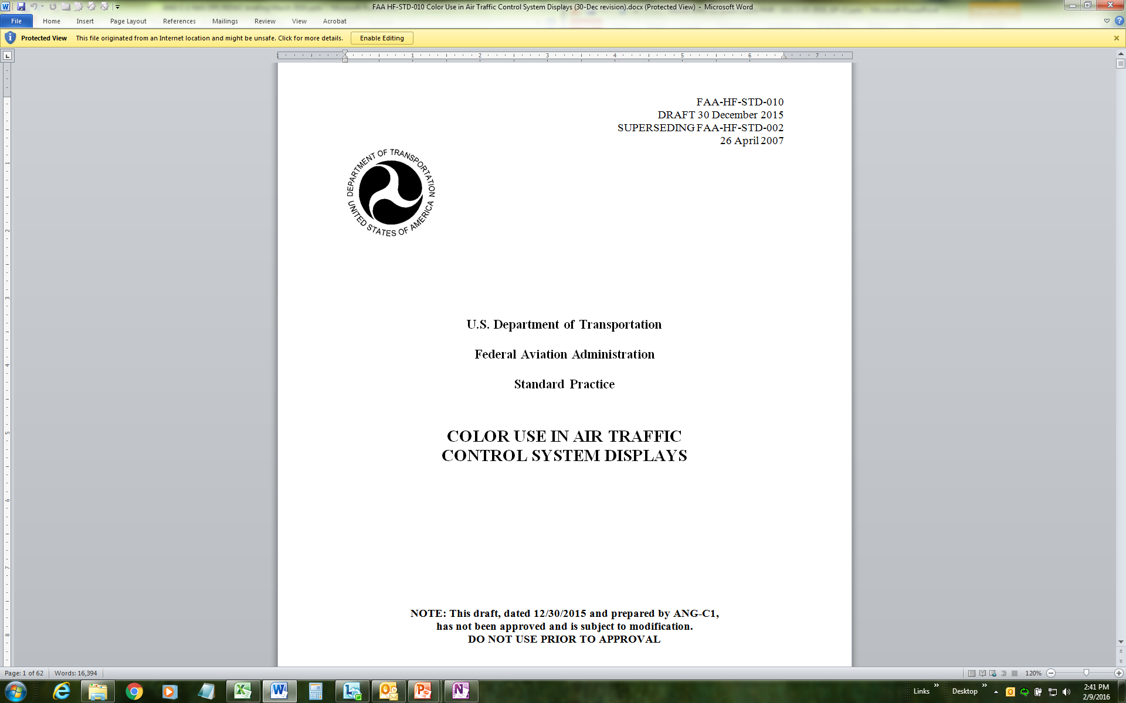
1.05 Develop ATC Display Color Standard and
Color Palette (FAA-HF-STD-010)
Research Requirement
Outputs/Outcomes
The new standard for ATC Display Colors replaces FAA-HF-STD-002 “Baseline requirements for color use in air traffic control displays” that we determined was insufficiently detailed and did not address display requirements to address the perceptual limitations of Color Vision Deficient (CVD) air traffic controllers.
Under this task, CAMI is to develop a color palette by applying color science practices, to ensure that ATC display colors are recognizable, discriminable, and legible for color-vision normal and CVD air traffic controllers.
CAMI will update the draft ATC display color standard (completed December 2015) to include the new color palette.
Sponsor: ATO Program Management Office (AJM-352)
Stakeholder: HFAWG (Bill Kaliardos)
POC: Dan Herschler, ATC/TO HF BLI Program Manager, ANG-C1
Product:
FAA-HF-STD-010, replacing FAA-HF-STD-002 (4/26/2007)
Note: This effort will help the PMO to define SOW requirements for the contractor’s human factors program regarding color display requirements for ATC system acquisition programs
FY 14/15 Accomplishment / Issues
Out Year Funding Requirements
Completed draft FAA HF-STD-010. Awaiting guidance from FAA General Counsel on intellectual property considerations.
FAA technical experts have evaluated color palette work completed at Embry Riddle Aeronautical University (ERAU) in 2015, and determined that ERAU tested an inadequate number CVD individuals. There were other problems noted: 1) we have little confidence in the chromaticities that ERAU claimed they used and 2) the ERAU color palette was less than optimal for CVDs.
FY14 | FY15 | FY16 | FY17 | FY18
$0 | $138K | $145K | $0 | $0
Research Performer:
  CAMI Aerospace Human Factors Research Division AAM-520 and consultants
30

Slide 31
2.04 Training Certification Standards
Research Requirement
Outputs/Outcomes
Assess a method for improving air traffic controller training certification rates for roll out across the NAS
Sponsor: Arlenne Gonzalez (ENE-N90)
POC: Stephanie Kreseen, Program Manager, ANG-C1
Nick Lento, Manager (A), ANG-C1
Product:
A complete and vetted collection of training standards
Research report providing data on the effectiveness of the training standards
Outcomes:
Increased certification rates
Reduced time to certification
FY 14/15 Accomplishment / Issues
Out Year Funding Requirements
Completed initial development of training standards with TRACON SMEs
Developed and delivered Phase 1 training workshops
  OJTIs and FLMs received skill enhancement and best practices training
  Developmentals received learning styles and study skills training
FY14 | FY15 | FY16 | FY17 | FY18
$0 | $310K | $61K | $0 | $0
Research Performer:
  National Institute of Aerospace, Evans Inc.
31

Slide 32

2.08 Evaluation of the MITRE Radar Vectoring Aptitude Test (RVAT) as a Job Placement Method
Research Requirement
Outputs/Outcomes
Success in as a developmental air traffic controller requires aptitudes that match the requirements of the job. To improve use of limited training resources, ATO Technical Training would like to institute a radar vectoring aptitude test for new-hire controllers.
CAMI will be assessing the validity, utility, and fairness of a recently developed Radar Vectoring Aptitude Test (RVAT) to evaluate it for potential use in the job placement of newly hired air traffic developmental controllers.
The RVAT tool was initially designed by MITRE for AJI, to train radar vectoring skills, however on this project, CAMI researchers are evaluating its potential use for evaluating aptitudes as part of job placement decisions. This year, the research project will be planned in detail.
Sponsor: ATO Technical Training (AJI-2)
POC: Dan Herschler, ATC/TO HF BLI Program Manager, ANG-C1
Product:
Develop a research plan in conjunction with MITRE, AJI, and FAA Academy.
FY 14/15 Accomplishment / Issues
Out Year Funding Requirements
The RVAT tool was initially designed by MITRE for AJI, to train radar vectoring skills.
This is a new task in FY16.
In FY2017, CAMI’s evaluation will address the tool’s predictive validity, utility, and fairness , allowing CAMI to make a recommendation to AJI-2 regarding its use as a job placement tool.
FY14 | FY15 | FY16 | FY17 | FY18
$0 | $0 | $0 | $0 | $0
Research Performer:
  CAMI Aerospace Human Factors Research Division AAM-520, collaborating with MITRE CAASD
32

Slide 33
3.02 Tower Controller Visual Scanning
Research Requirement
Outputs/Outcomes
Numerous safety incidents have led ATO to declare Tower Controller Visual Scanning as a Top 5 Safety issues for FY2016.
CAMI will review existing information to identify best practices based on what is currently known about visual scanning and what has proven effective for monitoring the airport environment from the air traffic control tower. These best practices will be confirmed in discussion with FAA SMEs.
Additional human performance data will be obtained in a low-fidelity laboratory simulation study of controller visual scanning patterns.
The results of these efforts will be combined to produce recommendations and guidance by September 2016 to ATO Safety (AJI-1) for tower controller visual scanning best practices.
Sponsor: ATO Safety (AJI-155)
POC: Dan Herschler, ATC/TO HF BLI Program Manager, ANG-C1
Product:
Develop a research plan in conjunction with AJI-155 based on a workshop with field personnel, a review of existing ATC handbook policy, field practices, incident/accident observations and lessons learned.
Conduct low-fidelity research to test some identified techniques and provide recommendations that AJI-155 can offer to the field for improved scanning
FY 14/15 Accomplishment / Issues
Out Year Funding Requirements
Tower Scanning was included on AJI’s list of the Top 5 ATC Safety Hazards.
AJI-155 (Jason Demagalski) identified a list of activities on visual scanning in the tower environment that he asked AAM-520 to support.
This is a new task in FY16.
FY14 | FY15 | FY16 | FY17 | FY18
$0 | $0 | $70K | $0 | $0
Research Performer:
  CAMI Aerospace Human Factors Research Division AAM-520
33

Slide 34
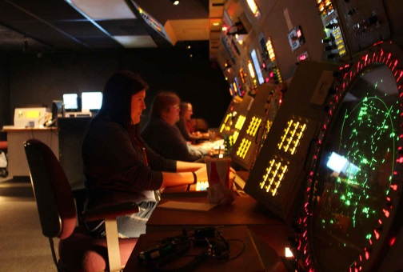
5.07 Understanding Why Some Developmental Controllers Fail to Succeed
Research Requirement
Outputs/Outcomes
ATO Management Services has requested research to better understand why air traffic control specialists (ATCSs) fail field qualification training. Developmentals, recently in training, will be surveyed.
CAMI is administering surveys to unsuccessful developmentals who were reassigned to a lower level facility after failing training at the first facility. Eventually, other developmentals, both those who failed and left the FAA and those who passed, will be surveyed.
The National Employee Services Team (NEST, http://nwp.natca.net/nest.php) receives the outputs and will use the results to determine if interventions or policy changes to improve facility success rates are needed.
Sponsor: AJG-R41
POC: Dan Herschler, ATC/TO HF BLI Program Manager, ANG-C1
Products:
Preliminary assessment of the data collected through 2016 for the successful and unsuccessful developmentals
FY 14/15 Accomplishment / Issues
Out Year Funding Requirements
The project focus is on non-cognitive factors (e.g., management, training program, facility location, and/or facility culture) as perceived barriers to success.
Researchers administer the Controller Transfer Questionnaire (CTQ) to trainees who come to the Academy to retrain in tower after failing field training at en route and higher level TRACON facilities.
NATCA coordination is in process for giving a similar questionnaire to developmentals who fail and leave the FAA and developmentals who pass and become CPCs.
FY14 | FY15 | FY16 | FY17 | FY18
$0 | $3K | $0 | $0 | $0
Research Performer:
  CAMI Aerospace Human Factors Research Division AAM-520
34

Slide 35

5.09 Job Analysis Information Database (JAIdB) Enhancement
Research Requirement
Outputs/Outcomes
FAA has invested substantial time and money in conducting job/task analyses (JTAs) for mission-critical occupations such as Air Traffic Control Specialist, but the JTAs were printed (and sometimes electronic documents) with limited distribution. The web-based JAIdB will ensure that the JTA data are accessible to FAA stakeholders who use the data.
CAMI will develop a web-based database for capturing JTA data, providing a single point of access to those data for the FAA’s HF and training communities of interest within the FAA.
The intent is to transition management of the JAIdB to ATO Technical Training (AJI-2).
Sponsors: Human Resource Services (AHF-10), ATO Technical Training (AJI-213)
POC: Dan Herschler, ATC/TO HF BLI Program Manager, ANG-C1
Products:
Cloud-based job analysis database (August 2016)
Includes controller (ATCS), technician (ATSS), and operations research analyst (ORA) job analysis data
FY 14/15 Accomplishment / Issues
Out Year Funding Requirements
American Institutes for Research (AIR) hosted a workshop on cognitive task analysis in FY2015 and delivered recommendations on how to incorporate cognitive task analysis information into the Job Analysis Information Database (JAIdB).
AIR Version 2.0 of the JAIdB in FY2015.
Work is underway to populate the database with job analysis information.
JAIdB will be installed and configured on the FAA Cloud in FY2016. This will provide easy access to all potential users.
$353K in FY13
FY14 | FY15 | FY16 | FY17 | FY18
$0 | $0 | $25K | $0 | $0
Research Performer:
  CAMI Aerospace Human Factors Research Division AAM-520
35

Slide 36
PROJECTS ENDING AFTER FY2017

Slide 37
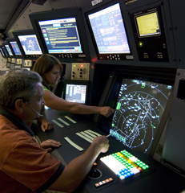
2.03 Longitudinal Database of ATCS Training and Performance: Predictors of Training Success
Research Requirement
Outputs/Outcomes
This is an infrastructure project in support of the FAA Academy and ATO Management Services (AJG-R41) that provides a data repository for tracking ATC student training performance.
The database allows CAMI human factors scientists to answer research questions posed by ATO sponsors using data such as: individual attributes (aptitude and experience); training performance criteria; and other outcome measures.
This research supports evaluation of proposed strategies, tests, or interventions in training, placement, and/or promotion of ATCSs, and supports data-driven decision-making by the ATO.
Sponsor: ATO Management Services (AJG-R41)
POC: Dan Herschler, ATC/TO HF BLI Program Manager, ANG-C1
Product:
This research supports evaluation of proposed strategies, tests, or interventions in training, placement, and/or promotion of ATCSs.
FY 14/15 Accomplishment / Issues
Out Year Funding Requirements
Established Memoranda of Understanding in previous years with multiple offices to allow CAMI to collect and match various types of data for ATCS developmentals.
Software and procedures were developed to process, review, and match the data.
Used data from database to assess training outcomes when controllers who were unsuccessful in training at their first assigned facility were allowed to transfer to a lower-level ATC facility.
FY14 | FY15 | FY16 | FY17 | FY18
$46K | $67K | $85K | $90 | $95
Research Performer:
  CAMI Aerospace Human Factors Research Division AAM-520
37

Slide 38
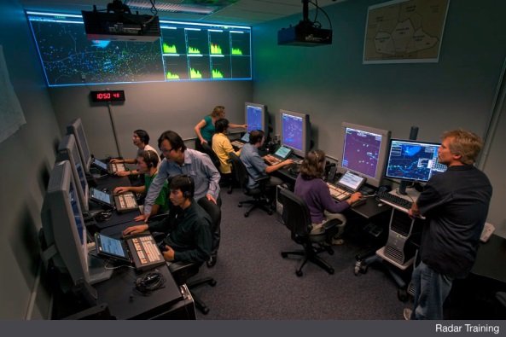
2.07 Data-Driven Decision Support for FAA Academy Air Traffic Division
Research Requirement
Outputs/Outcomes
FAA Academy Air Traffic Division requires approaches for improving the rating of developmental air traffic control specialists (ATC students) that are based on scientific data and state-of-the-art (best) practices.
FY2016 task: Help the Academy document and improve the reliability of the raters who evaluate ATC student performance at the end of their Initial courses.
  Provide expertise and training on the psychological biases and errors that can impact performance ratings. Incorporate best practices in this area.
  Analyze practice ratings made during the training program to document their reliability.
Sponsor: ATO Technical Training (AJI-2)
Stakeholders: FAA Academy (AMA-1, AMA-500)
POC: Dan Herschler, ATC/TO HF BLI Program Manager, ANG-C1
Product:
Help the Academy document and improve the reliability of the raters who evaluate ATC student performance at the end of their Initial courses.
FY 14/15 Accomplishment / Issues
Out Year Funding Requirements
New project in FY2016
FY14 | FY15 | FY16 | FY17 | FY18
$0 | $0 | $0 | $0 | $0
Research Performer:
  CAMI Aerospace Human Factors Research Division AAM-520
38

Slide 39
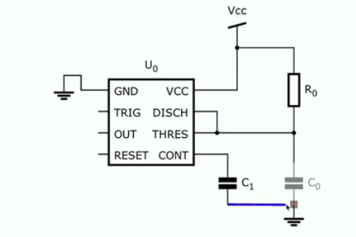
5.05 Develop a Pre-hire Assessment of
ATSS Applicants’ Electronics Technical Knowledge and Skills
Research Requirement
Outputs/Outcomes
The Technical Operations organization (AJW) is seeking methods to improve recruitment and selection of qualified applicants for the job of Airway Transportation Systems Specialist (ATSS).
Develop an objective assessment of the electronics knowledge and skills that are required at the time of hire and are essential to the performance of critical and/or important job duties and tasks.
The proposed assessment (a test battery delivered via the Internet) would provide objective verification of the applicant’s claimed experience and expertise in electronics.
In this first project phase, CAMI will define the requirements for a contractor to develop a suitable test battery, culminating in a contract SOW.
Sponsor: ATO Management Services (AJG-R42)
POC: Dan Herschler, ATC/TO HF BLI Program Manager, ANG-C1
Products:
Concept of Operations for pre-hire testing of electronics knowledge and skill
ATSS knowledge and skill test feasibility evaluation report and briefing
SOW for test battery development (for procurement)
FY 14/15 Accomplishment / Issues
Out Year Funding Requirements
New research task – no previous activity
Funding issue:
The initial estimate for test battery development is $500K and the BLI contract funding level is much less than this ($0K in FY16 and $230K in FY17 for all requirements). AJW may fund this with Ops $.
Contracting plan for test battery:
identifying existing and available assessments of the electronics Knowledge and Skills (K&S) identified through job analysis as essential to the performance of critical and/or important job tasks and required at the time of hire,
adapting those tests for internet delivery (which might require as much as a year), and
pilot- and stress-testing the test battery.
$269K in FY13
FY14 | FY15 | FY16 | FY17 | FY18
$0 | $0 | $0 | $500K AJW Ops | $0
Research Performers:
  CAMI Aerospace Human Factors Research Division AAM-520
39

