Slide 1
FY16 REDAC Briefing NextGen Portfolios
John Maffei, Manager (A), NAS Lifecycle Planning
ANG-D2
March 2015

Slide 2
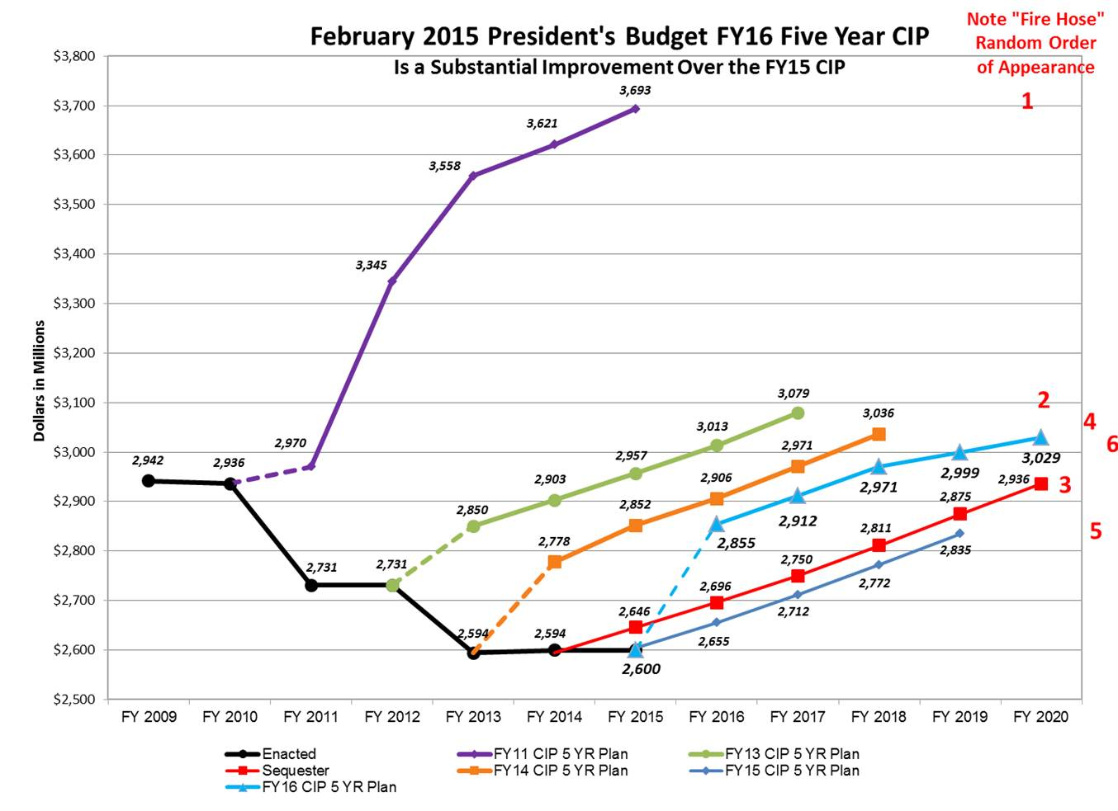

Slide 3
NextGen Investment Portfolio Summary: NextGen Funding History (FY15 in Portfolio Structure)

Slide 4
“(Pre-) Implementation” Activities
NextGen “pre-implementation” activities funded within the NextGen portfolios provide for concept development, demonstrations, requirements definition, and early engineering -- all targeted toward providing operational improvements within the National Airspace System (NAS). The end result may lead to an FAA investment decision on subsequent integration and implementation into the NAS.

Slide 5
Adjusted Budget Structure
Portfolio | BLI# | Program Name | Former Solution Set
Separation Management Portfolio
 | 1A05A | ADS-B In applications – Flight Interval Management | TBO
 | 1A05B | Modern Procedures | TBO
 | 1A05C | Alternative Positioning Navigation and Timing - APNT | FLEX
 | 1A05D | Wake Turbulence - Re-Categorization | SysDev
 | 1A05E | Oceanic Tactical Trajectory Management | TBO
 | 1A05G | Separation Management Concept & Analysis** | N/A
 | 1A05H | Reduced Oceanic Separation | N/A
Improved Surface/TFDM Portfolio
 | 1A06A | Terminal Flight Data Manager (TFDM) | Imp.
 | 1A06B | Trajectory Management – Surface Tactical Flow | HD
Time Based Flow Management Portfolio
 | N/A | Note: Future pre-implementation activities will appear here as apposed to the High Density Solution Set | N/A
 | 2A15A | Time Based Flow Management (TBFM) WP3 | HD
 | 2A15B | Time Based Flow Management Technology Refresh | N/A
 | 2A15C | Demonstrations – 4-D Trajectory | N/A
**Contains work formerly performed under ATC/Tech Ops Human Factors and Ops Concept Validation – Validation Modeling

Slide 6
Adjusted Budget Structure
Portfolio | BLI# | Program Name | Former Solution Set
Performance Based Navigation & Metroplex Portfolio
 | 1A12A | Metroplex, Performance Based Navigation – Area Navigation (RNAV)/Required Navigation Performance (RNP) | CATM
 | 1A12B | Concept Development for Integrated National Airspace Design and Procedure Planning | CATM
Collaborative ATM Portfolio
 | 2A14A | Collaborative Air Traffic Management Technologies - CATMT- Work Package 3 | Trans.
 | 2A14B | Strategic Flow Management Integration | CATM
 | 2A14C | Collaborative Air Traffic Management Technologies - CATMT- Work Package 4 | N/A
On Demand NAS Portfolio
 | 1A07A | Flight Object | CATM
 | 1A07B | Common Status and Structure Data | CATM
 | 1A07C | Flight Object Exchange Services (FOXS) | N/A
 | 1A07D | Dynamic Airspace | N/A

Slide 7
Adjusted Budget Structure
Proposed Portfolio | BLI# | Program Name | Former Solution Set
Environment Portfolio
 | 1A08A | Environmental Management System & Noise/Emission Reduction | SysDev
Improved Multiple Runway Operations Portfolio
 | 1A09A | Wake Turbulence Mitigation for Arrivals (WTMA) | FLEX
 | 1A09B | Closely Spaced Parallel Runway Operations | FLEX
 | 1A09C | Approaches, Ground Based Augmentation System (GBAS) | FLEX
 | 1A09D | Demonstrations – Paired Approach | N/A
NAS Infrastructure Portfolio
 | 1A10A | NextGen Weather Observation Improvements | RWI
 | 1A10B | NextGen Weather Forecast Improvements | RWI
 | 1A10C | NextGen Navigation Engineering | FLEX
 | 1A10D | New Air Traffic Management (ATM) Requirements | SysDev
System Safety Management Portfolio
 | 3A10A | Aviation Safety Information Analysis and Sharing (ASIAS) | Imp.
 | 3A10B | Systems Safety Management Transformation | SysDev

