Slide 1
REDAC NAS Ops Portfolio Review
NAS Operations PPT
John Marksteiner
March 2015

Slide 2
PPT Portfolio Overview
NAS Ops PPT for the FY2015 FAA budget process includes the following areas:
Concept Development and Validation (CD&V) activities
OCVM Funding ended in FY14
Future CD&V activities must be tied to Portfolios
FY16 proposed funding in Performance Based Navigation and Metroplex Portfolio (Optimized Route Capability, NextGen Trajectory Negotiation)
FY17 proposed funding in Separation Management (TMI Attribute Standardization, Vertical Conformance Verification) and PBN Portfolios (Optimized Route Capability, NextGen Trajectory Negotiation)
FY17 proposed funding in Improved Surface Operations Portfolio (Enhanced Services to Small Communities)
2

Slide 3
PPT Financial Summary
 | FY 13 Enacted |  | FY 14 Enacted |  | FY 15 Enacted
Program Title | In-House | Contracts | In-House | Contracts | In-House | Contracts
Base Program (RE&D)
Base Program (F&E)
NextGen Program (F&E)
NextGen Ops Concept Validation |  | 3,900,000 |  | 4,700,000* | 0 | 0
F&E Subtotal |  | 3,900,000 |  | 4,700,000* | 0 | 0
 |  |  |  |  | 0 | 0
PPT Total |  | 3,900,000 |  | 4,700,000* | 0 | 0
*Approved to spend $2.2 M in FY14 PLA. Remaining funding approval TBD based on FY16 funding availability
3

Slide 4
PPT 5-Year Financial Plan
Program | Out-Year Contract Dollars (For Planning Purposes Only)
 | FY 2015 | FY 2016 | FY 2017 | FY 2018 | FY 2019
Base Program (RE&D)
NextGen Program (RE&D)
RE&D Subtotal
Base Program (F&E)
NextGen Program (F&E)
NextGen Ops Concept Validation
Separation Management (VCV, TAS) |  | 0 | $1,000,000 | TBD | TBD
Performance Based Navigation (ORC, NTN) |  | $1,000,000 | $1,000,000 | TBD | TBD
Improved Surface Operations (ESSC) |  | 0 | $2,000,000 | $1,000,000 | $2,000,000
F&E Subtotal |  | $1,000,000 | $4,000,000 | $1,000,000 | $2,000,000
PPT Total |  | $1,000,000 | $4,000,000 | $1,000,000 | $2,000,000
4
Notes:
Separation Management (Vertical Conformance Verification, TMI Attribute Standardization)
$2M total available each year for HF and OCVM for FY18, FY19
PBN (Optimized Route Capability, NextGen Trajectory Negotiation)
$3M total available each year for HF and OCVM for FY18, FY19

Slide 5
FY14 Accomplishments
UAS Functional Analysis/Operational Requirements Report 11/1/2013
Deliver Report on NAS benefits of improved departure predictions 11/1/2013
Dynamic Network Analysis (DNA) Model 12/1/2013
ORC Functional Research Assessment Report 12/1/2013
Concept of Operations for Datalink of Complex PBN Clearances (Dynamic RNP) 4/1/2014
Datalink of Complex PBN Clearances (Dynamic RNP) White Paper 4/1/2014
Deliver Bayesian Belief Network (BBN) of NAS Model 6/1/2014
TMI Attribute Standardization Report 6/1/2014
SVO Concept of Operations in the NAS 6/1/2014
NTN Concept of Operations 7/1/2014
Final Requirements Document for One Additional Type of Space Vehicle Operations 8/1/2014
Leesburg Remote Towers Procedure Development Report 8/1/2014
Integrated NAS/SVO Simulation Model 10/1/2014

Slide 6
FY15 Accomplishments
VCV Operational Improvement Assessment 12/1/2014
Negotiate a Memorandum of Understanding with Virginia Small Air Transportation System (VSATS) 1/31/15
Completed End-to-End Operational Description for Dynamic RNP / Update to Dynamic RNP Concept (Worked with RTCA SC 214 / EUROCAE WG-78) 1/28/15
FY15 Planned Activities
Based upon MOU, complete FAA work plan for the engagement with Virginia Small Air Transportation System (VSATS) demonstration 3/31/15
Update concept for integrated UAS operations in Class A and B airspace to further develop operational requirements for both the FAA and UAS operators 8/31/2015
Complete Trajectory Operations (TOps) Simulation Plan Scenarios 9/30/2015
Final Requirements Document for Second Additional Type of Space Vehicle Operations 10/1/2015
ORC Initial Integration Analysis/Model Development Report 11/1/2015

Slide 7
FY16 Planned Activities
Performance Based Management Portfolio:
NextGen Trajectory Management Activities (TBD)
Optimized Route Capability Activities (TBD)
FY17 Planned Activities
Update 4D Trajectory Concept for SVO 1/1/2017
Draft TOps procedures (flight deck and Air Traffic Control) 8/1/2017
Performance Based Management Portfolio:
NextGen Trajectory Management Activities (TBD)
Optimized Route Capability Activities (TBD)
Separation Management Portfolio
TMI Attribute Standardization Activities (TBD)
Vertical Conformance Verification Activities (TBD)
Improved Surface Operation Portfolio
Enhanced Services to Small Communities (TBD)

Slide 8
Optimized Route Capability (ORC)
Description:
Additional IADCS and PBN route options/ playbooks make optimal route selection and coordination more complicated
ORC will research tools and procedures needed to assist ATM with assessment, coordination, and implementation of these new options in order to optimize the benefits
Partnerships:
MITRE
NASA
Accomplishments / Plans:
Functional Research Assessment (Dec 2013)
Functional Research Assessment Report (Completed Nov 2013)
Develop Analysis Approach (Completed Aug 2013)
Conduct Functional Research Assessment (Completed Nov 2013)
Initial Integration Analysis / Model Development (Nov 2015)
Initial Integration Analysis / Model Development Report (Nov 2015)
Define Model Attributes (Mar 2015)
Conduct Analysis (Nov 2015)
Funding:
FY13 | FY14 | FY15 | FY16 | FY17
$900,000 | - | - | * | *
* Proposed follow-on funding identified in Research Plan
8

Slide 9
4D Trajectory-based Operations Sim.
Trajectory Operations (Tops-Sim)
Description:
Supported AVS/RTCA/ANG/ATO in defining an overall TOps Concept and requirements for NextGen avionics automation and collaborative capabilities
Ensured domain specific concepts work end-to-end
Identified concepts and technologies within the FAA that may enable NextGen trajectory operations in the mid-term
Identified shortfalls in concepts and technologies for the mid-term
Accomplishments / Plans:
Partnerships:
ATO
AVS
Accomplishments:
Contract awards made February 2015 (Metron/Saab-Sensis and Boeing)
Project Kick-off Meeting March 11-12 (Seattle, WA)
Plans:
Draft 4D TBO procedures (flight deck and ATC)
Scenarios
Deliver 4D TBO initial simulation plan
Funding:
FY13 | FY14 | FY15 | FY16 | FY17
- | $780,000 | - | * | *
* Proposed follow-on funding identified in Research Plan
9

Slide 10
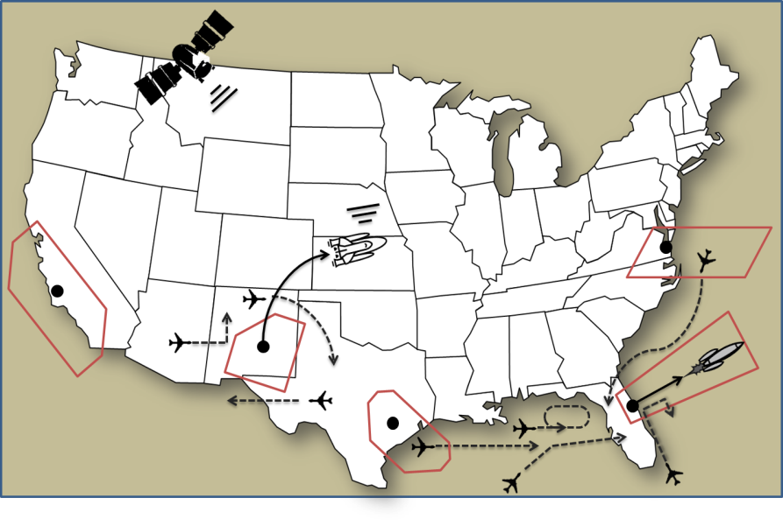
Space Vehicle Operations (SVO)
Description:
SVO research is bringing together FAA’s NextGen, Commercial Space, and Air Traffic Organization offices together with the Center of Excellence for Commercial Space Transportation (COE CST) and industry stakeholders to develop a concept that will enable the integration of air and space traffic management in the NextGen timeframe.
Partnerships:
FAA Commercial Space Transportation (AST)
Air Traffic Organization Space Operations Stanford University
William J. Hughes Technical Center
ACTA
ANG-C41
Accomplishments / Plans:
SVO Concept Development and Initial Validation (Oct 2014)
SVO ConOps in the NAS (Completed Jun 2014)
Develop SVO Concept of Operations in the NAS Report (Completed Jun 2014)
Integrated NAS/SVO Simulation Model (Oct 2014)
Develop SVO Trajectory Model (Completed Jun 2014)
Enhance SVO Debris Threat Model (Oct 2014)
Final Requirements Document for One Additional Type of SVO (Completed Aug 2014).
Draft Requirements Document for One Additional Type of SVO (Completed May 2014)
Final Requirements Document for One Additional Type of SVO (Completed Aug 2014)
SVO Identify NAS Information Requirements for Space Vehicles (TBD)
Final Requirements Document for Second Additional Type of SVO (TBD)
Draft Requirements Document for Second Additional Type of SVO (TBD)
Final Requirements Document for Second Additional Type of SVO (TBD)
Update 4D Trajectory Concept SVO (TBD)
Update 4D Trajectory Concept for SVO
Define Data Requirements for SVO (TBD)
Develop initial data elements for FIXM (TBD)
Develop 4D Trajectory Concept for SVO (TBD)
Funding:
FY13 | FY14 | FY15 | FY16 | FY17
$1,090,272 | $800,000 | - | * | *
* Proposed follow-on funding identified in Research Plan
10
Notes:
Kevin Hatton

Slide 11
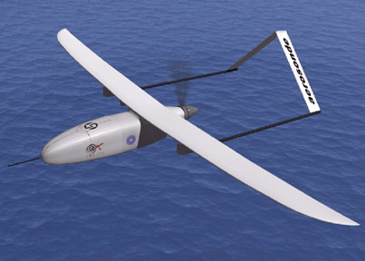
UAS Integration into the NAS
Description:
Mature concept of operations for UAS integration into the NAS
Identify concept level operational requirements for evolution to mature state integrated UAS operations
Ensure NextGen systems and capabilities are prepared for increased numbers of UAS operations
Address issues/questions associated with the UAS ConOps that require further consideration, development and/or validation
Accomplishments / Plans:
Conduct UAS Functional Analysis / Operational Requirements (Completed Nov 2013)
UAS Functional Analysis / Operational Requirements Report (Completed Nov 2013)
Assess UAS Functional Analysis/Operational Requirements (Completed Sep 2013)
Document UAS Functional Analysis/Operational Requirements (Completed Oct 2013)
UAS Integration Concept Development in Class A&B (Sep 2015)
Draft Concept Reports for Class A&B (Sep 2015)
Mature the integration concept by developing Level 3 concepts for Class A&B UAS operations (Sep 2015)
Document draft concepts (Sep 2015)
UAS Concept for Modified IFR (Jan 2016)
Develop UAS Concept for Modified IFR (June 2016)
UAS concept maturation products (June 2015)
Draft UAS Concept for Modified IFR (Oct 2015)
Adjudicate UAS Concept for Modified IFR (Jan 2016)
Assess need to develop addendum to Concept (Jan 2016)
Report on UAS Unique Characteristics in High Density Mixed Performance Environment (Jan 2016)
Final report on UAS Unique Performance Characteristics in High Density Mixed Performance Environment (Jan 2016)
Develop/execute test plan and modeling platform (Oct 2016)
Provide data analysis and draft/final report (Jan 2016)
Partnerships:
AJV-7
AFS-80
ANG-C2
Funding:
FY13 | FY14 | FY15 | FY16 | FY17
$500,000 | $360,535 $270,000 | - | * | *
* Proposed follow-on funding identified in Research Plan
Red indicates contingent funding per PLA Appendix
11
Notes:
Sherri Magyarits

Slide 12
Leesburg Remote Tower Services (RTS) Research
Description:
Develop operational concept to remotely operate currently non-towered airports.
Facilitate operational approval process to determine if Remote Tower (r-Twr) services can be provided at the Leesburg Executive Airport.
Project focus has shifted from large airports to smaller low-level/activity airports and aligns with FAA strategic initiatives.
Remote Facility
Partnerships:
MIT/LL, MITRE
CSSI
WJHTC Human Factors Laboratory
Virginia SATS Lab, Inc. (VSATS)
NATCA/PASS
Saab
Accomplishments / Plans:
Negotiate a Memorandum of Understanding with VSATS (Jan 2015)
Complete a work plan for the engagement with VSATS demonstration (Mar 2015)
Funding:
FY12 | FY13 | FY14 | FY15 | FY16
$681,367 | $372,000 | - | * | *
* Some additional funding may be needed to support this activity
12
Notes:
Jason Coon

Slide 13
Enhanced Services to Small Communities (ESSC)
Description:
ESSC will evaluate procedures and technologies, and leverage NextGen surveillance, communications, data sharing and new optical technologies to provide ATC tower-like services at airports that do not currently meet the criteria for an ATC Tower.
ESSC will identify and develop the recommended changes to controller equipment, standards, procedures and policies to provide the required surveillance, communications and other capabilities to support improved air traffic services and improved access to smaller airports. These services may be performed from a remote location.
The ESSC program will develop an approach to expanding low-cost service capability to small communities that are currently served by non-towered airports or airports with limited Air Traffic Control (ATC) services.
ESSC will identify and group airports based on similar characteristics. The program will recommend and evaluate a group of airports based on their required level of service and potential benefits to be achieved.
Partnerships:
TBD
Plans for FY17:
Complete analysis of current airport operational capabilities and characteristics
Complete draft ESSC alternatives analysis document
Complete draft ESSC feasibility study document
Complete draft concept of operations (ConOps) document for ESSC
Funding:
FY17 | FY18 | FY19 | FY20 | FY21
$2M | $1M | $2M | $3M | $3M
13

Slide 14
Vertical Conformance Verification (VCV)
Description:
Objective is to obtain and monitor real-time vertical rate (climb and descent).
Benefits: This information will improve controllers’ ability to monitor aircraft conformance. This enhances opportunities to utilize evolving NextGen trajectory design, increasing safety, efficiency and capacity in transition airspace
Accomplishments / Plans:
Partnerships:
Boeing
Vertical Conformance Verification (Dec 2014)
Operational Improvement Assessment (12/1/2014)
Operational Shortfall Assessment (Completed Aug 2014)
Technology Assessment (Completed Jun 2014)
Vertical Conformance Verification (VCV) Analysis (TBD)
Recommendation for Interim Solution Prior to ADS-B Implementation (TBD)
Technological and Procedure Review and Analysis of ERAM Vertical Limitations (TBD)
Minimum Vertical Performance Tolerance Analysis (TBD)
Funding:
FY13 | FY14 | FY15 | FY16 | FY17
- | $300,000 | - | * | *
* Proposed follow-on funding identified in Research Plan
Red indicates contingent funding per PLA Appendix
14
Notes:
Phil Bassett

Slide 15
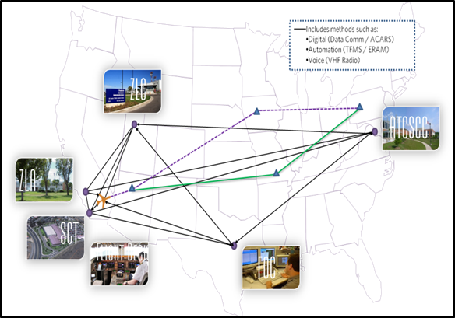
NextGen Trajectory Negotiation (NTN)
Description:
NTN will provide the methodology for performing real-time trajectory negotiation for trial planning, coordinating, issuing, and accepting or rejecting trajectory changes (reroutes) in real –time
Existing trajectory negotiation tools will be modified or developed as appropriate, utilizing defined research activities, to implement the NTN concept
Partnerships:
Boeing Airline Operations Experience (AOE)
Accomplishments / Plans:
NextGen Trajectory Negotiation Analysis (Completed Jul 2014)
Dynamic Network Analysis (DNA) Model (Completed Dec 2013).
Develop Dynamic Network Analysis (Completed Dec 2013)
Document DNA Findings (Completed Dec 2013)
NTN Concept of Operations (Completed Jul 2014)
Concept of Operations Annotated Outline (Completed Nov 2013)
Concept of Operations Draft Report (Completed Apr 2014)
FY14 Appendix 03.00.00 - NextGen Trajectory Negotiation (NTN) Analysis (TBD)
Deliver report on NTN simulation results (TBD).
Conduct Low-Fidelity Simulation of NTN environment (TBD)
Funding:
FY13 | FY14 | FY15 | FY16 | FY17
- | $775,000 | - | * | *
* Proposed follow-on funding identified in Research Plan
Red indicates contingent funding per PLA Appendix

Slide 16
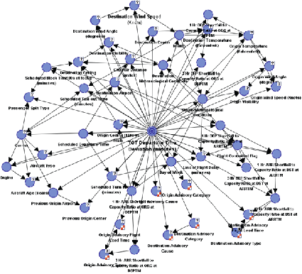
Statistical Methods for Departure Predictability (SMDP)
Description:
SMDP research will develop a probabilistic directed acyclic graphical model for improving departure time predictions by developing a Bayesian Belief Network (BBN) model.
BBN model will utilize historical data to improve the reliability of departure time predictions for real-time traffic flow management.
Accomplishments / Plans:
Partnerships:
Volpe Center
Booz Allen Hamilton
AJV
Statistical Methods for Departure Predictability (Completed Jun 2014)
Deliver Bayesian Belief Network (BBN) of NAS Model (Completed Jun 2014)
Develop BBN Model Approach (Completed Oct 2013)
Develop BBN Model (Completed Jun 2014)
Statistical Methods for Departure Predictability ConUse (TBD)
Develop SMDP ConUse supporting Traffic Flow Management System Work Package 5 (TBD)
Obtain TFMS Historical Database (TBD)
Develop SMDP Draft ConUse (TBD)
Funding:
FY13 | FY14 | FY15 | FY16 | FY17
- | $310,000 | - | * | *
* Proposed follow-on funding identified in Research Plan
Red indicates contingent funding per PLA Appendix
16

Slide 17
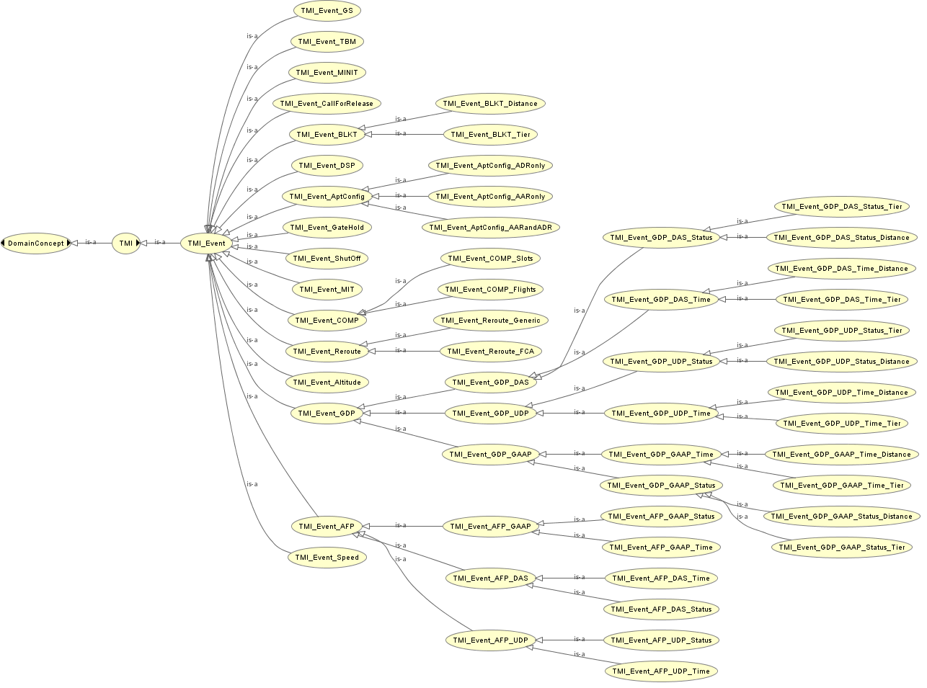
TMI Attribute Standardization (TAS)
Description:
TAS research utilizes historical and current Traffic Management Initiative (TMI) data to define a system model in which TMI attributes are categorized in a manner that will facilitate real-time TMI information and feedback to NAS users, unified TMI modeling, post-event analysis, and continuous flight day evaluation.
This research will also result in standardized TMI entry, parsing, and tracking, by enhancing functionality currently provided by NTML.
Partnerships:
Boeing
Mosaic ATM
AJV
JTA
Accomplishments / Plans:
TMI Attribute Standardization (Completed Jun 2014)
TMI Attribute Standardization Report (Completed Jun 2014)
Conduct Research of TMIs (Completed Nov 2013)
Develop TMI Taxonomy (Completed Jun 2014)
TMI Attribute Standardization Requirements (TBD)
Develop TAS Requirements (TBD)
Develop Initial Requirements (TBD)
Coordinate with AJV Advanced Methods (TBD)
Funding:
FY13 | FY14 | FY15 | FY16 | FY17
- | $290,000 | - | * | *
* Proposed follow-on funding identified in Research Plan
Red indicates contingent funding per PLA Appendix
17

