Slide 1

Technology
Development &
Prototyping Division
ANG-C5
Federal Aviation
Administration
RIRP Portfolio Update
Presented to: REDAC
Date: March 2015

Slide 2
Runway Incursion Reduction Program (RIRP)
Why do we do what we do?
FAA Strategic Priority 1 – Make Aviation Safer and Smarter
FAA Performance Metric 4 – Reduce Category A & B (most serious) runway incursions to a rate of no more than 0.395 per million operations, and maintain or improve through FY 2018.
FAA Mission Needs Statement 323 (circa 1998):
  Runway Incursions (RIs) are a major problem affecting the safe operations of the nation’s airports.
Destination 2025 (2011)
  2018 Performance Metrics: Maintain the rate of serious runway incursions at or below 20 per 1000 events.
NTSB Recommendation A-91-30
  Calls for the FAA to implement equipment aimed at reducing runway incursions
Notes:
Runway Incursions have been recognized as a risk to aviation safety for at least twenty years. The Runway Incursion Reduction Program (RIRP) initiative is based on several recommendations and requirements.
The RIRP conducts research, development, and operational evaluation of technologies designed and developed to increase runway safety. Consistent with standing National Transportation Safety Board (NTSB) recommendations and initiatives identified in FAA Destination 2025, research emphasis will remain on technologies that provide for direct safety indications and alerts to pilots and air crews at large airports as well as those that can be applied cost effectively at small to medium airports.

Slide 3
Runway Incursion Reduction Program (RIRP)
Why do we do what we do?
  March 27, 1977: Fatal collision between two Boeing 747 passenger aircraft on the runway of Los Rodeos Airport on Tenerife, one of the Canary Islands. This crash killed 583 people, making it the deadliest accident in aviation history.
  August 27, 2006: Comair Flight 5191 Lexington, KY, to Atlanta, GA, crashed on takeoff, just past the end of the runway, killing all 47 passengers and two of the three crew. The aircraft was assigned Runway 22 for the takeoff, but used Runway 26 instead.
Notes:
These two accidents illustrate the need for enhanced situational awareness, improved signage and markings, improved training for flight crews, and the development of runway incursion prevention technologies.

Slide 4
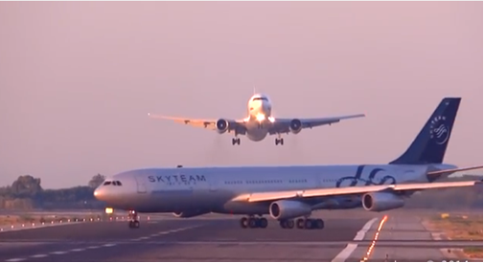
Runway Incursion Reduction Program (RIRP)
Why do we do what we do?
  April 24, 2014: Two planes nearly collided at Newark Liberty International Airport. United Express Flight 4100 was cleared to take off on runway 4R at the same time United Airlines Flight 1243 was landing on the intersecting Runway 29. The two aircraft passed within yards of each other.
  July 6, 2014: A passenger jetliner preparing to leave Barcelona’s El Prat airport taxied across a runway where another was about to land, forcing the arriving plane to abort its landing and climb sharply to avoid a possible disaster.
March 2015
Notes:
Here are two more recent incidents that could have been prevented through the implementation of conflict alerting systems.

Slide 5
Runway Incursion Reduction Program (RIRP) Projects
Low Cost Ground Surveillance (LCGS) - Cancelled by JRC
Enhanced FAROS (eFAROS) – Successful June 2014 Flight Check at BOS; pending approval for OpEval test from AFS.
Runway Safety Assessment (RSA) – conducting RI Prevention Shortfall Analysis; conducting on-site technical assessments for technologies selected from FY14 Market Survey.
Small Airport Surveillance Sensor (SASS) – evaluating technical performance of phased array surveillance sensor developed by MIT Lincoln Lab for real-time movement area coverage.
Notes:
RIRP portfolio of current projects.
Projects are owned by Runway Safety Office, and are funded through F&E dollars. These projects are actively managed by ANG-C5, the Technology Development and Prototyping Division.

Slide 6
Low Cost Ground Surveillance (LCGS)
RIRP Portfolio Update
Presented to: REDAC
Date: March 2015

Slide 7
LCGS Pilot Program History and Status
In August 2007, Runway Safety Call to Action identified LCGS as potential technical solution to increase in Runway Incursions
Runway Incursion Reduction Program Office requested LCGS Investment Analysis Readiness Decision (IARD) from the Executive Council on May 26, 2009.
ATO EC delayed making a final decision; EC met again on July 7, 2009, and made the following decision:
    Directed team to continue with contract awards for the prototype systems
    Directed team to operate the prototype systems for two years
    Directed team to return to the EC with results of the operational evaluation
JRC meeting 6/19/2013 determined that LCGS not viable as a program
All 5 sites were powered down by 09/01/2013
All LCGS displays were removed from ATCT cabs as of 9/30/2013
All LCGS cameras were removed from ATCT and radar towers as of 2/28/2014
Final equipment and infrastructure inventory and bar coding was completed as of 11/01/2014

Slide 8
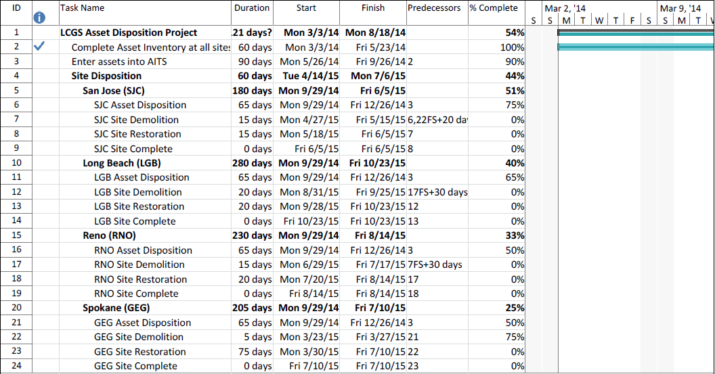
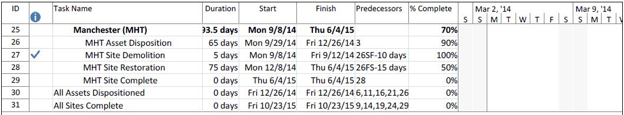
Notional Removal Schedule

Slide 9

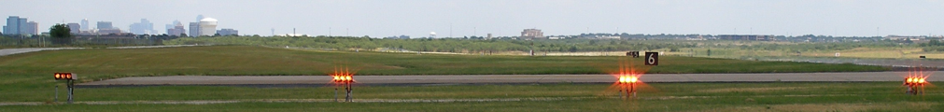
Enhanced Final Approach Runway Occupancy Signal (eFAROS)
RIRP Portfolio Update
Presented to: REDAC
Date: March 2015

Slide 10
Enhanced Final Approach Runway Occupancy Signal (eFAROS)
Enhanced-Final Approach Runway Occupancy Signal (eFAROS) uses surface surveillance with augmented safety logic to provide a visual warning to pilots on final approach that the runway is occupied and unsafe for landing. It does this by flashing the Precision Approach Path Indicator (PAPI) lights.
AJW-143 is providing design and engineering support for the development and implementation of eFAROS at RWSL test locations
Partners / Stakeholders
  Air Traffic Controllers
  AJW-14
  Airport Authorities (DFW, BOS)
  Local Tech-Ops personnel
Notes:
10

Slide 11
Milestone Schedule
FY 14 Milestones
Q1
Q2
Q3
Q4
Develop quicklook report on shadow operations testing of the prototype eFAROS system at BOS. |  | Complete
Complete installation of the FPAPI units at BOS. |  | Complete | Complete
Conduct flight check of the FPAPI units installed at BOS, and commence 90-day Operational Evaluation of the prototype eFAROS system at BOS |  |  | Flight check Completed 06/22/2014
August 2014
Notes:
11

Slide 12
Milestone Schedule
FY 15 Milestones
Q1
Q2
Q3
Q4
Commence operational evaluation at BOS (pending final AFS consultation/decision).
Complete report on 90-day prototype Operational Evaluation test of eFAROS at BOS.
Develop preliminary requirements document, final benefit/cost analysis report (BCAR) and IARD documents for JRC readiness decision.
Notes:
12

Slide 13
FY14/15 eFAROS Activities
FY14 Completed:
Conducted ATC training and pilot outreach for eFAROS at BOS – May/Jun 2014
Conducted successful Flight Check Test of eFAROS at BOS – Jun 21-22, 2014
FY15 Planned:
Commence “live” Operational Evaluation test of eFAROS at BOS – Mar 2015 (pending AFS-400 approval)
Publish initial Preliminary Requirements Document (PRD) for eFAROS – Sep 2015
Publish updated Cost-Benefit Analysis (CBA) for eFAROS – Sep 2015
August 2014

Slide 14
Runway Safety Assessment (RSA)
RIRP Portfolio Update
Presented to: REDAC
Date: March 2015

Slide 15
Runway Safety Assessment (RSA)
RSA is intended to address the NTSB recommendation A-00-66 that states: “Require, at all airports with scheduled passenger service, a ground movement safety system that will prevent runway incursions; the system should provide a direct warning capability to flight crews. In addition, demonstrate through computer simulations or other means that the system will, in fact, prevent incursions.”

Slide 16
ANG-C Market Survey - Overview
ANG-C5 issued a Market Survey on July 23, 2013 for Runway Incursion Reduction Technologies (Contract Opportunity ID: 14673).
The Market Survey solicits input on feasible technologies from industry partners and interested vendors. This survey is not a formal contract solicitation and is not intended to result in a contract award.
The intended outcome of the Market Survey is to evaluate one or more technologies which may be applied, or enhanced through additional research, to prevent runway incursions.
Market Survey closed on Aug 23, 2013; a total of 30 qualifying responses were received.
August 2014

Slide 17
ANG-C Market Survey - Assessment
Evaluation of the responses was conducted from 10/31/13 to 12/6/13.
The responses received were evaluated by a team of 8 FAA employees and contractors from ANG-C and AJI, consisting of SME’s in:
  ATC
  Engineering & Technology
  Program Management
  Runway Safety
The outcome of the evaluation process is focused on categorizing the responses by:
  the technical maturity of the proposal
  research viability within a 3-year timeframe
August 2014

Slide 18
Milestone Schedule
FY 15 Milestones
Q1
Q2
Q3
Q4
Perform technical evaluation of feasible technologies identified in Market Survey responses.
Develop Runway Incursion Prevention Shortfall Analysis report.
Develop report on proposed solution set for new Runway Incursion reduction technologies.
Notes:
18

Slide 19
FY15 Activities
Conduct Technical Feasibility Assessment of Candidate RI prevention technologies identified during market survey evaluation process. Q1-Q3FY15
Undertake data-driven analysis of coded historical Runway Incursion incidents to categorize RIs by causal factors. Q2-Q3FY15
Develop Runway Incursion Prevention Shortfall Analysis (RIPSA) report. Q3FY15
Develop “right-site-right-size” report on proposed solution set for new Runway Incursion reduction technologies based on RIPSA report and candidate technologies deemed feasible for evaluation. Q4FY15

Slide 20
Candidate RI prevention technologies for Technical Evaluation
August 2014

Slide 21
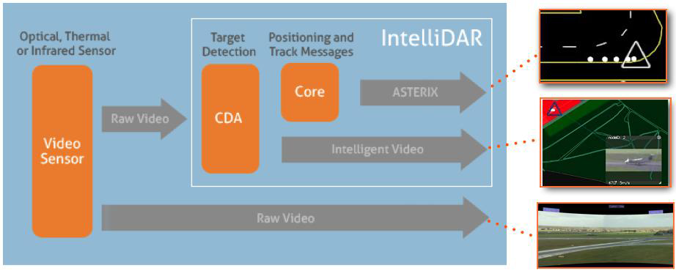
Searidge Technologies
IntelliDAR
  This system is based on real time video capture and processing for zone detection. It is primarily a surveillance tool with HMI capabilities for ATC, and is already being used in gate areas of airports in Canada such as Ottawa. It is currently under evaluation for Non-Movement Area (NMA) application at WJHTC.
August 2014

Slide 22
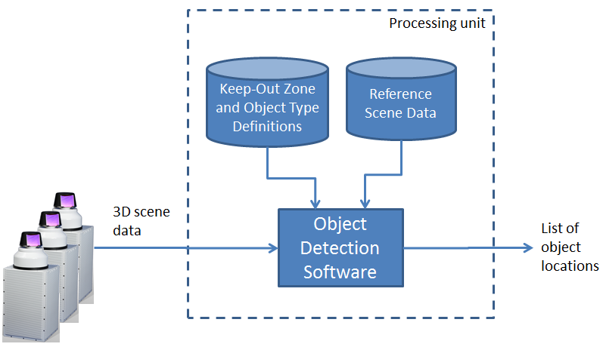
Neptec Technologies
LiDAR
  Neptec proposes using its Opal family of LiDAR sensors in conjunction with its 3D change-detection software as a sensor system for runway incursion prevention systems. This proposed technology can collect points at a high resolution, can collect object shape information, and can detect any object, regardless of whether it is equipped with a transponder or not.
August 2014

Slide 23
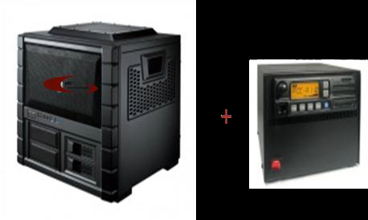
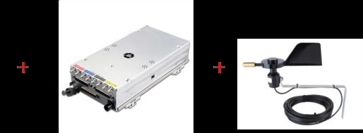
Aeropath Technologies
ARTI (Airport Real Time Information)
  Aeropath proposes using its ARTI system for ground surveillance at small to medium-sized airports. ARTI is based on a Garmin TCAS transponder unit that detects local airplane traffic via the airplane’s transponder. This is done in the airport control zone, defined as 5 to 10 miles and altitudes up to 3,000 feet AGL.
August 2014

Slide 24
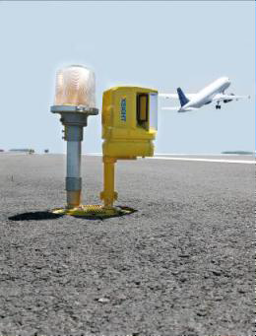
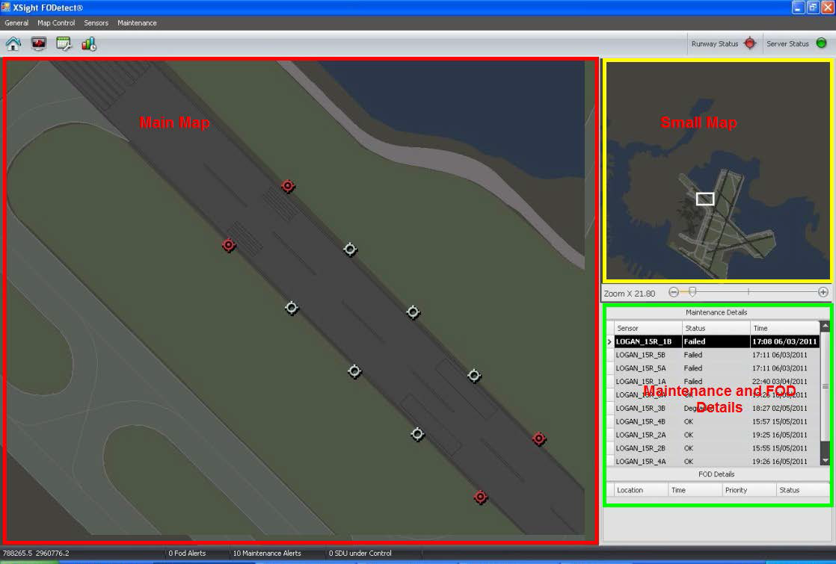
Thales
XSight
  Thales and its partner, Xsight Systems, provide Foreign Object Debris Detection technologies to airports such as BOS. They propose using this system that utilizes Surface Detection Units (SDUs) installed along both sides of the airport runway, as a runway surveillance sensor . Each SDU has a dual sensor head (DSH) that combines a Millimeter-Wave Radar sensor with a day/night Vision sensor.
August 2014

Slide 25
Small Airport Surveillance System (SASS)
RIRP Portfolio Update
Presented to: REDAC
Date: March 2015

Slide 26
Small Airport Surveillance Sensor (SASS)
SASS is a low-cost secondary surveillance solution
  Provides surface & airborne surveillance in airport vicinity
  Expected Surface accuracy ~30’, airborne targets ~20 nm out
Potential benefits
  Provides improved controller traffic situation awareness
  Improved safety & efficiency at towered airports
  Portability for disaster response (Haiti) & special events (Oshkosh)
Key design features
  High accuracy phased array antenna design
  COTS equipment use - Software Defined Radio (SDR) modules
  State-of-the-art digital signal processing leveraged from DoD work
  Requires only two sensors installed on airport property
Target airports
  GA airports with Class D airspace towers
  High traffic non-towered airports

Slide 27
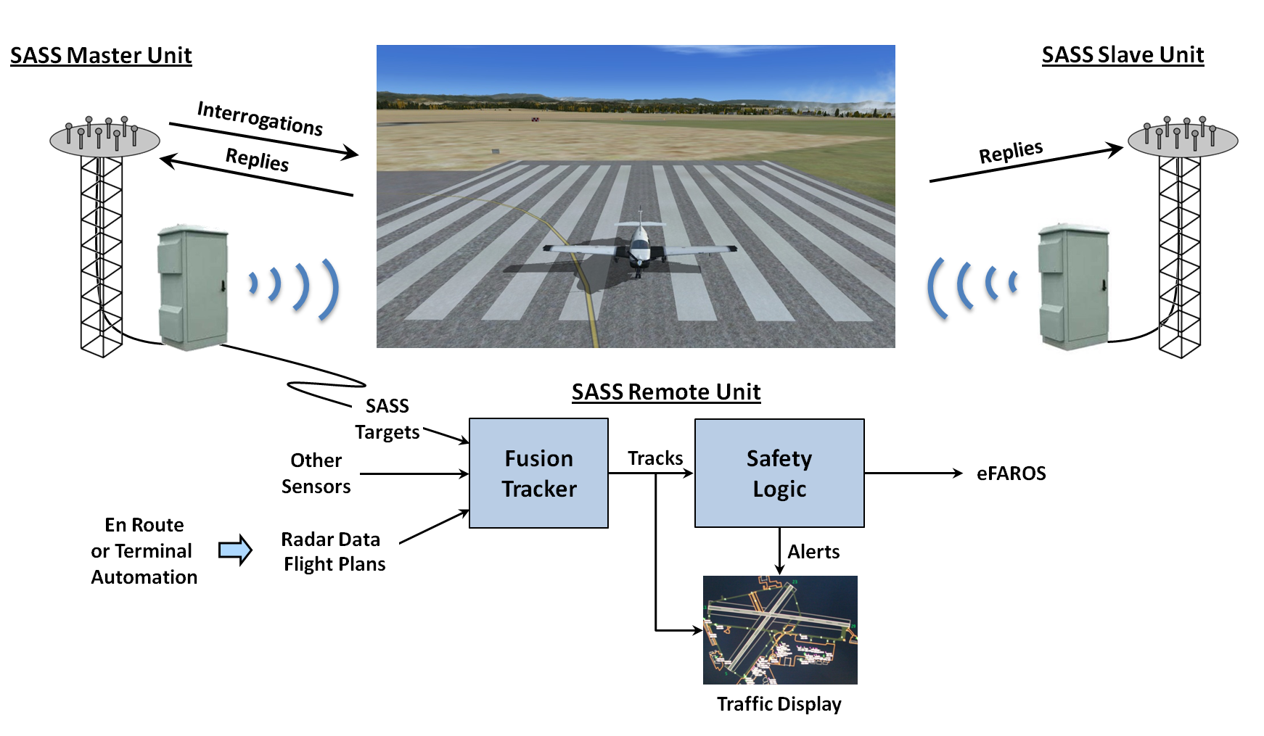
SASS System Diagram

Slide 28
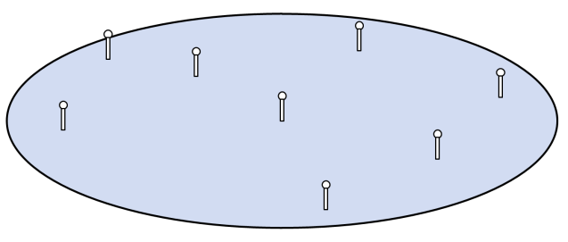
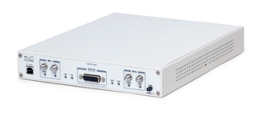
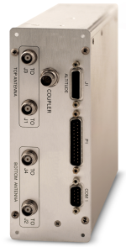
SASS Design Features
Phased Array Antenna
0.4° azimuth accuracy
Omni-directional reception
Software Defined Radio
Inexpensive COTS modules
Receiver, DDC, FPGA, I/Q output
TCAS Interrogator
Transponder disabled to prevent interference
1 m
Ettus X300 USRP dual channel ($4K)
COTS unit (~$20K)
Runway Incursion Alerting
Reuse existing Safety Logic software (no development cost)
Leverage expertise in developing eFAROS systems including extensive field testing experience
Surveillance Capabilities
30’ accuracy on airport surface
Airborne surveillance to 20 nm
Omni-directional reception
ADS-B (1090ES & UAT)
Installation & Maintenance
Only two sensors required
Installed on airport property
Simplifies maintenance
Eligible for AIP funding

Slide 29
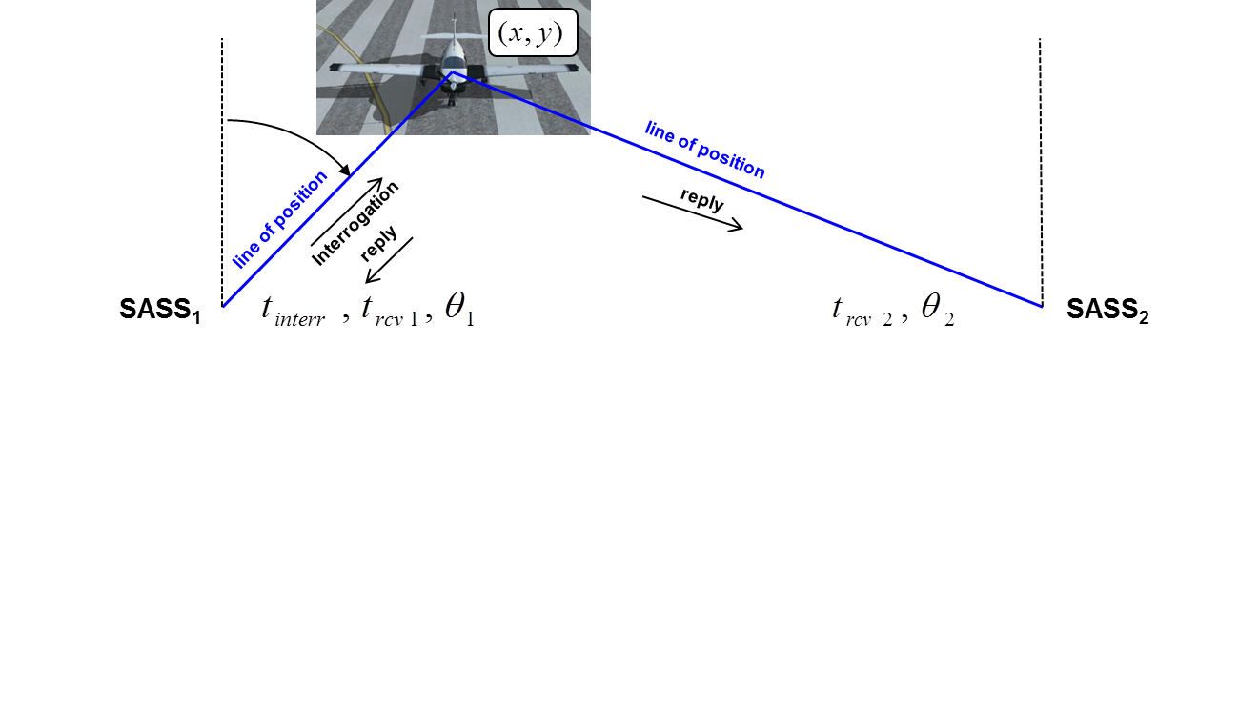
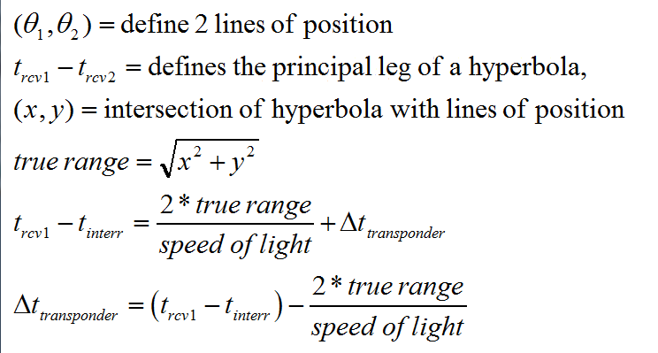
How SASS Works
Range bias determined from one interrogation and two replies

Slide 30
SASS Master & Slave Hardware Design
SASS Master Unit
TCAS
Unit
Dual Directional
Coupler
X300 USRP 1030 MHz @ 100 Msps
Interrogation
time
Omni Blade
TCAS Antenna
GPS Time
X300 USRP 1090 MHz @ 100 Msps
TOA₁
1090 XPNDR
1090 Receiver
8 x N200 USRPs @ 10Msps
θ₁
SASS Slave Unit
GPS Time
Monopole
AUX Antenna
X300 USRP 1090 MHz @ 100 Msps
TOA₂
1090 Receiver
8 x N200 USRPs @ 10Msps
θ₂
New design uses low-cost USRP* modules
*Universal Software Radio Peripheral

Slide 31
SASS Data Collection System
Thinkmate Server
RAID SSDs
(2.5 TB ≈ 55 min continuous recording for these 10 channels)
Raid
Controller
(6 Gbps)
512 GB
RAID Overhead
8 N200s (10 Msps)
1-GigE ports 1-8
2.56 Gbps
5.76 Gbps
GPS (10 MHz Ref, PPS)
1-GigE port 9
512 GB
512 GB
512 GB
GPS (10 MHz Ref, PPS)
1-GigE port 10
512 GB
512 GB
512 GB
1 X300 (50 Msps)
10-GigE port 1
3.2 Gbps
1 X300 (50 Msps)
10-GigE port 2
Boot SSDs
Additional channel
needed for receiving
UAT messages
256GB
256GB
RAM
(64 GB ≈ 90 sec recording)
Intel Xeon Quad Core (2.5 GHz)
Intel Xeon Quad Core (2.5 GHz)
8 GB
8 GB
8 GB
8 GB
8 GB
8 GB
8 GB
8 GB
Data collection system design supports very high data recording rate

Slide 32
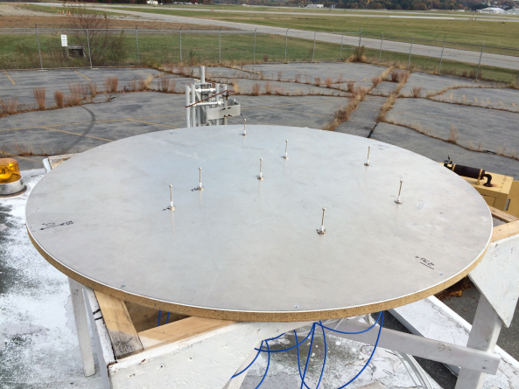
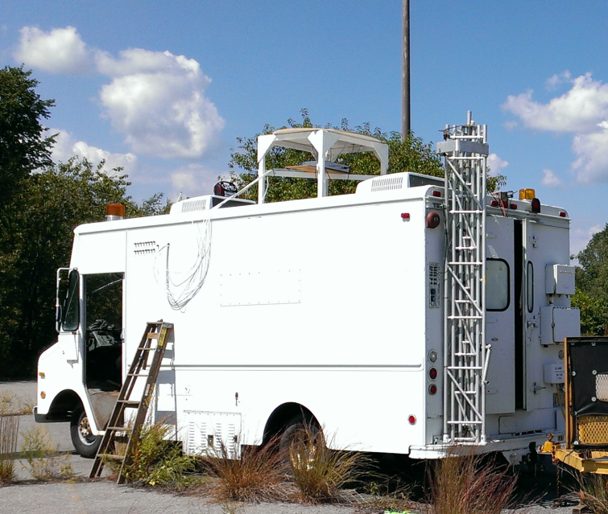
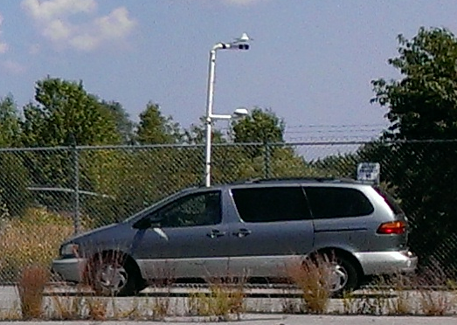
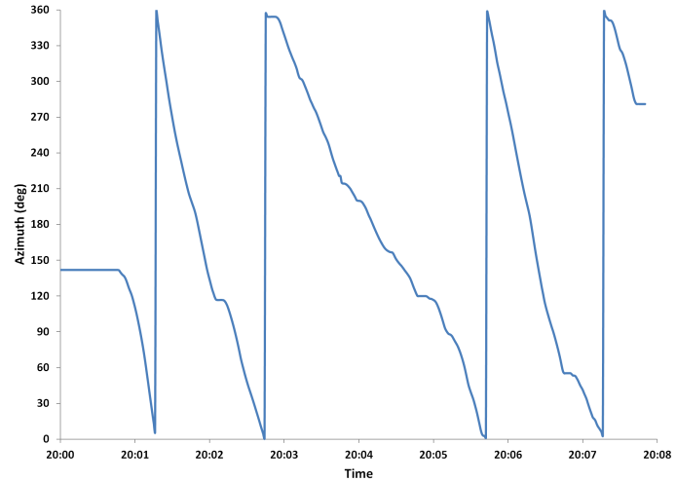
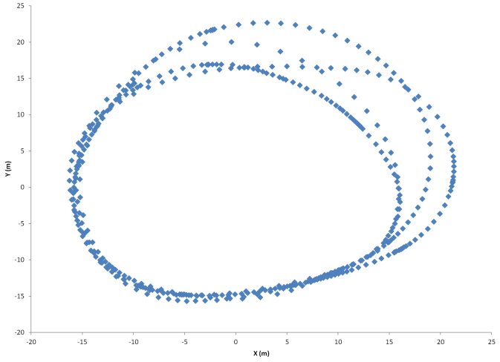
SASS Data Collection
(Hanscom Field, 15 December 2014)
Phased Array Antenna
SASS Van
Test Vehicle
Array
Transponder
Antenna
GPS
Antenna
Vehicle Azimuth (DGPS)
Vehicle Position (DGPS)
Test vehicle
path
o
Array
Test vehicle with Mode S transponder & DGPS driven slowly around array
8-channel I & Q data from phased array collected using borrowed equipment

Slide 33
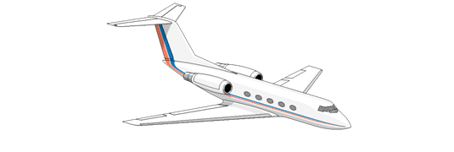
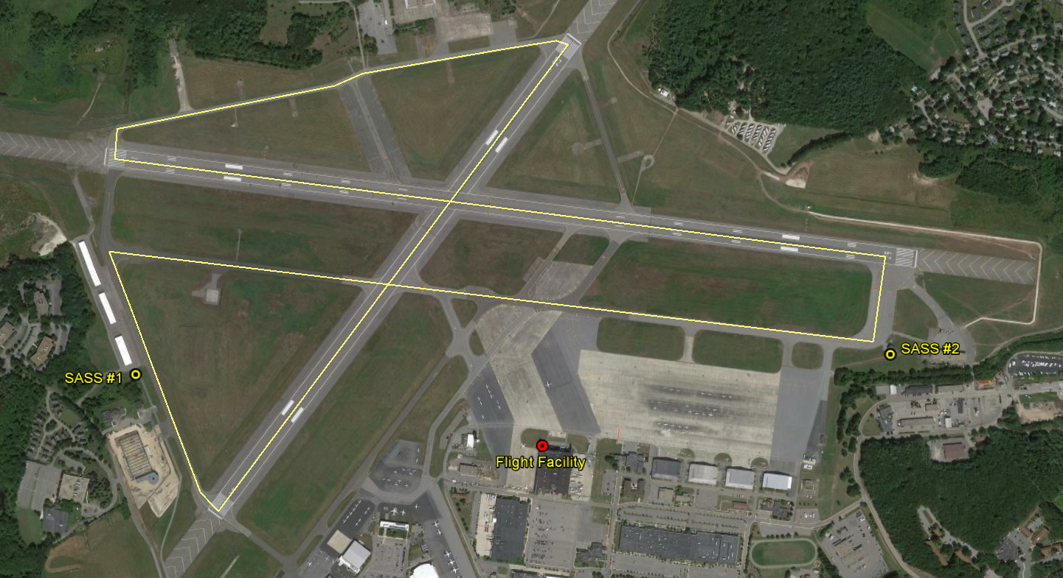

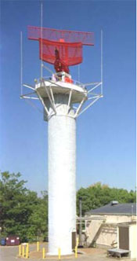
FY15 Hanscom Data Collection
Test vehicle with DGPS &
transponder
ADS-B
equipped
aircraft
WiFi
WiFi
Installing sensors in vehicles with generators for FY15 data collection pending semi-permanent installations
Truth sources: DGPS, Lincoln Mode S radar (MODSEF), ADS-B equipped targets of opportunity & video cameras
MODSEF
(1.3 nm away)

Slide 34
Milestone Schedule
FY 15 Milestones
Q1
Q2
Q3
Q4
Q1
Develop SOW and create new TASK for SASS project under current MIT LL contract
Build and test SASS hardware platform
Develop real-time signal processing software
Perform surveillance data collection at BED
Demo real-time surface surveillance at BED using SASS.
Notes:
34

Slide 35
FY15 Activities
Build and test SASS Master and Slave mobile units. Q2FY15
Develop and test real-time signal processing software. Q2-Q3FY15
Conduct field tests at Hanscom Field (BED) using SASS Master & Slave mobile units. Q4FY15
Perform analysis to evaluate the performance of the SASS system against truth data. Q4FY15
Develop report on the performance of the SASS system against truth data. Q1FY16

Slide 36
FY16 RIRP Proposed Activities

Slide 37
Complete annual technical and operational evaluation report of existing RIRP prototype systems.
Complete annual report documenting results of human-in-the-loop (HITL) testing Human Factors (HF), safety logic, aircraft performance, or any uncertainty or deficiency pertaining to surface based RI indications.
Complete annual report on Runway Incursion (RI) prevention shortfall analysis.
Complete annual report on testing of safety logic enhancements to Runway Incursion (RI) detection and prevention products.
Publish the Project Plan and Resource Management Plan (RMP) for the utilization of a Small Airport Surveillance Sensor (SASS) as a sensor to drive the activation of direct to pilot alerting safety logic.

Slide 38
FY17 RIRP Proposed Activities

Slide 39
Complete annual technical and operational evaluation report of existing RIRP prototype systems.
Complete annual report documenting results of human-in-the-loop (HITL) testing HF, safety logic, aircraft performance, or any uncertainty or deficiency pertaining to surface based RI indications.
Complete annual report on testing of safety logic enhancements to Runway Incursion (RI) detection and prevention products.
Complete report documenting candidate site selection for a system to test the utilization of a Small Airport Surveillance Sensor (SASS) as a sensor to drive the activation of direct to pilot alerting safety logic.
Complete report on integration of a system to test the utilization of a Small Airport Surveillance Sensor (SASS) as a sensor to drive the activation of direct to pilot alerting safety logic.
Publish the initial Project Plan and Resource Management Plan (RMP) for the utilization of an advanced ground surveillance sensor to drive the activation of direct to pilot alerting safety logic

Slide 40
BACKUP SLIDES

Slide 41
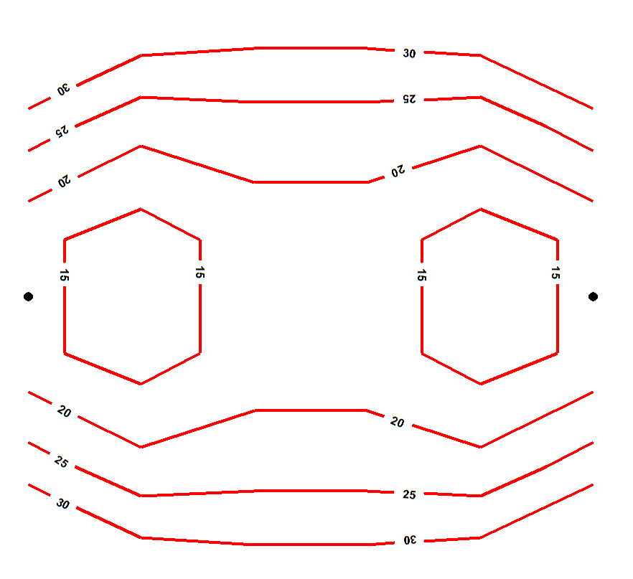
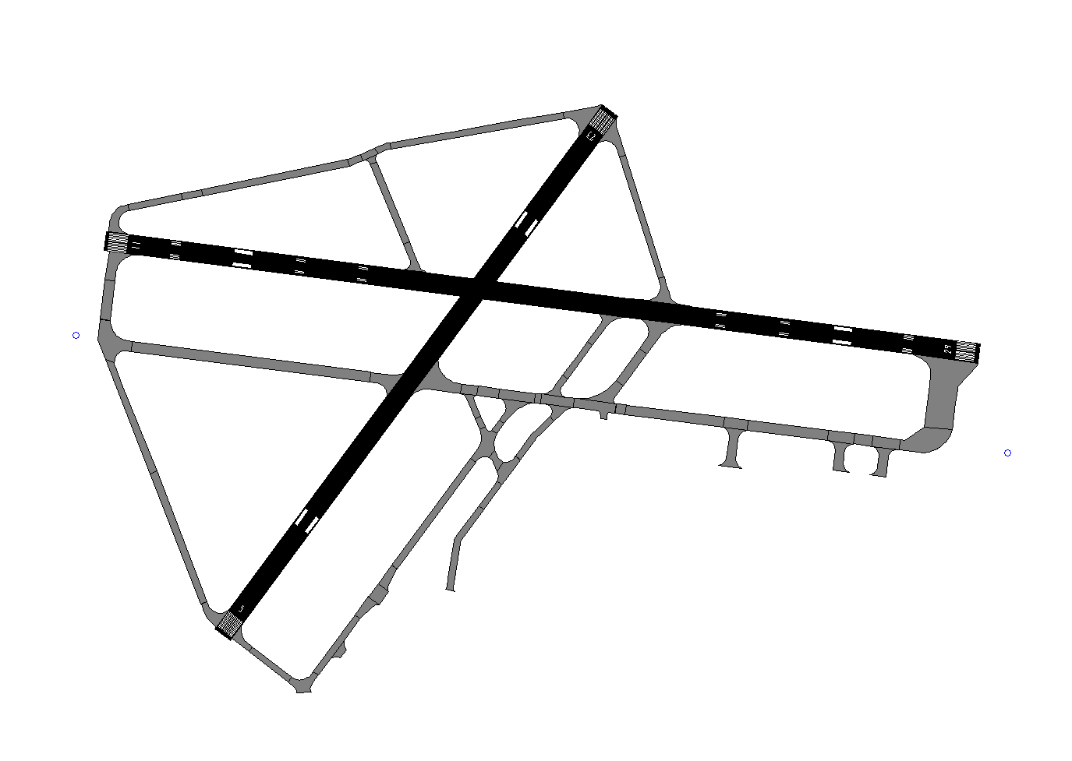
Modeled Surface Surveillance Error (ft)
(Hanscom Field in Bedford, MA)
SASS
Sensor
SASS Sensor
Model Assumptions
Range error: 10’ (1 σ) Azimuth error: 0.4° (1 σ)
30’ position error or less over entire surface movement area

Slide 42
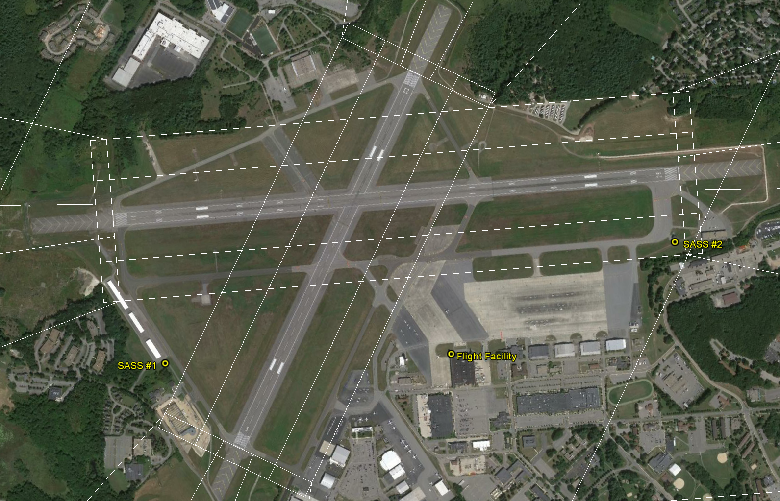
Siting Options with Obstruction Surfaces

Slide 43
Steps For Site Breakdown
1) Removal/Relocation of existing equipment racks located in shelter
2) Removal / crating of existing radar equipment located in shelter, including the disconnection of radar waveguide/transceiver/motor controller
3) Removal of electrical conduits between LCGS radar tower and shelter
4) Removal of copper ground leads to ground counterpoise
5) Removal of Ice Bridge connecting LCGS tower to shelter
6) Pull back of FAA single mode fiber from the shelter back to nearest pull box
7) Termination of existing power feed to FAA ATCT location (This will require support from the local Service Area)
8) Installation of Battery Operated Obstruction lights on LCGS radar tower until tower can be removed

Slide 44
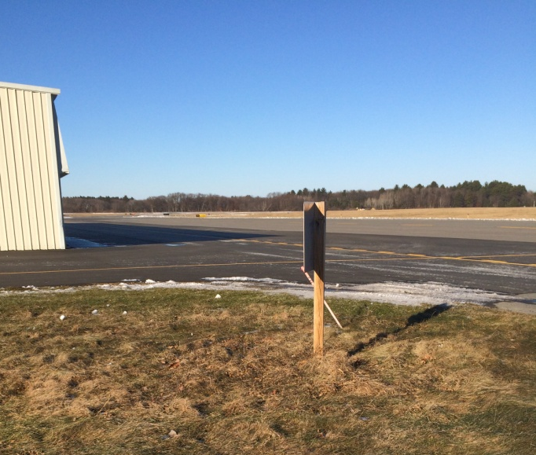
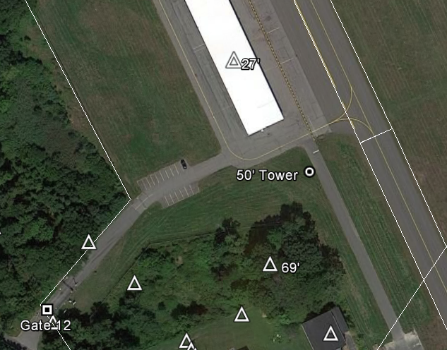
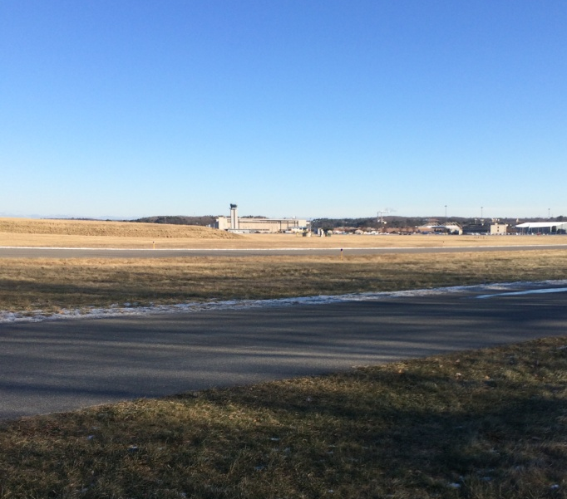
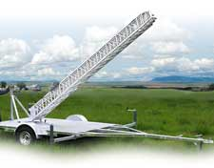

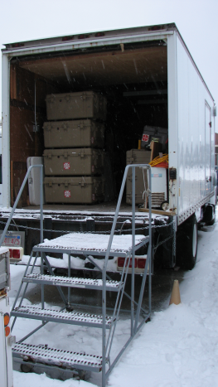
Site #1: Pine Hill T-Hangars
Telescoping tower with trailer
  50’ extended height
  15’ retracted height
Box truck obtained for second SASS unit
  Allows identical tall rack to be installed
  Towed generator for power

Slide 45
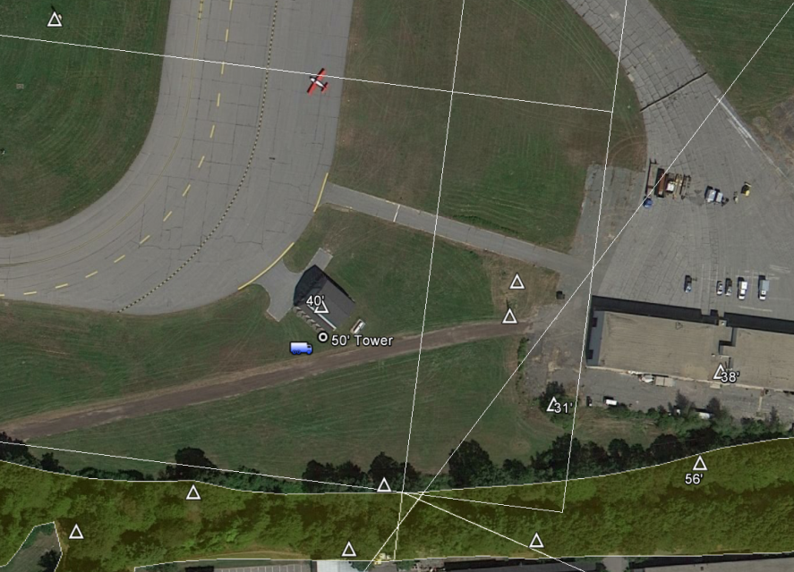
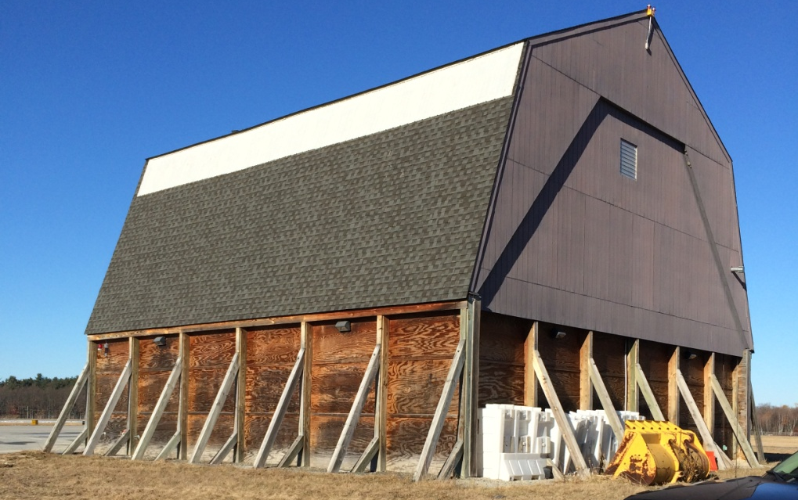
Site #2: Salt Shed
Antenna attached to truck
  50’ extended, 20’ retracted
  Set up at SE corner of salt shed
  May attach antenna to shed (MassPort suggestion)
Truck
  Contains data recording system
  Towed generator for power

Slide 46
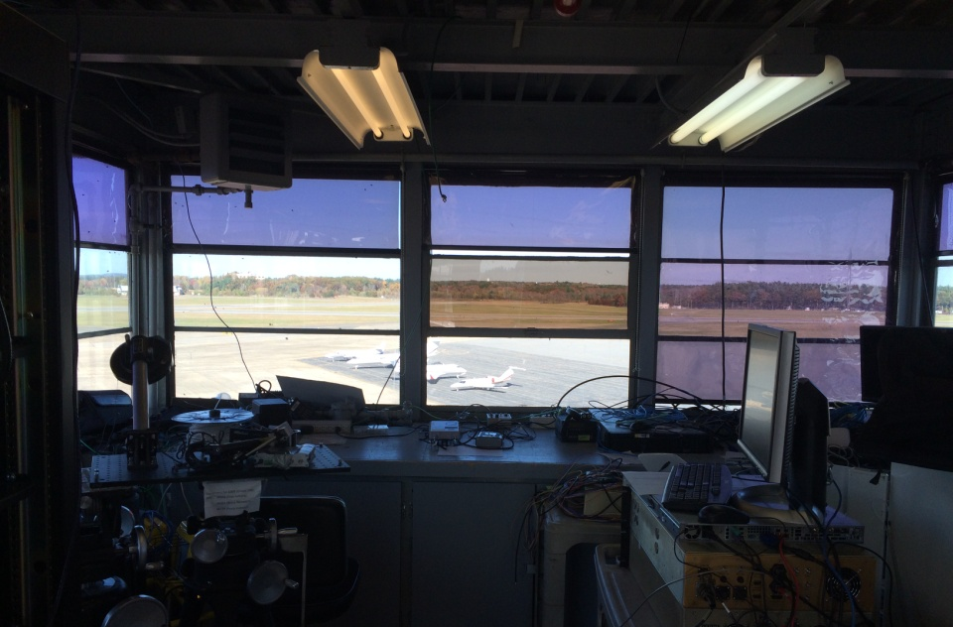
Flight Facility Tower Cab
View of airfield to North from Flight Facility tower cab
Will be used to mimic BED tower
  Good view of runways & taxiways (85’ tall)
  Near actual tower (550’)

