Slide 1
REDAC NAS Operations Subcommittee, Weather Performance Requirements Validation
10 March 2015

Slide 2
Simplified Needs to Solutions Process
NextGen Mid-Term CONOPS
NAS Segment Implementation Plan 5.0
Determine Weather Functions in CONOPS
Determine Weather Functions in NSIP
Assess Operational User Needs
Determine Weather Information Attributes
Develop Functional Requirements
Develop Preliminary Performance Requirements
Validate Performance Requirements
Allocate Performance Requirements
Capability Research (e.g., AWRP, WTIC)
Acquisition Process

Slide 3
Operational Weather Needs Analysis (OWNA)

Slide 4

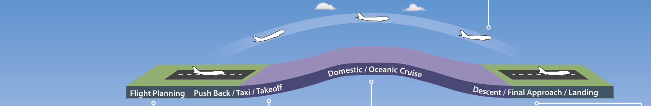

Operational Weather Needs Analysis (OWNA)
Identify weather attributes based on operational decision making associated with weather-constrained NAS flight operations
Pilot (PIC) Dispatcher (DSP)
Execution
Domain
(Linked to the Flight Event)
Controller (ATC)
Flight
Planning
Surface
(Pushback/
Taxi)
Departure
(Takeoff/
Climb)
Cruise
(Domestic/ Oceanic)
Arrival
(Descent/Approach/ Landing/Taxi)
ATM Timeline
Flow Contingency Management Traffic Management Separation Management
Next Day+ before the Weather Event
8+ to 4 hours before the Weather Event
4 to 2 hours before the Weather Event
2 to 1 hour before the Weather Event
1 hour before onset through cessation of the Weather Event
Planning
Domain
(Linked to the Weather Event)
ATC Coordinator (AOC)
Traffic Manager (TFM)
Prepared by The MITRE Corporation. © 2014

Slide 5
OWNA Scope – NSIP 5.0 Increments Directly Dependent on Weather Information
Direct weather dependency
  Systems and capabilities associated with the increment require raw and/or translated weather information in order to successfully function
  Raw weather is directly sensed or measured (e.g., temperature, wind, radar imagery)
  Translated weather is comprised of one or more raw weather elements that have been transformed into a parameter that is not directly sensed or measured (e.g., wind chill, heat index, ITWS microburst alert, weather avoidance field [WAF])
Of the 115 Increments found in the eight operational portfolios of NSIP V5.0, seven were determined to have direct weather dependencies
CATM Portfolio (5)
  CACR (A)
  RAPT (A)
  A-RAPT [ARSI] (B)
  IDRP (B)
  AARDS (B)
IMRO Portfolio (2)
  WTMD (A)
  WTMA-S (B)
Prepared by The MITRE Corporation. © 2014

Slide 6
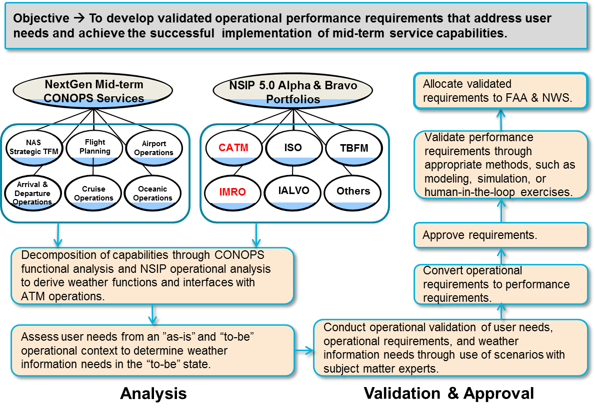
Relationship – OWNA to Requirements
OWNA
Prepared by The MITRE Corporation. © 2014

Slide 7
IDRP and ARSI – Attributes of Needed Weather Information
Attribute | Current | Future | Gap | NWP Mapping | Comments
Automated Alerting | None | Needed | Yes | No | Recommended Responsibility - FAA, NWS
Delivery Medium | Multiple | Graphical | No | Yes | Assumes NWP, CSS-Wx can provide
Number of Displays | Multiple | Single portal | Yes | Yes – AWD | Recommended Responsibility - FAA
Explicit Onset and Cessation | None | Needed | Yes | No (implicit) | Recommended Responsibility - FAA
Scoring | CIWS, CoSPA, ITWS | Needed | No | Yes | Assumes NWP can provide
Temporal Resolution | Multiple | None specified | No |  | SMEs thought current resolutions were adequate
Translated Weather | Yes, but not viewable | Viewable | No | Yes – AWD | Assumes NWP can provide
Prepared by The MITRE Corporation. © 2014

Slide 8
Weather Performance Requirements Validation (Modeling and Simulation)

Slide 9
Simplified Needs to Solutions Process
NextGen Mid-Term CONOPS
NAS Segment Implementation Plan 5.0
Determine Weather Functions in CONOPS
Determine Weather Functions in NSIP
Assess Operational User Needs
Determine Weather Information Attributes
Develop Functional Requirements
Develop Preliminary Performance Requirements
Modeling and Simulation will be used to Validate Weather Performance Requirements
Validate Performance Requirements
Allocate Performance Requirements
Capability Research (e.g., AWRP, WTIC)
Acquisition Process

Slide 10
Purpose of Weather Performance Requirements Validation
The FAA established a goal to develop firm mid-term performance requirements for enhanced weather information
Process follows a requirements development process. ¹
  Functional requirements for weather are developed from analysis of the Mid-Term ConOps, NSIP, and OWNA²
  Preliminary performance requirements from information provided by stakeholders.
  Final performance requirements are validated through modeling and simulation of operations.
Weather performance requirements should be representative of their “point-of-diminishing-return” of NAS performance improvements.
¹ FAA, “NAS Lifecycle Planning (NLP) Project Level Agreement (PLA) Systems Development – New ATM Requirements – Weather Transition Fiscal Year 2013.”
² Fronzak, Matt, McKnight, Claudia (MITRE CAASD), “Results from the OWNA of Weather Dependent Increments from the NSIP Version 5.0,” June 2014.

Slide 11
Scope of Weather Performance Requirements Validation
This activity will result in the development of Weather Performance Requirements that have direct impact to CATM operations in the Bravo segment.
Preliminary Forecast Weather Performance Requirements³ explain timing error, location error, POD, and FAR for
  Onset and Cessation of Thunderstorms at Core Airports
  Onset and Cessation of Thunderstorms in En Route Airspace
  Onset and Cessation of Instrument Flight Rules (Ceiling and Visibility) at Core Airports
  Onset and Cessation of Marginal Visual Flight Rules (Ceiling and Visibility) at Core Airports
  Onset and Cessation of Wind Direction Change at Core Airports
Preliminary Forecast Weather Forecast horizons to be studied
  0-1 Hour
  1-2 Hours
  2-4 Hours
  4-8 Hours
³ Heuwinkel, Richard, “Statement of Preliminary Functional Requirements for Weather Information to Support Traffic Management Initiatives,” March 2014.

Slide 12
Approach to validating Weather Performance Requirements (Notional Workflow)
Scenario Development
Simulation and Modeling
Analysis of Results
Weather Performance Requirements
NEXTGEN KEY PERFORMANCE INDICATOR AREAS⁴ | METRIC
Capacity | Daily Capacity
City Pair | Airborne Time
 | Effective Gate-to-Gate
Efficiency | Gate Arrival Delay
 | Taxi-In Time
 | Taxi-Out Time
Environment | Fuel Burn
Varied Weather Info Parameters
Weather and NAS Simulators
OTHER PERFORMANCE INDICATOR AREAS | METRIC
Airline Schedule | Cancellations
 | Diversions
Efficiency | Pre-Departure Delay
 | Total Departure Delay
 | Arrival Delay
 | Distance Flown
Airline Flexibility | Substitution Opportunities
Traffic Management Stability | Airport Program (GDP/GS) Re-planning
 | Number of Route Availability Changes
Actual Weather & Traffic Scenarios
ATM Business Rules
⁴ NextGen Performance Snapshots Reference Guide, URL: www.faa.gov/nextgen/snapshots/guide/, Last modified: 04 December 2014.

Slide 13
Scenarios/Simulations Address
Ability to alter weather forecast for Convection, Ceiling, Visibility and Winds
Ability to calculate NAS resource capacity/availability based on forecast and actual weather.
  For CATM we will need to derive airport capacity, en route airspace availability, and arrival/departure gate availability.
Ability to simulate TMIs for changes in capacity based on the weather forecasts (i.e., define a set of ATM business rules)
  Reroutes (including Playbook) affected by En route Convection
  Airspace Flow Programs (AFPs) affected by En route Convection
  Ground Stops (GS) affected by Terminal Convection
  Departure and Arrival reroutes (IDRP and ARSI) affected by Terminal Convection
  Ground Delay Program/GS (AARDS) affected by Terminal Convection, Ceiling and Visibility, Wind
  Collaborative Trajectory Options Program affected by Terminal and En route Convection
Ability to simulate imperfect execution of all ATM responses.
Ability to record the impact of ATM responses with operationally meaningful metrics.

Slide 14
Convection Scenarios – Study Regions and Actual Weather
Identifying four airspace regions (and demand profiles) for terminal convection:
  (1) N90,
  (2) C90,
  (3) DFW,
  (4) ATL
Identifying three airspace regions (and demand) for en route convection:
  (1) Northeast (ZOB, ZNY, ZBW, ZDC),
  (2) ZKC,
  (3) Southeast (ZME, ZTL)
Identifying three types of convection/thunderstorms:
  (1) air mass,
  (2) line,
  (3) lines with gaps

Slide 15
Schedule
Scenario Deliverable 1: Kick-Off, Project Plan
Scenario Deliverable 2: Preliminary Convective WX Scenarios
Scenario Deliverable 3: Preliminary Scenarios covering C&V and Surface Winds
Scenario Deliverable 4: Final Scenarios for Convection, C&V, and Surface Winds
AvMet is developing Scenarios to exercise the Weather Performance Requirements for CATM operations.
M&S Deliverable 1: Project Plan
M&S Deliverable 2: Convective WX Results
M&S Deliverable 3: C&V and Surface Winds Results
M&S Deliverable 4: Final Results
AvMet will simulate and analyze Weather Performance Requirements for CATM operations.
Oct 14 | Nov 14 | Dec 14 | Jan 15 | Feb 15 | Mar 15 | Apr 15 | May 15 | Jun 15 | Jul 15 | Aug 15 | Sep 15 | Oct 15 | Nov 15 | Dec 15
SME Kickoff
SME Update
SME Update
SME Review
SME Review
SME Review
SME Review
SME Review
Issue Final Report
Periodic reviews of approach, scenarios, and results by the FAA SME team.
M&S Deliverable 1v: Project Plan
M&S Deliverable 2v: Convective WX Results
ANG-C41 conducts a parallel analysis of Convective Weather in the terminal airspace to verify and validate M&S method.

Slide 16
Back up

Slide 17
Verification and Validation of Modeling and Simulation Approach
Communicate modeling and simulation approach for vetting through a team of weather/simulation/TFM experts that are internal to the FAA.
  AFI-300: Dan Citrenbaum
  ANG-5: Sanjiv Shresta
  ANG-C41: Mike Paglione, Michael Konyak, Al Schwartz, Christina Young
  ANG-C6: Rick Heuwinkel, Sandra Schmidt, Starr McGettigan, Stewart Stepney, Randy Bass, (more to come when we evaluate C&V and Surface Winds)
Scenarios are constructed agnostic to the simulation system. Scenario descriptions cover
  (1) Actual weather event, (2) forecast weather performance parameters, (3) airspace description, (4) demand description, (5) traffic management initiative description in the Bravo timeframe (including weather translation), and (6) impact metrics.
Independent parallel studies will be conducted by ANG-C41 (with the use of AirTOp) and AvMet (with the use of DART) for thunderstorms in terminal airspace.

Slide 18
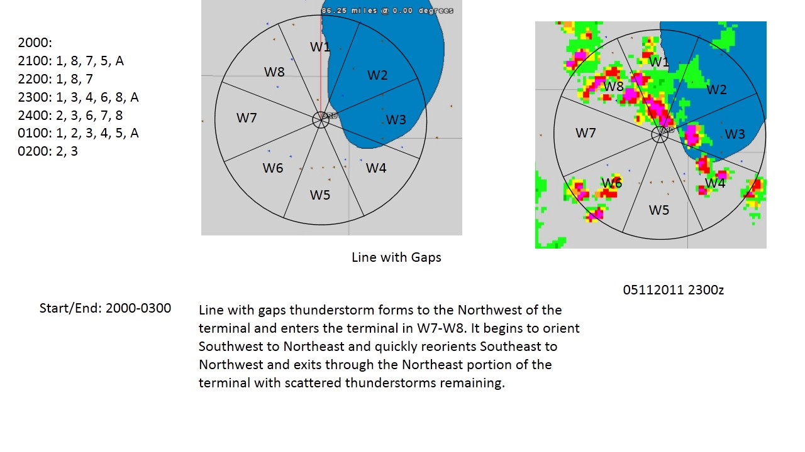
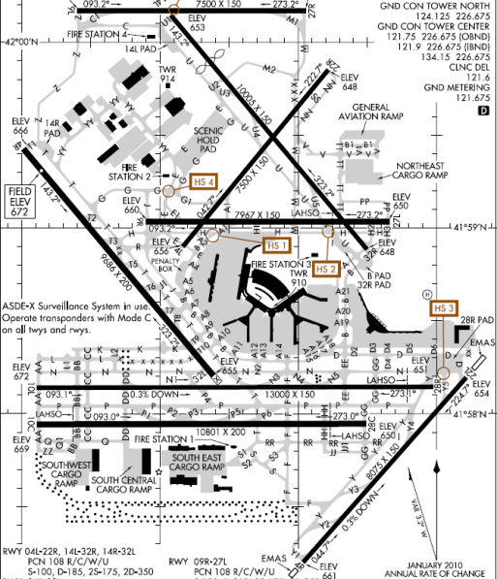
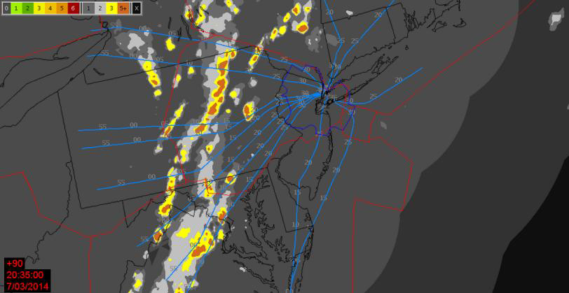
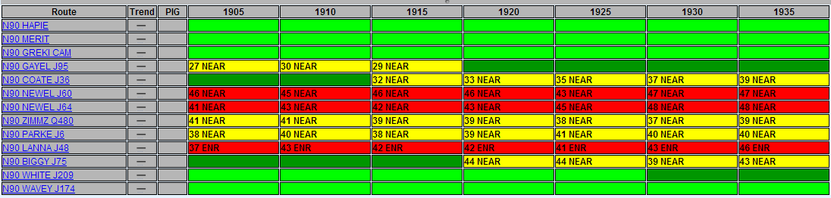
Scenario Illustration – Departure Rerouting:
05112011 ORD 1.1⁵
Actual Weather (historical event):
  Fast moving line storms with gaps north west of Chicago, IL.
  Forming/entering study airspace ~21GMT and Dissipating/Exiting study airspace ~02GMT
Airspace (actual operations):
  Terminal Airspace surrounding KORD within 75 nm of airport including all departure fixes
  Airport departure configuration: 32L | 22L | 28R
Demand (historical norm):
  Currently looking at 85th percentile of daily demand level.
  Affected hours determined demand impacted by route blockage 00-02GMT
Forecast Weather Performance Parameters (study scope):
  Lead Times: 0-2 Hour
  Accuracy Resolution Range: 3 nm to 15 nm
  Accuracy Range for Onset or Cessation 20% to 100%
  Timing Error Range for Onset or Cessation: 0 to 40 minutes
Traffic Management Initiative (CATM operating description):
  Identify blocked departure routes
  Operate departure rerouting based on CATM WP4 IDRP
Performance Metrics
  NextGen Performance Metrics: Airborne Time, Effective Gate-to-Gate, Taxi-out, Fuel Burn
  Other Performance Metrics: Diversions, Cancellations, Throughput
⁵ Newton, Steven, et. al. (AvMet), “Mid-Term Weather Requirements Validation Modeling & Simulation Scenarios,” 30 January 2015.

Slide 19
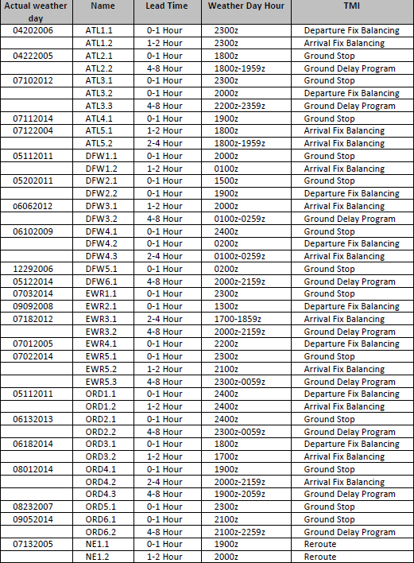
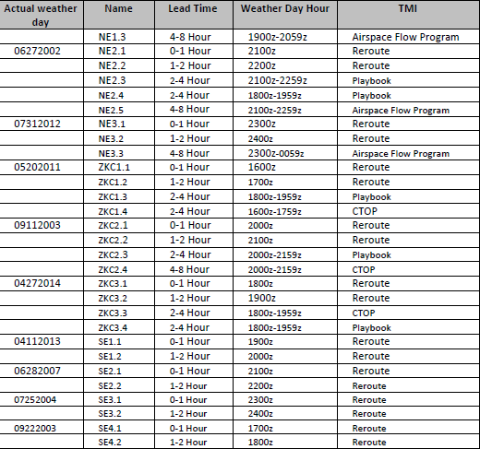
AvMet Convection Scenarios
Full SME review completed Feb 10, 2015 with ANG-6, ANG-C41, ANG-5, and AFI-300.

