Slide 1
FY 2016 Aircraft Safety PPT Portfolio Review
Aeromedical (AM)
BLI A11.j
By: Jean Watson, AAM-5 Washington, DC Dr. Estrella Forster, AAM-600 CAMI, Oklahoma City, OK
Date: 5 March 2014

Slide 2
Aeromedical Overview
Why is this program necessary?
Supports FAA regulatory and advisory missions to improve the safety, security, health, and survivability of the most important component of the NAS: the human operator and the public which s/he serves.
What risk areas or technology gaps need attention?
Continued Operational Safety – Results of research maximize the strengths of the human link in the NAS and minimize inherent human weakness to prevent accidents and improve safety and health in both commercial and general aviation aircraft through evidence-based medicine.
Standards and Policy – Investigation and analyzes of injury and death patterns in civilian flight accidents and incidents determine their cause and results in the development of preventive strategies including language for proposed standards, regulations, educational materials, and policies. This research supports FAA regulatory and medical certification processes that develop safety and health regulations covering all aerospace craft occupants and their flight environments.
Certification – The program combines toxicological and medical aspects of all fatal aircraft accidents to support accident investigation and medical certification processes to rapidly identify issues and augment aeromedical safety information systems. Crash survival research recommends equipment, technology, and procedures for optimal aircraft evacuation and human safety in emergency operations.

Slide 3
Aeromedical Overview
What is this program?
The purpose of this program is to conduct aeromedical research to improve the safety, security, health, and survivability of aviators, cabin crew, and the flying public. Ten research areas form the focus of research activities: cabin safety, biodynamics, physiology, aeromedical accident investigation, vision, biochemistry, forensic toxicology, functional genomics, radiobiology, and bioinformatics.
What are the overarching outcomes?
Aeromedical research outcomes are described in several directives including:
FAA Destination 2025 – Four Aspirations: next level of safety; workplace of choice; aviation access through innovation; global performance through collaboration. http://www.faa.gov/about/plans_reports/media/Destination2025.pdf
National Aeronautics Research and Development Plan (NARDP) – Goal 3: Demonstrate enhanced passenger and crew survivability in the event of an accident. http://www.whitehouse.gov/sites/default/files/microsites/ostp/aero-rdplan-2010.pdf
National Aviation Research Plan (NARP) – Goal 5: six research targets. http://www.faa.gov/about/plans_reports/
AOA major strategic priorities – (1) Make aviation safer and smarter; (2) Deliver benefits through technology and infrastructure; (3) Enhance global leadership; and (4) Empower and innovate with the FAA's people. AVS Flyer, Volume 5, Issue 1, 9 January 2014 and https://www.faa.gov/about/plans_reports/performance/
Title 14 Code of Federal Regulations – Cabin Safety, Biodynamics, Forensic Toxicology, Biochemistry, Functional Genomics, and Physiology. http://www.ecfr.gov/cgi-bin/text-idx?tpl=/ecfrbrowse/Title14/14tab_02.tpl
OST Research and Development Budget Priorities – Bioinformatics and Gene Expression. http://www.whitehouse.gov/administration/eop/ostp/rdbudgets
The President’s Council of Advisors in Science & Technology Priorities for Personalized Medicine – http://www.personalizedmedicinecoalition.org/sites/default/files/files/PMC%20Strategic%20Plan%20%203-25-11.pdf
NTSB Memorandum of Agreement with CAMI, numerous recommendations, and 10 Most Wanted – For the latter, #1 Address Unique Characteristics of Helicopter Operations; #3 Eliminate Distraction in Transportation; #4 Eliminate Substance Impaired Driving; #6 Improve Fire Safety in Transportation; and #10 Strengthen Occupant Protection in Transportation. https://www.ntsb.gov
President’s “Strategy for American Innovation” – http://www.whitehouse.gov/assets/documents/SEPT_20__Innovation_Whitepaper_FINAL.pdf

Slide 4
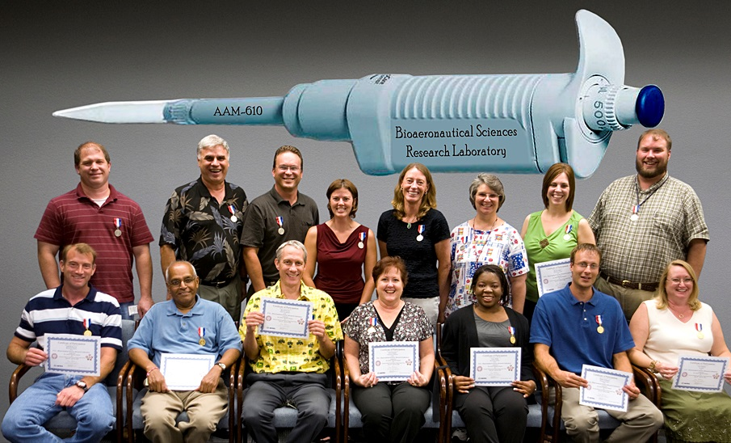
AM Program Capabilities: People
1,391 years of knowledge, skills, and experience (earliest: 1946 – latest: 2012). Median = 24 yrs.
Scientists, physicians, engineers, technical, and administrative staff
10 Associate (AAS/ABT/EMT/ACS)
1 Nursing (RN)
44 Baccalaureate (BS/BA)
29 Master (MS/MA/MPH, MAT)
20 Doctorate (1 LLD, 14 PhD, and 5 MD/DO)
16 With multiple advanced degrees
4 Pilots
11 Fellows/Diplomates of various professional organizations
13 With additional registrations/licenses
149 Professional organizations - Liaison
75 Professional committees or workgroups
Members of the staff serve or have served in various capacities including as executive officers of 30 organizations/committees
Research Division AAM-600
Bioaeronautical Sciences AAM-610
Protection & Survival AAM-630
5 Teams each
58 Personnel:
49 Government FTEs
8 In-House Contractor FTEs
1 Emeritus Principal Scientist (no cost)

Slide 5
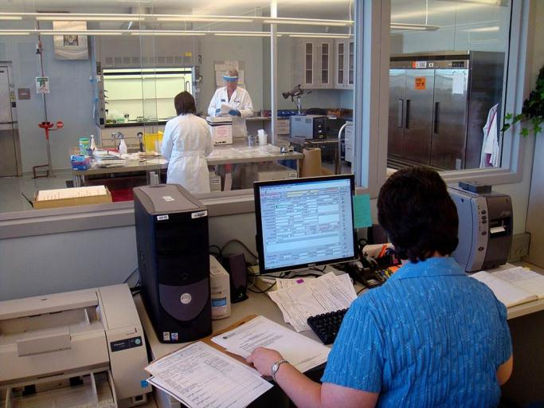
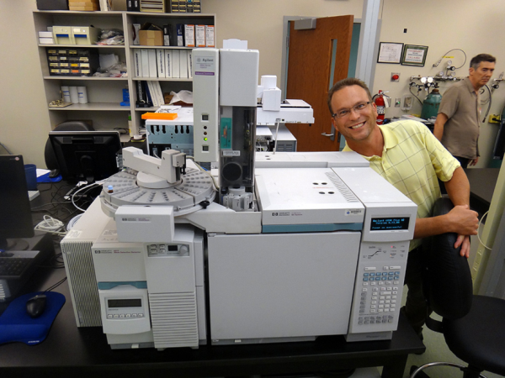
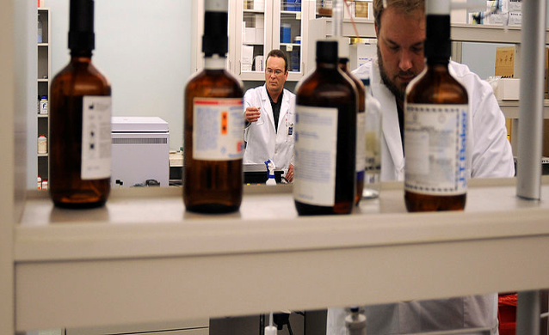
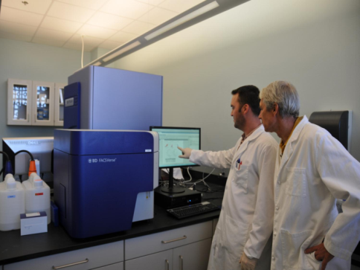
AM Program Capabilities: Brick & Mortar
Wet-Labs
Forensic Toxicology Laboratory
Biochemistry Laboratory
Functional Genomics Laboratory
2
1
3
1

Slide 6
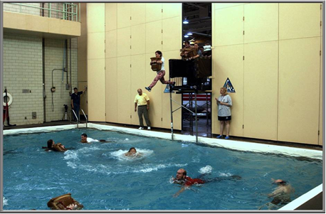
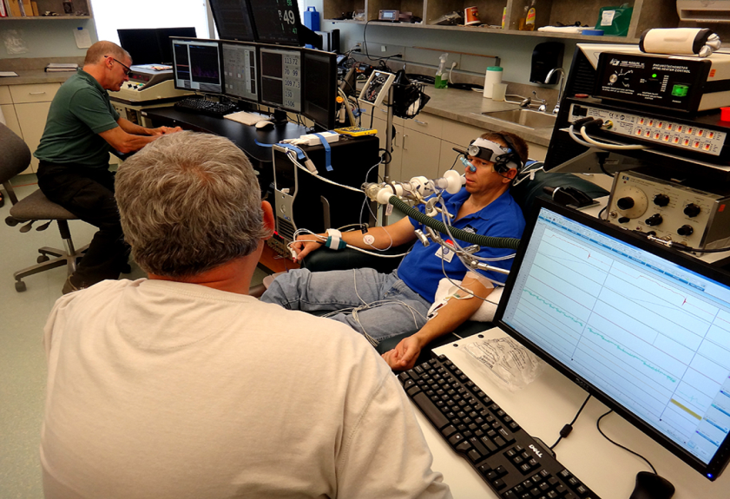
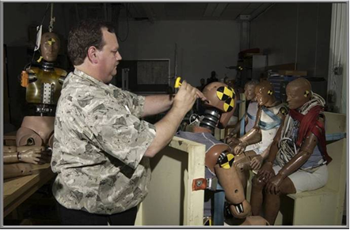
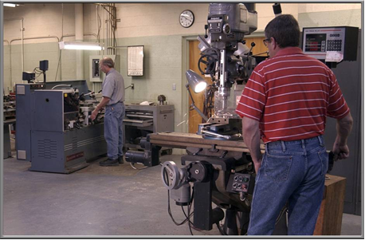
AM Program Capabilities: Brick & Mortar
Dry-Labs
Water Survival Research Tank
Anthropometric Test Dummy Laboratory
Machine Shop
Altitude Research Laboratory
1
4
3
2

Slide 7
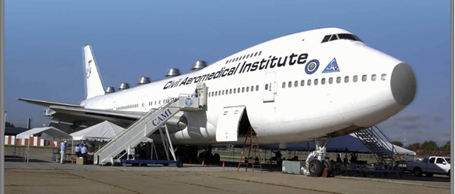
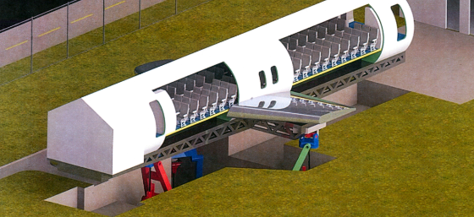
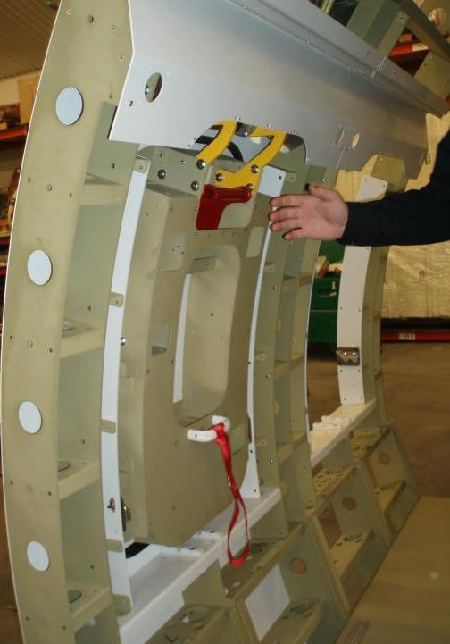
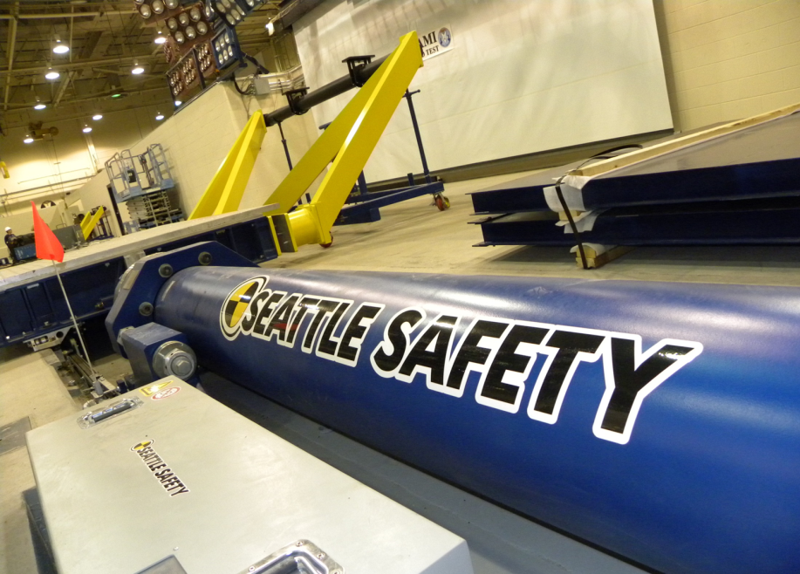
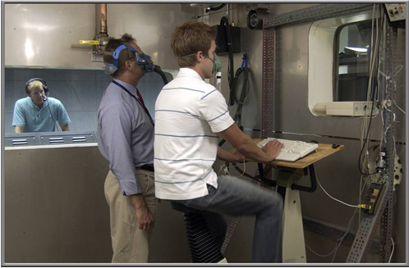
AM Program Capabilities: Simulators
B-727 Fire Safety Facility
B-747 Aircraft Environment Research Facility
Aircraft Cabin Research Facility (NEW, 9/2014)
Altitude Research Chamber
Impact Sled (NEW 9/2013)
2
1
3
5
4

Slide 8
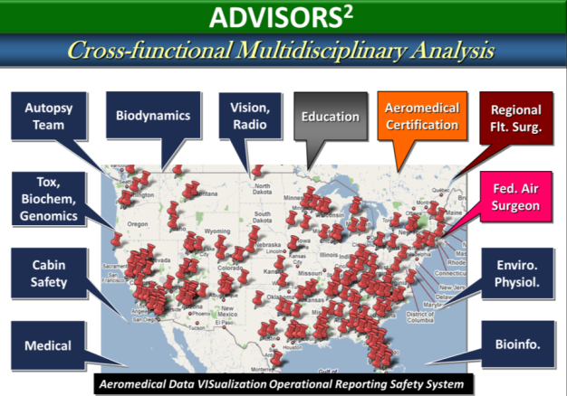
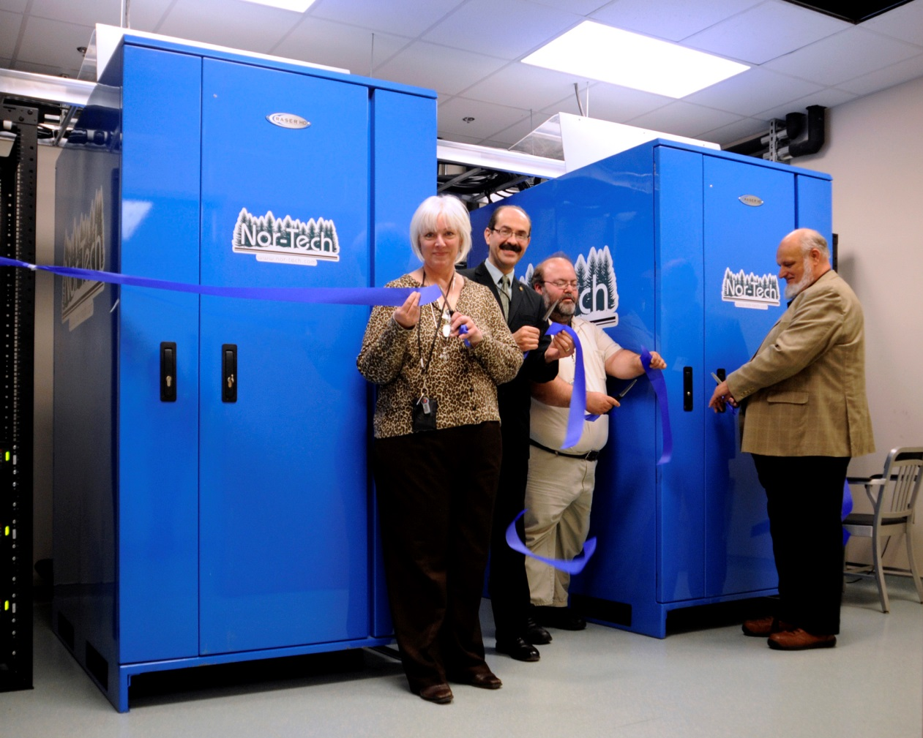
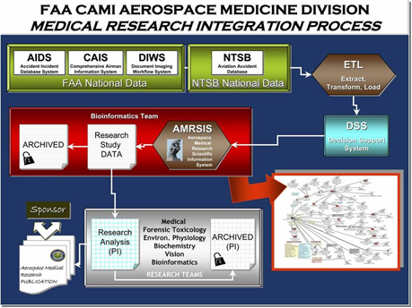
AM Program Capabilities: Virtual
Bioinformatics Research Laboratory
Friedberg Numerical Sciences Laboratory (2013)

Slide 9
AM Program Capabilities: Collaboration
ACADEMIA
U. of Oklahoma Health Sciences Center
U. Of Central Oklahoma
Washington State University
Rose State College
SW Oklahoma State University
GOVERNMENT
National Safety Council (NSC)
National Research Council (NRC)
National Oceanic and Atmospheric Administration (NOAA)
National Transportation Safety Board (NTSB)
Department of Justice Civil Division (DOJ)
US Coast Guard (USCG)
Air Force Research Laboratory (AFRL)
Transportation Safety Institute (TSI)
National Institute of Safety and Occupational Health (NIOSH)
Department of Homeland Security (DHS)
Immigration & Customs Enforcement (DHS/ICE)
Environmental Protection Agency (EPA)
Centers for Disease Control and Prevention (CDC)
Oklahoma State Health Department (OSHD)
National Aeronautics and Space Administration (NASA)
INTERNATIONAL
European Aviation Safety Agency
Transportation Safety Board of Canada
ISO Toxic Gas Committee
ISO Radiation Committee
International Cabin Safety Research Technical Group
Royal Canadian Air Force
National University of la Plata, Argentina
National University of Colombia
Argentinean Association of Flight Attendants
ALSO! Laboratories Certifications
ISO 9000
ISO 14001
American Board of Forensic Toxicology
OTHER
Society of Automotive Engineers
Flight Attendants Medical Research Institute
Aerospace Medical Association
American Academy of Forensic Toxicology
Notes:
In this slide the sponsor and provider, describe how the research in the program area is supported by people, labs, and partnerships. Describe, where applicable, collaborations with other government agencies and Centers of Excellence. Note that partnerships are where two or more organizations carry on a joint venture in which each brings resources to the table and shares in the risk of the venture. A relationship in which the FAA solely provides resources to an organization that then performs the research for the FAA is not a partnership.
People should include FAA personnel and the current contractors, both those working in the FAA laboratories and off site. Present how Aviation Safety RE&D resources are being spread, and who is actually doing the research.

Slide 10
FY16 Requirement AM-1 Aerospace Medical Systems Analysis
Research Requirement
Outcomes & Implementation Plan
Conduct Aeromedical Systems Analysis Research relative to the medical factors that affect human safety, specifically in the areas of medicine and bioinformatics:
Assess medical certification, accident, and other biological data to derive methods, recommendations, and/or tools to enhance aircrew health, medical certification decision-making processes, and Aviation medical Examiner (AME) education programs.
Identify trends in physiological, human factors, and clinical findings from civil aviation aircraft accidents and incidents to support accident investigation processes and develop strategies to mitigate aeromedical risks.
Develop and maintain comprehensive aeromedical research databases towards an Aeromedical Safety Management System and Probabilistic Risk Analyses.
Identify of current and anticipated aeromedical issues and technology that may impact human performance in aviation activities.
Serve as an advisory resource in areas relating to aeromedical factors affecting or expected to affect aerospace safety.
Results from this research will include (a) an accurate inventory of current and emergent prosthetic devices; (b) guidance regarding flight operations with these devices, including their function relative to aircraft systems (e.g., avionics); (c) proposed processes and protocols for testing new prosthetic devices; (d) details of the epidemiology for SODAs, the mishap history for various SODAs, whether any mishaps are related to the SODA condition, and whether there a significant association of SODAs with mishaps compared to the overall pilot population; (e) assist the FAA in aeromedical review of aviation accidents which cause is assigned to human factors due to pilot error, physiologic insult, prohibited medications, or disqualifying pathologies; (f) Recommendations for medical certification and education processes.
Implementation: 2016 – 2018
Sponsor: AAM-1
Stakeholders: AVS, AAM, AVP; NTSB, TSI
Performers: CAMI In-house personnel - Bioinformatics (AAM-610) and Medical (AAM-630) Research Teams
Products: 3 Reports, Data Requirements; Statistical Models; Probabilistic Risk Models
Outputs
1. Aeromedical certification strategies in response to emergent prosthetic technology development addressing the impact of advanced prosthetic devices on medical certification processes.
2. Aeromedical certification and AME training strategies regarding Statement of Demonstrated Ability (SODA) waivers addressing whether traditional procedures are adequate in the modern flight environment.
3. Aeromedical certification and AME training strategies concerning medically related NTSB events as these are related (or not) to antecedent medical certification records.
Contracts: 4 In-house CTRs and CAMI AAM-600 Laboratory Materials, Supplies, Licenses, & Maintenance
FY12 | FY13 | FY14* | FY15 | FY16
$500 K | $723 K | TBD ($645 K) | TBD | $684 K
Notes:
FY14 TAS quad charts shown for example. The notes listed below are typical for each Quad Chart.
Present the sponsor outcome and implementation plan and how the research supports accomplishment of the sponsor outcome.
FY13 amount should agree with the FY13 allocation as modified by the REP.
FY14 amount should match the amount shown in the FY14 AVS Brfg Matrix found at: https://avssharepoint.faa.gov/avs/RED/TCRG/AVS%20RD%20Requirements%20Matrix%20Archive/Forms/AllItems.aspx
If available, include the FY16 & FY17 amounts provided with the FY15 Cost Estimate for the requirement. Use the funding level option allocated to FY15. (i.e. if FY15 was allocated the LOW funding option, then the FY16 & FY17 should match the LOW funding option as well).

Slide 11
FY16 Requirement AM-2 Accident Investigation & Prevention
Research Requirement
Outcomes & Implementation Plan
Conduct accident prevention and investigation research relative to the physiological, biochemical, molecular, and forensic factors that affect human safety and performance inflight:
Develop advanced toxicological and biochemistry methodologies to analyze human biological samples for emerging drugs, toxins, and other substances that may impact pilot performance or assist in determining accident causality.
Develop gene expression (biomarker) methodologies to quantify the effects of alcohol, drugs, fatigue, hypoxia, and other environmental or aeromedical stressors relating to pilot performance and accident investigation.
Serve as an advisory resource in areas relating to biochemistry, forensic toxicology, and functional genomic factors affecting or expected to affect aerospace safety.
Results from this research will: assist the FAA and the NTSB in accident investigations, enhance the drug abatement objectives of the AAM, and refine the existing knowledge-base for human performance under the influence of (a) opiates and (b) anti-epileptics; (c) determine the suitability of aviation accident victim samples for gene expression testing.
Implementation: 2016 – 2019
Sponsor: AAM-1
Stakeholders: AVS, AAM, AVP, AGC; TSI, NTSB, DOJ, National Safety Council
Performers: CAMI In-house personnel – Forensic Toxicology, Biochemistry, and Functional Genomics Research Teams (AAM-610)
Products: 3 Reports and 2 Laboratory Methods
Outputs
1. Forensic toxicology laboratory methodology to perform analysis of opiates in postmortem fluids and tissues using ultra performance liquid chromatography/mass spectrometry and safety strategies to address the prevalence of opiates found in civil aviation pilots involved in fatal aviation accidents.
2. Aeromedical certification, AME training, and aeromedical accident investigation strategies to address the prevalence of anti-epileptics found in civil aviation pilots involved in fatal aviation accidents.
3. Molecular biology methodology to purify ribonucleic acid (RNA) from accident victim blood and tissues and evaluate such samples via Quantitative Reverse Transcriptase – Polymerase Chain Reaction (QRT-PCR) to asses the within-tissue similarity of expression patterns across genes between live subjects and the victims’ samples.
Contracts: 3 In-house CTRs and CAMI AAM-600 Laboratory Materials, Supplies, Licenses, & Maintenance
FY12 | FY13 | FY14* | FY15 | FY16
$647 K | $878 K | TBD ($904 K) | TBD | $959 K
Notes:
FY14 TAS quad charts shown for example. The notes listed below are typical for each Quad Chart.
Present the sponsor outcome and implementation plan and how the research supports accomplishment of the sponsor outcome.
FY13 amount should agree with the FY13 allocation as modified by the REP.
FY14 amount should match the amount shown in the FY14 AVS Brfg Matrix found at: https://avssharepoint.faa.gov/avs/RED/TCRG/AVS%20RD%20Requirements%20Matrix%20Archive/Forms/AllItems.aspx
If available, include the FY16 & FY17 amounts provided with the FY15 Cost Estimate for the requirement. Use the funding level option allocated to FY15. (i.e. if FY15 was allocated the LOW funding option, then the FY16 & FY17 should match the LOW funding option as well).

Slide 12
FY16 Requirement AM-3 Crash Survival
Research Requirement
Outcomes & Implementation Plan
Conduct crash survival research relative to aviation accidents, cabin safety, and the hazards posed by emergency operations:
Develop design and certification test methods and criteria to ensure occupant survival at maximum airframe impact tolerance.
Develop and validate mathematical models to simulate, facilitate, and improve these tests methods and criteria.
Develop safety and emergency equipment standards, procedures, and criteria to ensure evacuation capability for all aircraft occupants from all aircraft incidents and survivable aircraft accidents.
Serve as an advisory resource in areas relating to biodynamics and cabin safety issues affecting or expected to affect aerospace safety.
Results from this research will (a) identify and specify technological improvements and guidance materials, as well as potential new regulatory requirements addressing safety features of helicopters, particularly as these refer to emergency evacuation and survival applicable to both civilian and military operations and (b) determine the effectiveness of Virtual ATDs in aviation loading scenarios.
Implementation: 2016 – 2017
Sponsor: AAM-1
Stakeholders: AAM, AFS, AIR-120, ANM-115, AVP, FAAST, FAA Academy; NTSB, TSI, SAE, CSRTG
Performers: CAMI In-house personnel – Cabin Safety and Biodynamics Research Teams (AAM-630)
Products: 2 Reports; Data Requirements; and Mathematical Models - evaluation/validation
Outputs
1. Mathematical Prediction of Emergency Evacuation Performance, Helicopter Evacuation and Validation.
2. Evaluation of the physical limits of applicability and the ability of anthropomorphic test devices (ATDs) to predict occupant injury in obliquely oriented seats. The optimization of these ATDs limits the ability of the ATD to predict occupant injury in an impact direction different from the standard fore/aft or lateral design basis. Physical testing of advanced ATDs in a typical transport category aircraft pod seat may damage the ATDs, suggesting that the most efficient means to evaluate the existing ATDs is through numerical models. During this research effort, multiple virtual ATDs will be evaluated in typical pod seats. These results will indicate whether any current ATD’s are suitable for testing obliquely oriented seats.
Contracts: 1 In-house CTR and CAMI AAM-600 Laboratory Materials, Supplies, Licenses, & Maintenance
FY12 | FY13 | FY14* | FY15 | FY16
$0 K | $219 K | TBD ($226 K) | TBD | $240 K
Notes:
FY14 TAS quad charts shown for example. The notes listed below are typical for each Quad Chart.
Present the sponsor outcome and implementation plan and how the research supports accomplishment of the sponsor outcome.
FY13 amount should agree with the FY13 allocation as modified by the REP.
FY14 amount should match the amount shown in the FY14 AVS Brfg Matrix found at: https://avssharepoint.faa.gov/avs/RED/TCRG/AVS%20RD%20Requirements%20Matrix%20Archive/Forms/AllItems.aspx
If available, include the FY16 & FY17 amounts provided with the FY15 Cost Estimate for the requirement. Use the funding level option allocated to FY15. (i.e. if FY15 was allocated the LOW funding option, then the FY16 & FY17 should match the LOW funding option as well).

Slide 13
FY16 Requirement AM-4 Aerospace Physiology
Research Requirement
Outcomes & Implementation Plan
Conduct aviation physiology research relative to the hazards posed by altitude and other environmental stressors that affect human safety and performance inflight:
Investigate the effects of altitude, ionizing, and non-ionizing radiation on living systems.
Investigate environmental factors that influence human physiology and performance in aerospace environments.
Serve as an advisory resource in areas relating to environmental factors affecting or expected to affect human systems in aerospace operations including altitude stress and radiobiological hazards.
Results from this research will (a) provide new data on the cognitive and physiological effects of lowering the preemptive breathing oxygen content and (b) provide the allowable doses, levels of radiation doses in space, and effects of various forms of shielding materials.
Implementation: 2016 – 2019
Sponsor: AAM-1
Stakeholders: AAM, AST, AIR, AFS; NOAA, NASA, OUHSC
Performers: CAMI In-house personnel – Aerospace Physiology (AAM-630) and Radiobiology (AAM-610) Research Teams
Products: 2 Reports; Data Requirements; and Statistical Model
Outputs
1. Establish the Physiological Requirements for Preemptive Breathing Gas Composition. Currently, FAA regulations require at least one pilot of commercial airliners flying above 40 K feet to have their aviators mask in place. Based on the requirements of the Society of Automotive Engineers (SAE) standard AS 8027 (crew member oxygen regulators, demand), the regulator is actually delivering around 40% O2 instead of the ambient 20.9% at cabin cruise altitudes. There is interest in lowering the 40% requirement because of fuel costs associated with carrying the oxygen needed for this level of preemptive protection.
2. Determine the effects of various shielding materials (e.g., aluminum, graphite, polyethylene) on effective radiation dose on humans. The recent shift in emphasis from "point estimates" to 95% confidence intervals adds significantly to the challenge in designing human space missions.
Contracts: CAMI AAM-600 Laboratory Materials, Supplies, Licenses, & Maintenance
FY12 | FY13 | FY14* | FY15 | FY16
$58 K | $60 K | TBD ($62 K) | TBD | $66 K

Slide 14
FY16 Requirement F&CS-1 Evacuation Analytical Tools
Research Requirement
Outcomes & Implementation Plan
The ability to evaluate many aircraft evacuation scenarios, especially beyond those that can be tested, as well as utilize analytical modeling in lieu of certification tests: Validate analytical tools and develop criteria for current and future applications.
Following receipt of reports, Transport Airplane Directory would initiate revision to AC 25.803-1A
Publish proposed revision for comment
Issue final Advisory Circular
Develop and maintain analytical tools, empirical data and scientific expertise to support regulatory actions, standards development, accident investigations, and enhanced safety of airplane cabin interior arrangements and emergency equipment/operations, as they relate to the ability to evacuate an airplane.
Implementation: by 2018
Sponsor: ANM-115
Stakeholders: AFS-200, AAM
Performers: CAMI In-house personnel – Cabin Safety Research Team (AAM-630)
Products: 3 Reports and improvements to evacuation modeling software
Outputs
Reports documenting guidelines for analytical tools that provide predictive assessment of evacuation capability, as well as criteria for application of evacuation modeling and validation of future analytical tools. These will support revision to Advisory Circular AC 25.803-1A, “Emergency Evacuation Demonstrations.”
Contracts
FY12 | FY13 | FY14* | FY15 | FY16
$200 K | $200 K | $0 K ($200) | TBD | $ 0 K
Notes:
FY14 TAS quad charts shown for example. The notes listed below are typical for each Quad Chart.
Present the sponsor outcome and implementation plan and how the research supports accomplishment of the sponsor outcome.
FY13 amount should agree with the FY13 allocation as modified by the REP.
FY14 amount should match the amount shown in the FY14 AVS Brfg Matrix found at: https://avssharepoint.faa.gov/avs/RED/TCRG/AVS%20RD%20Requirements%20Matrix%20Archive/Forms/AllItems.aspx
If available, include the FY16 & FY17 amounts provided with the FY15 Cost Estimate for the requirement. Use the funding level option allocated to FY15. (i.e. if FY15 was allocated the LOW funding option, then the FY16 & FY17 should match the LOW funding option as well).

Slide 15
FY16 Requirement F&CS-3 Injury Criteria for Oblique Seats
Research Requirement
Outcomes & Implementation Plan
Develop a means to assure that occupants of obliquely oriented seats are afforded the same level of protection currently provided to occupants of conventional seats.
Determine the injury mechanisms and human impact tolerance levels and methods of predicting occupant injuries in obliquely facing seats during a survivable crash.
Develop techniques to use advanced occupant models to accurately simulate human response to impact and predict potential injuries for all impact vectors and occupant sizes.
Determine equivalent Anthropomorphic Test Devices for certification testing of all orientations and test configurations.
Results from this research will provide the technical basis for development of Special Conditions and an Issue Paper template for certification of obliquely oriented seats.
Implementation: 2015 – 2016
Sponsor: ANM-115
Stakeholders: AAM, AIR-100, ANM-115
Performers: CAMI In-house personnel – Biodynamics Research Team (AAM-630), Medical College of Wisconsin, Academia TBD
Products: 2 Reports: Injury Mechanisms and Thresholds; Injury Criteria for use with ATD’s or vATD’s
Outputs
Identification of the unique injury risks posed by oblique seats.
Injury criteria for use with ATDs or virtual ATDs (vATD) that can predict the potential oblique seat injuries.
Advanced occupant models suitable for determining injury risk for all impact vectors.
vATD’s capable of measuring injury criteria relevant for all expected impact vectors.
Contracts
FY12 | FY13 | FY14 | FY15 | FY16
$400 K | $0 K | $0 K | TBD | $1.4 M
Notes:
FY14 TAS quad charts shown for example. The notes listed below are typical for each Quad Chart.
Present the sponsor outcome and implementation plan and how the research supports accomplishment of the sponsor outcome.
FY13 amount should agree with the FY13 allocation as modified by the REP.
FY14 amount should match the amount shown in the FY14 AVS Brfg Matrix found at: https://avssharepoint.faa.gov/avs/RED/TCRG/AVS%20RD%20Requirements%20Matrix%20Archive/Forms/AllItems.aspx
If available, include the FY16 & FY17 amounts provided with the FY15 Cost Estimate for the requirement. Use the funding level option allocated to FY15. (i.e. if FY15 was allocated the LOW funding option, then the FY16 & FY17 should match the LOW funding option as well).

Slide 16
FY16 Requirement F&CS-4 System Level Crashworthiness Criteria and Certification Methodology
Research Requirement
Outcomes & Implementation Plan
Reduce injuries and fatalities during survivable aircraft crashes by ensuring that occupants of all aircraft are afforded the same level of protection currently provided regardless of seat orientation or aircraft type.
Determine the likely impact scenarios, occupant loading and resulting injury risks for occupants of all types of aircraft and seating configurations. Recommend methods to evaluate the risk and injury criteria that permits safe egress after a survivable crash.
Evaluate current seating configurations using proposed injury evaluation methods and criteria. This evaluation will consist of a review of existing seat test data and simulations of potential crash conditions to assess the criteria.
Results from this research when completed will provide the technical basis for development of a Notice of Proposed Rule Making (NPRM). Interim phases may yield information that is suitable for policy/guidance under the current rules.
Implementation: 2016 - 2018
Sponsor: ANM-115
Stakeholders: AAM, AIR-100, ANM-115
Performers: CAMI In-house personnel – Biodynamics Research Team (AAM-630), Academia TBD
Products: 2 Reports on injury risks, test methods, and injury criteria. Assessment of current seating configuration level of safety
Outputs
Contracts
1. Aviation specific injury risks, test or simulation methods to quantify the risks, and injury criteria to limit the risk.
2. Assessment of the level of safety provided by current seating configurations, as measured by the proposed injury evaluation methods and criteria.
FY12 | FY13 | FY14 | FY15 | FY16
$0 K | $0 K | $0 K | $0 K | $350 K
Notes:
FY14 TAS quad charts shown for example. The notes listed below are typical for each Quad Chart.
Present the sponsor outcome and implementation plan and how the research supports accomplishment of the sponsor outcome.
FY13 amount should agree with the FY13 allocation as modified by the REP.
FY14 amount should match the amount shown in the FY14 AVS Brfg Matrix found at: https://avssharepoint.faa.gov/avs/RED/TCRG/AVS%20RD%20Requirements%20Matrix%20Archive/Forms/AllItems.aspx
If available, include the FY16 & FY17 amounts provided with the FY15 Cost Estimate for the requirement. Use the funding level option allocated to FY15. (i.e. if FY15 was allocated the LOW funding option, then the FY16 & FY17 should match the LOW funding option as well).

Slide 17
FY16 Requirement F&CS-5 Evacuation Equipment/Aids
Research Requirement
Outcomes & Implementation Plan
Identification, assessment, and development of improved evacuation equipment and evacuation aids for visual, aural and tactile aides to rapid evacuation (such as lighting, aural way-finding systems, symbolic information media and new presentation methods).
Analysis of Results: Criteria Definition, recommendations and prototype identification for equipment/ aids that improve survival and promote efficacious emergency evacuation.
Initiate evaluation of “Serious Games” as an information/safety education medium and develop tools for each use to enhance passenger safety.
Results of studies and identified equipment technology to develop guidance and possible new regulatory requirements. Initial implementation in the form of operational advice (SAFO, INFO etc.) used to encourage early adoption of enhanced evacuation systems and information. In FY16 initiate new or amended advisory material to address improved evacuation aids. In FY18 work with AFS to implement into passenger briefings and education 'serious games' concept when research shows its effectiveness, via ACs, SAFO, or potential rule change.
Implementation: by 2018
Sponsor: ANM-115
Stakeholders: AFS-200, AAM
Performers: CAMI In-house personnel – Cabin Safety Research Team (AAM-630)
Products: 3 Reports and serious games software
Outputs
Evacuation aids identified to improve survival and promote more efficient evacuation.
Serious Games utility for improving passenger safety.
Contracts
FY12 | FY13 | FY14 | FY15 | FY16
$311 K | $0 K | $0 K | $0 K | $288 K
Notes:
FY14 TAS quad charts shown for example. The notes listed below are typical for each Quad Chart.
Present the sponsor outcome and implementation plan and how the research supports accomplishment of the sponsor outcome.
FY13 amount should agree with the FY13 allocation as modified by the REP.
FY14 amount should match the amount shown in the FY14 AVS Brfg Matrix found at: https://avssharepoint.faa.gov/avs/RED/TCRG/AVS%20RD%20Requirements%20Matrix%20Archive/Forms/AllItems.aspx
If available, include the FY16 & FY17 amounts provided with the FY15 Cost Estimate for the requirement. Use the funding level option allocated to FY15. (i.e. if FY15 was allocated the LOW funding option, then the FY16 & FY17 should match the LOW funding option as well).

Slide 18
*FY 2014 Omnibus Appropriations Bill
15 January 2014
AM requested $1.837 M for FY14 Budget, baseline operations (Requirements AM-1 to AM-4) and additional $200 K were approved for F&CS Evacuation Analytical Tools requirement. Total = $2.037 M “contracts” funds.
FY14 Aeromedical Research cut by $1.672 M.
This resulted in (1) FY14 F&CS Evacuation Analytical Tools $200 K cut and (2) a reduction of AM baseline “contracts” funds to $1,121,120 (confirmed by M. Gallivan 2/11/2014). Thus, an effective shortfall of $715,880 for aeromedical research baseline operations.
As a result, in the event that there are no other ways to restore AM funding, FY12 F&CS Prevention of Injuries that Prevent Egress ($750 K) will be re-assigned to address this shortfall – Vetted through sponsor, J. Gardlin.

Slide 20
THANK YOU
AM
FAA R&D Budget

