Slide 1
Next Steps - Moving beyond just the prioritization process
Subcommittee on Aircraft Safety
Mark S. Orr
11 Sep 2014

Slide 2
Agenda
Purpose of FAA research
Purpose of the AVS R&D program
Program vision
Benchmarking
Future Strategic Guidance

Slide 3
Purpose of FAA/AVS sponsored research
OMB Circular A-11, Section 84
“…RE&D activities comprise creative work undertaken on a systematic basis in order to increase the stock of knowledge, including knowledge of man, culture, and society, and the use of this stock of knowledge to devise new applications…”
Aviation Safety R&D Prioritization Process Document
The primary purpose of AVS-sponsored research is to support the development of regulations, standards, and guidance materials needed to meet the FAA safety goals and objectives.

Slide 4
Aviation Safety R&D Program
The AVS R&D Program has at it’s core a structured process to prioritize R&D projects and document funding decisions based on SMS and project management principles. The program allows AVS to respond to changing budgets and safety needs to supply the information necessary for AVS organizations to accomplish their mission, and to provide the documentation necessary to justify and account for these activities to Congress.
Mark S. Orr

Slide 5
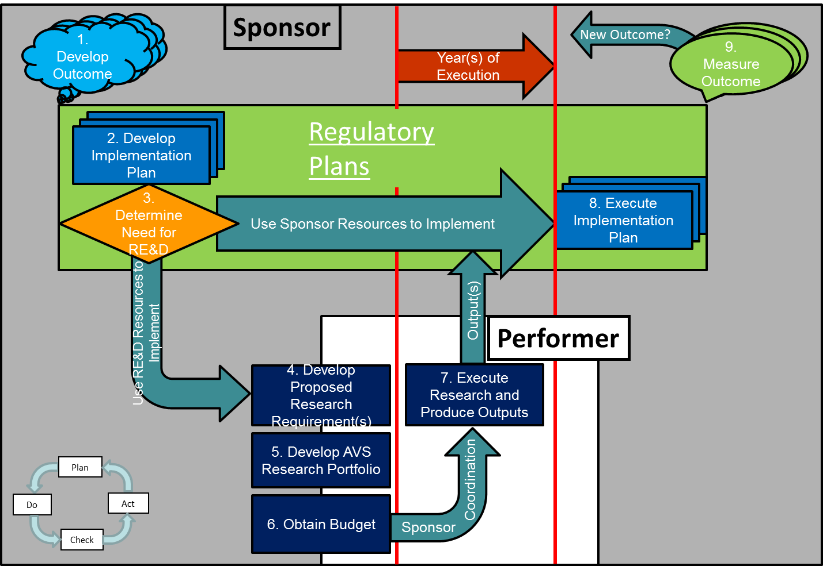
RE&D Vision
Life Cycle approach
Outcome based
Driven by safety risks
Active Sponsorship
Project-based research requirements
Approve initial project once
Measure and Manage project to obtain outputs in support of sponsor implementation plans

Slide 6
System Level Outcome Management
System Management/SMS
AVS Outcomes
AVS Processes
AVS R&D

Slide 7
Staircase to the future
Research
Requirement
Management
Life-Cycle
Management
Risk Based Decision Making
Outcome Measurement
Safety Risk
Accidents & Incidents
Strategic Thinking
Top-down AVS Strategic Guidance
Top-down R&D Strategic Guidance
Bottom-up R&D Strategic Guidance
Project Management
Phases, Metrics, Milestones, Exit Criteria
Year-to-year Requirements
Communications
Active Sponsorship
Programmatic Dashboard
Service Level Agreement
Process Improvement
AVS Life-cycle Management Document
Updated Process & Criteria
Annual Process Updates

Slide 8
Benchmarking
MITRE
Andy Lacher gave presentation on MITRE research process to AVS R&D Team – July 24, 2014
Many apparent similarities
Some apparent differences
Next step is side-by-side comparison

Slide 9
Future Strategic Guidance
Currently
FY16 & FY17 SG focused on CAST & GAJSC
Past Accident and Incident data
Some limited vulnerability analysis
Next Year
Add new section to FY18 SG on future trending
Consider input from this meeting
Engage with the AVS Chief Scientists and Technical Advisors (CSTAs) to develop
Beyond
AVS Level?
Include modeling data?

Slide 10
Spring 2014 SAS meeting
Action Item 6: Set aside one hour at the next SAS meeting to discuss improvements to the AVS prioritization process that focus on other successful programs like MITRE. Joe asked that principal participants be there in person. Topics will include risk tradeoffs in technical approach and execution quality for both short- and long-term frameworks. Joe added that Dres and Dennis Filler should participate and Andy should show examples of successful prioritization at MITRE. This is not intended as a redesign of the AVS Prioritization Process but FAA customers and their need for products should be identified. There should be a balance between short- and long-term research.

