Slide 1
FAA Air Transportation Centers of Excellence
FAA COE Overview
Current Status
Presented: SAS Meeting
Presented by: Patricia Watts
FAA Centers of Excellence
Date: March 25, 2015

Slide 2

Agenda
FAA Research Funding Options
Grants Legislation
Why Centers of Excellence ?
COE Legislation
Selection Criteria
COE Teams - Geographic Distribution
COE Requirements
COE Funding Options and Levels
Current Activities
COE UAS Tasks Remaining
COE / COE UAS Oversight Teams and Control
COE UAS Schedule
University Members and Co-Sponsors

Slide 3
FAA Research - Funding Vehicle Options
Individual contracts, Interagency Agreements and other Agreements
2020 Portfolio of Contracts
Aviation Research Grants
Centers of Excellence (COE)

Slide 4
Grants Legislation
DOT: 92 Grants Programs ~ $80B / annually
2 Centers Programs
  UTCs
  COEs
FAA: Legislative Grant Authorities
  1. AIP
  2. Airway Science
  3. Aviation Research
  4. COE / P.L. 101-508 ~$500M / LOE
  Establish on behalf of AOA. Enacted to enhance FAA’s access to resources and research facilities available at colleges, universities, and other non-profit research institutions, train and educate future professionals.

Slide 5
Why Centers of Excellence ?
Standard COE competitive process enables AOA selection to comply with Congressional intent to establish FAA COEs to conduct world-class, research, education and training with other public and private entities over the next decade
A proven business model which engages industry, generates matching contributions, provides a framework for coordinated effort within a trusted and flexible structure
Enables research within a collaborative network of the best and brightest subject-matter-experts and scientists throughout the U.S. and abroad

Slide 6
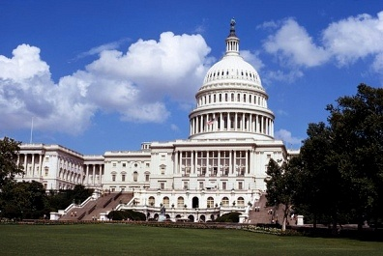
COE Legislative Authority – P.L. 101-508
Omnibus Budget
Reconciliation Act of 1990
Public Law 101-508
Title IX – Aviation Safety
and Capacity Expansion Act
“The Administrator may make grants to one or more colleges or universities to establish and operate several regional centers of air transportation excellence, whose locations shall be geographically equitable. The responsibilities of each regional center shall include, but not be limited to, the conduct of research concerning airspace and airport planning and design, the air transportation environment, aviation safety and security, the supply of trained air transportation personnel including pilots and mechanics, and other aviation issues pertinent to developing and maintaining a safe and efficient air transportation system.…each center may make contracts with nonprofit research organizations and other appropriate persons….”

Slide 7
COE Selection Criteria – P.L. 101-508
(d) Selection Criteria: The Administrator shall select recipients of grants under this section on the basis of the following criteria:
(1) the extent to which the needs of the State in which the applicant is located are representative of the needs of the region for improved air transportation services and facilities.
(2) the demonstrated research and extension resources available to the applicant to carry out this section.
(3) the ability of the applicant to provide leadership in making national and regional contributions to the solution of both long-range and immediate air transportation problems.
(4) the extent to which the applicant has an established air transportation program.
(5) the demonstrated ability of the applicant to disseminate results of air transportation research and educational programs through a statewide or regionwide continuing education program.
(6) the projects the applicant proposes to carry out under the grant.

Slide 8
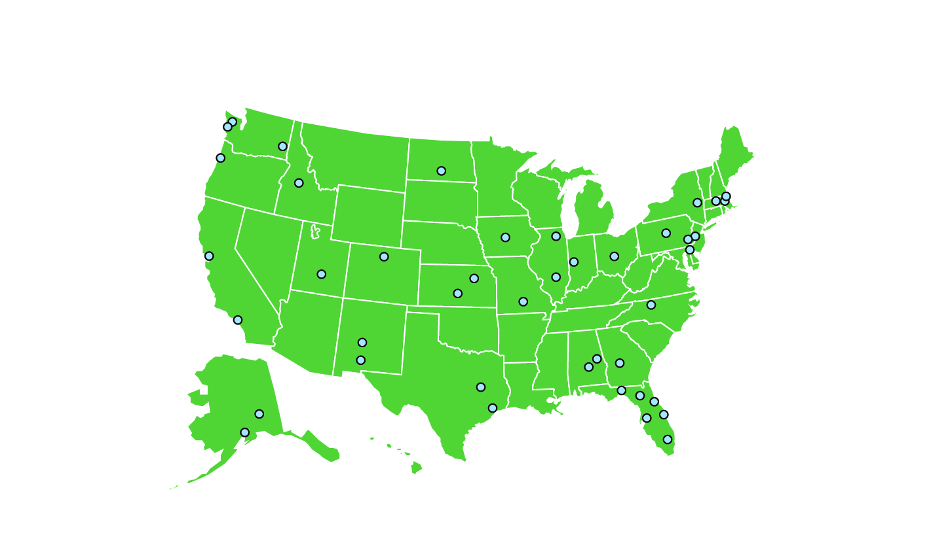
COE Teams - Geographic Distribution
Alternative Jet Fuels & Environment
(ASCENT)
Washington State Un. (Lead)
MIT(Co-Lead)
Boston Un.
Georgia Institute of Technology
Missouri Un. of Science & Technology
Oregon State Un.
Pennsylvania State Un.
Purdue Un.
Stanford Un.
Un. of Dayton
Un. of Hawaii
Un. of Illinois – UC
Un. of North Carolina – CH
Un. of Pennsylvania
Un. of Tennessee
Un. of Washington
Noise and Emissions Mitigation (PARTNER)
MIT (Lead)
General Aviation
(PEGASAS)
Purdue Un. (Lead)
Florida Institute of Technology
Georgia Institute of Technology
Iowa State Un.
Ohio State Un.
Texas A& M Un.
Commercial Space Transportation
(CST)
Florida Institute of Technology (Admin Lead)
Florida State Un.
New Mexico Institute of Mining & Technology
New Mexico State Un.
Stanford Un.
Un. of Florida
Un. of Central Florida
Un. of Colorado – Boulder
Un. of Texas Medical Branch
Advanced Materials
(JAMS)
Un. of Washington (Co-Lead)
Wichita State Un. (Co-Lead)
Edmonds Community College
Florida International Un.
Northwestern Un.
Purdue Un.
Oregon State Un.
Tuskegee Un.
Un. of California – LA
Un. of Delaware
Un. of Utah
Washington State Un.
Airliner Cabin Environment-Intermodal Research
(ACERite)
Auburn Un. (Admin Lead)
Kansas State Un. (Tech Lead)
Harvard Un.
Purdue Un.
Boise State Un.
Rutgers Un.
UAS
TBD 2015
Airport
Technology
(CEAT)
Un. of Illinois (Lead)
General Aviation (CGAR)
Embry Riddle Aeronautical Un. (Lead)
Operations Research
(NEXTOR)
UMD (Lead)
Airworthiness Assurance
(AACE)

Slide 9
COE Requirements
  FAA
    AOA concurs w request to establish = selecting official w OST
    Competitive process & mandated selection criteria
    Geographic equity - distribution of funds and location
    Long-term commitment - w annual base funding
    UNIVERSITIES
    Matching contributions from non-federal sources ~ $250M
    Management/Technical COE oversight, coordinate activities, avoid duplication
    Long-term commitments - faculty, students, industry affiliates

Slide 10
COE Funding Options
COE Grants Required)
Universities submit proposals
Sponsor evaluates & makes funding available
Pros:
Funds: R&D, Ops, F&E, AIP
Matching requirement 1:1
    Shared burden
    Industry generally involved
Cons:
Products may be provided / cannot be required
For public purpose
COE Contract (Optional)
Competition satisfied via COE
After year 1 > IDIQ
Pros:
Available to competitively selected COEs
Able to obtain deliverables for FAA purpose
May contract w others as appropriate
Cons:
Access to COE members primarily
Matching contributions: Negotiable
Contracts usually focus on expanded topics initially funded through grants

Slide 11






FAA COE Funding Levels
Year | Center of Excellence (Topic Areas) | Sponsor | LOE
2015 - 2020 | Unmanned Aircraft Systems * (UAS) September 2015 | AFS/ANG / HQ | $ 10 M
2013 - 2023 | Alternative Jet Fuels & Environment * (AJF&E) Phase I | AEE / HQ | $ 24 M
2012 - 2022 | General Aviation Safety * (PEGASAS) Phase I | ANG / TC | $ 10 M
2010 - 2020 | Commercial Space Transportation (CST) > Phase II Phase I | AST / HQ | $ 11 M
2004 - 2015 | Research in the Intermodal Transport Environment (ACERite) | AAM / HQ | $ 49 M
2004 - 2015 | Joint COE Advanced Materials (JAMS) > | ANG / TC | $ 47 M
2003 - 2014 | Aircraft Noise and Emissions Mitigation * (PARTNER) | AEE /HQ | $ 112 M
2001 - 2014 | General Aviation * (CGAR) | ANG / TC | $ 39 M
1997 - 2007 | Airworthiness Assurance * (AACE) | AAR/ANG / TC | $ 124 M
1996 – (2007) | Operations Research * (NEXTOR) | ARA / HQ | $ 45 M
1995 - (2013) | Airport Technology (CEAT) | AAR/AIP / TC | $ 42 M
1992 - 1996 | Computational Modeling of Aircraft Structures (CMAS) | AAR / TC | $ 10 M
NOTE: Figures includes Grants & Matching Contributions; Interagency Agreements, and * Contracts |  | Total | >$ 513 M

Slide 12
COE Program Current Activities
  * Manage COE Program (2014)
    - Execute Grant Awards: $15M / 275 Actions
    Conducted Evaluations: ACERite & CST
    Selection/Establishment: AJF&E
  * Transition COEs through Phase Down
    - COE Cabin Environment/Intermodal (ACERite)
    - COE Noise & Environment (PARTNER)
    - Joint COE for Advanced Materials (JAMS)
    - COE Commercial Space - Phase I > >> Phase II
  * Competition
  COE UAS Selection & Establishment

Slide 13
COE UAS - 2015 Tasks Remaining
AOA / OST - Announce Selection | April
COE Program Management Office (PMO) Negotiate Agreements / Sign Award startup funds (~ $250K) | May
Office of Primary Interest (OPI) Prepare Research Agenda w/Levels of Effort | May
COE Universities Conduct 1st Meeting / Prepare Proposals | June/July
OPI Evaluates Proposals Submits Grant Requests to COE PMO | Aug 1 Sept
COE PMO Executes Grant Awards | 5 Sept
COE UAS Conducts initial Research | Sept

Slide 14
COE Levels of Oversight, Teams & Control
4) Advisors
1) FAA COE Program Director/Grants Officer
DOT Office of Acquisitions &
Grants Management
FAA Sponsoring Organization
FAA w/University Offices
Counsel, Contracts,
Public Affairs, & Fiscal Officers
COE University Director(s)
Principal Investigators, Contracts
Industry Advisory Boards
2) FAA COE Program Manager(s)
3) FAA Technical Monitor(s)

Slide 15
COE UAS Draft Planning Schedule

Slide 16
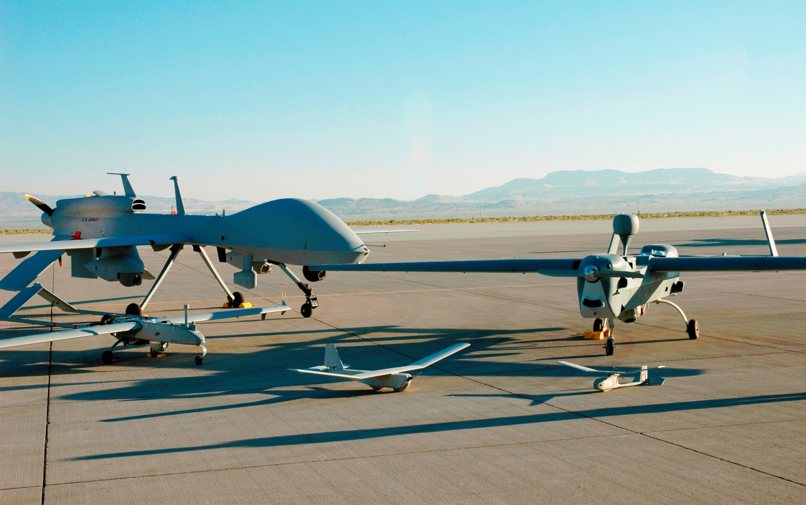
Q&A

Slide 17
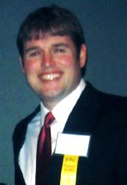
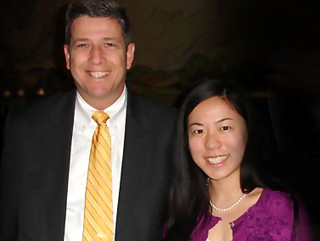
COE University Members (1 of 3)
Andrew Leonard, UND
COE for General Aviation
2010 DOT FAA COE
Student of the Year
Auburn University
Boise State University
Boston University
Edmonds Community College
Embry-Riddle Aeronautical University
Florida Institute of Technology
Florida International University
Florida State University
Georgia Institute of Technology
Harvard University
Iowa State University
Kansas State University
Massachusetts Institute of Technology
New Mexico Inst. of Mining & Tech
New Mexico State University
Northwestern University
Oregon State University
Pennsylvania State University
Purdue University
Rensselaer Polytechnic Institute
Stanford University
John Porcari
Deputy Sec. of Transportation w/
Chelsea He, MIT
COE for Noise & Emissions
2011 DOT FAA COE
Student of the Year

Slide 18
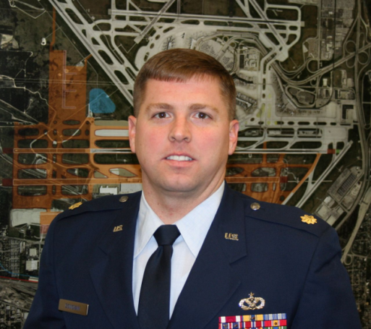
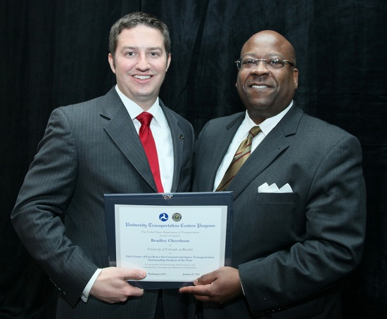
COE University Members (2 of 3)
Texas A&M University
The Ohio State University
Tuskegee University
University of Alaska at Anchorage
University of Alaska at Fairbanks
University of California at Los Angeles
University of Central Florida
University of Colorado at Boulder
University of Delaware
University of Florida
University of Illinois at Urbana Champaign
Un. of Medicine & Dentistry of NJ
University of Missouri at Rolla
University of North Dakota
University of North Carolina at Chapel Hill
University of Pennsylvania
University of Texas Medical Branch
University of Utah
University of Washington
Washington State University
Wichita State University
Phillip Donovan, UIUC
COE for Airport Technology
2009 DOT FAA COE
Student of the Year
Gregory D. Winfree
Deputy Administrator, RITA w/
Bradley Cheetham, Un. of Colorado at Boulder
COE for Commercial Space Transportation
2012 DOT FAA COE
Student of the Year

Slide 19
COE Co-Sponsors (3 of 3)
Professional Flight Attendants Association
Raytheon Aircraft Company
Regional Airport Authority of Louisville and Jefferson County
Rockwell International
Rolls Royce
SAE International
San Francisco Inter. Airport/Community Roundtable
Sandia National Laboratories
Seagull Technology
Sikorsky Aircraft
Southern Air Transport
Southern California Association of Governments
Southwest Research Institute
Spitfire Aviation Partners
SRI International
Illinois Dept. of Transportation
STERIS Corporation
Sun Microsystems
Transport Canada
United Airlines
United Parcel Service
US Airways
US DOT Volpe National Trans.
Systems Center
US EPA
Virginia Department of Transportation
Wyle Laboratories
Indiana Department of Transportation
International Centre for Indoor Environment & Energy, Technical University of Denmark
JENTEK Sensors, Inc.
Livermore Software Technology Corp.
Lockheed Martin Aeronautics Co.
Los Angeles World Airports
Lufthansa
Maryland Aviation Administration
Massachusetts Port Authority
McDonnell Douglas Aerospace
Metron Aviation, Inc.
Metropolitan Washington Airport Authority
NASA
National Business Aviation Assn. (NBAA)
NMS Bio-Defense
Northrop Grumman Corporation
Northwest Airlines
Northwest Composites
O'Hare Modernization Program (OMP)
O’Hare Noise Compatibility Commission
Ohio Department of Development
Ohio Department of Transportation
Pratt & Whitney
Bell Helicopter TEXTRON
BF Goodrich R&D Center
Boeing Company
Bombardier Aerospace-Learjet
Brookhaven National Lab
California DOT
Cape Air
Cessna Aircraft
Chicago O'Hare International Airport
Cirrus Aviation
Comair, Inc.
Continental Airlines
Delta Airlines
Donaldson Company, Inc.
Draper Laboratory
Elite Air Center
Executive Jet Aviation
Experimental Aircraft Assoc. (EAA)
FedEx Corporation
General Electric Company
General Aviation Mfg. Assn. (GAMA)
Goodrich
Gulfstream Aerospace Corporation
Harris Corporation
Honeywell
Illinois Department of Aeronautics
Advanced Transportation R&E Laboratory (ATREL)
Aero Shell
AeroClave
Aerodyne Research Inc.
Air Force Research Laboratory
Air Tran Airways
Air Transport Association of America (ATA)
Airborne Express
Airbus Industries
Aircraft Owners & Pilots Association (AOPA)
Airline Pilots Association (APA)
Airports Council International – North America
Alaska Airmen’s Association
Alaska Airways
Alaska Science and Technology
Alcoa Technical Center
AlliedSignal
Allison Engine Company
Aloha Airlines
American Airlines
American Eagle Airlines, Inc.
American Institute of Aeronautics and Astronautics (AIAA)
ARINC Dayton
Battelle

Slide 20
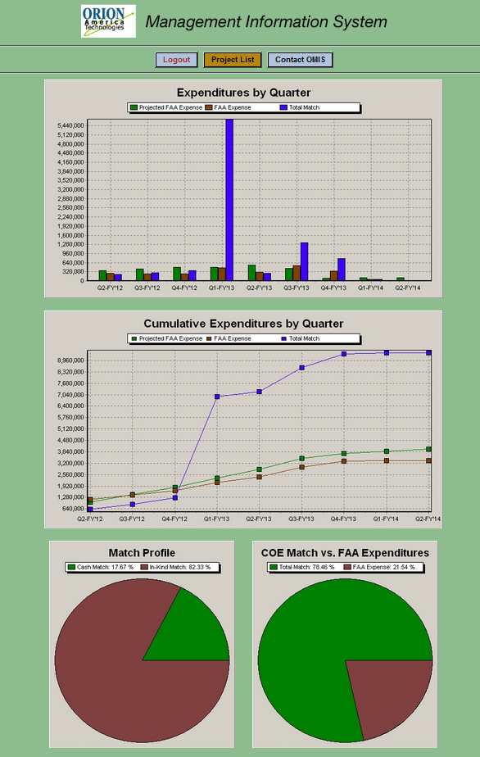
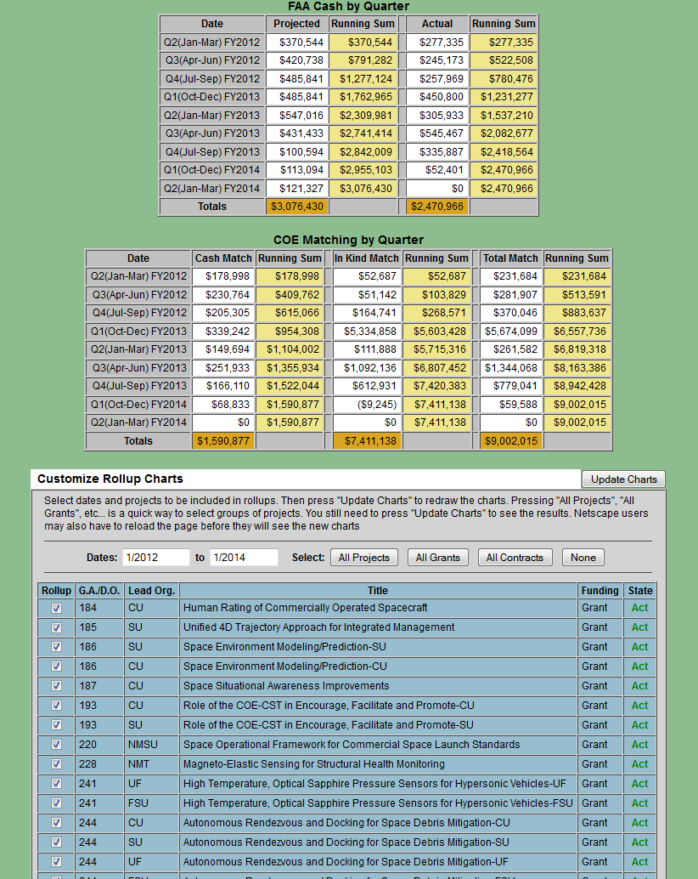
COE Financial Roll-Up Data – Reports / Reports / Reports

Slide 21



FAA Air Transportation
Centers of Excellence
Contact:
Patricia Watts, Ph.D.
National Program Director
FAA William J. Hughes Technical Center, ANG-E4
Atlantic City International Airport, NJ 08405
Phone: (609) 485-5043
Email: patricia.watts@faa.gov
Website: http://www.faa.gov/go/coe

