Slide 1
ANG-E2 NextGen Shared Services (NSS) within the NextGen Prototyping Network (NPN)
Presented to: Subcommittee on Aircraft Safety
Presented by: Cliff Johnson
Date: March 25, 2015

Slide 2
Lots of Data Out There
No Control of Data Flow

Slide 3
Hardware and Software Licensing
Everybody Uses Their Own Tool Sets

Slide 4
Need for faster COMPUTNG POWER

Slide 5
Opportunity To Work Together
High Performance
Computing
Secure Storage & Data
Access Mechanisms
Analytic Tools

Slide 6
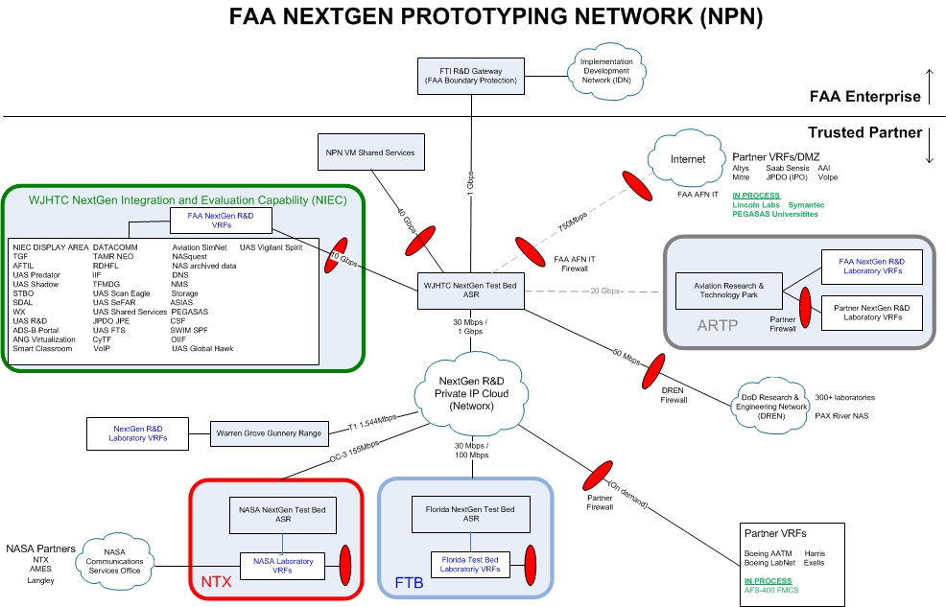
NPN Accessible to ALL FAA USERS

Slide 7
Why the NPN?
Networks are accessible by:
FAA admin LAN
FAA Mission Support
WJHTC Labs
NextGen Testbeds
Research partners (MITRE, NASA, MIT LL)
Provides common network infrastructure focused on sharing and collaboration

Slide 8
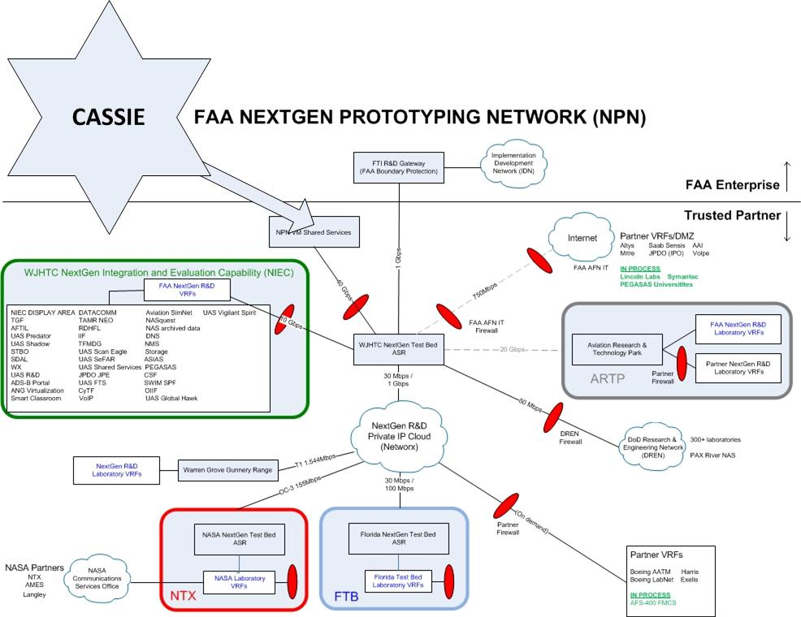
CASSIE resides within the NPN

Slide 9
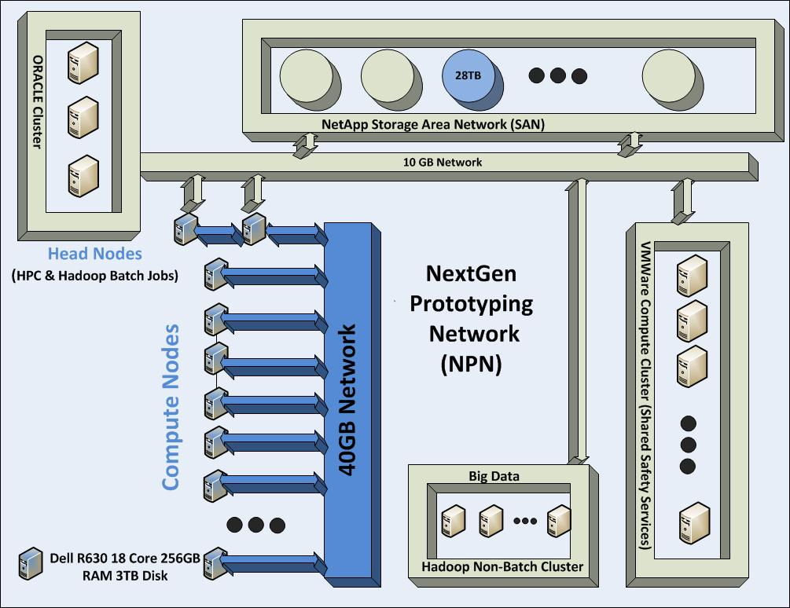
CASSIE Hosts NSS and Provides Data Storage & Access, Virtualized Servers, Big Data and HPC Capability

Slide 10
Computing and Analytics Shared Services Integrated Environment (CASSIE)
Shared Data Services – Shared ORACLE
Shared Data Services – Shared Storage Area Network (Threaded Track, ASDE-X, SBS etc.)
Shared Compute Services – Vmware compute cluster
NextGen Shared Services (NSS) – N-tier architecture in support of shared services (i.e. Authentication, Logging, Web Services Interface, Business Logic, Controlled Access)
High Performance Compute Cluster – 9 node parallel compute capability
Big Data - Hadoop

Slide 11
Benefits of CASSIE/NSS
Accessibility
Effective Collaboration
Effective Data Access
Shared Compute Power and Transition to FAA Cloud Strategy
Cost Effective to Work Together

Slide 12
NextGen Enterprise Repository (NER) Prototype Overview
Hosted in CASSIE using NSS (Leverages current infrastructure)
Single, authoritative, historical access to all NAS Data (Reduces multiple copies and derivations of data)
Common, standardized access mechanisms (Data provided in format readily available for researchers)
Collaborative environment to share information, technologies across the enterprise (Supported by FAA WJH TC Management, Enterprise Information Management and Chief Scientist for NextGen)

Slide 13
Contact Information
CASSIE/NextGen Shared Services–
charles.c.johnson@faa.gov
tom.tessitore@faa.gov
NextGen Prototyping Network – chris.malitsky@faa.gov
NextGen Enterprise Repository (NER) –
robert.higginbotham@faa.gov natesh.manikoth@faa.gov

