Slide 1
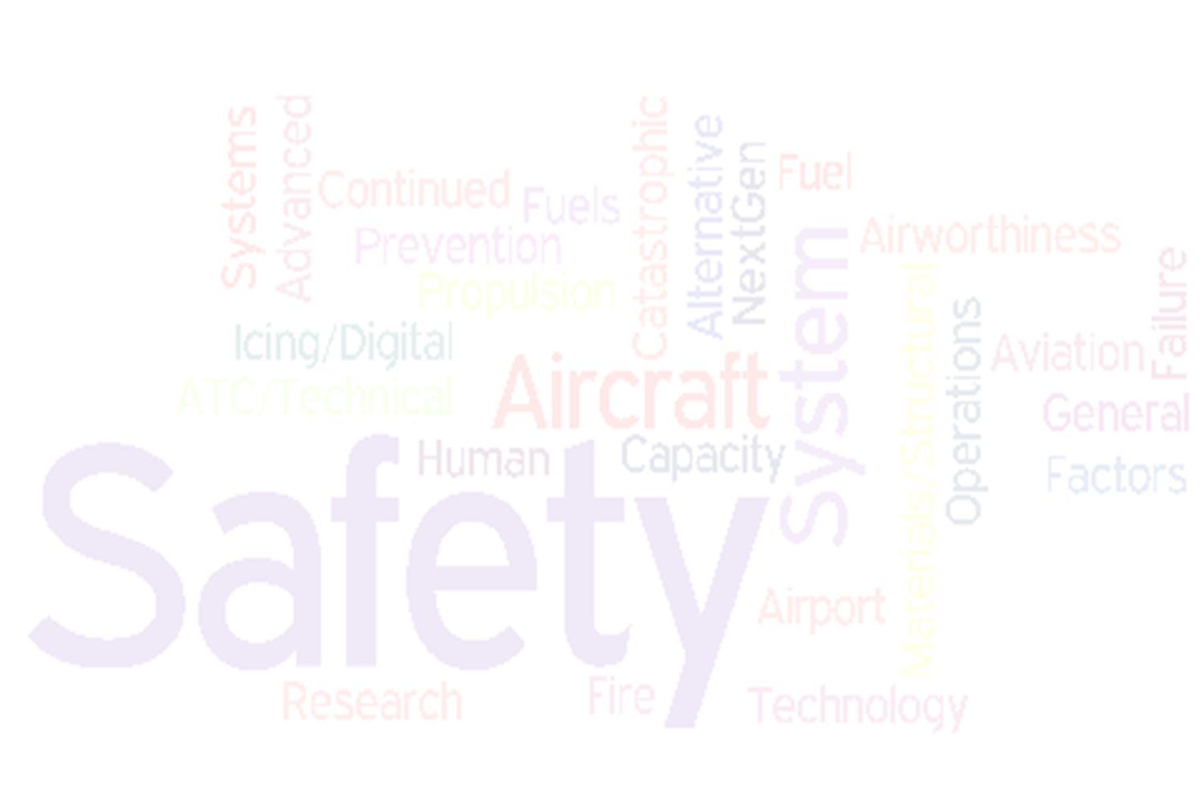
ACTION ITEM # 7 RESPONSE
Action: Provide an explanation of SDS Core Capability.
Response:
Staffing:
Prior to 2013, only an electronic engineer (knowledge of avionics hardware) and, a PhD general engineer, with strong software background, managed /supported the SDS research effort.
Since 2013, core staff has increased to six; expectation to add a seventh:
Hired -- Supervisor, Software & Electronics Section; General Engineer with 20+ years of experience with ATM software systems.
Reassigned Aerospace Engineer, received his Ph.D. in 2013; 10+ years of experience in software modeling.
Reassigned Senior General Engineer to support the SEE mitigation research as well as complex systems.
Recently hired: Aerospace Engineer, with NIST Software Engineering Diploma.
New Announcement to seek a mid-level computer scientist.
Information Exchange: At least once a week, the providers and sponsors (Barbara Lingberg and John Strasburger) and AVS stakeholders, i.e., CSTAs (Peter Skaves and Mike DeWalt)discuss proposed execution of the research, proposed SOWs, status of the research, draft reports and other related technical issues.
Collaboration: Weekly, both FAA and NASA participated in the Government/ Industry/Academia effort known as Aerospace Vehicle System Institute/Systems Architecture Virtual Integration. On a monthly basis, the FAA and NASA have information exchange telecons as well as share research results.

Slide 2
ACTION ITEM # 8 RESPONSE
Action: Provide information regarding NASA Ames tool to track safety cases.
Response: NASA Ames/Aeronautics Research Mission Directorate (ARMD) is responsible for achieving NASA Strategic Goal 3E, “Advance knowledge in the fundamental disciplines of aeronautics and develop technologies for safer aircraft and higher capacity airspace systems.”
With contract support, ARMD develop a safety assurance approach and tool for the automated generation of safety cases from both formal verification and additional informal (that is, non-mathematically defined) evidence.
AUTOCERT Tool takes a set of mission safety requirements, and formally verifies that the autogenerated code satisfies these requirements. The tool generates a natural language report that explains why and how the code complies with the specified requirements.
AdvoCATE, the Assurance Case Automation Toolset, showing how patternsare defined and can be instantiated
Recent Paper: Safety Case Patterns: Theory and Applications Authors: Ewen W. Denney, SGT, Inc., Ames Research Center; and Ganesh J. Pai, SGT, Inc., Ames Research Center, (Document Number: NASA/TM–2015–218492)

