Slide 1
AM Update per SAS Recommendations
Presented to:
REDAC Subcommittee on Aircraft Safety
September 9, 2015
William J. Hughes Technical Center, NJ
Presented by:
Dr. Michael Gorelik
FAA Chief Scientist and Technical Advisor
for Fatigue and Damage Tolerance

Slide 2
Key SAS Recommendations on AM
Accelerate development of the FAA AM Roadmap over the next 12 months…
FY17 and FY18 FAA R&D portfolio to include consideration of proactive research … to identify hazards and mitigations necessary to establish the appropriate standards and methods of compliance…
Reference:
May 28, 2015

Slide 3
1. AM Roadmap Development
Development of a comprehensive roadmap for new “disruptive” technology like AM is a major undertaking, as evidence by experience with developing a similar roadmap for Composites.
AMNT *⁾ will target development of a draft roadmap within the next 12 months, and will solicit feedback from industry and other government agencies during the 2016 CSTA AM Workshop (planned for Sep. 2016)
This feedback will be incorporated in the final roadmap as appropriate, and submitted to senior FAA management for approval
One of the key outcomes – recommendations for the National AM Plan (similar to National Composites Plan)
*⁾ AMNT - Additive Manufacturing National Team

Slide 4
1. Roadmap Development - Approach
Internal AMNT meetings
Benchmarking of other agencies and consortia roadmaps (NIST, AF, NASA, NavAir, America Makes, …)
Inter-agency collaboration
Industry outreach
Initial focus on engine and airframe OEMS
Engagement with standards organizations (ASTM, SAE, MMPDS, …)
In order to accelerate the process, FAA requested formation of the industry working group focused on qualification / certification issues for AM
Started initial discussion with AIA, GAMA and others
Collaboration with Industry and Other Agencies is Key

Slide 5
Benchmarking of Composites Timeline
Composites
One of the first composite applications (Part 25):
Horizontal tail stabilizer (Boeing) – circa 1985
30 years of manufacturing, design and field experience
Hundreds of certified structural / safety critical parts
Over $15M in FAA R&D investments
Additive Manufacturing (metals)
No field experience (commercial); very limited military
one metal AM part (non-structural) certified to date by FAA
No industry-level material or process specs
First available FAA R&D funds → FY17
1985
2015
2020
First structural composite parts
Body of work →
Composite Plan
AM Roadmap
AM Plan
First certified AM part
Mgmt Review
Original AC20-107 Published

Slide 6
2. AM Research
Internal
FY15 – exploratory research task (low level of effort)
FY16 – TBD
FY17 → allocated $300K via pop-up mechanism
Research plan being developed by AMNT and Tech Center
FY 18 – RE&D Research Requirement submitted
“Metal AM for Aircraft, Engine and Propeller Applications”
MMPDS Task 9 – focus on process-intensive materials
External
Very significant AM R&D investments by US agencies
e.g. USAF alone invests ~ $20M per year
USAF, NASA and NIST offered to share results of recent and on-going R&D programs in AM
No IAAs are required!

Slide 7
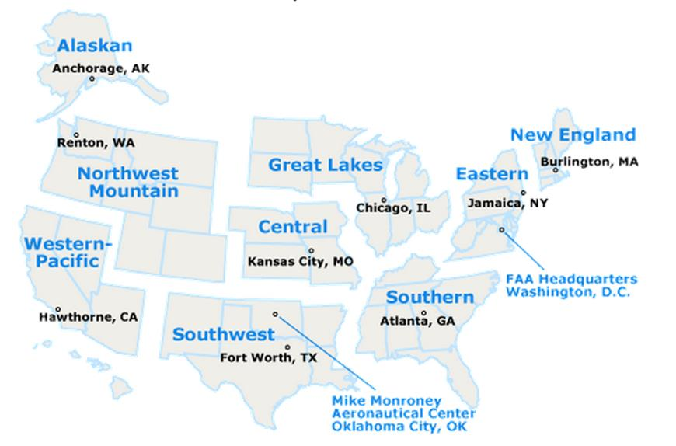
Complex Regulatory Environment
Small Airplane Directorate
(14 CFR Part 23)
Engine and Propeller Directorate
(14 CFR Parts 33, 35)
Transport Airplane Directorate
(14 CFR Part 25)
Rotorcraft Directorate
(14 CFR Parts 27, 29)
Directorate-Specific Requirements vs. National-Level Synergies

Slide 8
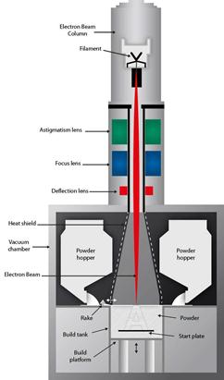
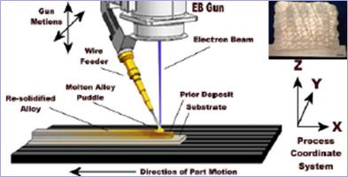
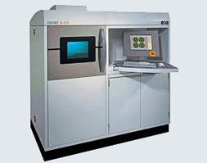
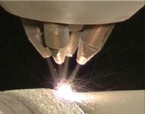
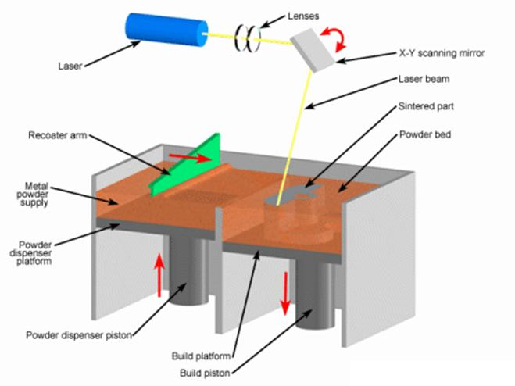
Breadth of AM Processes and Application Domains
By Source of Material: Powder vs. Wire
By Source of Energy: Laser vs. E-Beam
New Type and Production Certificates
Repair and Overhaul (MROs)
Aftermarket Parts (PMAs)

Slide 9
Focused AVS AM Research Needed to Address Complex Regulatory Environment
Proposed consideration for new AIR-level AM TCRG *⁾ to explore synergies of AM research across product types and application domains
Benchmarking – Internal:
Dedicated Composites TCRG
Benchmarking - External:
Air Force and Navy have AM IPTs (Integrated Product Teams) supported by the corresponding focused R&D programs
*⁾ TCRG - Technical Community Representative Group

Slide 10
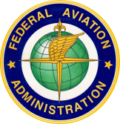
Joint FAA – Air Force Workshop on Qualification / Certification of Additively Manufactured Parts
Co-sponsored by FAA Chief Scientist (M. Gorelik) and
AFRL / ManTech (R. Dutton)
September 1-3, 2015
TecEdge Facility, Dayton, OH
Workshop facilitator: Brad Cowles, Cowles Consulting, LLC

Slide 11
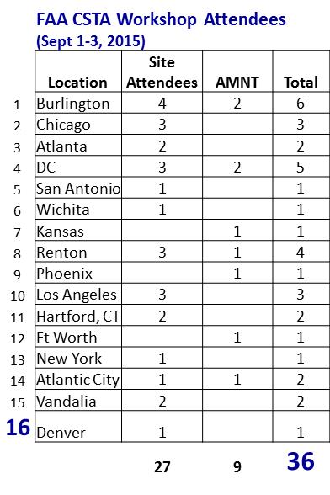
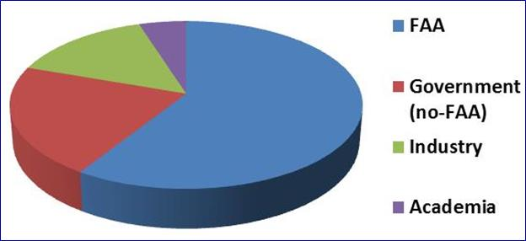
Workshop Objectives and Demographics
Educate FAA workforce in the area of AM technology
Benchmark qualification / certification efforts of other agencies, and promote inter-agency collaboration
Establish a stronger linkage between the AMNT and regional offices (ACOs, MIDOs)

Slide 12
Key Workshop Observations
Awareness training for a broad cross-section of FAA sites
Established line of communication between AMNT and 15 FAA sites
Common understanding of key AM challenges
Most major OEMs and agencies support risk-based decision making approach, including “system-level” considerations:
Manufacturing process controls and specs development
Identification and characterization of key failure modes and anomalies
Lifing system and certification criteria
IPQA and NDI methods
Longer term – push for model-based “rapid” qualification
FAA certification (ECO / ACOs) and manufacturing offices (MIDOs) need both near-term and longer term support
All participants acknowledged importance of industry and agencies collaboration to support safe implementation of AM

Slide 13
Appendix

Slide 14
AM Workshop Agenda – Day 1
8:15am Introductions (All)
8:30 Workshop overview and objectives (R. Dutton / AFRL and M. Gorelik / FAA)
9:00 FAA Management Perspective (R. Jennings / FAA HQ)
9:15 AFRL AM Seminar (M. Kinsella, J. Miller / AFRL)
10:30 Break
10:45 AFRL AM Seminar – cont. (J. Brausch, M. Kinsella, J. Miller / AFRL)
12:15pm Lunch (catered on site)
1:00 AFRL Research & Future AM (J. Miller / AFRL)
1:45 NIST Perspective on AM (K. Jurrens / NIST)
2:45 Current Capabilities and Process Mapping Methods tied to Qualification
(Prof. J. Beuth / CMU)
3:15 Break
3:30 Microstructure in AM (Prof. A. Rollett / CMU)
4:00 Mechanical Behavior of Components Fabricated Using AM (Prof. S. Daniewicz / MSU)
4:30 Summary of Day 1 / Discussion (B. Cowles / All)
6:45 - … Team Dinner – Texas Roadhouse (Fairborn, OH)

Slide 15
AM Workshop Agenda – Day 2
8:00 am Coffee, introductions
8:15 USAF Senior Leader Perspective (D. Carlson / USAF)
8:30 DARPA OM Overview (M. Maher / DARPA)
9:15 NavAir AM Certification Perspective (L. McMichael / NavAir) – via telecon
9:45 Air Force AM certification Perspective (M. Kinsella / AFRL)
10:15 Break
10:30 NASA AM Certification Perspective and AM R&D (K. Morgan / MSFC and K. Taminger / LaRC)
11:15 FAA AM Certification Perspective and Go-forward Plans (J. Kabbara, M. Gorelik / FAA)
12:00 pm Lunch (catered on site)
12:30 Industry Perspective on AM - Panel session (moderated by B. Cowles and M. Gorelik)
• Bell Helicopter (T. Chiang)
• Boeing (M. Crill)
• GE Aviation (M. Shaw)
• GKN Aerospace (B. Thompson)
• Honeywell Aerospace (B. Hann)
• Lockheed Martin (C. Brice)
P&W (W. Brindley)

Slide 16
AM Workshop Agenda – Day 2 (cont.)
3:00 Break
3:15pm Overview of AM Standards Development
• ASTM F42 and ASME Y14.46 – K. Jurrens, NIST (30 min)
• SAE AM committee – D. Abbott, GEA (15 min)
• MMPDS – M. Freisthler, FAA (30 min)
• AWS standards – J. Calcaterra, AFRL (15 min)
4:45 Meeting wrap-up / discussion
5:00 Adjourn (for general audience)

Slide 17
AM Workshop Agenda – Day 3
(government only)
8:30 Summary of workshop observation and go-forward plans
(M. Gorelik / R. Dutton / B. Cowles)
9:30 FAA round table (AMNT + site representatives)
Government attendance based on interest
Feedback from the sites
Additional discussion re. AMNT work plans, roadmap outline etc.
Engagement with external organizations, training requests etc.
11:30 Adjourn

Slide 18
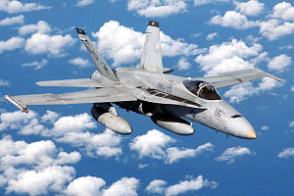
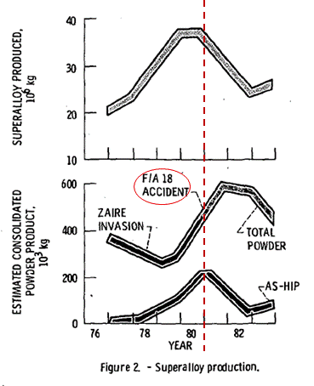
Lessons Learned – Powder Metallurgy
FLIGHT INTERNATIONAL, 11 October, 1980, pg 1413
… The US Navy grounded its 13 F-18s following the crash of a TF-18 in England on September 8 (see Flight, September 20, page 1177), following an inflight failure of one General Electric F404 engine. The cause of the accident was the disintegration of the low-pressure turbine (LPT) disc in the right-hand (No 2) engine.
Shortly after F/A-18 crash, production of as-HIP P/M superalloys decreased dramatically
Turbine disk failure linked to a large undetected material flaw…
Key Takeaways:
Risks of transition to full-scale production
“Unknown unknowns”
Process controls vs. “inspecting in” quality
Understanding of material flaws, including “rogues”, is critical
In case of PM, gave rise to probabilistic lifing systems
Reference: “P/M Superalloys – A Troubled Adolescent?”, R. L. Dreshfield and H. R. Gray, NASA Technical Memorandum 83623, 1984.

