Slide 1

Aircraft Systems
Information Security Protection (ASISP) Research
September 2015
Presented to
the REDAC Subcommittee for Aircraft Safety (SAS)
By Isidore Venetos
609-485-5207

Slide 2
ASISP Problem Statement
Migration to Network-centric Architectures
  Aircraft manufacturers and modifiers are installing systems with network-centric architectures that allow increased wired and wireless connectivity to aircraft systems within an aircraft and to networks external to the aircraft.
Potential ASISP Vulnerabilities
  These network-centric architectures may have aircraft systems information security protection (ASISP) vulnerabilities that could negatively impact aircraft airworthiness if exploited.
Potential Impact to Airworthiness
  Unauthorized access to aircraft systems and networks could result in the malicious use of networks, and loss or corruption of data (e.g., software applications, databases, and configuration files) brought about by software worms, viruses, or other malicious entities.

Slide 3



Research Need
Addressing Cyber Risks through Safety Policy
Research is needed to assess:
  ASISP vulnerabilities, risks, and
  Explore possible mitigations
Methodology is required to systematically guide the potential development of:
  Regulation, policy, and guidance for the certification and continued airworthiness of aircraft

Slide 4


A Paradigm Shift in Aviation Safety Risk
ASISP challenges do not match the standard AIR or AFS certification time frames
Expands the risk scope to include malicious activity beyond aircraft manufacturing and design challenges
ASISP threat change daily
Malicious activity is the norm
Research may propose a new way for safety risk assessment methodologies.

Slide 5
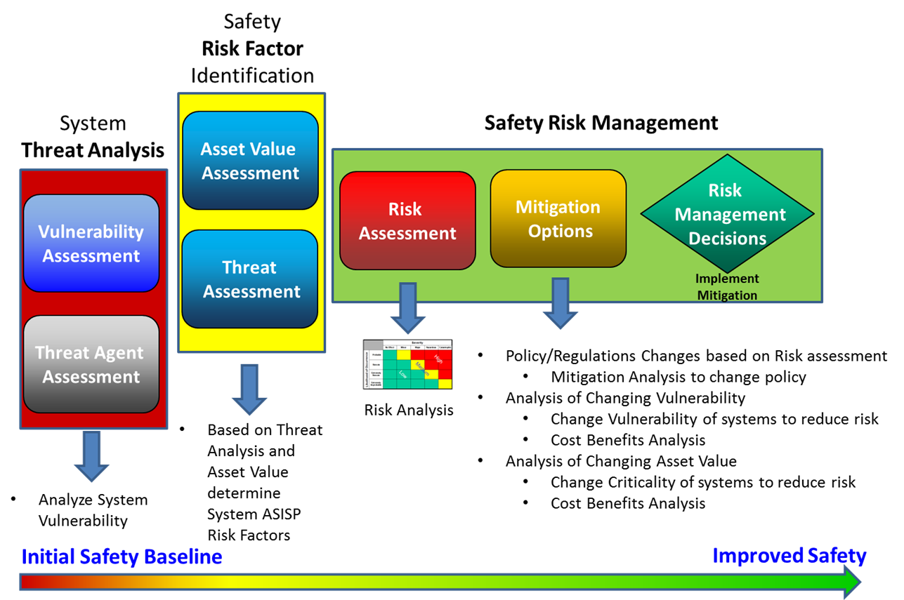
ASISP Safety Risk Assessment
Research Framework
The initial goal is establish a research capability to conduct an ASISP risk assessment for AVS.

Slide 6
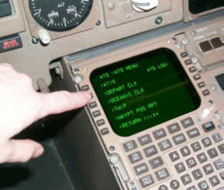
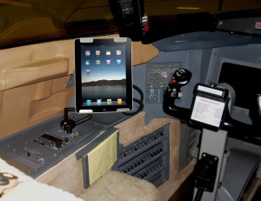
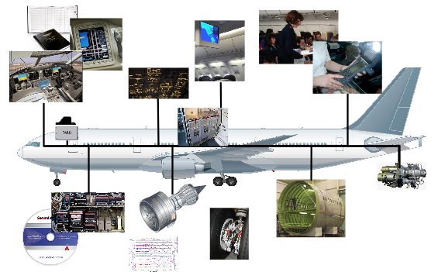
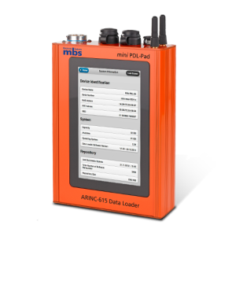
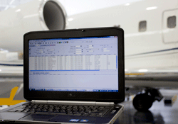

System Interfaces
Apertures to be researched include:
Aircraft Communications Addressing and Reporting System (ACARS)
Portable Electronic Flight Bag (EFB) Systems
Wired or Wireless Installed Aircraft Network Access Points
Field-Loadable Software (FLS)
Maintenance Laptops
Focus: Non-Government Controlled Interfaces

Slide 7

Aircraft Rules, Processes and Standards
Federal Aviation Regulation's (FARs)
FAR 25.1301 “General Requirements for Intended Function”
FAR 25.1309 “Equipment Systems and Installation”
Special Conditions establish the rule basis for Aircraft Systems Information Security Protection (ASISP) for certain make and model aircraft with new and novel architectures
  Companion Issue Papers to Special Conditions provide a means of compliance
Development Assurance Industry Process Standards
RTCA DO-178C “Software Development Guidance”
RTCA DO-254 “Airborne Electronic Hardware Development Guidance”
ARP 4754a “Guidelines for Development of Civil Aircraft and Systems”
ARP 4761 “Guidelines and Methods for Conducting the Safety and
Assessment Process on Civil Airborne Systems”
ASISP Industry Standards for Transport Category Airplanes
RTCA, DO-326a, DO-355, DO-356 “Industry standards for ASISP include initial certification and continued airworthiness to address the ever-evolving security threat environment”
Technical Standard Orders (TSO) for External Aircraft Connectivity
FAA TSO’s invoke certain industry standards for aircraft safety, performance and interoperability connectivity requirements to United States Air Traffic Service Providers (ATS)
TSO’s include aircraft standards for connectivity to Air Traffic Management (ATM), NextGen Communication, Navigation, and Surveillance (CNS) services and public networks
Notes:
The final slide, when Issue Papers and Special Conditions are required the Issue Papers and Special Conditions should require a Security Plan that address these topics.
CISSP listed in first item is Certified Information Systems Security Professional awarded by ISC2. There are other organizations such as SANS that award security certifications.
Security Controls listed in fifth item can be technical, operational, or management. See National Institute of Standards Special Publication 800-53A.

Slide 8
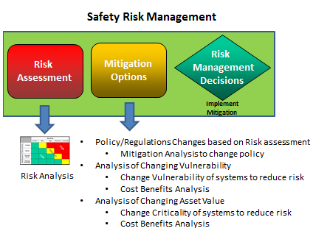

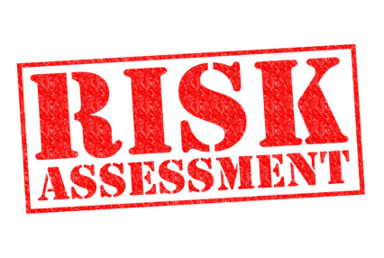
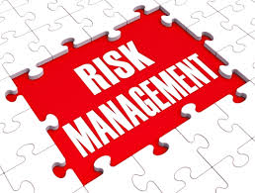
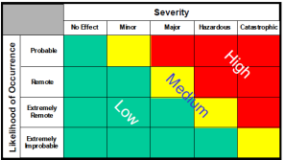
Three Phase Approach
2016-2020
PHASE I: Identify ASISP interfaces and conduct risk assessments FY16-FY17
PHASE II: Extend the risk assessments to the development of mitigation techniques FY18-FY20
PHASE III : Identify recommended ASISP strategies for aircraft certification, maintenance and continued operational safety FY19-FY20

Slide 9

Research: Phase I
Identify Interfaces and Vulnerability/Risk Assessment
Identify the internal/external wired and wireless interfaces that could affect aircraft safety and
Develop a methodology to carry out an avionics vulnerability & risk assessment.
The diversity of avionic suites makes a vulnerability assessment a difficult problem set since the FAA does not manage or control the configurations of these suites.
  Cannot acquire all the various systems given the diversity of avionic suites that exists and the associated cost to acquire these systems.

Slide 10
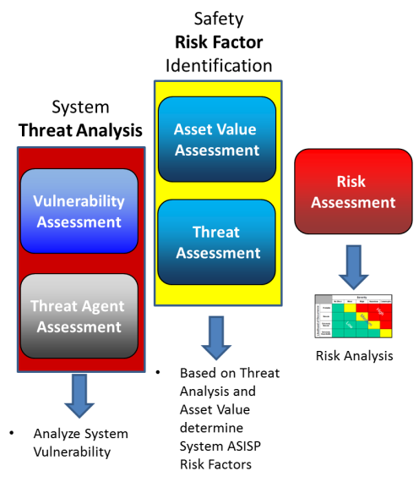
Research: Phase I
Identify Interfaces and Vulnerability/Risk Assessment
Study to determine feasible method(s) to conduct an ASISP Vulnerability Assessment based on a system view perspective.
  The effort will begin with one system interface which will be used to explore how to conduct a system view vulnerability assessment. The approach(es) if successful will be expanded to include several interfaces (e.g., ACARs, EFB, FLS, maintenance laptops, etc.).
  The system view means that the vulnerability assessment will be conducted on a system with a black box approach.
A Risk Assessment Methodology will also be developed to take into account the ASISP threat assessment and asset value assessment.

Slide 11
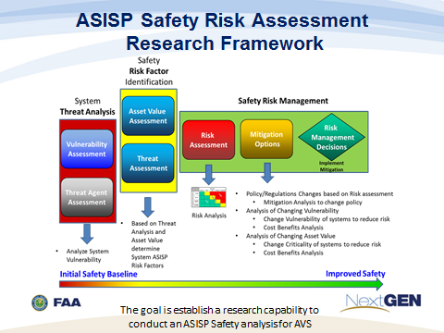
Research: Phase I
Identify Interfaces and Vulnerability/Risk Assessment
FY16 – FY17
In FY17, the task will further investigate and refine the prototype efforts from FY16 with additional interfaces and apply system level test to verify and validate the results of the risk assessments the use of simulations and or actual avionic components will be utilized as required.

Slide 12

Research: Phase II
Extend the Risk Assessments to the Development Mitigation Techniques
FY18 – FY20
Extend beyond risk assessments and explore how AVS can utilize a systems based approach to optimize new policies and regulations.
Goal: Reduce the specific ASISP risks being analyzed.

Slide 13

Research: Phase II
Validate Risk and Mitigation Approach
In FY18 the risk assessments will be used to develop methodologies for a deeper analysis of the vulnerabilities and risks found in Phase I.
  Explore ASISP tools and techniques to generate mitigation options.
  Analysis techniques will include the impact of changing the vulnerability and/or changing the asset values.

Slide 14






















Critical ANG-E2 ASISP Partnerships
SC-222
AVS
ASH
ANG
Private
Sector &
FAA & Aviation Community
ATO
Academia
SC-216
SC-222
International
Government Agencies
DHS
DOD
NASA
Cybercom

Slide 15
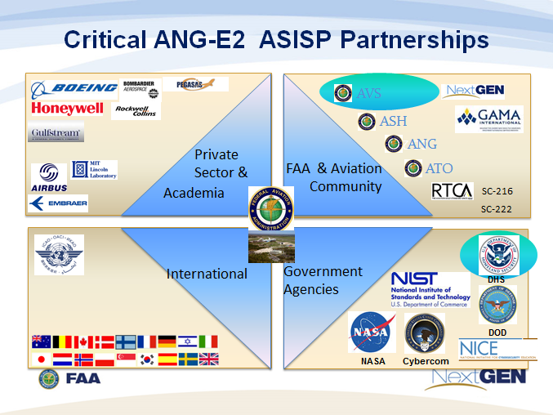
Research: Phase III
Identify Recommended ASISP Strategies for Aircraft Certification, Maintenance and Continued
Operational Safety
FY19 – FY20
Explore an AVS ASISP safety risk management process and integrate all of the components developed in Phase I & II with all available resources.
Propose effective formal strategies which will leverage the efforts from other government agencies and industry stakeholder.
Goal: Reduce the associated ASISP risks for aircraft certification, maintenance and continued operational safety.

Slide 16
Research: Phase III
Identify Recommended ASISP Strategies for Aircraft Certification, Maintenance and Continued
Operational Safety
FY19 – FY20
Components of the entire ASISP safety risk management process will be integrated and applied to test cases.
  Strategies will be proposed on how to integrate industry and government processes (FAA, DHS, TSA, FBI, etc.) and forums (A-ISAC, OEM ASISP labs, etc.) to reduce the risk from ASISP events.
  Specific mitigation techniques and tools will be explored or developed to meet the time demands of ASISP risks. Integrating ASISP resources from the aviation stakeholders will be a critical element to developing the best of practice policies and procedures through policy and regulations.

Slide 17
Research Products
Report describing the development of ASISP vulnerability and risk assessment methodologies on a specific interface(s).
Report describing the application ASISP risk assessment(s) to develop mitigation options.
Report describing the FAA capability to conduct a threat analysis, determine the risk factors and utilize those elements in ASISP safety risk management process.

Slide 18
Aviation Rulemaking Advisory Committee (ARAC) for ASISP
Provide recommendations regarding ASISP rulemaking, policy, and guidance on best practices for airplanes and rotorcraft, including both certification and continued airworthiness.
The issue is that without updates to regulations, policy, and guidance to address ASISP, aircraft vulnerabilities may not be identified and mitigated, thus increasing exposure times to security threats.
  Federal register in Feb. 2015
  First meeting held in June 2015
  Final report with recommendations in August 2016
May Impact Research Efforts

Slide 19
ASISP Working Group Seven Tasks
The ASISP Working Group is tasked to:
  Provide recommendations on whether ASISP-related rulemaking, policy, and/or guidance on best practices are needed and, if rulemaking is recommended, specify where in the current regulatory framework such rulemaking would be placed.
  Provide the rationale as to why or why not ASISP-related rulemaking, policy, and/or guidance on best practices are required for the different categories of airplanes and rotorcraft.
  If it is recommended that ASISP-related policy and/or guidance on best practices are needed, specify (i) which categories of airplanes and rotorcraft such policy and/or guidance should address, and (ii) which airworthiness standards such policy and/or guidance should reference.

Slide 20
ASISP Working Group Seven Tasks
4. If it is recommended that ASISP-related policy and/or guidance on best practices is needed, recommend whether security-related industry standards from Aeronautical Radio Incorporated (ARINC), Federal Information Processing Standards (FIPS), International Standards Organization (ISO), National Institute of Standards and Technology (NIST), Radio Technical Commission for Aeronautics (RTCA), Society of Automotive Engineers (SAE) Aerospace Recommended Practices (ARP) 4754a and/or SAE ARP 4761 would be appropriate for use in such ASISP-related policy and/or guidance.
5. Consider European Aviation Safety Agency (EASA)
requirements and guidance material for regulatory
harmonization.

Slide 21
ASISP Working Group Seven Tasks
6. Develop a report containing recommendations on
the findings and results of the tasks explained
above.
  The recommendation report should document both majority and dissenting positions on the findings and the rationale for each position.
  Any disagreements should be documented, including the rationale for each position and the reasons for the disagreement.
The working group may be reinstated to assist the ARAC by responding to the FAA's questions or concerns after the recommendation report has been submitted.

Slide 22
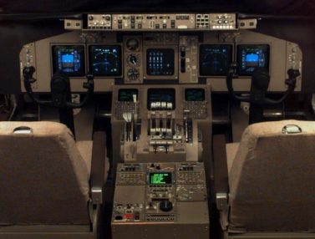
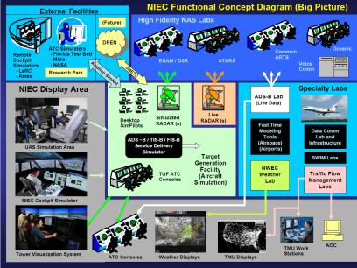

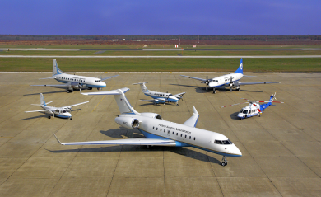
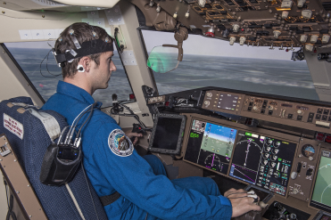

ANG Future Core Research Labs
R&D to Support AVS, Operations and the PMO
Mission Statement: Research, develop and evaluate cyber technologies to provide effective, proactive aviation cyber protection solutions that transition into relevant capabilities for the aviation safety and NextGen community.
Avionics & Navigation Protection
ANG-E2
Focus Areas
Air Traffic Management Data Link Integrity & Reliability
Continuous Diagnostic & Mitigation (CDM)
Cyber Attack and Recovery Lab
RF Cyber Flight Testing

Slide 23


Slide 24

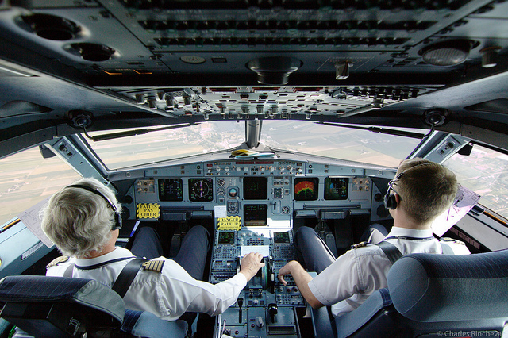
Defining Risk and Program Activities for
Aircraft System Information Security Protection (ASISP)
Isidore Venetos 31 March 2015

Slide 25
Purpose of Briefing
Establish common understanding of Risk in the context of ASISP
  Finalize the ASISP Prep Requirements
Initiate discussion on Program activity plan
  Start to establish Timelines & Capabilities

Slide 26
ASISP TASK 1
TASK #1 DEFINE AND ASSESS THE RISK WITH “COMMUNICATION APERTURES”
Identify the “Apertures” (electronic entries into the aircraft’s systems) that produce potential ASISP risks for various platforms
Define and Identify the potential associated risks with those apertures
Generate system level testing to test those risks for individual apertures
Determine how maintenance tools work to maintain airworthiness integrity in relation to ASISP risks. Use case developments may be used to support the risk levels.
Definition of risk level?

Slide 27
Vulnerability: exposure to attack
Dictionary Definition – open to attack or damage
  In Information Security, a vulnerability could be defined as: “a flaw or weakness in hardware, software or process that exposes a system to compromise”.
NIST SP 800-30 – Risk Management Guide for Information Technology Systems – defines a vulnerability similarly:
  A flaw or weakness in system security procedures, design, implementation, or internal controls that could be exercised (accidentally triggered or intentionally exploited) and result in a security breach or a violation of the system’s security policy.
Information Technology Security Evaluation Criteria ( ITSEC ), a standard used by a number of European Countries, defines vulnerability as:
  The existence of a weakness, design, or implementation error that can lead to an unexpected, undesirable event compromising the security of the computer system, network, application, or protocol involved.

Slide 28
ASISP Vulnerability Samples
System Design (Hardware or Software)
Processes
Implementation errors
Flawed internal controls
Violations of Policy
Maintenance Upgrades
Procedure
Unprotected Data links
Not Authenticating users or Authorizing inappropriate users
Connecting unapproved devices to Avionics
Uploading malicious code to include Flight Loadable Software
Installing software configurable components with out verifying settings
VULNERABILTY IS NOT Just ABOUT SOFTWARE CODE
and Includes Processes IN Parts 21/43/91

Slide 29
Threat
In the Oxford Dictionary: Threat (noun)
  a stated intention to inflict injury, damage, or other hostile action on someone.
  a person or thing likely to cause damage or danger.
  the possibility of trouble or danger.
Both, NIST SP800-30 and the Common Criteria for Information Technology Security Evaluation (an ISO standard replacing ITSEC) differentiate between a “threat source” or “threat-agent” and a “threat”.
NIST defines “threat-source” as the interaction of an actor and motivation, and “threat” as the interaction between a “threat-source” and a vulnerability.
Threat: The potential for a threat-source to exercise (accidentally trigger or intentionally exploit) a specific vulnerability.

Slide 30
Composition of Threat
Note: Need to consider actor and motivation along with the threat sources understanding of the system vulnerability to determine the threat
Vulnerability
Vulnerability
Threat
Source
Threat
Actor
Motivation
Actor
Motivation
Independent elements
Threat Source
Or Threat Agent
Threat
Vulnerability ➔function of (Design, Hardware, Software, procedures, process, violation of policy, flawed, internal controls, etc.)
Actor ➔function of (State organized, organization based, company based, individual, etc)
Motivations ➔ function of (Financial, political, publicity, challenge, terrorist )

Slide 31


ASISP Threat ≠ ASISP Risk

Slide 32

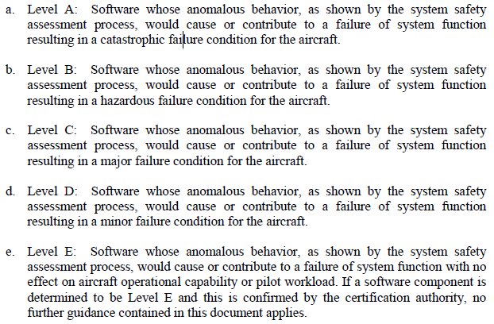
ASISP Risk is a function of…
Vulnerability
Threat
Actor
Motivation
Threat
Flight Controls
Navigation systems
Critical control systems
Etc.
Asset Value
Flight Controls
Navigation systems
Critical control systems
Etc.
and
RTCS DO-178C
Level A: Catastrophic Failure
Level B: Hazardous Failure
Level C: Major Failure
Level D: Minor Failure
Level E: No Effect

Slide 33
ASISP Risk is a function of…
Vulnerability
Asset Value
Flight Controls
Navigation systems
Critical control systems
Etc.
and
Threat
Actor
Motivation
Vulnerability includes
System Design (Hardware or Software)
Processes
Implementation errors
Flawed internal controls
Violations of Policy
Maintenance Upgrades
Procedure
The Actor’s understanding of Vulnerability and their Capabilities & Motivation will impact the Risk

Slide 34
ASISP Risk is a function of…
Vulnerability
Asset Value
Flight Controls
Navigation systems
Critical control systems
Etc.
and
Threat
Actor
Motivation
Threat and Risk are not deterministic values but can be assigned a probability based on the actors, motivations and vulnerability to carry out an assessment.

Slide 35
ASISP Vulnerability, Threat & Risk
Vulnerability, Threat and Risk are NOT interchangeable terms
Risk is a function of threat sources, vulnerability and asset value
Important characteristics of what can be mitigated:
  Threats (effects) generally can NOT be controlled.
    One can’t stop the efforts of an international terrorist group, prevent a rogue actor or a state sponsored group. Threats need to be identified, but they often remain outside of your control.
  Vulnerability CAN be treated
    Weaknesses should be identified and proactive measures taken to correct identified vulnerabilities.
  Risk CAN be mitigated
    Risk can be managed to either lower vulnerability or change the criticality of the vulnerability (Value Asset).

Slide 36
ASISP Assessments and Risk Management
Vulnerability assessment looks for system weakness
Threat assessment looks at threat actors, actor motivations and system vulnerabilities
Asset Value assessment determines critical assets
Risk assessment looks at the threat Impact and Likelihood
ASISP safety Risk Management:
  ASISP Safety Risk can be mitigated which is the fundamental AVS ASISP tasking: Safety Risk Management
  The support role for the Technical Center is to provide assessments and mitigation options for AVS to carry out the Safety Risk Management

Slide 37

ASISP Safety Analysis
Safety
Risk Factor Identification
System
Threat Analysis
Asset Value
Assessment
Safety Risk Management
Risk
Management
Decisions
Risk
Assessment
Mitigation
Options
Vulnerability
Assessment
Threat
Assessment
Implement Mitigation
Threat Agent
Assessment
Policy/Regulations Changes based on Risk assessment
  Mitigation Analysis to change policy
Analysis of Changing Vulnerability
  Change Vulnerability of systems to reduce risk
  Cost Benefits Analysis
Analysis of Changing Asset Value
  Change Criticality of systems to reduce risk
  Cost Benefits Analysis
Risk Analysis
Based on Threat Analysis and Asset Value determine System ASISP Risk Factors
Analyze System Vulnerability
Initial Safety Baseline
Improved Safety

Slide 38
ASISP Vulnerability
Safety
Risk Factor Identification
TASK #1 DEFINE AND ASSESS THE RISK WITH “COMMUNICATION APERTURES”
Identify the “Apertures” (electronic entries into the aircraft’s systems) that produce potential ASISP risks for various platforms
Define and Identify the potential associated risks with those apertures
Identifying the aperture is a Vulnerability Assessment which will impact specific Risk factors (parts of the Avionics suite which are Level A & B critical )
Sets up a Threat assessment, Asset Value Assessment and Risk Assessment
Note dependency on Platform which will be chosen
System
Threat Analysis
Asset Value
Assessment
Safety Risk Management
Risk
Management
Decisions
Risk
Assessment
Mitigation
Options
Vulnerability
Assessment
Threat
Assessment
Implement Mitigation
Threat Agent
Assessment
Risk Analysis
Based on Threat Analysis and Asset Value determine System ASISP Risk Factors
Analyze System Vulnerability
Initial Safety Baseline
Improved Safety

Slide 39
ASISP Risk Assessment
Safety
Risk Factor Identification
TASK #1 DEFINE AND ASSESS THE RISK WITH “COMMUNICATION APERTURES”
Generate system level testing to test those risks for individual apertures
Determine how maintenance tools work to maintain airworthiness integrity in relation to ASISP risks. Use case developments may be used to support the risk levels , Definition of risk level?
Verify and Validate the Risk Assessment through testing which need to be defined by the Tech Center
Sets up mitigation options (Task #2)
Note dependency on Platform which will be chosen
Risk is defined by the Analysis
System
Threat Analysis
Asset Value
Assessment
Safety Risk Management
Risk
Management
Decisions
Risk
Assessment
Mitigation
Options
Vulnerability
Assessment
Threat
Assessment
Implement Mitigation
Threat Agent
Assessment
Risk Analysis
Based on Threat Analysis and Asset Value determine System ASISP Risk Factors
Analyze System Vulnerability
Initial Safety Baseline
Improved Safety

Slide 40

ASISP Mitigation Options
ASIP Policy Lens vs. Cyber IT Lens
CONFIGURATION MANAGEMENT
Bus architectures
Access CONTROLS
SW UPLOAD Procedures
Processes
Software CODE analysis
Cryptography Algorithms
System Design (Hardware or Software)
Violation of Policy ISSUES
SECURITY ARCHITECTURE
Implementation error
INTRUSION Algorithms
USER & NETWORK Authentication ALGORITHMS
Undesirable event Avoidance
Flawed internal controls
INPUT VALIDATION

Slide 41
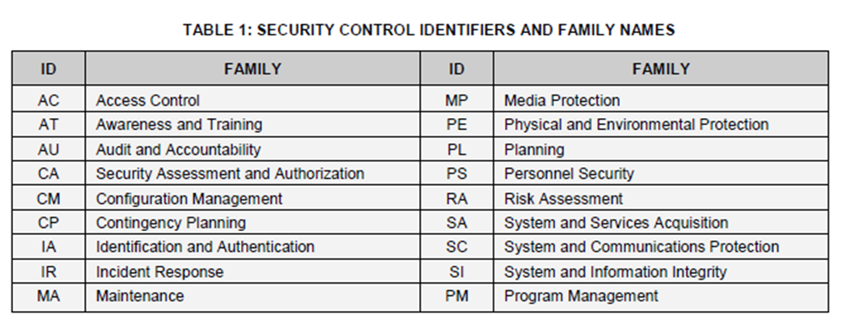
ASISP Policy Lens Solutions
CONFIGURATION MANAGEMENT
Policy Solution set:
Specific Access Controls
  Boundary Protection
  Identification & Authentication of users
  Authorization restrictions
  Cryptography implementation
  Audit and Monitoring Procedures
Configuration Management
Other NIST compliant controls
Access CONTROLS
SW UPLOAD Procedures
Processes
System Design (Hardware or Software)
Violation of Policy ISSUES
Implementation error
Undesirable event Avoidance
Flawed internal controls
http://nvlpubs.nist.gov/nistpubs/SpecialPublications/NIST.SP.800-53r4.pdf

Slide 42
ASISP Mitigation Options
Safety
Risk Factor Identification
TASK #2 RESEARCH MITIGATION TECHNIQUES ASSOCIATED WITH TASK #1
What can be done at the system level for part 21, 91 and 43 that would mitigate those ASISP risks?
e.g., Field loadable software?
institute digital signature processes, PKI certificates, etc.
e.g., ACARS
e.g., Secure data links
Goal: simple policy and processes to protect code/data from the time it is produced to installation and operation.
Utilize Testing and Risk Assessment Analysis to develop mitigate options as described in the process
System
Threat Analysis
Asset Value
Assessment
Safety Risk Management
Risk
Management
Decisions
Risk
Assessment
Mitigation
Options
Vulnerability
Assessment
Threat
Assessment
Implement Mitigation
Threat Agent
Assessment
Policy/Regulations Changes based on Risk assessment
  Mitigation Analysis to change policy
Analysis of Changing Vulnerability
  Change Vulnerability of systems to reduce risk
  Cost Benefits Analysis
Analysis of Changing Asset Value
  Change Criticality of systems to reduce risk
  Cost Benefits Analysis
Risk Analysis
Based on Threat Analysis and Asset Value determine System ASISP Risk Factors
Analyze System Vulnerability
Initial Safety Baseline
Improved Safety

Slide 43
BACK-UP

Slide 44
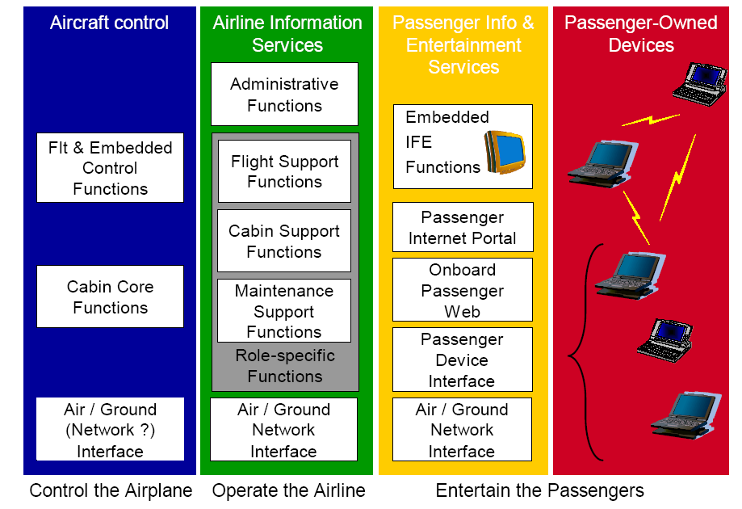
Aircraft Systems Information
Security Protection (ASISP)
Network Security Access Points
Notional Aircraft Domains
2
E-Enabled Aircraft Connectivity including FLS
1
2
Internal Aircraft Network Security Controls
3
FAA Air Traffic Services Connectivity
3
Air Traffic Services (ATS) Provider
Non-Air Traffic Services Provider
Airline Networks
(ACARS)
CNS/ATM & NextGen Services
Communication Navigation & Surveillance
Air Traffic Control Centers
Controls
1
GPS & Ground Navigation Aids
Internet / Public Networks

Slide 45
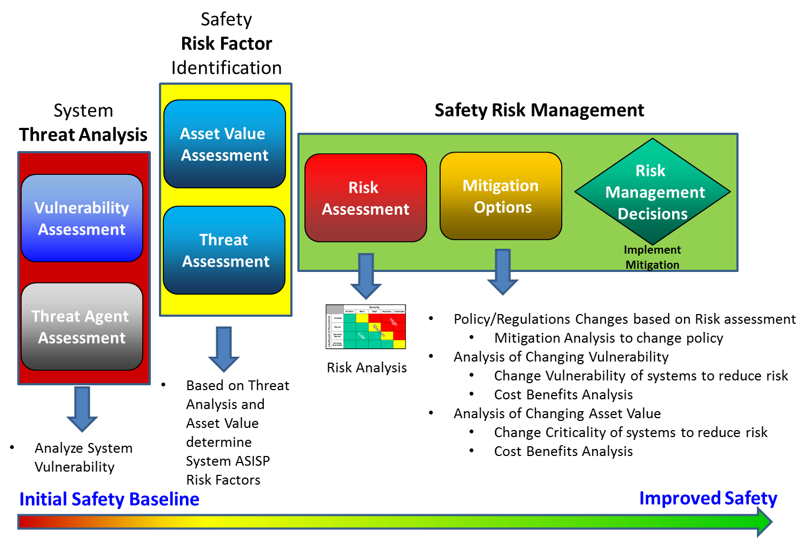
Capability: ASISP Safety Analysis
Technical
Center
AVS

