Slide 1
AVS Portfolio Overview
Subcommittee on Aircraft Safety
Mark S. Orr, AVS R&D Manager
9 Sept. 2015

Slide 2
Outline
FY15 Changes
Plans (F&R - SAS Spring_2015-2: Research Roadmap Development)

Slide 3
Modifications to FY 2015 Portfolio
Completed A11E.RS.1, Health and Usage Monitoring System (HUMS)
  Originally requested $950K
  Funds reprogrammed to support 4 requirements
    A11E.RS.2 Advanced Control Systems
    A11D.SDS.4 Systems Considerations for Complex Software Intensive Systems
    A11C.SIM.1 Structural Factors Influencing the Survivability of Occupants in Airplane Accidents
    A11A.FCS.1 Aircraft Fire Safety
2 Pop-Ups added addressing current needs
  A11C.SIM.1 Structural Factors Influencing the Survivability of Occupants in Airplane Accidents
  A11E.FCMS.1 Stall Departure Identification, Recognition, and Recovery

Slide 4
FY2015 Portfolio Adjustments
Congressional Appropriations: Contract funds received 10.3% less than requested ($43,872K to $39,352K)
$6,000K was directed to UAS (A11L)
Other BLIs: Avg. 18.9% decrease, impacting 29 requirements
  18 requirements continuing from FY2014 received reduced funds
    1 did not receive any funds
    7 received 25% less than requested
  11 new requirements for FY2015 received no funds

Slide 6
Notes:
NOT requested in FY2016
A11C.SIC.6
A11E.MI.3
A11G.HF.7

Slide 7
F&R - SAS Spring_2015-2: Research Roadmap Development
SAS understands and recognizes the ongoing need for research focused on operational safety of the current fleet. Notwithstanding, focused research must be conducted to address emerging issues. The FAA should develop and implement a process to produce 5 to 10 year research roadmaps to guide sponsors in the development of research requirements and to assist in prioritizing and focusing research on strategically significant elements. The roadmaps should define the FAA’s vision for the future, quantify success measures to the greatest extent possible, and identify the research areas necessary to support the roadmap vision. It is further recommended that the FAA make available and use the roadmaps as the basis for its comprehensive strategic research plan, research needs, program initiatives, and intended outcomes for aviation safety.

Slide 8
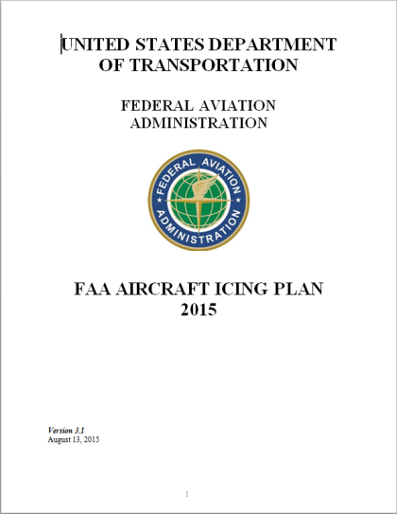
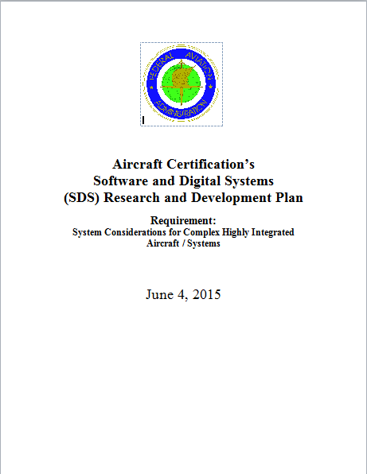
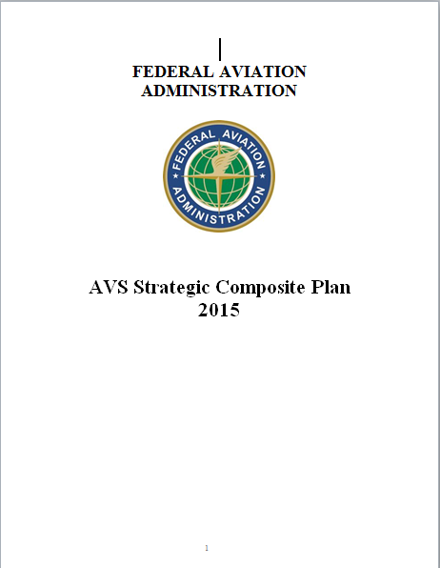
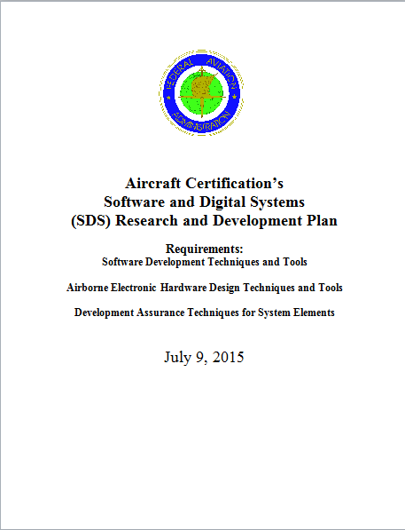
Plans
Additive Manufacturing Plan
TBD

