Slide 1


The Future Sky Safety program
... And Collaboration in Aviation Safety Research

Slide 2
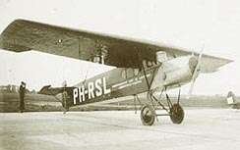
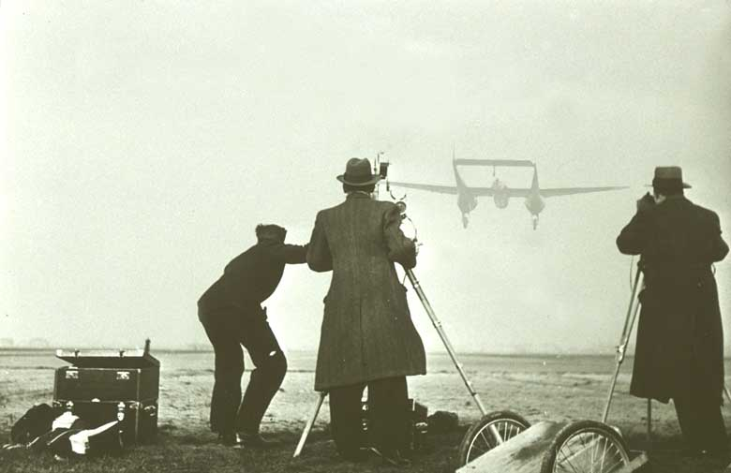
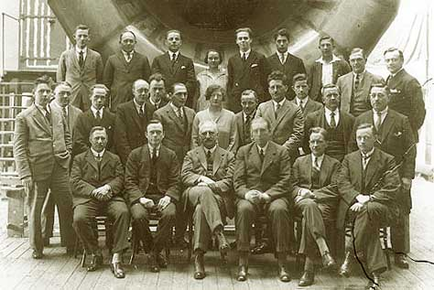
Past and Present
Past:
Established as the National Department of Aviation in 1919
In 1937, this became an independent, non-profit organization

Slide 3
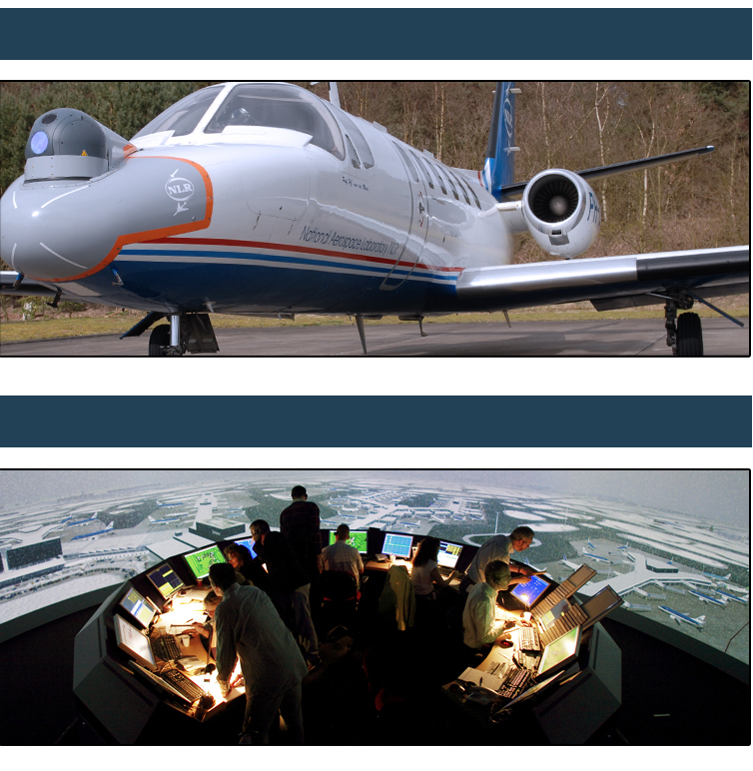
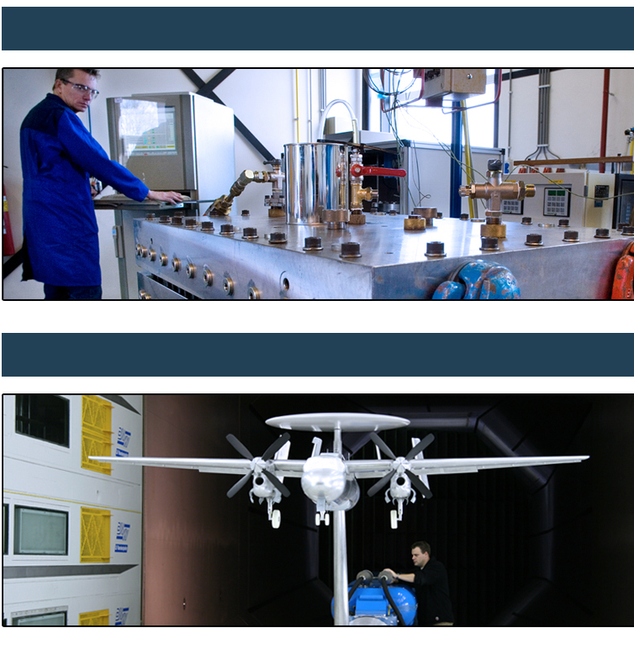
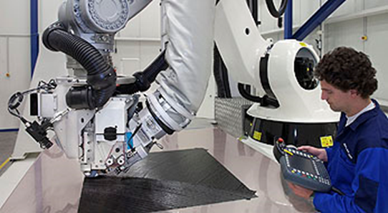
Today ...
Laboratory aircraft
Testing facilities
Simulators
Wind tunnels

Slide 4
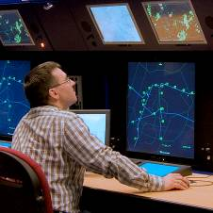
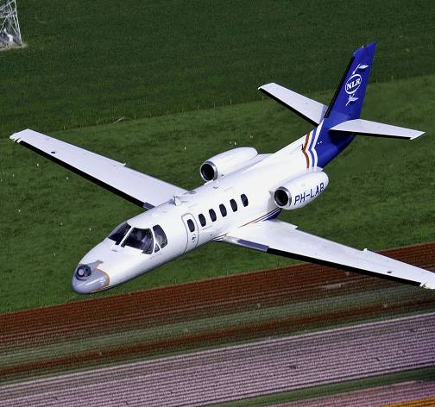
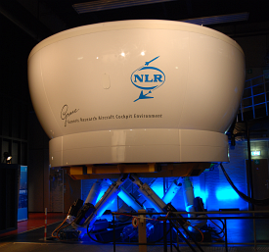
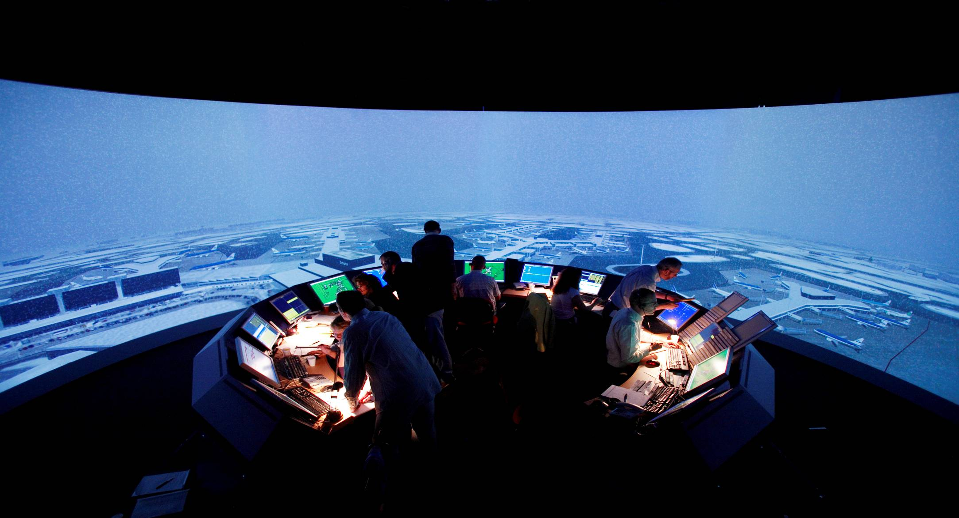
Research infrastructure
Area Control Sim
Research Aircraft
Flight Simulator
External ATC + flight simulators or ops. systems
Tower Simulator

Slide 5
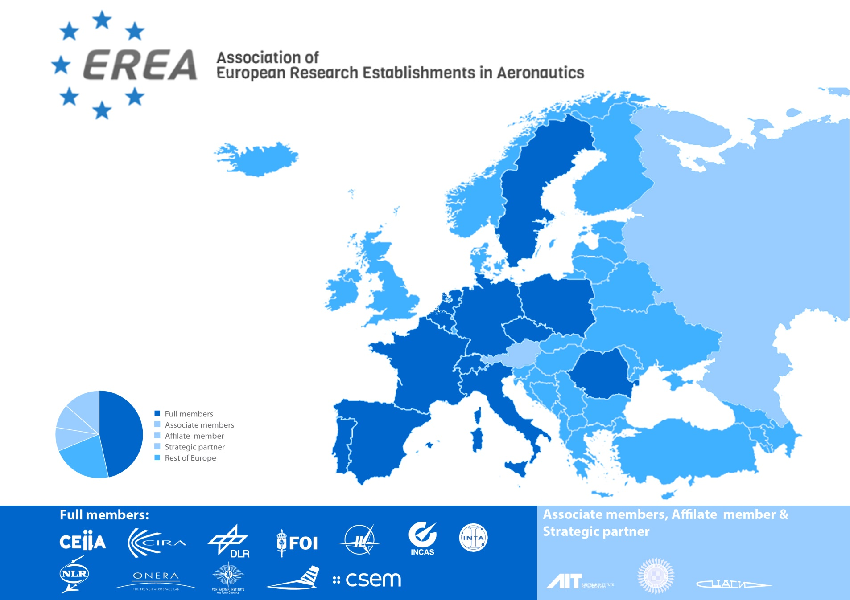
Association of European Research Establishments in Aeronautics
Notes:
EREA in numbers 2011
4.136 Employees in aviation
€ 407.000.000 Spent on research in aviation

Slide 6

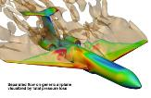




The Role of EREA
Development
& Integration of technologies
Production
& commercialisation
Research
Transfer to
industry
Universities
Industrial partners,
Spin-offs, Start-ups

Slide 7
EREA in numbers
180
Number of PhD Thesis
5.000
Employees in aeronautics
6.000
Number of Publications
€ 0,5 Bln
Annual research budget

Slide 8
Future Sky Safety program overview
and perspectives on cooperation in safety R&D

Slide 9
Future Sky Safety Pogram
EU MG1.4 Coordinated Research & Innovation Action Safety
Two main activities:
Research coordination
Research into specific safety priorities
Scope:
Not Security
Not Military.
Lower TRL’s
One program, 7 year roadmap, two calls
First Call: 15 M€ EU funding, 25M€ budget

Slide 10
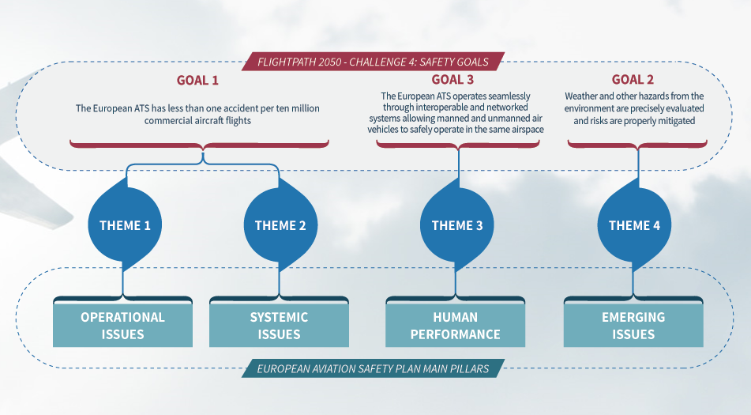
Connecting to European Safety Strategies

Slide 11
Nine technical projects
Theme 1 - New protections against todays accidents
P3 Specific solutions for runway excursion accidents
P5 Resolving the organizational accident
P8 Advanced flight envelope protection
Theme 2 - Strengthening the capability to manage risk
P4 Total system risk assessment
P9 Getting ahead of the curve; emergence detection and big data
Theme 3 - Building ultra-resilient systems and operators
P6 Human Performance Envelope
P10 More resilient crew – flight deck automation cooperation
Theme 4 - Building ultra-resilient vehicles
P11 Reducing the effect of environmental hazards
P7 Mitigating the risk of fire, smoke & fumes

Slide 12
Nine Technical Projects Two coordination Projects
P1 Coordination of Institutionally Funded Safety Research
P2 Dissemination, exploitation and communication
Call 1
P3 Specific solutions for runway excursion accidents
P4 Total system risk assessment
P5 Resolving the organizational accident
P6 Human Performance Envelope
P7 Mitigating the risk of fire, smoke & fumes
Call 2
P8 Advanced flight envelope protection
P9 Getting ahead of the curve;
emergence detection and big data
P10 More resilient crew –
flight deck automation cooperation
P11 Reducing the effect of environmental hazards

Slide 13
Consortium
Effort distribution:
Research: 53%
Industry & others: 32%
Universities: 15%

Slide 14
Advisory Board
ICAO
SESAR Joint Undertaking
EUROCAE
FAA
IMG
Scientific Advisors (3)
EASA (expected)

Slide 15
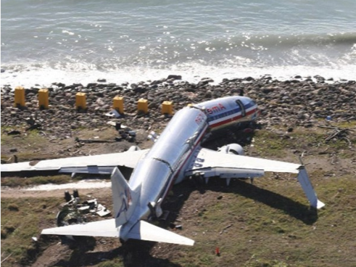
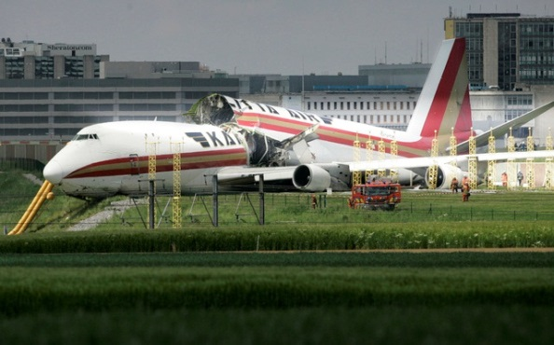
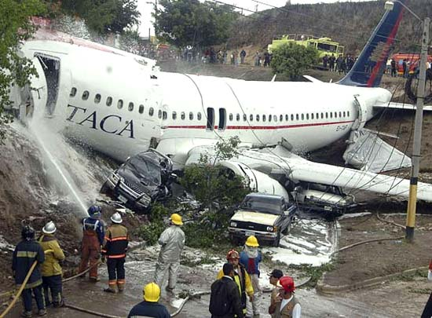
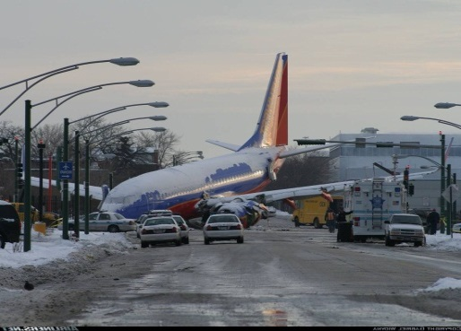
Theme 1 projects
P3 Specific solutions for runway excursion accidents
The European Action Plan for the Prevention of Runway Excursions (EAPRRE) has identified research needs to further reduce risk:
Flight mechanics of slippery runway ops in crosswind,
Impact of fluid contaminants on stopping performance,
Advanced methods to monitor risk factors in flight data.
A fourth workpackage will look into new technologies* (e.g. gear technologies, pavement technologies, onboard guidance, etc.) to prevent excursions or the consequences of excursions.
* Other than ROPS
Air Transport Safety Institute - overview
15

Slide 16
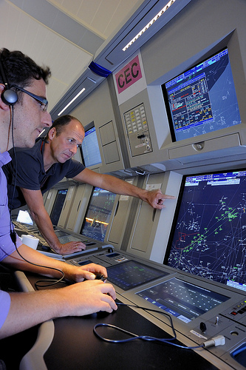
Theme 1 projects
P5 Resolving the organizational accident
Safety focus has traditionally been on technical failures and human error as they occur in operations
New approaches consider the overall sociotechnical system in the full operational and organizational context.
Research will address the effects of organizational structures, processes and cultural phenomena on safety performance in aviation organizations.
The findings will address both fundamental scientific obstacles and connection between the scientific theories and their practical use in safety performance management.

Slide 17
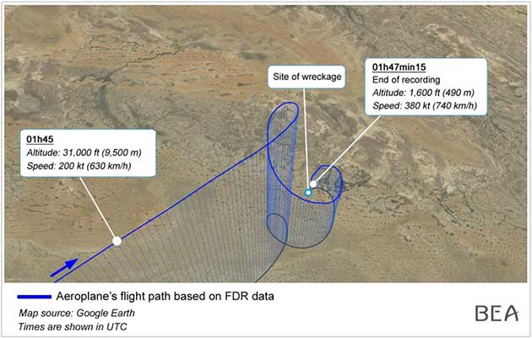
Theme 1 projects
P8 Advanced flight envelope protection
Research into higher levels of fixed and rotary wing flight operations integrity in nominal and off nominal conditions.
Flight envelope extensions through development of improved models to predict aircraft behaviour in off-nominal conditions.
Improved envelope protections
Improve envelope awareness
Methods to retain adequate performance and controllability in case of system failures or "exogenous" events.

Slide 18
Theme 2 projects
P4 Total system risk assessment
Adequate means for safety risk assessment and safety performance monitoring of large, complex and dynamic systems of sufficient accuracy and depth not yet available.
Explicit representation of latent factors in risk assessment and data, processes and techniques for continuous updating of the risk picture must be developed.
Project will build on progress made in several programs (ASCOS, EUROCONTROL IRP/AIP, FAA-ISAM, CATS-NL)
Project will contribute to the development of a next generation of safety assessment techniques.
Study the possibility of establishing a European risk observatory to monitor safety risk on a continuous basis using flight ops data (incl. FDM)

Slide 19
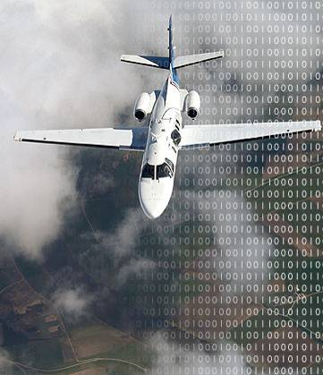
Theme 2 projects
P9 Getting ahead of the curve; emergence detection and big data
Current diagnostic approaches, use occurrence reports or ‘exceedances’ (these are pre-defined “knowns”.)
This project will develop methods to:
Develop data-traps to monitor approach to risk criticality
Analyze big data to find evidence of the emergence of new risks
Mitigate the identified emerging safety risks before realization
Methods to allow concurrent (daily) analysis enabling identification of emergent safety risks profiles.

Slide 20
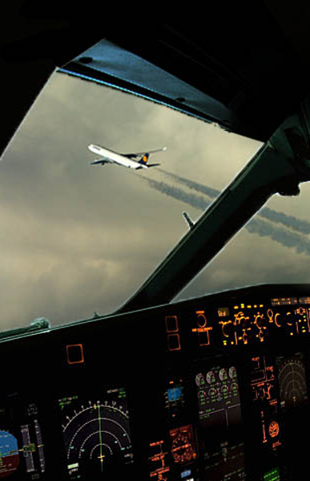
Theme 3 projects
P10 More resilient crew – flight deck automation cooperation
Research into startle, surprise and cognitive lock-up in the crew interaction with non-nominal automation behaviour and unanticipated flight conditions.
Development of training to increase crew resilience in case of non-nominal flight deck automation behaviour.
Development of automation strategies to support continued flight crew performance in case of automation degradation.
Building on ACROSS, Man4Gen, other.
* Project is not about loss of control, but findings could also help reduce LoC risk.

Slide 21
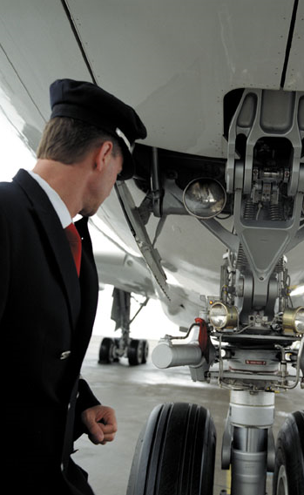
Theme 3 projects
P6 Human Performance Envelope
HPE is new paradigm in Human Factors
Instead of focus on one or two individual factors (e.g. fatigue, sit. awareness), it considers multiple factors and how they influence performance.
Through studies and simulations the project will:
Find points where performance deteriorates
Determine behavioural or physiological markers and recovery measures in real-time
Identify ways to augment the envelope in order to increase safety and improve performance.

Slide 22

Theme 4 projects
P11 Reducing the effect of environmental hazards
The physics of icing clouds containing of Supercooled Large Droplets & high altitude ice crystals not sufficiently understood.
Building on FP7 WEZARD and HAIC, this project will:
Improve SLD models
Further develop 3D ice accretion numerical tools
Improve 3D numerical tools for aero performance degradation

Slide 23
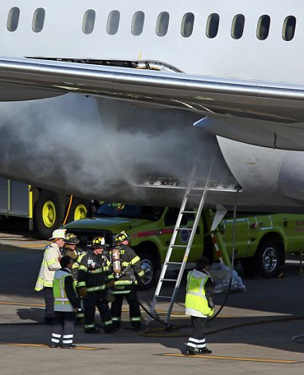
Theme 4 projects
P7 Mitigating the risk of fire, smoke & fumes
Important knowledge gaps exist around fire behavior of CFRP materials for primary structures, and the risks of fire in the modern cabin environment
Project will study the fire behavior of CFRP composite structures:
Develop better methods to assess thermo-mechanical properties
Analyse composite decomposition under various flame and mechanical load conditions and develop better numerical methods
Improve understanding of risks of fire, smoke & fumes in the modern cabin and explore new mitigating technologies
Risks associated with Cabin Air Quality will be studied to improve understanding and propose mitigatons.

Slide 24
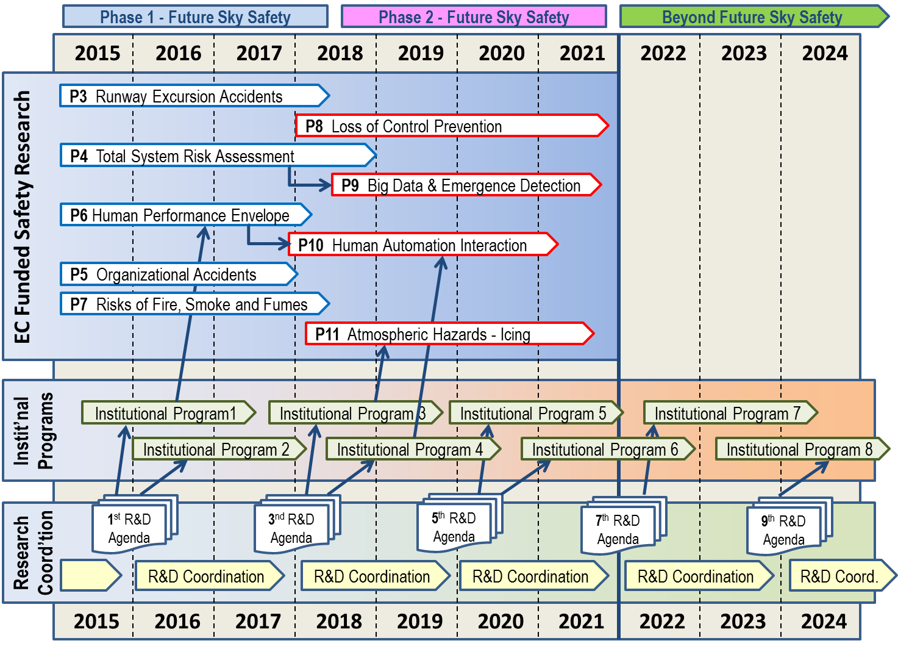
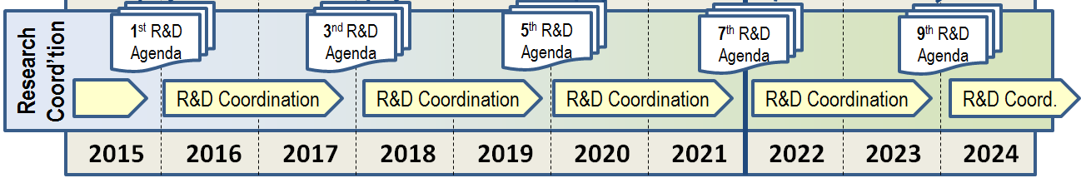
Notes:
To create a shared insight among the RE’s of the ongoing and planned safety research in the RE’s by developing and maintaining a detailed overview of the safety research conducted in each of the RE’s.
To achieve coordination in the planning and conduct of new safety research projects by the development and annual renewal of a Safety Research Agenda.
To create cooperative research projects in which multiple RE’s work together on a single safety research challenge, among other by creating the common administrative provisions and incentives needed to make safety scientists work at other RE’s.

Slide 25
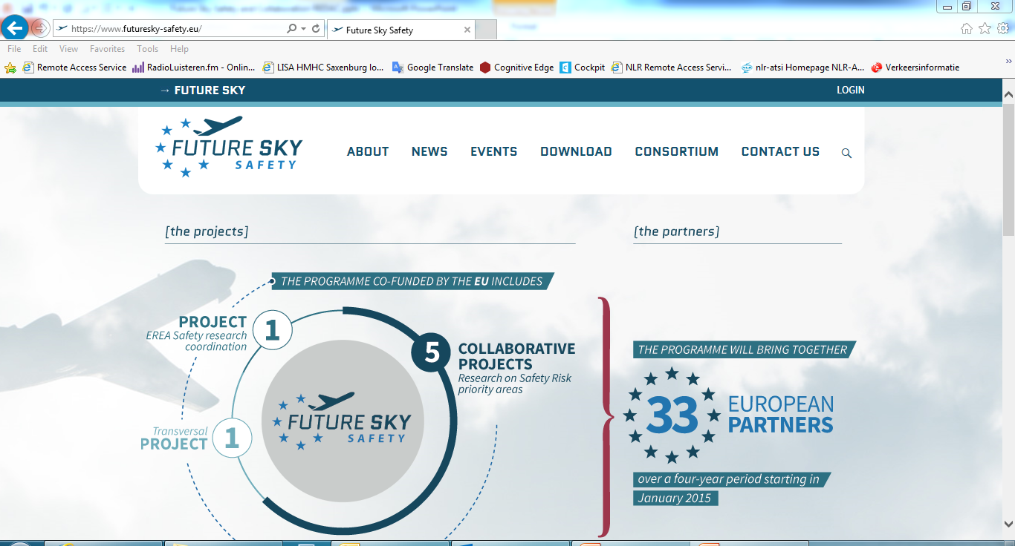
For more information: www.futuresky-safety.eu

Slide 26
The Future Sky Safety program
... And Collaboration in Aviation Safety Research

Slide 27
