Slide 1
REDAC Subcommittee for Aircraft Safety

Slide 2
Initial SAS Planning
July 15, 2015
Meting focus:
Overview of the FY15 RE&D aviation safety portfolio.
What are the research findings?
How are we progressing?
What is next (strategy)?

Slide 3
Approach:
2 days (Sept 9/10)
1 hour max per briefing/topic area
Show long-term plans (to address roadmap concerns)
Have CSTA involvement
Provide some hands on tours – limit time in a windowless room
Be selective in the topics discussed
Provide charts in advance on all
projects (homework assignment)
Leave time for discussion of additional items of interest.

Slide 4
Key Themes:
Software
System Safety
Composites / Additive Manufacturing

Slide 5
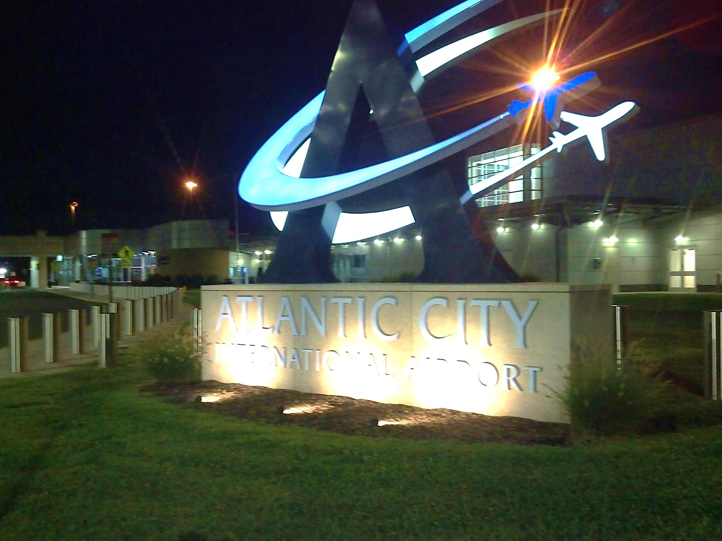
Questions?

