Slide 1
Software & Digital Systems Research
Sponsor: Barbara Lingberg (AIR)
Presented to: REDAC Subcommittee on Aircraft Safety (SAS)
Date: Sept 9, 2015

Slide 2
ANG-E271 Research Team
Alanna Randazzo
Chuck Agava
Charles Kilgore
Dr. Srini Mandalapu
Dr. Manny Rios
Jolea Russotto
John Zvanya
Software and Digital Systems

Slide 3
AGENDA
Research Overview
Software Tools and Technologies
System Complexity Research
Safety Issues with Integration of Complex Digital Systems
Single Event Effects

Slide 4

ANG-E271 Research Overview
Core Research Areas
Software Digital Systems
Systems
Software
Airborne Electronic Hardware
Assist the Aircraft certification personnel with understanding new technology and the potential impacts
Support Policy guidance and training material development
Support development of certification techniques, compliance and verification methods
Support development of position papers, standards and harmonization of certification guidance with international certification agencies
AIR, AFS, CAST, and Industry

Slide 5
SDS Research Tracking-AIR
FY 15 Tracking of SDS Research Results
AC 00.66-Data Integrity uses the research report DOT/FAA/TC-14/49, “Selection of Cyclic Redundancy Code and Checksum Algorithms to Ensure Critical Data Integrity”
Draft AC.20-115D-Software Topics uses the research report RevEngFinalDraft-090413, “Reverse Engineering Software and Digital Systems”
Draft AC 20-152A uses the research report DOT/FAA/TC-14/41, “Advanced Verification Methods for Safety-Critical Airborne Electronic Hardware”

Slide 6
Significant Accomplishments- Advisory Circulars
ANG-E271 Research | Guidance Development
1. Position Paper : Proposed recommendations for user-modifiable software for AC and order | Draft AC.20-115D, Software CHAPTER 3. USER-MODIFIABLE SOFTWARE (UMS)
2. Position Paper : Proposed recommendations for software Problem reporting | Draft AC.20-115D, Software CHAPTER 4. SOFTWARE PROBLEM REPORTING
3. Position Paper : Proposed recommendations for field-loadable software for the AC and Order | Draft AC.20-115D, Software Chapter 5. Approval of Field-Loadable Software (FLS)
4. Position Paper : Document recommendations for FAA policy/guidance on extraneous code including dead and deactivated code | Draft AC.20-115D, Software CHAPTER 7. ADDRESSING EXTRANEOUS CODE
1. Task on Data Integrity Techniques: “Selection of Cyclic Redundancy Code and Checksum Algorithms to Ensure Critical Data Integrity” | DRAFT AC-00.66 DATA INTEGRITY, ALGORITHMS FOR VARIOUS CRITICALITY LEVELS and BIT SIZE
2. Task on Reverse Engineering: "Reverse Engineering" Software and Digital Systems” | DRAFT AC.20-115d, Software CHAPTER 6. REVERSE ENGINEERING
3. Task on Advanced Verification Methods for Safety-Critical AEH: “Advanced Verification Methods for Safety-Critical Airborne Electronic Hardware” | DRAFT AC-20-152A, DO-254 DESIGN ASSURANCE GUIDANCE FOR AEH

Slide 7
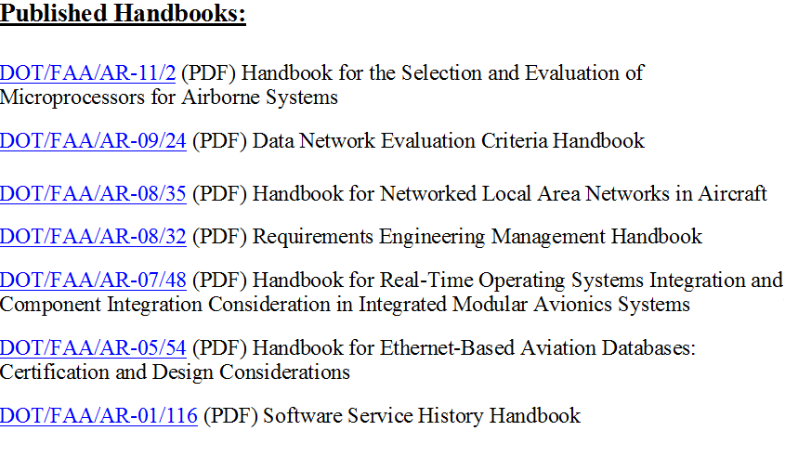
Significant Accomplishments- Handbooks
1.
2.
3.
4.
5.
6.
7.

Slide 8















2014 National Systems, Software and Airborne Electronic Hardware Standardization Conference
How does FAA and Industry respond to the challenges of increased system complexity?

Slide 9
Significant Accomplishments- Conference Proceedings
Proceedings from the 2014 National Systems, Software & Airborne Electronic Hardware Standardization Conference
Research Topics Presented
Single Event Effects – Safety Concerns and Solutions for Aircraft Systems
Semiconductor and Integrated Reliability Modeling
Requirements Definition, Validation and Verification
Criteria for Evaluating Adequacy of an Assurance Case in DO-178C
Data Integrity Techniques
Multicore Processors- Why, What & How
How does FAA and Industry respond to the challenges of increased system complexity?

Slide 10
Software Tools and Technologies

Slide 11
Software Technologies and Tools
Outline:
  Assurance Case applicability to DO-178C
  Multi-Core Processors
  Service History and Service Experience

Slide 12
Assurance Case Applicability to DO-178C

Slide 13


Assurance Case Explained
This is Jon
This is Jon’s dad
150032gc1
Images are in the public domain via CC0 1.0 Universal (CC0 1.0). Downloaded from pixabay.com

Slide 14
Tim will give me a ride to
the game.
Is he a
safe driver?
140003gc1
Images are in the public domain via CC0 1.0 Universal (CC0 1.0). Downloaded from pixabay.com

Slide 15
Yes, he is.
How do you know?
140004gc1
Images are in the public domain via CC0 1.0 Universal (CC0 1.0). Downloaded from pixabay.com

Slide 16
It’s just one of those things
I know.
That’s not good enough. Try again.
140005gc1
Images are in the public domain via CC0 1.0 Universal (CC0 1.0). Downloaded from pixabay.com

Slide 17
No one says he’s not a safe driver.
How many people have you asked?
140006gc1
Images are in the public domain via CC0 1.0 Universal (CC0 1.0). Downloaded from pixabay.com

Slide 18
Um, well, one, but …
140007gc1
Images are in the public domain via CC0 1.0 Universal (CC0 1.0). Downloaded from pixabay.com

Slide 19
… He passed the state test to get a license, so he must drive safely.
Just being
legal
doesn’t
mean
he’s safe.
140008gc1
Images are in the public domain via CC0 1.0 Universal (CC0 1.0). Downloaded from pixabay.com

Slide 20
Well, Dad, what’s gonna convince you to let me ride with Tim?
Reasons …
140009gc1
Images are in the public domain via CC0 1.0 Universal (CC0 1.0). Downloaded from pixabay.com

Slide 21
Well, Dad, what’s gonna convince you to let me ride with Tim?
Reasons …
Good reasons to believe Tim will get you there and back in one piece.
140010gc1
Images are in the public domain via CC0 1.0 Universal (CC0 1.0). Downloaded from pixabay.com

Slide 22
I’ll ask Tim
if he has
one.
Or, in other words,
I want an
assurance
case.
140011gc1
Images are in the public domain via CC0 1.0 Universal (CC0 1.0). Downloaded from pixabay.com

Slide 23
Assurance Case applicability to DO-178C
Task
Why do we need an Assurance Case?
  Traditional verification approaches may not provide the justified confidence in complex systems
  Assurance case provides a means to structure and reasoning
  Gives additional confidence in the process
  Assurance case methodology will augment testing and evaluation
  Aircraft Certification Office (ACOs) can apply a uniform approach in assessing the certification packages

Slide 24
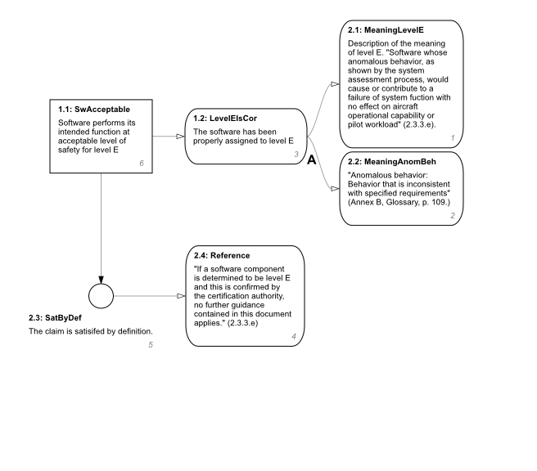
Assurance Case for Level E Software
Assurance Case Argument for Level E Software

Slide 25
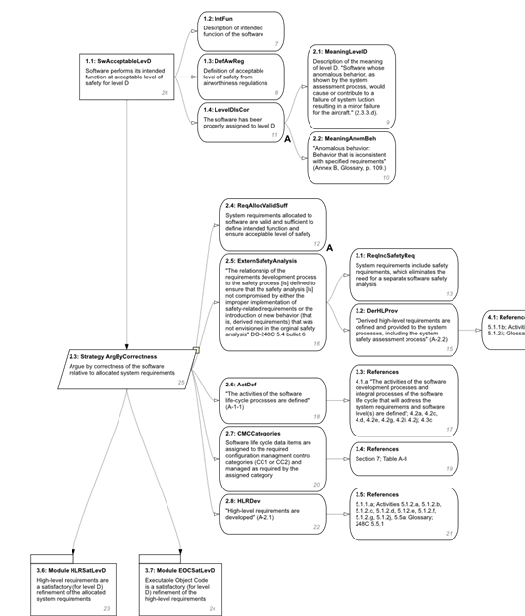
Assurance Case for Level D Software
Assurance Case Argument for Level D Software

Slide 26
Assurance Case Applicability to DO-178C Progress
Planned end date: 31 December 2015
  Status - On Schedule
Accomplishments to date:
  Developed Assurance cases for Level A, B, C, D, and E
  Phase 1 of the task completed and a dynamic (web page style) report was prepared using Goal Structure Notation (GSN).
  Presented at the 2014 FAA National Software and Airborne Electronics Hardware Standardization Conference
  Published as “Explicate ‘78: Uncovering the Implicit Assurance Case in DO–178C”

Slide 27
Multi-core Processors in Avionics

Slide 28
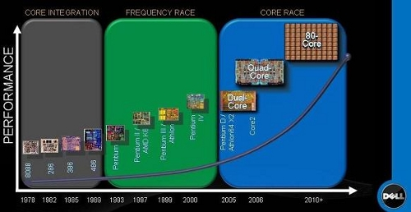
Multi-core Processors in Avionics Task
Safety issues with use of Multi-core Processors (MCP)
True Simultaneous Execution of Tasks
Single core: Disable interrupts to prevent interference
Multi-core: Disabling interrupts does not prevent access from other CPU cores
Resource Contention
Contention from multiple CPU cores causes increased timing variance
Difficult to prove that timing constraints are met
Limited or No Access to CPU Internal Design Data
Limited ability to analyze effects of shared resources
Changes in internal microcode can alter system behavior
Get ready an 80-core monster machine from Dell.
Read more: http://www.itnews.com.au/News/128855,dell-talks-about-80-core-processor.aspx#ixzz3dESg2tTF

Slide 29
Multi-core Processors in Avionics Task
Approach:
EASA conducted a preliminary research in 2011 on the use of Multi-core in airborne systems
There were several publications on multi-core issues published since. Need to review the latest research.
CAST-32 (Multi-core Processors) position paper - Limits to only dual core
This research will consider more cores
Determinism and resource contention are the major issues to be considered

Slide 30
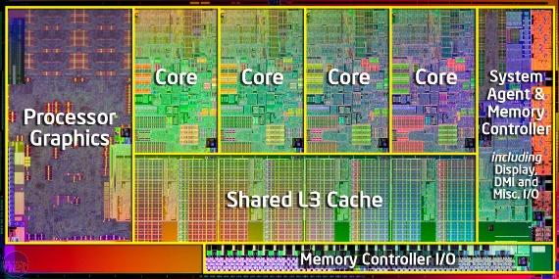
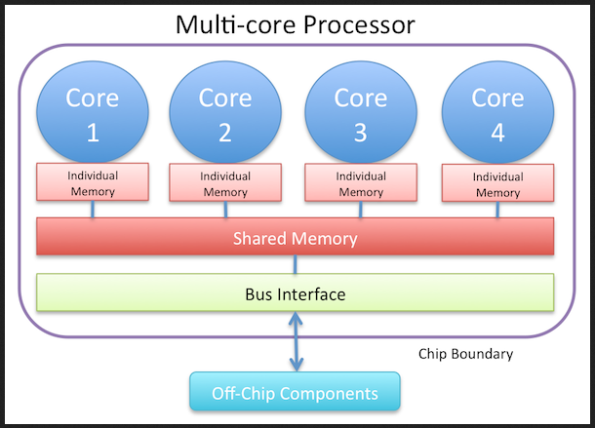
Multi-Core Processors in Avionics
Tasks:
Investigate of safety issues associated with the use of MCP in safety critical application with special focus on airborne systems.
Investigate types of failures and errors specific to MCPs.
Investigate in depth the issues related to indeterminism, ( definition, sources of indeterminism, types of indeterminism, impact on safety, adequacy of current verification process, mean to address the indeterminism).
Investigate further on the issues with interference (shared resources, cashes, memory)

Slide 31
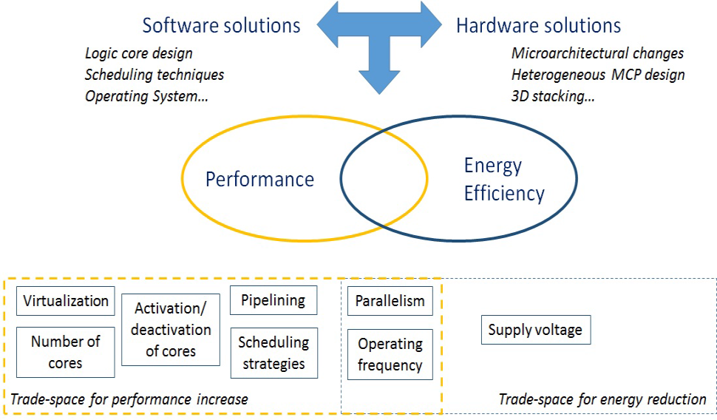
Multi-Core Processors in Avionics Progress
Start date: November 2014
Status: On Schedule
Accomplishments to date:
  White Paper on Safety Issues Associated with the Use of Multi-core Processors
What is expected:
  Recommended Criteria for assurance of Multi-core processors

Slide 32
Software Service History and Airborne Electronic Hardware Service Experience

Slide 33
Service History Task
Research need:
Acceptance of service history on actual certification projects for airborne avionics systems has been extremely limited.
How much service history and types of substantiation data are required to meet the software or Airborne Electronic Hardware (AEH) development assurance objectives?
What criteria needs to be applied to accept in-service reliability data from other domains?
What is the criteria to determine the acceptability of data to support the certification proposal?

Slide 34
Service History Task
Approach:
Review of current guidance and standards (DO-178C and DO-254).
Investigate what service history data is suitable for credit.
Conduct a review of applicable quantitative approaches and statistical models.
Develop criteria and recommendations for acceptable data and models.

Slide 35
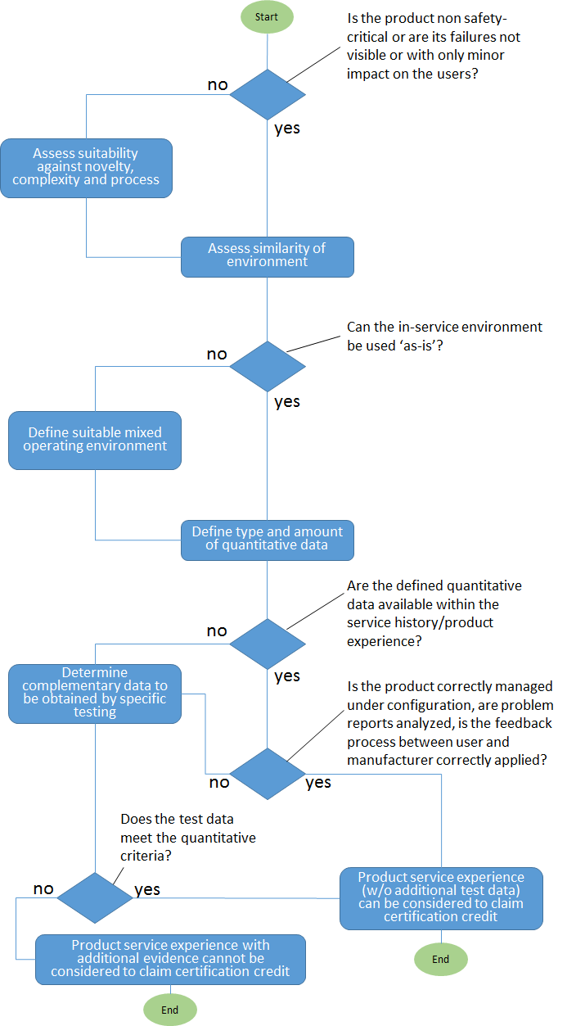
Service History Task Progress
Decision Flow for Assessing Suitability of in-service data
Planned end date: September 2015
  New concepts developed
    Equivalent Level of Design Assurance (ELDA)– A, B, C, D
    Estimated Level of Safety
Accomplishments to date:
  Completed the review of current guidance on service history
  White paper on quantitative approaches to software service history and AEH service experience
  White paper on recommended Criteria for acceptability of data

Slide 36
System Complexity Research
System Architecture Virtual Integration

Slide 37












System Architecture Virtual Integration (SAVI)
Aerospace Vehicle Systems Institute (AVSI)
  Cooperative research with the following participation
    Boeing
    Embraer
    Airbus
    Honeywell
    Rockwell Collins
    GE Aviation
    FAA
    DoD
    NASA

Slide 38
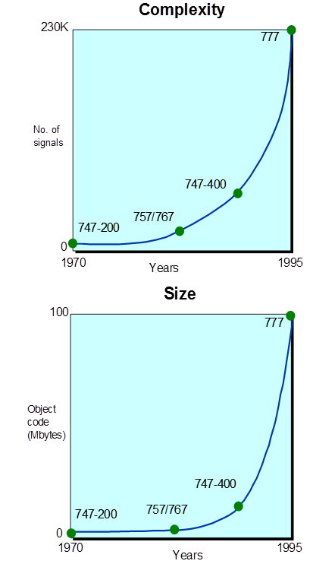
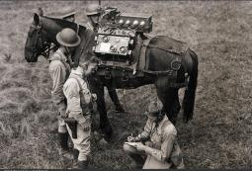
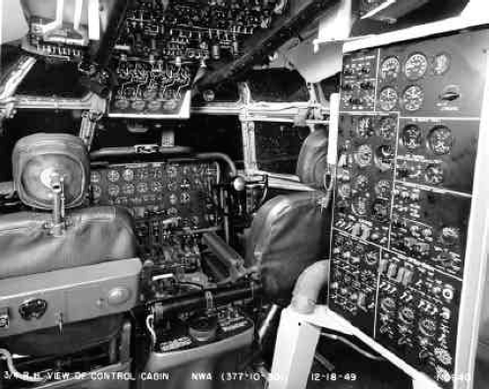


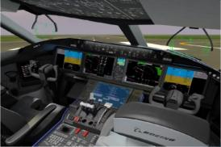
SAVI
Research Need?
  Rapid growth in software in aircraft systems.
  80% of accidents are found to be due to operator error which may be related to complexity of aviation system. Incomplete / inaccurate requirements and operator errors major factors in systems problems.
  Legacy Aircraft/system development process can no longer handle growing complexity.
  Current methods for development of new standards and guidance are too slow to keep up with new technologies.
  Increase in the late discovery of errors and development/certification costs.
  Certification challenges to assure safety in complex systems
Number of communication
paths and type
Software lines of code
  Portable phones
  Airliner cockpits

Slide 39
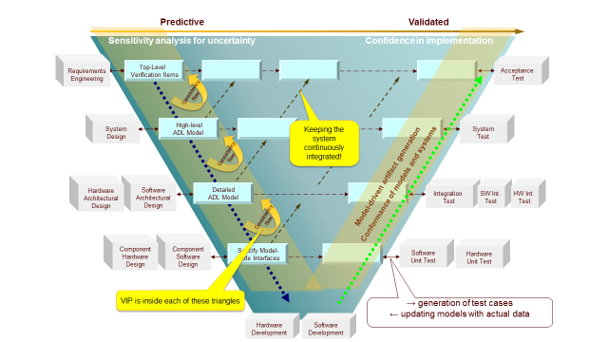
Systems are Continuously Integrated
Continuously Checking the Consistency
- Changing requirements
- Dependent properties and interfaces
Perform Virtual Integration Process (VIP)
Conduct Analyses
- Safety Analysis
- Change Impact Analysis

Slide 40
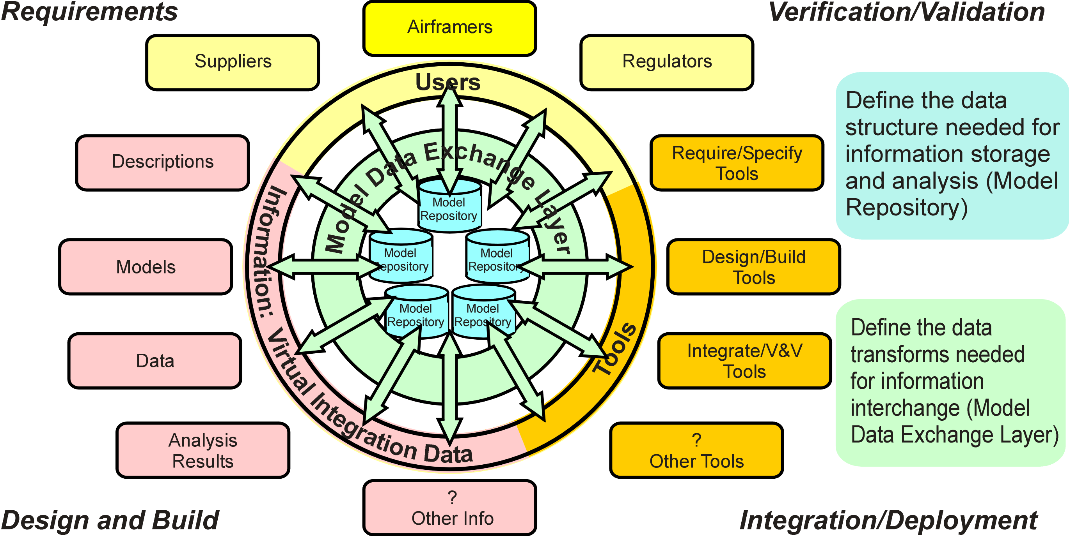
SAVI Virtual Integration
Core Elements

Slide 41
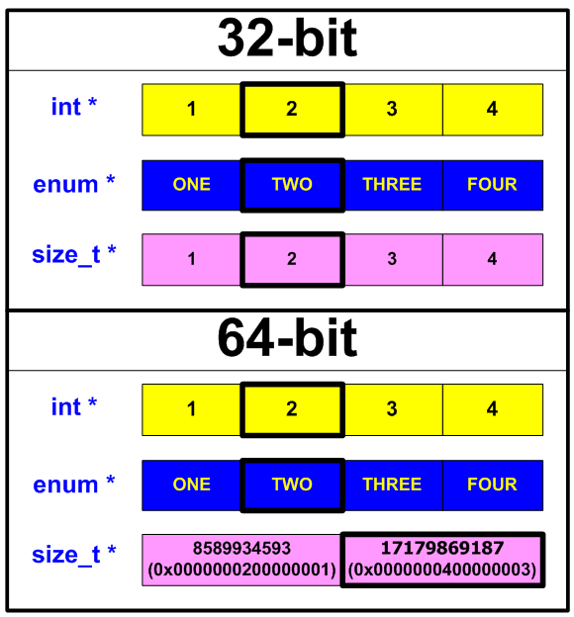
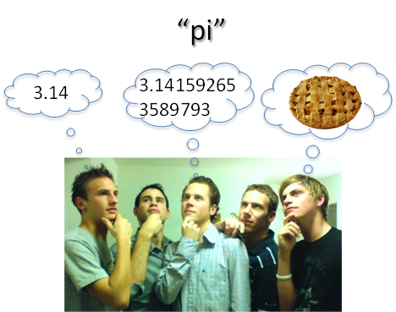
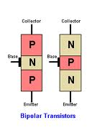


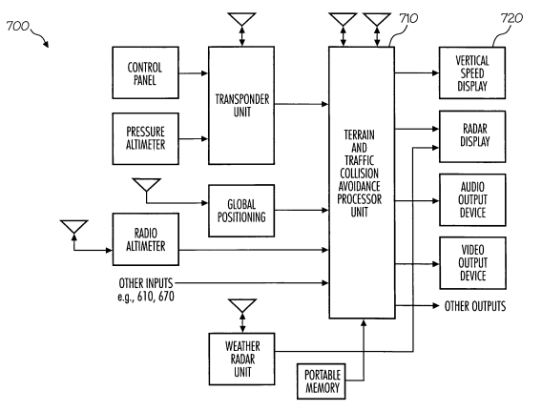
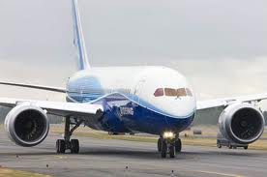
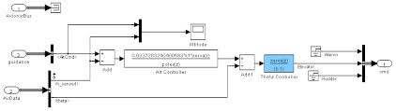
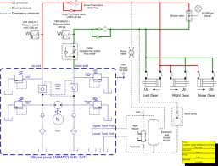
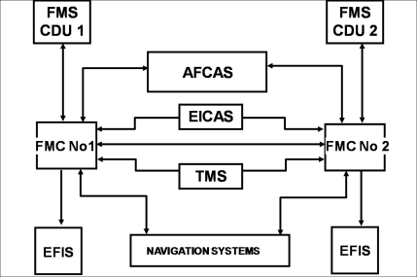


What is SAVI Consistency?
Types of consistency
  Interface
  Compositional
  Constraint
  Behavioral
  Version
  Verification
Physical
Geometry
On Ground
Ground Proximity Warning System
Radio Altimeter
Shape
PNP or NPN Junction
Weight on Wheels Switch
Altimeter
Speed Indicator
Landing Gear Model
Engine Indication and Crew Alerting System
Air/Ground Signal
Avionics Model
In Flight

Slide 42
SAVI Progress
Initiated in 2010
Current phase end date : November 2015
  Fit analysis, consistency checking, and Business Object Model development for Data Exchange (DeX)
  Behavior analysis, consistency checking, and Business Object Model development for DeX
Accomplishments to date:
  Completed Return of Investment (ROI) analysis, demonstrated significant benefit
  Proof of Concept demonstrated
  Developed use cases for incremental development
  Developed models using different tools to demonstrate exchange of information and consistency checking
  Continued to develop specifications for Virtual Integration and Data Exchange Layer (Living Document)

Slide 43
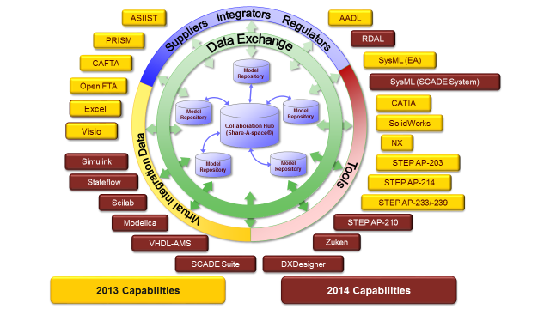
Models, Tools, and Data Exchange Standards Considered so far

Slide 44
Fit Consistency: Logical and Physical Properties
Model Set used:
MCAD assembly model (STEP-203)
MCAD connector model
ECAD PWB/CCA and Connector models
SysML interconnect model
Steps considered:
Extract properties from each model
Convert properties to common representation (STEP AP-239)
Perform SAVI VIP automated consistency check.

Slide 45
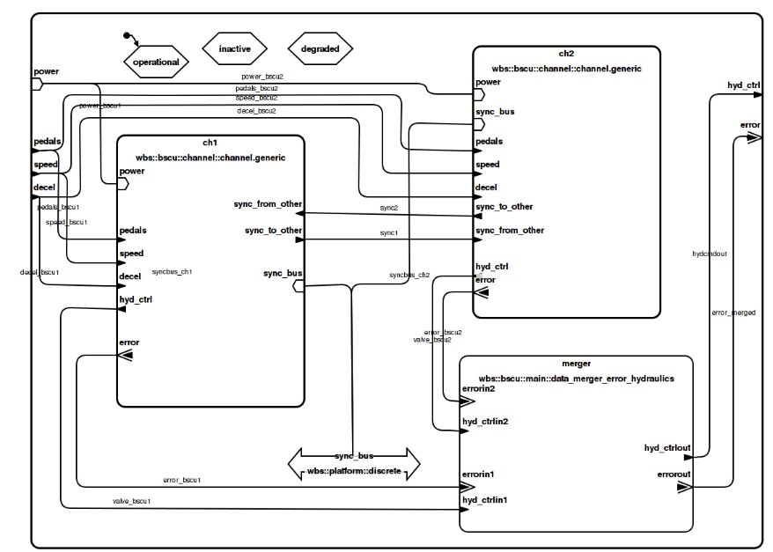
BSCU Architecture – AADL model
E.g. Model on Brake and Steering Control Unit (BSCU)
Developed using Architecture Analysis Design Language (AADL)
Data exchanged with Simulink, SysML, and Modelica models
Performed consistency Checks

Slide 46
Complexity Measurement

Slide 47
System Complexity Effects on Aircraft Safety
A11n - Advanced Systems and Software Validation
  Executed with NextGen funding
  Follow-on research will be funded under A11.D
Software Engineering Institute (CMU)
  A Federally Funded Research and Development Center (FFRDC)
  Signed an IA with Air Force Life Cycle Center (Hanscom, MA)

Slide 48
System Complexity Effects on Aircraft Safety
Task
Research need:
Aircraft systems are increasing in complexity and integration
As aircraft systems become more integrated failures can have effects that are difficult to anticipate
Increased interdependence increases the risk of failure associated with system complexity
With increasing level of integration, one system may impose requirements on other systems.
How do we measure and mitigate system complexity?
How to improve aircraft certification process in assuring complex systems?

Slide 49
System Complexity Effects on Aircraft Safety
Approach:
Initial Literature review
Identify standard ways of defining and reducing complexity, and analyze which definitions are useful for which purposes
Identify Candidate Measures of Complexity
Investigate the best practices of measurements and apply to the selected complexity measures
Quantify the Effects of System Complexity on Aircraft Safety and Identify Relevant Complexity Measures
Test the Identified Metrics
Make recommendations on the use of the Metrics for certification
How to measure aircraft complexity?
How to mitigate aircraft complexity?
What is the role of complexity on aircraft safety?
How to improve aircraft certification process in assuring complex systems?

Slide 50
Overview of Taxonomy
System Complexity Effects on Aircraft Safety
Mission
Changes
Environment
Changes
Stakeholders
introduce C
in
requirements
Designers
introduce C
in design
Users
suffer C
in operations
New
Technologies
Human
Artifact
Measuring Complexity
Mitigating Complexity

Slide 51
System Complexity Effects Project Status
Start date: July 2014
End date : July 2016
  On Schedule
Accomplishments to date:
  Completed the literature review to define complexity for avionics systems, developed a taxonomy of the definition and identified the prime causes of complexity.
  Completed the investigation of candidate complexity metrics and documented some preliminary thoughts about the relationship of a system’s composition to complexity metrics and the relationship of both to safety.

Slide 52
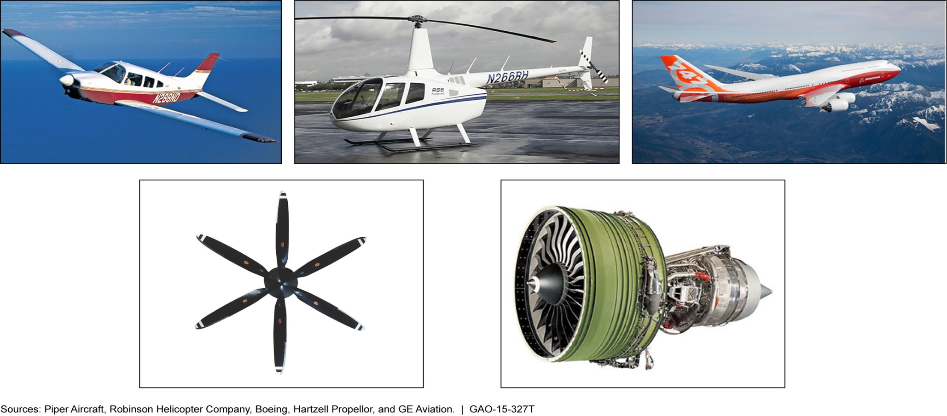
Safety Issues with Integration of Complex Digital Systems

Slide 53
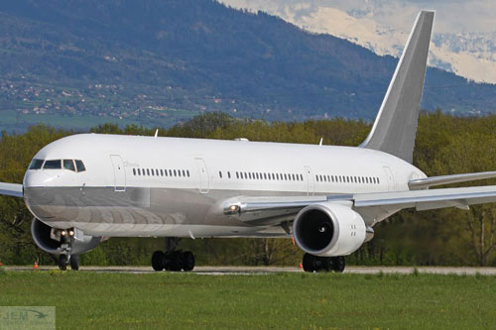

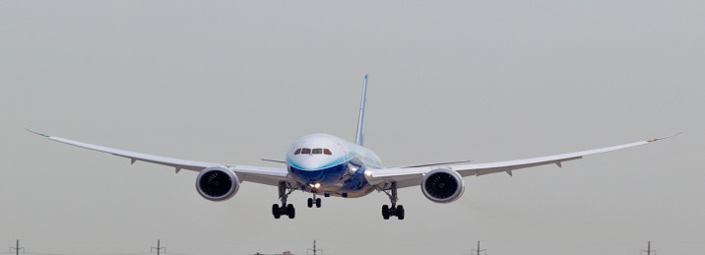
Evolution of Aircraft Digital Systems
767 & Earlier Models
Use the Federated Architecture that have dedicated Line Replaceable Units (LRUs) responsible for specific functions that do not change over time
777
Implemented Integrated Modular Avionics (IMA) and uses the Aircraft Information Management System (AIMS)
787
Use the IMA which replaces the point-to-point cabling with a virtual backplane data communications network
Industry Trend – IMA 2G

Slide 54
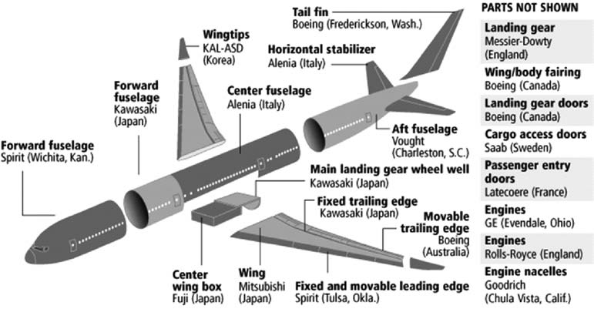
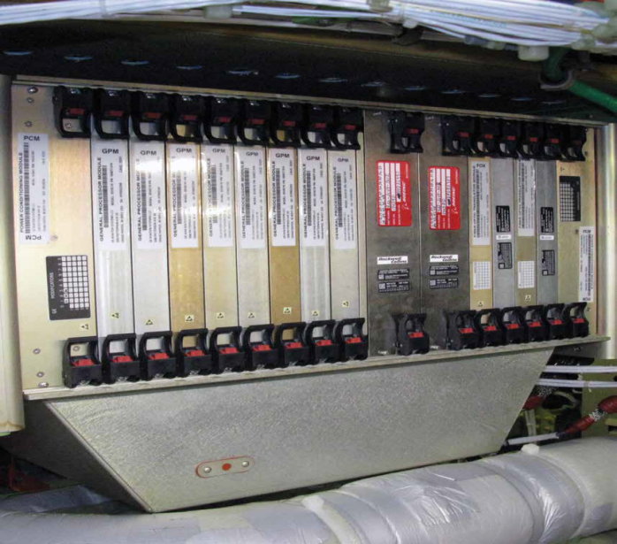
IMA Systems Integration - Emerging Safety Issue
1st layer of Complexity : Increased Inter-system Integration, Automation & New Technology
“B787 introduced novel manufacturing and assembly processes that were unprecedented in scope and scale and has created unanticipated challenges in FAA Oversight ” – CSRT Report
– CSRT Report
Source: Boeing.com
2nd layer of Complexity : Increased Outsourcing, Supplier Responsibility & Supply Chain Risks
Notes:
Revise heading

Slide 55

U.S. Versus Foreign Supplied Parts
Data Source: GAO AV-026
Part of Airframe | 727 | 737 | 747 | 757 | 767 | 777 | 787
Wings
Flaps
Engine nacelle
Nose
Front Fuselage
Center Fuselage
Stabilizer
Vertical fin
Elevators
Rudders
Keel Beam

Slide 56
Integrated Safety Management Framework
Requirements
V&V
System
processes
Supplier
oversight
Multi-tier oversight
System Requirements
Supply Chain
Requirements development guidance
Multi-tier supplier management
guidance
FAA Certification
Aircraft
Safety
Design of complex
Integrated systems
Gaps in FAA Policy
System Design & Integration
FAA Policy
Change impact analysis
Shift of development, verification and integration to suppliers
FAA Certificate Management Policy
Guidelines
Assessment
Holistic Approach to Identifying Safety Issues in Complex Systems

Slide 57
AIR Roadmap For 2018 & Beyond
Field Offices
ACOs
MIDOs
MIOs
Increase focus on the globalization of the aircraft manufacturing supply chain
Open new MIDO satellite offices internationally
Open new MIOs to support oversight of critical system/part suppliers
CSRT
AIR 1
Testimony
GAO
14 CFR Part 21
FAA Order 8120.23
FAA Order 8120.22
FAA Order 8130.2
FAA Order 8110.42
Development of Activity Based Certificate Management (ABCM)
Direct FAA oversight to areas of the greatest risk, wherever the location, and at any tier in the supply chain.
FAA Policy Change Recommendations
FAA Order 8100.15B
FAA Order 8120.12
FAA Order 8120.23
MIDO- Manufacturing Inspection District Office; MIO- Manufacturing Inspection Office; CSRT- Critical Systems Review Team

Slide 58
Research Status
October 2015
March 2017
Projected Outputs
  Kickoff Meeting
  Complex Systems V&V Safety Issues
  Change Impact Analysis
  Complex Systems Integration Failure & Failure Effects
Technical Report
Findings
Recommendations

Slide 59
Single Event Effects
(SEE)

Slide 60
Single Event Effects
Susceptibility of the electronics used in aircraft are vulnerable to the effects of atmospheric conditions
  SEE in which cosmic ray secondary neutrons in the atmosphere cause electronics within aircraft systems to malfunction during flight have been observed and documented since 1992
  Upset rates vary as a function of altitude and geographic latitude which corresponds with the neutron flux energy; The latitude variation of the atmospheric neutrons is governed primarily by the earth’s magnetic field. The neutron flux is greater at the poles than at the equator
Corrupted data; leading to possible Hazardous Misleading Information (HMI)
Central Processing Unit (CPU) halts and interrupts
Unplanned events; including system failure

Slide 61
Some Classes of Single Event Effects
Soft Errors (no permanent damage)
  Single-Event Upset (SEU)
  Single-Event Functional Interrupt (SEFI)
Hard Errors (permanent damage to device/circuit)
  Single-Event Latchup (SEL)
  Single-Event Burnout (SEB)
  Single-Event Gate Rupture (SEGR)

Slide 62
Reasons for Atmospheric Radiation Testing
Regulatory Authorities working in conjunction with Industry Groups
Regulatory Requirements
EASA CM No.: EASA CM – SWCEH – 001 Issue: 01. Requires SEU analysis and its inclusion into the safety process
EASA CRI
FAA Issue Papers – Safety Impact of the Full Authority Digital Electronics Control’s (FADEC) Susceptibility to Atmospheric Neutrons
  Industry Standards Development
  SAE S-18 & Eurocae WG-63
  AIR6219 / ER-008 – SEE Safety Analysis – being drafted by S-18/WG-63/AVSI AFE72

Slide 63
Need for Cosmic Ray Neutron Simulation Facility
Additional facilities needed to meet
  Increasing demand for SEE testing on components
  System level testing for robustness and mitigation verification
  High energy (solar storm) testing
  Thermal testing
Oak Ridge National Laboratory (ORNL)
  Incorporates neutron beam for testing microelectronics within Spallation Neutron Source facility
  World’s most intense pulsed accelerator-based neutron source
  Flux level >50 times higher than that at Weapons Neutron Research (WNR)
  Proton testing for polar routes

Slide 64
SEE Projects
SEE Mitigation Techniques
  Study to identify and document SEE mitigation technique(s), both built-in and not built-in mitigation techniques, used for systems and components. Mitigation techniques can include methods and functions that are capable of detecting and correcting faults generated by upsets, and can be implemented in airborne software, airborne electronic hardware, or system architecture.

Slide 65
SEE Projects (Continued)
INTERAGENCY AGREEMENT BETWEEN THE FAA and DEPARTMENT OF ENERGY
  Definition of Capabilities Needed for a Single Event Effects Test Facility
  The FAA recognizes that existing facilities have insufficient test capacity to meet new demand from such mandates; it desires more flexible irradiation capabilities to test complete, large systems and would like improved capabilities to address greater concerns for thermal neutrons. FAA funded this study by Spallation Neutron Source (SNS) staff with the ultimate aim of developing options for SEE test facilities using high-energy neutrons at the SNS complex.

Slide 66
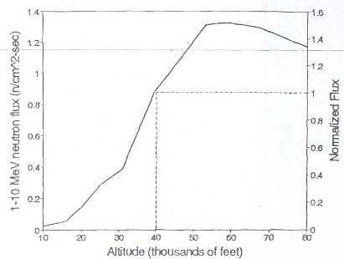



It is a BIT Difficult to UPSET you
HI, I am Jimmy Neutron

Slide 67
High Energy- Neutron Test Station (HETS)
The most capable, flexible and highest test capacity option is a new stand-alone target station named HETS
It is also the most expensive option with a cost to complete of approximately $100M but with dual test enclosures will allow for simultaneous testing activity.
Using about 1 kW of proton power extracted from the accelerator prior to injection in the accumulator ring, its operation would be unnoticeable by neutron scattering users at the SNS target station. The H- beam laser stripping technique would allow for control of beam power on the HETS target independent from power delivered to the SNS.

Slide 68
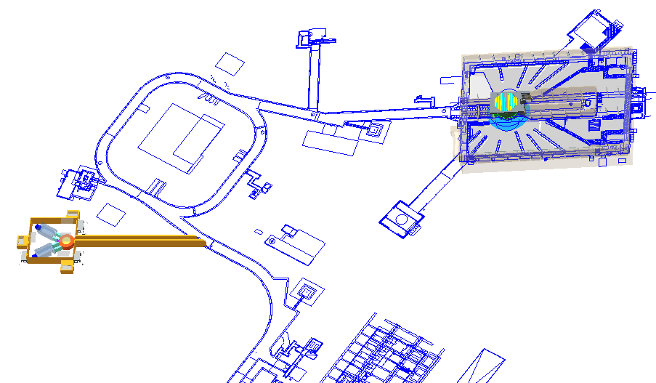
Future Addition
High Energy-Neutron Test Station (HETS)
Existing 18 Beam Lines
Location of beam extraction from main SNS H- beam for HETS
Notes:
High Energy- Neutron Test Station (HETS)

Slide 69
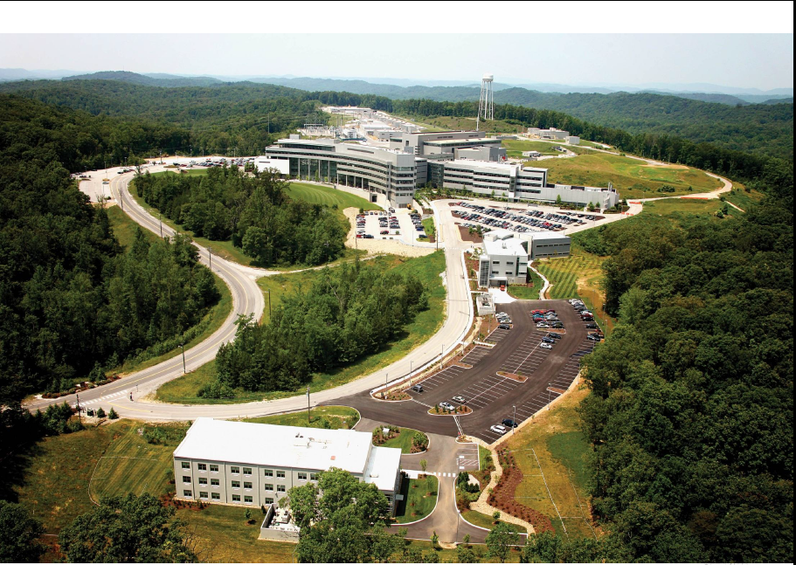
$100 Million
Addition

Slide 70
Questions/Comments
Contact: Alanna Randazzo
609-485-5298 alanna.randazzo@faa.gov
Thank You!

