Slide 1
UAS R&D Update
Claude Jones, Manager, ANG-C21
September 9, 2015

Slide 2
UAS Research Program
Informs Safe, efficient, and timely integration of UAS in the NAS:
  Standards and processes for the certification of UAS systems, pilots/crewmembers, and supporting UAS technologies
  Policies, guidance materials, and advisory circulars for regulatory compliance for UAS operating in the NAS
  Procedures and mitigation strategies to ensure safe UAS operations

Slide 3
New Entrants UAS R&D Portfolio
UAS R&D Portfolio
UAS
Partnerships
UAS AVS
Technical Community
Representatives Group
(TCRG) Core R&D
UAS
Concept, Plans
Mapping
UAS
Demonstrations
UAS
Center of Excellence
Academia
AVS/AFS, ARP,
ATO/AJV/AJM/AOV
Detect & Avoid (DAA)
Certification Obstacles
Data Fusion Strategy
System Safety Criteria
Standards Evaluation
Collision Avoidance
FAA Concept of
Operations
UAS NextGen Demos
Demos 1-6
ASSURE
5/8/2015
NASA (NAS Integration,
UTM RTT)
FAA Research
Mapping
FAA/NASA
ACAS-X Demo
DoD, DHS, DOI
Control & Communication
Control Performance
Communication Security, Cyber Security
Control Non-Payload Communications
NAS Enterprise
Architecture
TBO-UAS Demo
Industry (UAS ARC,
RTCA SC-228)
sUAS Command &
non-Payload
Communication (CNPC)
SWaP Demo
UAS Safety Criteria
and Oversight
Safety Threshold (Kinetic energy)
and Safety Evaluation Tools
FFRDCs (MITRE,
MIT/LL) , CAMI,
VOLPE
Industry CRDAs
Maintenance & Repair
Data Collection
Elements and Standards
Pathfinder
Program
Human Factors
Analyses and Recommendations
on UAS Control Stations
Weather Impacts on UAS
Wake Separation Stds for UAS
FAA Test Sites
Data Collection & Analysis
Notes:
3
3
3
Speaker: Sabrina

Slide 4
FY15 Research Activities
Multi-Sensor Data Fusion Strategy
  Objective: Evaluate surveillance sensor fusion function which supports autonomous detection and avoidance of both cooperative and non-cooperative aircraft
  Current status: Implemented several different sensor fusion strategies into a high speed simulation environment. These strategies included centralized, distributed and hybrid configurations, including several different tracker filters.
UAS System Safety Criteria
  Objective: Recommend safety thresholds for characteristics such as kinetic energy, structure, shape, or other safety features that can be utilized to identify threshold levels
  Current status: Hazard severity and likelihood criteria for UAS collisions to third parties on the ground has been defined.
Simulating UAS in NAS Operation
  Objective: Develop capability for FAA ATO to collect and analyze UAS safety data from COA and other sources to support safety oversight responsibilities for UAS
  Current status: “Beta” version web portal development is complete.
UAS Test Site Data Collection
  Objective: Collect and analyze data from UAS test site operations to determine technical and operational trends
  Current status: Data has been collected from all six test sites preliminary findings have been documented

Slide 5
FY15 Research Activities, cont’d
UAS SAA System Certification Obstacles
  Objective: Determine certification criteria associated with operational and airworthiness approval that a SAA system will be required to address, and provide a means of compliance to 14 Code of Federal Regulation (CFR) Part 91
  Current status: Analyzed obstacles to integrating UAS into the NAS. To date 24 operational obstacles with mitigations have been identified. Preparing final report.
Ground-to-Ground Communication Architecture Assessment
  Objective: Analyze architectural alternatives for Ground-to-Ground communication between a Pilot-in-Command at a UAS Control Station (CS) and Air Traffic Control (ATC)
  Current status: Analysis of various telecommunication options, as well services available from FTI, and provide comparisons based on architectural complexity, cost, quality of Service, and other factors has been provided.
Integration of Collision Avoidance System (CAS) into Detect and Avoid (DAA) for Unmanned Aircraft Systems (UAS):
  Objective: Determine how a UAS DAA system might use CAS as part of its functionality in various classes of airspace
  Current status: Provided the Radio Technical Commission for Aeronautics (RTCA) with an Inter-Special Committee Requirements Agreement to develop an interoperability standard for collision avoidance (CA).

Slide 6
Research inventory mapping

Slide 7
Research Inventory Mapping (RIM)
The RIM database application will be a web based database application which will facilitate the identification of on-going and completed research and will reduce the duplication of related research activities
Identified partners such as NASA, DoD, and others will be able to upload research documents to the repository
The repository will be searchable based on specified criteria and will store completed and approved research deliverables
The repository will have executive dashboards to display information about published research

Slide 8
UAS Center of Excellence

Slide 9
UAS COE Overview
Congress mandated that the FAA establish the UAS COE under the Consolidated Appropriations Act of 2014.
In May 2015, DOT/FAA selected the Alliance for System Safety of UAS through Research Excellence (ASSURE) led by Mississippi State University as the FAA’s first Center of Excellence for Unmanned Aircraft Systems.
The COE will focus on research, education, and training in areas critical to safe and successful integration of UAS into the nation’s airspace.
FAA and other government funding will be matched by the COE one-for-one providing a significant return on investment of tax-payer funds.

Slide 10
UAS COE Program Management
Oversight & Coordination
FAA COE Program Mgr
(Patricia Watts, ANG-E)
UAS COE Program Mgr
(Sabrina Saunders-Hodge, ANG-C2)
UAS R&D Objectives
(FAAStakeholders:AVS/ATO/etc.)
UAS COE Deputy PM
(Paul Rumberger, ANG-C2)
UAS ASSURE COE Lead
University 1
University 2
University n

Slide 11
ASSURE Composition www.ASSUREuas.org
Core Members (15)
Affiliate Members (6)
Mississippi State University - Lead
Drexel University
Embry Riddle Aeronautical Univ.
Kansas State University
Montana State University
New Mexico State University
North Carolina State University
Oregon State University
University of Alabama - Huntsville
University of Alaska - Fairbanks
University of Kansas
University of North Dakota
Wichita State University
Ohio State University
University of California - Davis
Auburn University
Concordia University – Canada
Louisiana Tech University
Tuskegee University
Indiana State University
University of Southampton - UK
Corporate Partners (114+)
ASSURE requires that they generate profitable benefit in 1-2 years
Includes: Disney (ABC), Amazon Prime Air, Fedex, Etc.

Slide 12
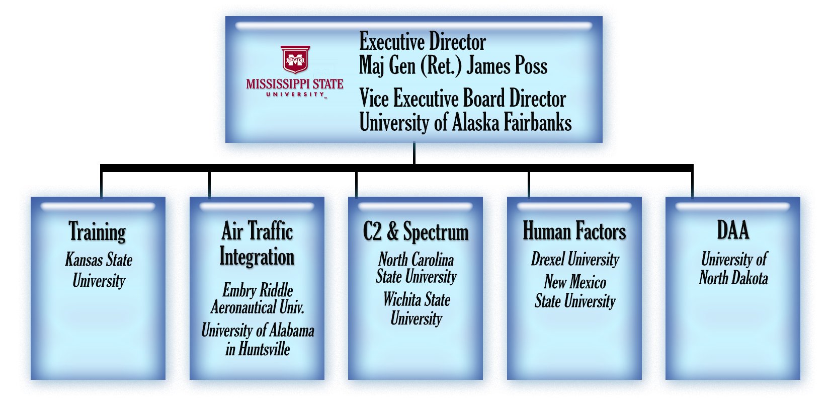
ASSURE Executive Board
Airworthiness – Wichita State
Low Altitude Safety Scenarios – Alaska

Slide 13
UAS COE Initial Technical Focus Areas
Air Traffic Control Interoperability
Airport Ground Operations
Control and Communication
Detect and Avoid (DAA)
Human Factors
Low Altitude Operations Safety
Noise Reduction
Spectrum Management
Unmanned Aircraft (UA) Crew Training and Certification, Including Pilots
Unmanned Aircraft Systems Traffic Management
UAS Wake Separation Standards for UAS Integration into the NAS

Slide 14
Planned FY15/FY16 UAS COE Research
Surveillance Criticality for Sense and Avoid (SAA)
  Evaluates the sufficiency of existing airborne surveillance equipment for manned aircraft (e.g. transponders and/or ADS-B) in providing separation and collision avoidance functions for UAS.
UAS Maintenance, Modification, Repair, Inspection, Training, and Certification Considerations
  Supports establishment of maintenance data requirements for UAS to include the collection and analysis of maintenance and repair data from multiple UAS platforms.
Small UAS Detect and Avoid Requirements Necessary for Limited Beyond Visual Line of Sight (BVLOS) Operations
  For sUAS, this supports the development of a BVLOS operational framework, the minimum performance standards for detect and avoid systems, and the proposed operating rules, limitations, and guidelines.

Slide 15
Planned FY15/FY16 UAS COE Research
UAS Ground Collision Severity Evaluation
  Examines hazard severity thresholds for UAS collisions with property and people on the ground and informs airworthiness requirements for UAS.
UAS Airborne Collision Severity Evaluation
  Examines hazard severity thresholds for UAS collisions with other aircraft in the NAS and informs airworthiness requirements for UAS.
Certification Test Case to Validate sUAS Industry Consensus Standards
  Supports the standards development organization, ASTM F38, in the development of standards for UAS airworthiness, maintenance, and flight proficiency requirements.

Slide 16
Planned FY15/FY16 UAS COE Research
UAS Human Factors Control Station Design Standards
  Supports UAS human factors research in areas of function allocation, control station requirements, pilot training/certification requirements, and visual observer requirements which will inform the development of standards.
Unmanned Aircraft Systems (UAS) Noise Certification
  Supports the collection of noise measurements of UAS using 14 CFR Part 36, Noise Standards, to begin the initial assessment of whether noise certification procedures designed for manned aircraft are appropriate for unmanned aircraft.

Slide 17
FAA/NASA partnership

Slide 18
Partnership with NASA
Memorandum of Agreement – FAA/NASA UAS Research cooperation
NASA “UAS in the NAS” Project culminates in April 2016 National UAS Flight Campaign/Demo at FAA Test Sites, UAS CAPSTONE
RTCA SC228 DAA & C2 MOPs
Relevant research in the following areas:
  DAA performance standards
  C2 performance standards
  Human Systems Integration
  Certification and Safety
  Air Transportation System Interoperability
  Integrated Test and Evaluation
Research applicability
  FAA NAS Enterprise Architecture New Entrants Roadmap
  FAA UAS research inventory for mapping all relevant research to corresponding FAA integration requirements
FAA-NASA-DoD-DHS-DoC Autonomy Research Transition Team (RTT)
  UAS Traffic Management (UTM)

Slide 19
PathFinder Program

Slide 20
UAS Pathfinder Program
Focus Area 1: UAS in Visual Line of Sight (VLOS)
  Example: Media Coverage & Aerial Imagery
  Example: Agriculture & Infrastructure Inspection
Focus Area 2: UAS Extended Visual Line of Sight (EVLOS), Rural
  Example: Package Delivery & Long range Infrastructure Inspection
Focus Area 3: UAS Beyond Visual Line of Sight (BVLOS), Rural
Extended Visual Line of Sight
(EVLOS)
sUAS rule
Beyond Visual Line of Sight
(BVLOS)
Visual Line of Sight
(VLOS)
Urban Environment
Notes:
Purpose: Work with three industry partners to establish proof of use case operations, safety assessments, risk mitigations, and operational approval for key UAS operations

Slide 21
Focus Area 1 Pathfinder Goals
Increase UAS access to the NAS beyond the small UAS rule by;
  Partner with CNN Team through the approval process
  Develop Safety Assessments for operations
  Develop Risk Mitigations
  Achieve Flight Approval
  Develop a repeatable process

Slide 22
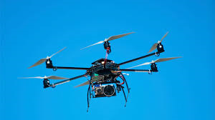
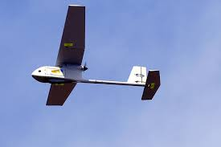
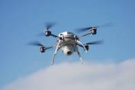




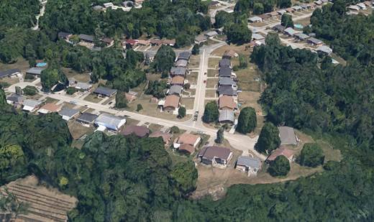

Focus Area 1 – Aerial Imagery
Small UAS, < 55 Pounds
All flights within Visual Range
Low Altitude
Urban populated areas including public gatherings
Media Coverage
Construction Imagery
Real Estate
Infrastructure Inspection
First Responders

Slide 23

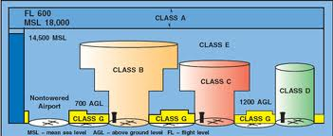
Focus Area 1 Pathfinder
Urban, Low Altitude VLOS Operations
Example Applications
Media Coverage
News Events
Natural Disasters
Public Events
Documentaries
Operational Domain: Low altitude, controlled & uncontrolled airspace
UAS Type | Small
Altitude | Low Altitude
Aircraft Endurance | Short (Minutes) - Medium (Hours)
Expected Traffic Density | Limited
Aircraft Range | Short, within Visual Line of Sight
Conditions | Day/Night, Visual Metrological Conditions (VMC)
Potential Airspace Classes | B/C/D/E/G
Operational Limits | Slow cruise speeds
Media Coverage
Use Case: Small UAS (sUAS) – Media Coverage UAS – departs from road in urban environment within Class B/C/D/E/G airspace and operates at low altitude via visual line of sight (VLOS). Multiple sUAS are allowed to operate in this area with the provision that they maintain separation from each other.

Slide 24
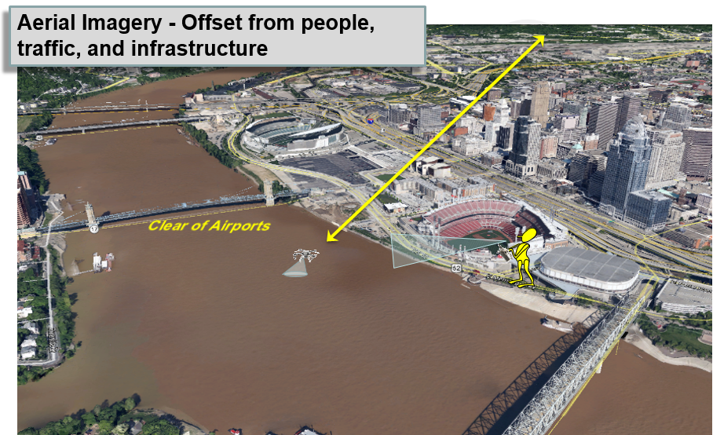
Focus Area 1 Pathfinder - Phased Approach
UAS in Visual Line of Sight (VLOS)
Populated & Public gatherings
Not Over People
Challenges to Access
Phase 2
Medium Impact to NAS
High Impact to Safety
  Class G, B, C, D & E Altitudes as assigned
  Traffic density: Medium
  ATC: Yes (B, C, D & E)
  VLOS
  Beyond Section 333 Exemption
Phase 1
Low Impact to NAS
Low Impact to Safety
  Class G, <500 ft. AGL
  Traffic Density: Extremely Low
  No ATC
  VLOS
  Section 333 Exemption
Level of Access

Slide 25


Slide 26
FY16 Research Requirements
Sense and Avoid (SAA) System Certification Obstacles:
  Determine certification criteria associated with operational and airworthiness approval that a SAA system will be required to address, and provide a means of compliance to 14 Code of Federal Regulation (CFR) Part 91 which governs General Operating and Flight Rules, and includes policies such as visual flight rules, instrumental flight rules, special flight operations, and noise limits
  Provide civil certification requirements for systems and equipment, which is designed to provide a means of compliance to 14 CFR Part 91 “see and avoid”
Detect and Avoid (DAA) Multi-Sensor Data Fusion Strategies:
  Evaluate surveillance sensor fusion function which supports autonomous detection and avoidance of both cooperative and non-cooperative aircraft
  Incorporate acceptable data fusion strategies and performance parameter sensitivities to support validation of DAA technical standards, design use, certification, and approval guidance
Collect and Analyze UAS Safety Data from the Congressionally Mandated Test Sites:
  Collect and analyze safety data reported per Certificates of Waiver (COA) requirements from flight operations conducted by each UAS Test Site
  The UAS test site research results will be utilized to support the following critical activities:
    Regulatory and standards development processes necessary for the safe, efficient, and timely integration of UAS into the National Airspace (NAS)
    Identify and address challenge areas for UAS integration as documented in the UAS Concept of Operations (ConOps) and Roadmap

Slide 27
FY16 Research Requirements, cont’d
UAS System Safety Criteria:
  Recommend safety thresholds for characteristics such as kinetic energy, structure, shape, or other safety features that can be utilized to identify threshold levels which are not hazardous to people, airborne aircraft, ground aircraft, or property when UAS collides with them
  Develop guidance on system safety characteristics into UAS existing approvals and future rulemaking for the purpose of assisting the FAA determine standardized airworthiness requirements for unmanned aircraft which are safe for operations
  Develop engine ingestion research study to assess potential damage of small UAS (sUAS) near an airport with the possibility of being ingested into an aircraft engine:
    Develop operational risk mitigation plan for engine ingestion to advance the safety of the NAS and improve current engine standards
    Address potential engine damage resulting from sUAS engine ingestion and draw upon existing research associated with bird engine ingestion
Integration of Collision Avoidance System (CAS) into Detect and Avoid (DAA) for Unmanned Aircraft Systems (UAS):
  Determine how a UAS DAA system might use CAS as part of its functionality in various classes of airspace
  Define requirements to ensure Collision Avoidance System (CAS) is compatible with existing Traffic Collision Avoidance Systems (TCAS II)
  Research results will establish criteria for Collision Avoidance System (CAS) interoperability requirements within the NAS

Slide 28
FY16 Research Requirements, cont’d
Certification Test Case to Validate UAS Industry Consensus Standards:
  Research will be conducted by taking a candidate small UAS (sUAS) to validate American Society for Testing and Materials (ASTM) F38, committee which has been tasked with developing sUAS design, certification, flight operations, and training standards
  Utilize sUAS industry consensus standards for compliance with 14 CFR 91 requirements
  Recommend revisions to ASTM F38 sUAS industry consensus standards, as required based on sUAS certification test case
UAS Maintenance, Modification, Repair, Inspection, Training, and Certification Considerations:
  Develop consensus standards, certification requirements, and proposed rulemaking efforts for maintenance, modification, repair, inspection programs, tracking systems, and associated UAS mechanic training and certification procedures
  Collect maintenance, repair, and inspection data in order to increase the capabilities of the UAS prototype tracking system allowing for the discovery of maintenance issues across multiple platforms for analyzing trends on UAS operations

