Slide 1
The Air Force Qualification Pathway and its Challenges for AM
REDAC Subcommittee on Aircraft Safety
9 September 2015
Rollie E. Dutton,
Mary E. Kinsella
AFRL/RXM
Air Force Research Laboratory
Distribution A: Cleared for Public Release Case No. 88ABW-2015-2477 19 May 2015

Slide 2
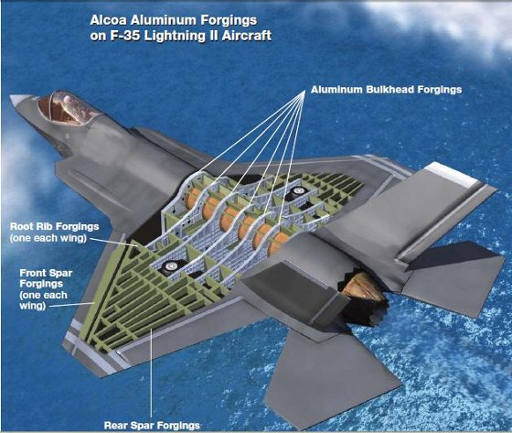
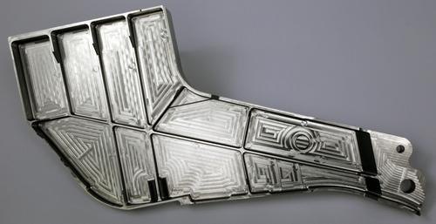
“Advanced manufacturing technologies are out-pacing structural analysis capabilities”
Structural Complexity is
Increasing
19 ft x 4 ft x 4 ft
Additive Manufacturing
Large Forgings (Unitization)
Notes:
• Advanced materials / manufacturing techniques out-pacing structural analysis capabilities
• Structural complexity increasing with unitization, AM
• Advanced capabilities currently exist and are employed on ad-hoc basis
Need development project(s) to make advanced methods more accessible for production use:
Mixed mode fracture
Improved crack shape modeling
Life prediction with FEA, BEA
Multi-site damage
Thermo-mechanical loading
Temperature dependent mechanical properties
Dale L. Ball, Ph.D.
LM Fellow
Lockheed Martin Aeronautics Company

Slide 3
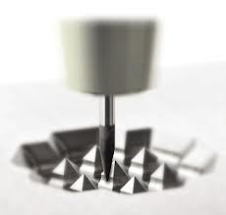
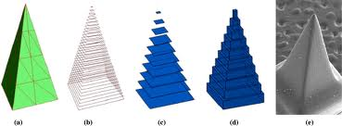
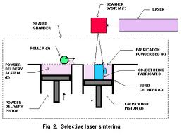
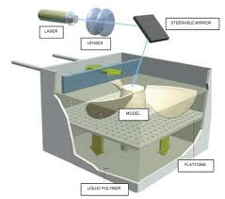
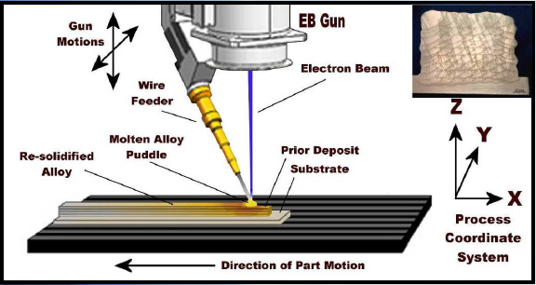
Additive Manufacturing Overview
Build a part by adding material layer by layer from a CAD file…
…vs. subtracting material from a larger form, e.g., machining.
emeraldinsight.com
ctemag.com
Encompasses many process types…
Powder Bed Fusion
Directed Energy Deposition
Material Extrusion
Vat Photopolymerization
…using various materials.
Metals
Polymers
Composites
Ceramics
Material Jetting
Binder Jetting
Sheet Lamination
Distribution A: Cleared for Public Release Case Number 88ABW-2015-2419 15 May 2015

Slide 4
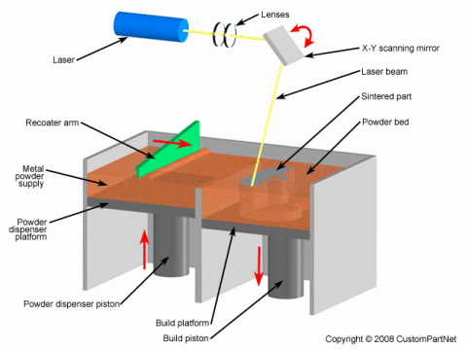
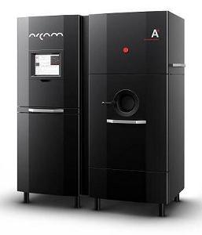
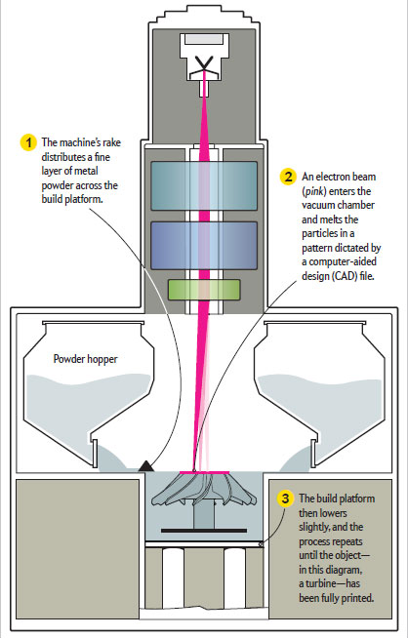
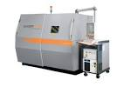
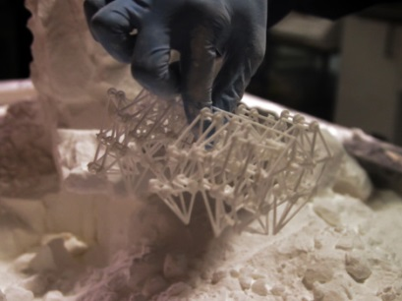
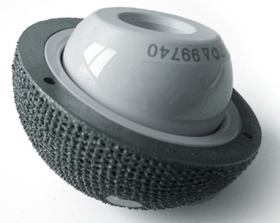
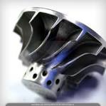
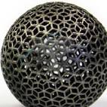
Powder Bed Fusion
Process Schematic
Equipment
Work in Process
directmetallasersintering.net
Dezeen.com
nature.com/scientificamerican/journal/
Finished Parts
An additive manufacturing process in which thermal energy selectively fuses regions of a powder bed
axisproto.com
solidconcepts.com

Slide 5
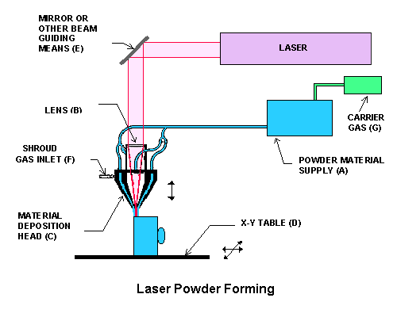
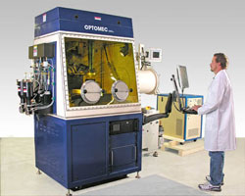
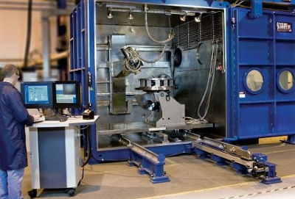
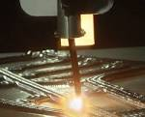
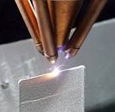
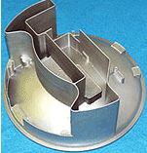
Directed Energy Deposition
Equipment
Process Schematic
An additive manufacturing process in which focused thermal energy is used to fuse materials by melting as they are being deposited
Work in Process
Finished Parts
Sciaky.com
Courtesy: Lockheed Martin
tms.org
rpmandassociates.com
Sandia.gov
Distribution A: Cleared for Public Release Case Number 88ABW-2015-2419 15 May 2015
Notes:
In these processes, deposited material comes together with an energy source, a melt-pool forms on a substrate. As the material/energy source (and/or the platform) moves, a part is deposited layer by layer. Size restrictions are not as stringent as those for powder bed processes. Thus it is a good candidate process for larger structures. Materials can be deposited on other components. Thus it is a good candidate process for repair operations.

Slide 6
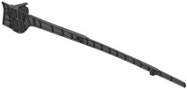
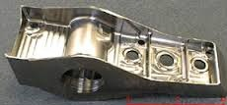
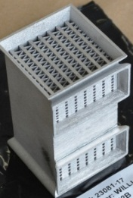
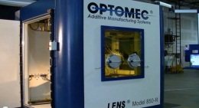
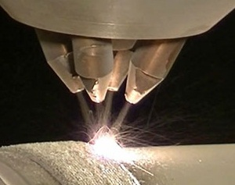
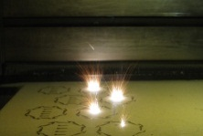
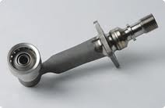
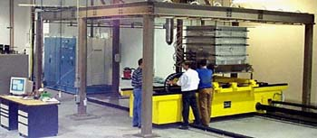
AFRL/RX
Metallic Additive Manufacturing History
Materials and Manufacturing Directorate Critical Activity
~$30M Investment
MAI – AM
Powder Bed
F35 Flaperon
Spar
F-15 Pylon Rib Substitution
OEM Teaming
to Address Gaps
7 publications:
M&P of Ti LAM
Application “Rules”
Developed
MAI Deposition
On Engine Cases
Obsolete Parts: Form/Fit Models
M&P In-house R&D
Complex HXs
1980
1985
1990
1995
2000
2005
2010
2015
Significant Additive
Aerospace Events
OPTOMEC
EOS
Gas Turbine Fuel Nozzles
AEROMET
Stereo Lithography & Selective Laser Sintering Invented
Open Manufacturing
Program
Academic Engagement
Notes:
Rollup funding

Slide 7
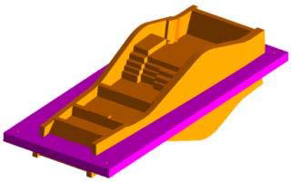
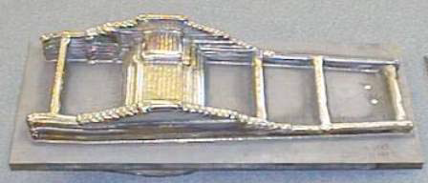
F-15 Pylon Rib Insertion Success Story
Issue: - Pylon Rib, 7075 Al Forging, Corrosion Fatigue Cracking
- Decision to move to Ti 6-4 forging
- Long lead time for Ti forging ~1 year
Solution: -Replace with Ti 6Al-4V Additive
- Quality concerns lessened due to high
margin for Ti in this application.
RX Role: -Provided Technical Leadership to Acquisition
-Executed Technology Demonstration Project
-Worked Attachment Issues (bushings, fasteners, etc...)
Results: - Additive Substitution Certified for use in Structural Application!
- Parts Manufactured and Qualified although cost 3-5X over forging cost
- Prior to Insertion on AC, Aluminum Industry Provided Forgings
- Forging cost reduced due to competition
Distribution A: Cleared for Public Release Case No. 88ABW-2015-2477 19 May 2015
Notes:
Older version of this chart has been cleared for Public Release 9 August 2012; Case Number: 88ABW-2012-4303

Slide 8
Process Qualification Requirements
Qualification of processes and certification of components used on AF systems requires that components meet or exceed the following criteria, regardless of the manufacturing process used:
Airframe or engine specifications
AF system requirements and structural integrity policies/procedures
Drawing compliance
Conformance to material specifications
Justifiable and attractive business case
All manufacturing processes (including AM) also must demonstrate:
Stability – no suitable public specs exist, very few OEM-based, mostly internal
Producibility – most AM vendors/OEMs have not demonstrated reproducibility
Characterized Mechanical and Physical Properties – limited non-proprietary data
Predictability of Performance – insufficient component-level testing
Supportability – undefined in-field inspection and/or repair processes
Challenges for qualifying AM processes and certifying AM components arise due to a lack of reproducibility and a lack of a governing process specification.
Distribution A: Cleared for Public Release Case No. 88ABW-2015-2477 19 May 2015

Slide 9
Qualification Pathway: New Materials and Processes
Process Qualification
Part Qualification
Stability
Characterization of Mechanical and Physical Properties
Performance Predictability
Strength Requirements
Material &
Process
Specs
Process Development
Process Optimization
Mat’l Sensitivity to Process Variation
Effect of Defects
Post-Processing & Residual Stress Management
Design
Allowables
Engineering
Design Analysis
Part Zoning
Proof Test Validation
Business Case
Analysis
On-Wing Inspection Validation
Repair Options/ Focused Inspection
A-Basis
99/95
B-Basis
90/95
Statistical Mech. Property Databases
S-Basis
90/50
Damage Tolerant
Validated Quality Assurance
Fail Safe
Component
Conformance/ Equivalency
Inspection
Protocols
Safe Life
Demonstrated Process Controls and Repeatability
Fatigue & Fracture
Dr. Lincoln’s Requirements
Producibility
Supportability
Distribution A: Cleared for Public Release Case No. 88ABW-2015-2477 19 May 2015

Slide 10
Why AM Implementation Is a Challenge
Structures Bulletin: Substitution with AM
NOT RECOMMENDED without significant testing and AFRL/RX support
Bulletin to be appended with position paper on critical AM considerations
Considerations for Implementation of AM
Demonstrated Process Controls
Nondestructive Evaluation & Quality Assurance
Post-Deposit Processing & Residual Stress Management
Statistically-Based Mechanical Property Database
How to statistically ensure material integrity for design with
continually-changing, local processing environment with changes in geometry and process parameters (similar to welding)
lack of constrained process controls
stochastic formation of difficult-to-inspect weld-type defects
post-deposit distortion and residual stress
undefined post-processing requirements, lack of POD for NDI
Distribution A: Cleared for Public Release Case No. 88ABW-2015-2477 19 May 2015
Notes:
This chart previously cleared for public release 88ABW-2014-4313
Considerations for Implementation of AM
Demonstrated Process Controls
continually emerging new AM technologies
equipment-proprietary process manipulation
Multiple processing approaches and parameters to achieve form and fit with different material integrity
Nondestructive Evaluation & Quality Assurance
Volumetric inspection required based on process physics
Complex geometry and common micro-cracking complicate inspectability
Macrostructure interferes with inspectability, false negatives
Post-Deposit Processing & Residual Stress Management
Range of heat treatment conditions considered ‘typical’: as-deposited, stress-relieved, hot iso-static pressing, conventional heat treatments
Significant distortion and residual stress during deposition, may impact material integrity
Statistically-Based (& Properly Developed) Mechanical Property Database
How to statistically ensure material integrity design point with
continually-changing local processing environment with changes in geometry and process parameters
lack of constrained process controls
stochastic formation of weld-type defects
post-deposit distortion and residual stress
undefined post-processing requirements

Slide 11
Additive Manufacturing: Challenges to AF Implementation
Value Proposition,
Accurate Cost Models
Fielded System Risk Mgmt
Integrated, Risk-Based
Qualification Methodology
Design
Print
Part
System
Component Design
Tool Integration, CAD Validation
& Control
Process Design, Optimization, Control & Monitoring
Component Certification
Feedstock Control & Qualified Materials Options
Quality Assurance & Post-Processing Req’mt Definition
Distribution A: Cleared for Public Release Case No. 88ABW-2015-2477 19 May 2015

Slide 12
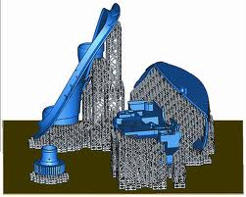
AM Challenges to AF Implementation: Design
Mechanical Design Approach
Process regularly produces what would be considered defects in conventional processes: porosity and lack of fusion
Anisotropic & variable mechanical properties
Design is not “unconstrained by manufacturing”
There are “AM design rules” that are different than conventional manufacturing design rules
Undefined AM Limitations
Min/Max Wall Thicknesses
Complexity
Wall Pitch, Radii
“Overhangs”, “Ceilings”
Support Structures
4
3
2
software.materialise.com
5
Distribution A: Cleared for Public Release Case No. 88ABW-2015-2477 19 May 2015
Notes:
Defects:
- Multiple (tens +) defects per part
- Implications to 90/95 approach to inspection (will miss some)
- Experience in casting factors and welding knockdowns
Variability:
- Increased variability compared to conventional processes
- Observed variability: tens of percent differences in strength and stiffness (conventionally very reproducible)
- Order-of-magnitude differences in fatigue tests in different orientations
- Significant fatigue knockdowns for as-built surfaces
- Powder lot-to-lot, build-to-build, machine-to-machine, vendor-to-vendor, heat-treatment batch-to-batch variability has been observed

Slide 13
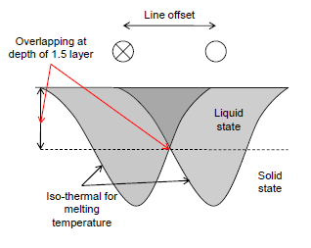
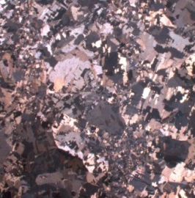
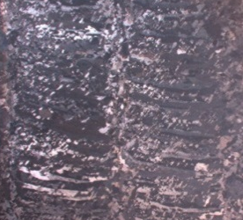
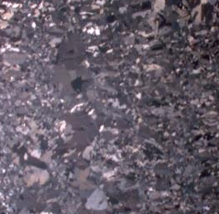
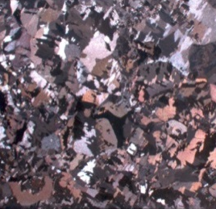
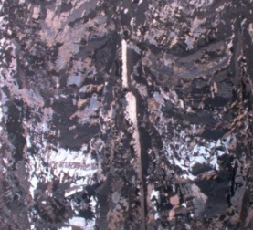
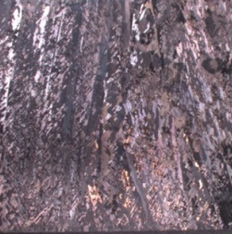
AM Challenges to AF Implementation: Print
AM Processing
Range of process parameters
Current, speed, hatch spacing
Laser/beam focus and offset
Contour, passes, turning point
Empirical corrections, scaling factors
Surface temperature, environment
Qualitative calibration procedures
recalibration frequency, inconsistent maintenance procedures
Powder recyclability procedures
Pseudo-Empirical Black Boxes to control process
Manufacturing variability is unknown & a major consideration:
two parts, same fixed process, different structure
Distribution A: Cleared for Public Release Case No. 88ABW-2015-2477 19 May 2015

Slide 14
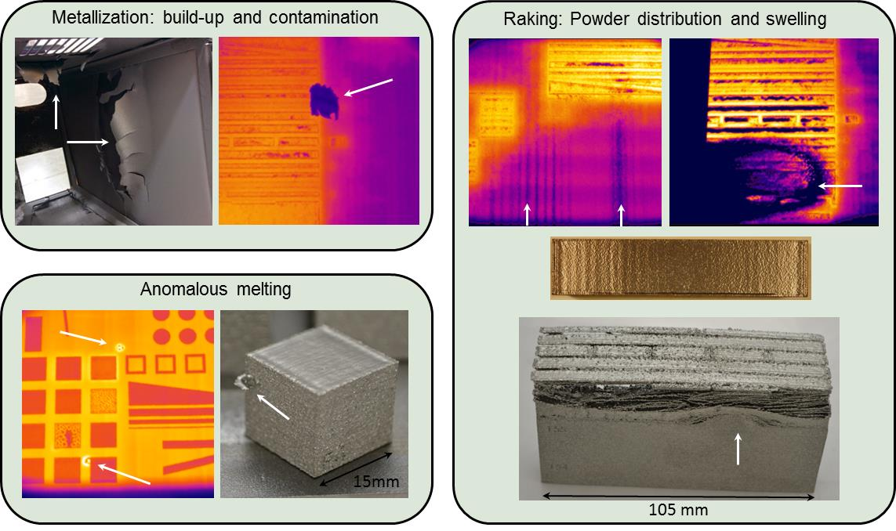
AM Challenges to AF Implementation: Print
AM Powder Bed Fusion
Examples of process-induced defects
Add some more here,
videos and images,
Descriptions of
processes
Distribution A: Cleared for Public Release Case No. 88ABW-2015-2477 19 May 2015

Slide 15
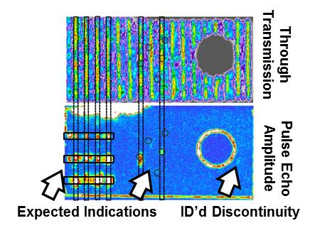
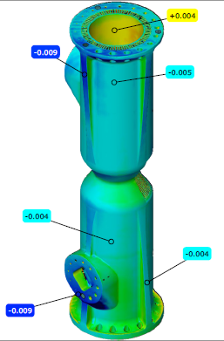
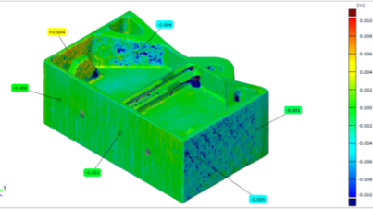
AM Challenges to AF Implementation: Part Inspection
Surface Finish
As-deposited and porous surface finish reduces inspection effectiveness
Fluorescent Penetrant: High background fluorescence and false positives
Ultrasonics: Poor coupling of sound into substrate from coarse and non-planar surfaces.
Micro/Macro Structure
EBAM Ti-6Al-4V Beta Anneal heat treat results in coarse and columnar microstructures.
Limits effective inspection depth to < 1 inch to detect 3/64” FBH
Result: process layup & post-deposit sequence re-design required
Complex Geometries
Limits inspectability of 100% part volume
Computed Tomography of Powder Bed, Ni and Ti
X-ray scattering challenges – thick vs. thin wall challenges
Need technique qualification and flaw characterization tools/algorithms
High Propensity for Flaw Generation
Distributed/linear porosity and incomplete fusion
Distribution A: Cleared for Public Release Case No. 88ABW-2015-2477 19 May 2015

Slide 16
AM Challenges to AF Implementation: System
Certification
Proof testing
Viable means to assure material quality with sufficient design analysis
Only for suitable applications/components
Component performance equivalency to material data
Generally, lack activity in this area
Very thin walls & complex geometries limit ability to excise test specimens
How to certify component
Certify by similarity? Similar to what?
Certify by analysis? With what tools?
Sub-scale testing? How to justify?
Full scale test? Expensive.
In-Field Inspections
unknown inspection tools
post-processing affects inspectability
increased inspection burden?
Distribution A: Cleared for Public Release Case No. 88ABW-2015-2477 19 May 2015

Slide 17
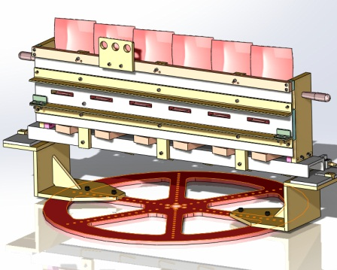
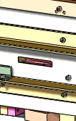
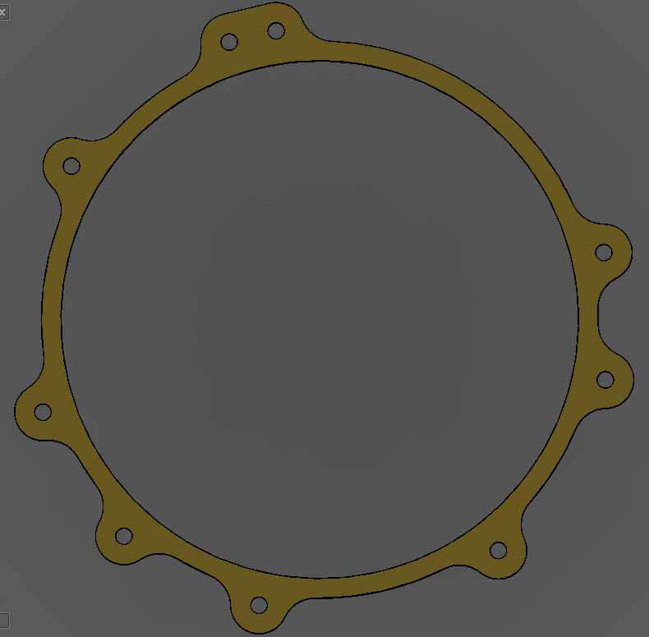
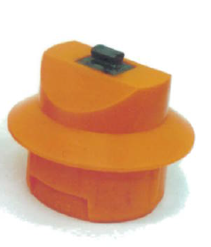
AM is a Ready-for-Use Technology for Some Applications
Coating of Blades and Engine Components
Specialized Masking
Blade tip dimensional restoration, complex repairs, hard-facing and corrosion/heat resistant coatings
Thermal spray/painting requires intricate masking techniques – mask cannot interfere with spray path
Shot peening masking is also required which permits shot to be applied at precise angles and small areas.
Complex tooling fixtures take time to manufacture
Plasma/HVOF spray fixtures often have long lead times for manufacture. Special tooling is hard to machine!
Print On-Demand Tooling will reduce production lead times
Plasma spray
Shadow mask
Gearbox painting
Mask profile
The big picture: Improve existing processes by implementing hard masking.
How do we get from drawing/concept to manufactured component in the least amount of time?
A fundamental change in how fixtures are designed and how we do repairs (repair approval) must precede this added technology!
Shot peening
Mask fixture
Distribution A: Cleared for Public Release Case No. 88ABW-2015-2477 19 May 2015
Notes:
This chart previously cleared for public release through AFLCMC/EZP (for DoD Maintenance Symposium 2014)

Slide 18
Strategic vs Tactical Planning
Factors
Time Period
Reversibility
Scope
Affected Areas
Goals
Strategic Planning
Long
Harder
Broad
Many Functional Areas
Means & Ends
Tactical Planning
Short
Easier
Narrow
Few Functional Areas
Means
“Plans are nothing; planning is everything.”
- Dwight Eisenhower

Slide 19
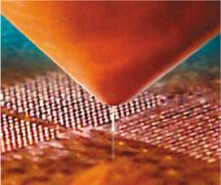
AFRL Additive Manufacturing Strategy
Develop Risk-Quantification Tool for Substitution and Implementation of AM technologies in AF Systems
Conduct Targeted Research to Inform the Qualification of Additive Materials and Processes
Process monitoring and sensing
NDE and material characterization
AM-tailored material development
Component demonstration
Advance AM Capabilities via Modeling & Simulation
Process simulation for design & control
Verification & Validation for qualification
Process-structure-property relationships
Develop digital thread for AM components
Distribution A: Cleared for Public Release Case No. 88ABW-2015-2477 19 May 2015
Notes:
This chart previously cleared for public release 88ABW-2014-4313
Current AFRL/RX Strategy:
Develop Risk-Quantification Tool for Substitution and Implementation of AM technologies in AF Systems
Conduct targeted research to inform the qualification of additive materials and processes
Process monitoring, sensing and analytics
NDE and highly-pedigreed material characterization
AM-tailored material development
Component demonstration
Advance additive manufacturing capabilities via ICME methodologies
Process simulation for process design and control
Verification & Validation for process qualification
Process-structure-property relationships
Develop digital thread for AM components
AF Benefits:
Reduced lead time and cost for small production runs
→ Aircraft Availability & Sustainment Affordability
Mass customization and geometric complexity
→ Adaptive Warfighter & Energy Efficiency
Weight reduction via part consolidation
Reduced Sustainment Burden & Increase Energy Efficiency
Technical Challenges:
Unquantified material quality with undefined inspection protocols to meet structural requirements
Highly variable material properties and lack of statistical databases for design
Lack of standardized process controls typically required for structural applications
Inadequate cost models for representation of post-processing requirements (Inspection, Machining, and Heat Treatment)
AF AM Transition Opportunities: An AFRL Perspective
AM for Structural and Functional Applications across metallic, ceramic, composite, biological and electronic applications
Near
Tooling, fixtures and non-structural polymerics
Mid
Non-critical, short-life metallic structural applications
Direct-write and flexible electronics
Far
Critical structural hardware
Fiber-reinforced composites
Multifunctionally embedded structural materials

Slide 20
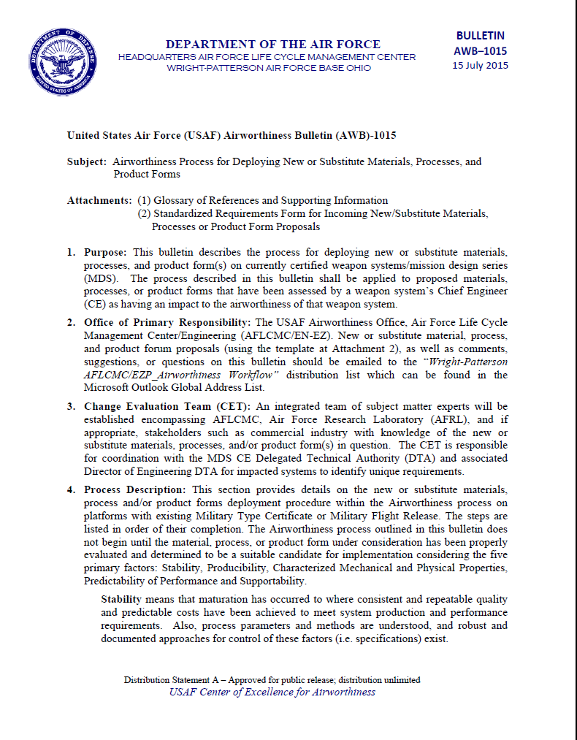
Strategy for Insertion of Advanced Manufacturing Technologies (not just AM!)
Establish Rules to Quantify Risk
Develop Decision Matrix and Guidelines
Component-Specific Attributes Propagated through Decision Tree
Systematically Identify Risk & Needs
Scientifically-Informed Engineering Judgment
Extendable Framework
Example Guideline Questions
Access to Designer’s Intent?
Static or Dynamic Loading?
Current Material & Process?
Established Processing Parameters?
Inspection Requirements?
Component Cost, Lead Time?
Establish rules and develop tools for systematic and evolutionary adoption of rapid manufacturing technologies
Notes:
The Rules/Guidelines for successful application of the technology can be perceived as a decision tree. Component-specific attributes will be queried along the decision tree. If the risk is too great based on a particular component attribute, then the deficiency for rapid-manufacturing implementation is identified. If a particular component’s attributes are such that all risks are mitigated, then rapid-manufacturing is a viable approach for the component.
The foundation for the decision tree is the scientific understanding of the processing, inspection and service environment. The guidelines, on the other hand, are cast in the context of a designer or maintainer, such as the ones listed on the right.
In the beginning (without critical research) it is anticipated that a small fraction of the parts will be rapid-manufacturing viable.

Slide 21
Closing Thoughts
This is a unique moment in time to Change the Paradigm for the qualification of new Materials & Processes
Strategic Planning is essential:
Definitions
Focus
Roles & Responsibilities
Requirements
Standards
“A Vision without a plan is a hallucination.”
- Diran Apelian

Slide 22
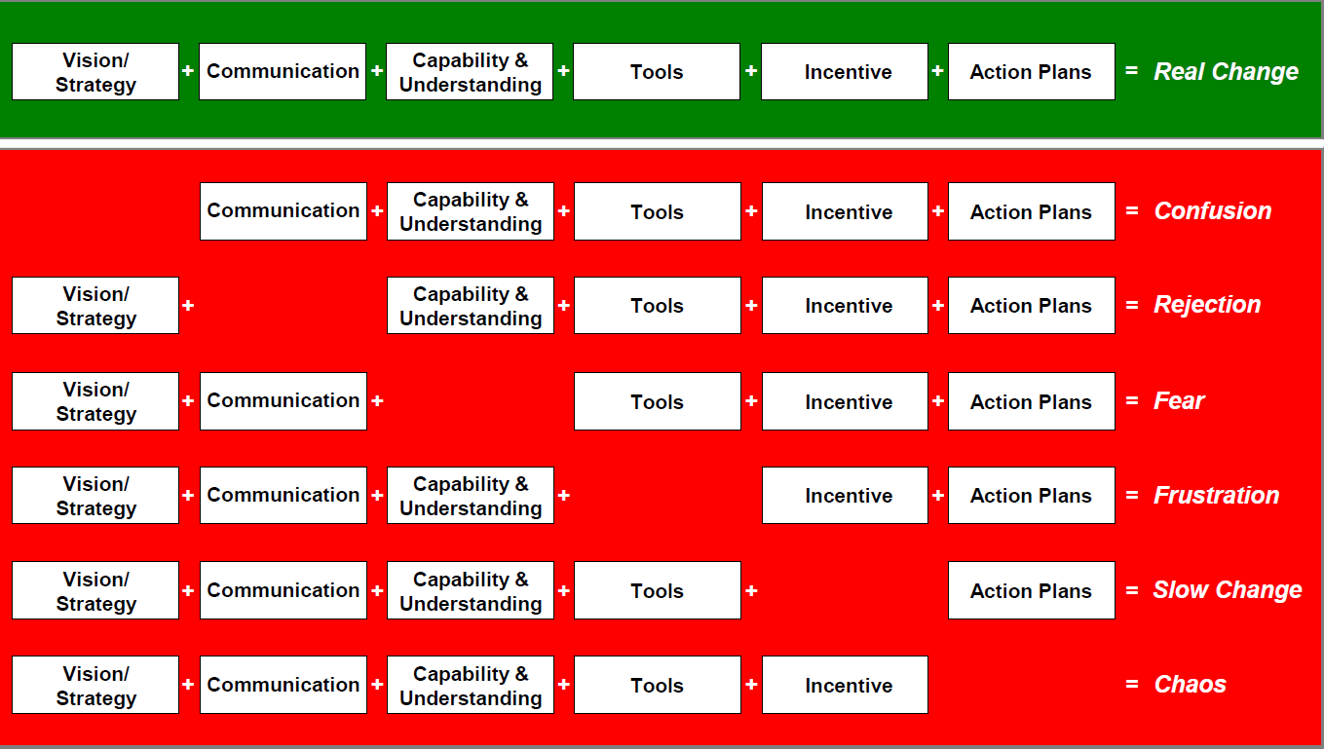
Elements Required for Real Change
Courtesy Bob Bucci
Cleared for Public Release 88ABW-2012-5158

Slide 24
Additive Manufacturing IPT Concept
Core Team
IPT Strategic Development &
Long-Term Research “seeding”
Structural AM Lead
Coordination & Collaboration Lead
Functional AM Lead
Focused Research and Transition Team
Knowledge Exchange
Focused Research and Transition Team
Structural Problem Set #1
Collaboration/ National Awareness
and Outreach Team
Functional Problem Set #1
Structural Problem Set #2
Functional Problem Set #2
Structural Problem Set #3
Functional Problem Set #3
Integrated Problem:
Multifunctionally-Embedded Structures
Distribution A: Cleared for Public Release Case Number 88ABW-2015-2419 15 May 2015
Notes:
Concept expands current IPT (yellow) to include focused research efforts and strategic technology development
Team Titles are Hypothetical to Provide Context
All: Responsible for strategic development of rapid manufacturing technologies to benefit the AF, focused leads maintain veto power for the execution authority
Focused Team Leads Responsibilities:
-Programmatic execution and authority
-Responsible for activities of team
-External communication, particularly when technical context is required
Coor. & Collab Team Lead Responsibilities:
-Information receiving and dissemination to key players inside RX (focused team leads, SMEs, etc.)
-Includes national community activities: other TDs, other agencies, Army, Navy, DARPA, AFOSR, Industry, Academia, …
-Connect RX key players to critical national-community players

Slide 25
A Defense-wide Manufacturing S&T team-led, Multi-agency collaboration between industry, government and universities
Public-private partnership
Shared facilities open to industry
Especially attractive to small businesses
Enabling technology transition and commercialization
Addressing Technology Readiness Level (TRL) / Manufacturing Readiness Level (MRL) 4-7
Bridge the gap in Manufacturing Innovation
Educational outreach and workforce development
A Model for Subsequent Manufacturing Innovation Institutes
Distribution A: Cleared for Public Release Case Number 88ABW-2015-2419 15 May 2015

