Slide 1
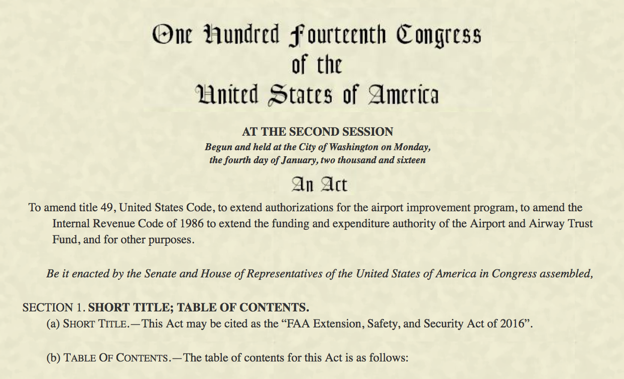
FAA Extension, Safety, and Security Act of 2016 – Public Law No: 114-190
Presented to: REDAC Subcommittee on Aircraft Safety (SAS)
Date: September 14, 2016

Slide 2
FAA Extension, Safety & Security Act of 2016
FAA Reauthorization – H.R. 636
Signed on July 15, 2016, Public Law 114-190
Extension of expiring authorities to FY2017 (September 30, 2017)
Three titles:
Title I – FAA Extensions
Title II – Aviation Safety Critical Reforms
Title III – Aviation Security (TSA)

Slide 3
Title II – Aviation Safety Critical Reforms Research & Development
Subtitle A – Safety
Sec. 2102. Cockpit automation management.
Sec. 2104. Laser pointer incidents.
Sec. 2111. Aviation cybersecurity.
Subtitle B – UAS Safety
Sec. 2208. UAS traffic management (UTM).
Sec. 2211. UAS research and development roadmap.
Sec. 2212. UAS-manned aircraft collision research.
Sec. 2213. Probabilistic metrics R&D study.
Subtitle C - Time Sensitive Aviation Reforms

Slide 4
Technical Center is uniquely positioned to support the Agency R&D mandates in the Reauthorization!

Slide 5
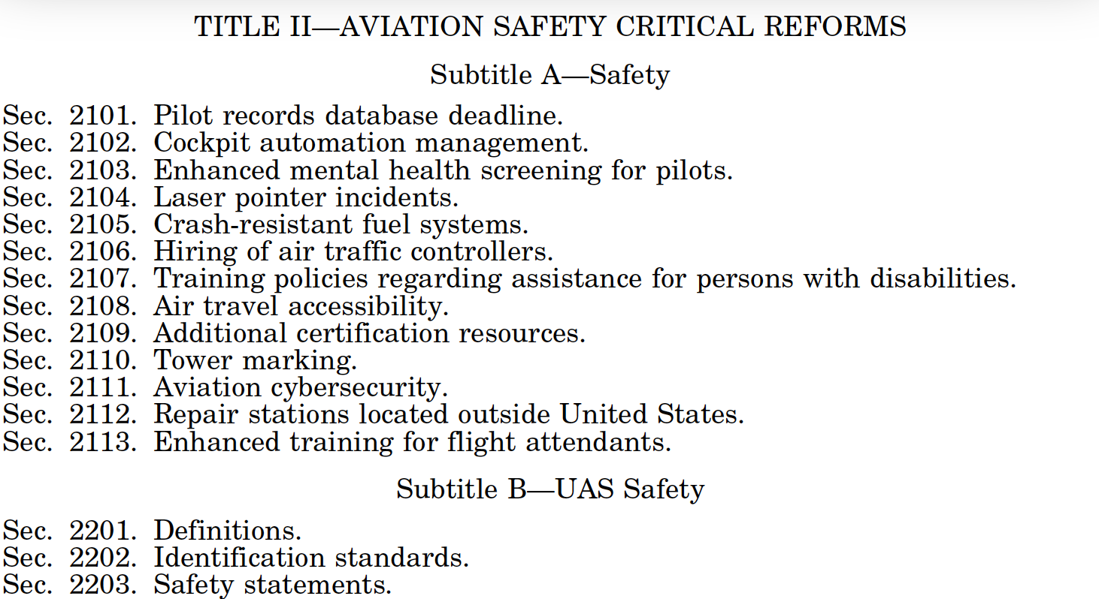

Slide 6
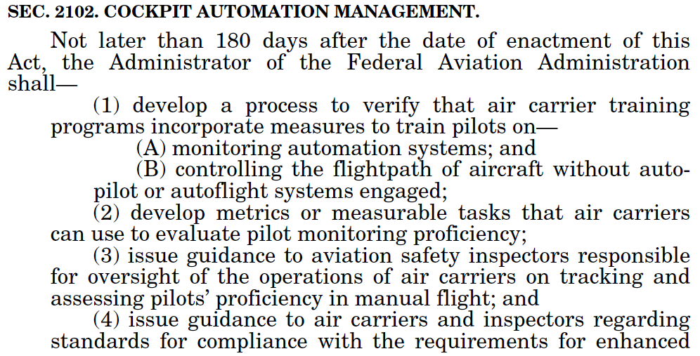

Slide 7
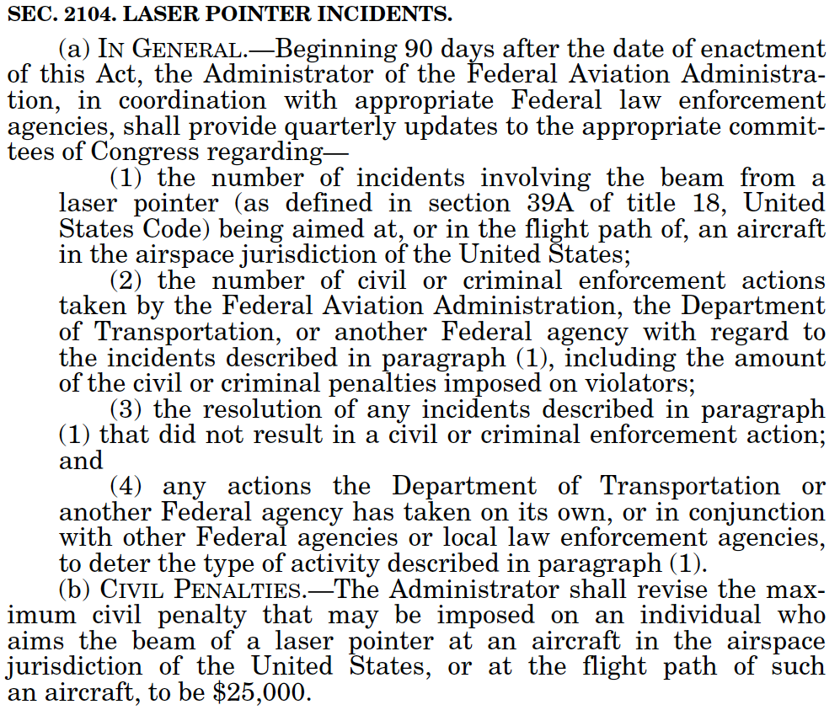

Slide 8
