Slide 1
Developing Objective Metrics for Fatigue Impairment
REDAC SAS
Hilary Uyhelji, PhD
9 March 2017

Slide 2
FAA needs improved fatigue metrics
“In accident statistics, fatigue is generally inferred from the time of day that the incident took place (midnight to 6 a.m.). Single vehicle accidents in which suicide has been ruled out are also included. Other factors that are considered include time on task (greater than 9 hours) and the work schedule of the previous seven days. You can see that this is not very exact — the contribution of fatigue to accidents is probably under-reported.”
https://www.faa.gov/about/initiatives/maintenance_hf/fatigue/faq/#q05
Notes:
Besides under-reporting, this can also falsely attribute fatigue impairment for individuals who are fatigue resistant: those whose genetic inheritance makes them less susceptible than most people to the effects of sleep loss.

Slide 3
RNA responds to stress and can be measured to identify stress presence
DNA
RNA
Protein
Notes:
Genes that are up-regulated (turned on) are expressed as RNA molecules.
Down-regulation (turning off) results in a decrease or absence of RNA molecule.
Fatigue is one aeromedical stressor of great importance, and hard to measure via other approaches

Slide 4
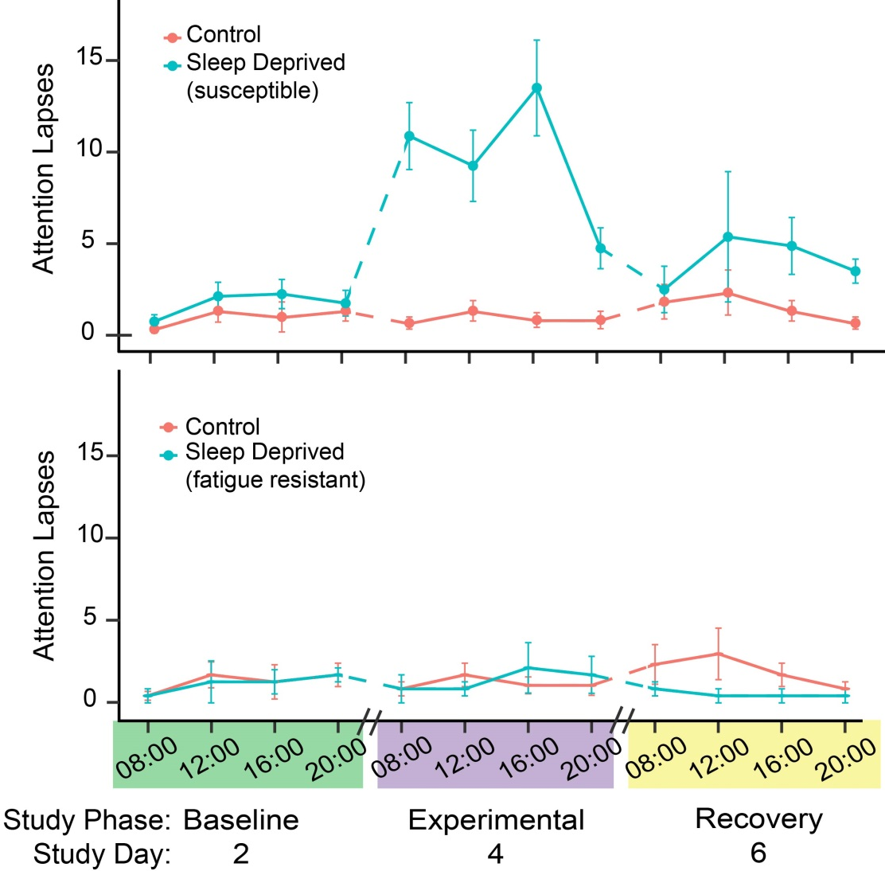
Fatigue impairs performance
Fatigue impairs attention (in most people)
RNA levels for biomarker genes are associated with fatigue impairment levels
Notes:
Measuring performance metrics directly is not a viable option for post-mortem accident investigation, and often too time-consuming for a pre-flight fitness for duty assay.

Slide 5
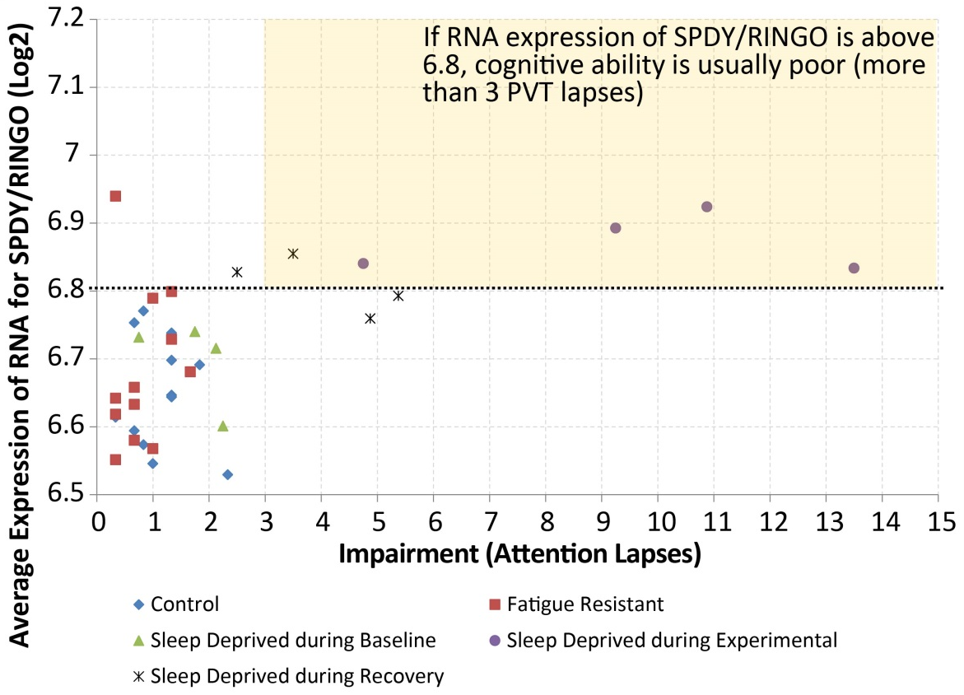
Research RNA biomarkers that can be measured as a fatigue-impairment metric

Slide 6
Comparison across multiple types of sleep deprivation
FY18 TCRG (study years 2018-2022)
4 study groups:
Well-rested control
Total sleep deprivation for 62 h
Chronic sleep deprivation – nighttime sleep of ~5 h
Chronic sleep deprivation – daytime sleep of ~5 h

Slide 7
Comparison across multiple types of sleep deprivation (cont.)
Outcome: validate RNA metrics across multiple types of sleep loss, and multiple measures of performance
Attention
Decision making
Responses to feedback

Slide 8
Gene expression patterns in response to modafinil
FY19 TCRG (study years 2017-2021)
30 people x 2 study runs
36 h total sleep deprivation
36 h total sleep deprivation + modafinil
Outcome: discover how RNA metrics are affected by presence of a fatigue drug countermeasure (modafinil)
Notes:
Modafinil: a countermeasure to sleep deprivation

Slide 9
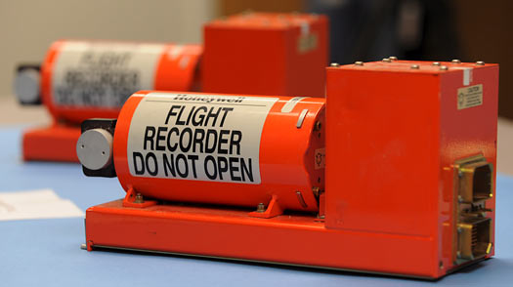
Goal: develop RNA-based fatigue-impairment metric for two applications
Molecular Flight Recorder for accident investigation
Sleep-alyzer kit to test fitness for duty for accident prevention

