Slide 1
NASA Airspace Operations and Safety Program
System-Wide Safety (SWS)

Slide 2
Scope of System-Wide Safety (SWS) Project
Safety Assurance Process
Operational V&V (run-time)
CAST SEs: flight deck techs and metrics
RSSA techs and metrics
Systems engineering V&V (design-time)
CAST SEs: training tools and metrics
Risk Identification
Compare with Target Level of Safety
Design
Mitigation
Operational
Mitigation
Observations
Assessments
Mitigation Options
THRUST 1
THRUST 5
THRUST 6
This safety assurance loop:
Cycle time = months to years
years to decades
This safety assurance loop:
Cycle time = seconds to minutes
hours to days
Notes:
Left side is prior to deployment; Right side is after deployment, but may lead to re-designs (new versions).

Slide 3
System-Wide Safety Project Summary: Technical Challenges
Strategic Thrusts
1
5
6
In-Time Terminal Area Risk Management (TA)
Progress toward real-time system-wide safety (RSSA)
In-Time Safety Nets for Emerging Operations (EO)
Progress toward real-time system-wide safety (RSSA)
Safe Avionics for Future ATM Evolution (SAAFE)
Near-term V&V support for current safety critical systems
V&V: Complex Autonomous Systems Assurance (CASA)
Long-term V&V support for complex safety critical & autonomous systems
Technologies for Airplane State Awareness (TASA)
Research to support CAST airplane state awareness safety enhancements
RSSA research (TA and EO) will help to enable Thrust 1 and 6 outcomes
Notes:
The two on V&V and the two on RSSA are somewhat symmetrical in that the 1st is more incremental, the 2nd more long-term “clean slate”.

Slide 4
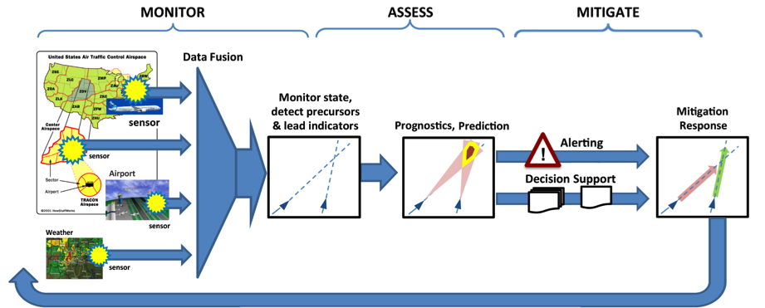
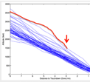
Thrust 5 – RSSA Concept and Roadmap
Feedback loop:
More selective monitoring
Improved models for assessment
Evaluation and validation of mitigation strategies
Supports existing off-line safety assurance methods
30-yr roadmap

Slide 5
Thrust 5 RSSA Roadmap (Epoch 1)
Domain Specific (Real-time) Safety
Monitoring and Alerting
Methodologies and Tools
Many domains, each may have domain-specific safety goals and associated challenges
(e.g. N+x vehicles, ATM+y ConOps, z mission types)
Architecture requirements for data capture and fusion
System-wide models and metrics to characterize safe operations
Matured analysis tools and techniques
Tools to manage assurance throughout system-wide evolution
Framework for uncertainty management
Tools for state awareness of all elements of the NAS
Initial decision support tools
Methods & tools for integ PMR plans with info uncertainty and system dynamics
Demo of local domain-wide data fusion and analysis tool predictive risk assessment capability
Demo of notification and guidance to end users for domain specific individual safety event detection and mitigation
Technology Infusion Points
Monitoring
Tools for High Integrity Data Capture and Fusion
Mitigation Selection Capability for Selected Applications
Local Real-Time Domain Monitoring and Alerting Tools
Assessment
R&D Outcome requires selection of domain(s)
TC-1 Domain: Terminal Area Operations
TC-2 Domain: Emerging Operations
Mitigation
Why these and not others?
Coverage, so that inferences can be drawn w.r.t. other domains
Impact / benefit
Demonstration
PMR – Prevention, Mitigation, and Recovery

Slide 6
RSSA Domain Space
Level of System/Human Authority & Autonomy
Real-Time Safety Assurance spans a Complex Multi-Dimensional Space
(additional dimensions not shown)
Real-time (RT) Autonomous Safety Assurance
RT Semi-Autonomous Safety Assurance
RT Automated Safety Assurance
RT Warnings for Safety Assurance
Aeronautics and Aviation
Application Domain
Vehicle
Airline-like Ops
Mixed UAS/Manned Ops
Large UAS Ops
Small UAS Ops
ODM Ops
Environment
Operational
Aviation System
Various Vehicle/Mission Combinations
Hazard Sources, Types, and Risk/Safety Impacts

Slide 7
RSSA Domain Space – TC Coverage
Level of System/Human Authority & Autonomy
RSSA TC-2
Emerging Ops
RSSA TC-1
Terminal Area Ops
Real-time (RT) Autonomous Safety Assurance
RT Semi-Autonomous Safety Assurance
RT Automated Safety Assurance
“In-Time”
Context-Specific
Risk Management
Solutions
RT Warnings for Safety Assurance
Aeronautics and Aviation
Application Domain
Vehicle
Airline-like Ops
Mixed UAS/Manned Ops
Large UAS Ops
Small UAS Ops
ODM Ops
Environment
Operational
Tightly Controlled ATM
Loosely Controlled ATM
Aviation System
Various Vehicle/Mission Combinations
Hazard Sources, Types, and Risk/Safety Impacts
These SWS/RSSA TCs Form the Basis to Eventually Span the Entire RSSA Space (Epoch 2 and 3)

Slide 8
RSSA Domain Space – State of the Art*
Level of System/Human Authority & Autonomy
RSSA TC-2
Emerging Ops
RSSA TC-1
Terminal Area Ops
Real-time (RT) Autonomous Safety Assurance
Env Li
ACAS
RT Semi-Autonomous Safety Assurance
ROP
Env Pr
GCAS
Limited health monitoring
RT Automated Safety Assurance
ABS
A/T
A/P
RT Warnings for Safety Assurance
Aeronautics and Aviation
Application Domain
CREW
ATC
STALL
FIS
PFD
EICAS
OEMs
DAA/SAA, ACAS Xu
WxR
ASIAS
UTM, Geo-fencing
Large UAS Ops
Small UAS Ops
ODM Ops
Vehicle
TAWS
NTSB
Airline-like Ops
Mixed UAS/Manned Ops
Low TRL techs (e.g. LiDAR, radar, SLAM)
TCAS
ASDE
CAST
Environment
MSAW
SWIM
AIS/MET
AIXM
PRM
FSF
UAST
Operational
NOTAMs
SMS
Not driven by a Target Level of Safety (TLS), or standards for assurance provision
Aviation System
Tightly Controlled ATM
Loosely Controlled ATM
(or uncontrolled)
Hazard Sources, Types, and Risk/Safety Impacts
*Example technologies and methods (not an exhaustive list)

Slide 9
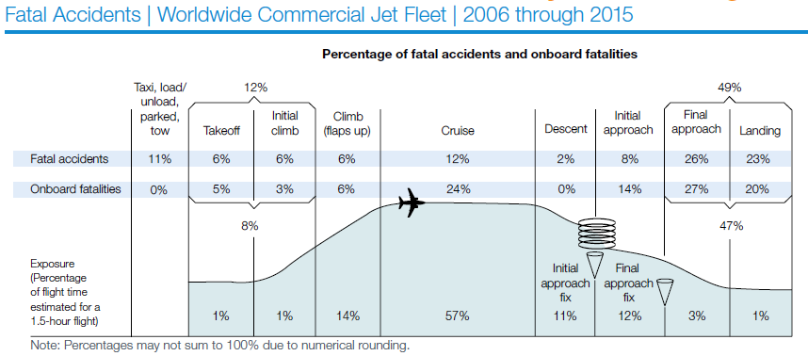
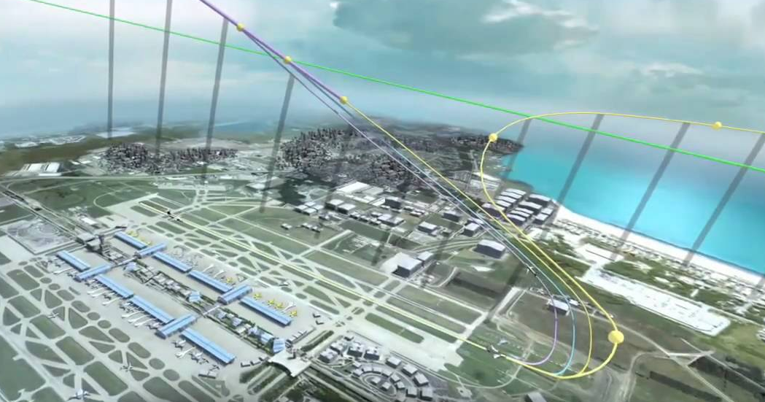
Impact/Benefit – Terminal Area Operations
Recent findings and recommendations
88% of fatal accidents in TA (2006-2015)
42 CAST Safety Enhancements def. since 2007
FAA Automation Working Group findings
AvSP Tall Poles studies (2010, 2013) [rev. (2016)]
Opportunity to demonstrate near-term benefit
Many terminal area safety decisions have longer time horizons - requirement for information is often an hour or more ahead rather than minutes or seconds
Proactive mitigation of future TA risks
Domain of most-likely unknown unknowns regarding transformation to ARMD/AOSP vision (ATM+1,2,3) (e.g. FIM, TBO, EVO, UAS in the NAS)
Potential non-safety benefits
Quick-turn operational efficiencies enabled with justifiable (data-driven) confidence
Safety technologies more likely to be implemented when they also demonstrate positive ROI

Slide 10
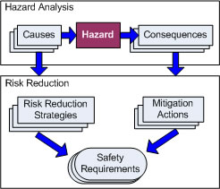
Impact/Benefit – Emerging Operations
High demand for enabling beyond visual line of sight (BVLOS) unmanned operations
Many, many applications under development
FAR Part 107 ops becoming commonplace
Many waivers being granted
More data needed to decide how/what to regulate
Early data is a warning sign (>2000 reports in 2016)
Opportunity for infusion of RSSA early in development of operations
Requirements for safety monitoring can be “built in”
Opportunity to provide near-term benefit
Many small UAV operators are new to aviation and could benefit from safety support
Early data suggests significant unknown hazards (>2000 reports in 2016)
Early technologies supporting mitigation strategies, not yet mature enough for use in complex commercial aviation environments, may be ripe for use in small UAV operations
Constraints
Enablers
(RSSA
technologies)
11/19/2014 13:57 New York New York PRELIM INFO FROM FAA OPS…ON 2 MILE FINAL FOR RUNWAY 31R OBSERVED A UAS OPERATING AT 300-400 FEET. NASSAU COUNTY PD AND NYPD AVIATION UNIT NOTIFIED.
BVLOS – Beyond Visual Line of Sight

Slide 11
System-Wide Safety Assurance (SWSA) RTT Status
Data Tools and Prognostics
NASA’s anomaly detection tool for use in the ASIAS architecture (AVS/MITRE)
Safety relevant anomalies detected
Tool transferred to MITRE in January along with new feature that automatically groups anomalies
NASA to visit MITRE in spring to train analysts
Working to set up access to North Texas Facility for threaded track data to support use of NASA anomaly detection and precursor identification tools
NASA and FAA teams discussing integrating NASA safety modeling tools with the FAA’s Integrated Safety Assessment Model - ISAM (AVS)
NASPAS access to validate NASA SBIR partner tool to identify and model increased risks associated with infrastructure outages
Next workshop scheduled for April 25, 2017
Human Performance
Workshop at held at NASA Ames, October 12 – 13, 2016
NASA ARC and LaRC, FAA (Kathy Abbott, lead) AVS & ANG, UAAARL
Topics included fatigue management, operator monitoring, flight path management, spatial disorientation, simulator capabilities, human-autonomy teaming, UTM
Follow-up planned as tag-on to HF REDAC at NASA Ames, March 30
Verification and Validation
Workshop in planning for Spring

Slide 12
Backup

Slide 13
UAS Operational Environments*
60K’ AGL
I. “Manned like” IFR
UAS will be expected to meet certification standards and operate safely with traditional air traffic and ATM services. (Example Use Case: Communication Relay /Cargo Transport)
Cooperative Traffic
18K’ AGL
10K’ AGL
MINIMUM ENROUTE ALTITUDE
II. Tweeners
These UAS will operate at altitudes below critical NAS infrastructure and will need to routinely integrate with both cooperative and non-cooperative aircraft. (Example Use Case: Infrastructure Surveillance)
Non-cooperative Traffic
Non-cooperative Traffic
IV. Low Altitude Unpopulated
Low risk BVLOS rural operations without aviation services. (Example Use Case: Agriculture)
III. Low Altitude Populated
Must interface with dense controlled air traffic environments as well as operate safely amongst the traffic in uncontrolled airspace. (Example Use Case: Traffic Monitoring /Package Delivery)
Terminal Airspace
500’ AGL
Airport
*Chart source: UAS in the NAS project

Slide 14
Potential Out-year RSSA TCs (draft)
2017 2025
Domain Specific (Real-time) Safety Monitoring and Alerting Methodologies and Tools | Integrated Predictive Technologies with Domain Level Application
TECHNOLOGY INFUSION POINTS
1
2
3
4
Tools for High Integrity Data Capture and Fusion
Mitigation Selection Capability for Selected Applications
Local Real-Time Domain Monitoring & Alerting Tools
Continuous NAS-Wide Monitoring
In-Time Terminal Area Risk Management (TA)
Initial decision support tools
System-wide models and metrics to characterize safe operations
Safe and Effective Teaming for Prevention, Mitigation and Recovery
Matured analysis tools and techniques
Uncertainty Management
In-Time Safety Nets for Emerging Operations (EO)
Requirements for data transfer and fusion
Tools for state awareness of all elements of the NAS
Architecture for Secure NAS-wide Data collection and Sharing
Matured analysis tools and techniques
Assurance of Predictive Automated Mitigations
Tools to manage assurance throughout system-wide evolution
Complex Autonomous Systems Assurance (CASA)

Slide 15
5 – Real-time System-wide Safety Assurance
2015 2025 2035
Domain Specific (Real-time) Safety Monitoring and Alerting Methodologies and Tools | Integrated Predictive Technologies with Domain Level Application | Adaptive Real-time Safety Threat Management
TECHNOLOGY INFUSION POINTS
1
2
3
4
5
6
7
8
9
Tools for High Integrity Data Capture and Fusion
Mitigation Selection Capability for Selected Applications
Local Real-Time Domain Monitoring & Alerting Tools
Continuous NAS-Wide Monitoring
Trustworthy Tactical and Strategic Decision Support Tools
Adaptive Human-Automation Teaming
Assurance Tools for Safety Preservation Systems
Real-time intelligent safety monitoring
Automated Tools for Intelligent Threat Management
Architecture requirements for data capture and fusion
Architecture for data transfer and fusion
Integrated Framework for interoperability with SMART-NAS
Accommodation of dynamically evolving requirements, datasets, scenarios, and models
Monitoring
System-wide models and metrics to characterize safe operations
Operational integrity assurance on inputs to critical decision-making functions
RSSA communication application
Automated intelligent safety monitors for real-time system-wide aviation data collection approaches
Matured analysis tools and techniques
Assurance tools for complex airspace / aviation system-of-systems.
Tools to manage assurance throughout system-wide evolution
Assurance tools for predictive system components
Automated safety assurance for aviation state assessment systems
Assessment
Framework for Uncertainty Representation
Tools for uncertainty propagation
Tools for Uncertainty Management
Tools for state awareness of all elements of the NAS
Design that enables full state awareness
Monitoring frameworks for known risks
Initial decision support tools
Methods for automated tactical and strategic decision making
Multi-objective safety decision making
Mitigation
Methodologies and tools for integrated PMR plans with information uncertainty and system dynamics
Adaptive human-automation teaming for optimum threat management
Automated execution agents for safety threat management
Integ. Modeling, Sim. & Testing
Safe and effective human/machine teaming in PMR executions
Assurance tools for safety preservation systems
Interface for automated mitigation
Demonstration of local domain-wide data fusion & analysis tool predictive risk assessment capability
Demonstration of integrated predictive capability effectiveness for safety relevant anomaly detection and mitigation across the entire NAS
Demonstration of automated RSSA System in real world operations and hardware systems
Demonstration
Demonstration of notification and guidance to end users for domain specific individual safety event detection and mitigation
Demonstration of effective alert notification and guidance to end users for NAS-wide/system-wide safety event mitigation
Demonstration of feasibility and effectiveness of autonomous/automated event mitigation based on RSSA detection and guidance

