Slide 1
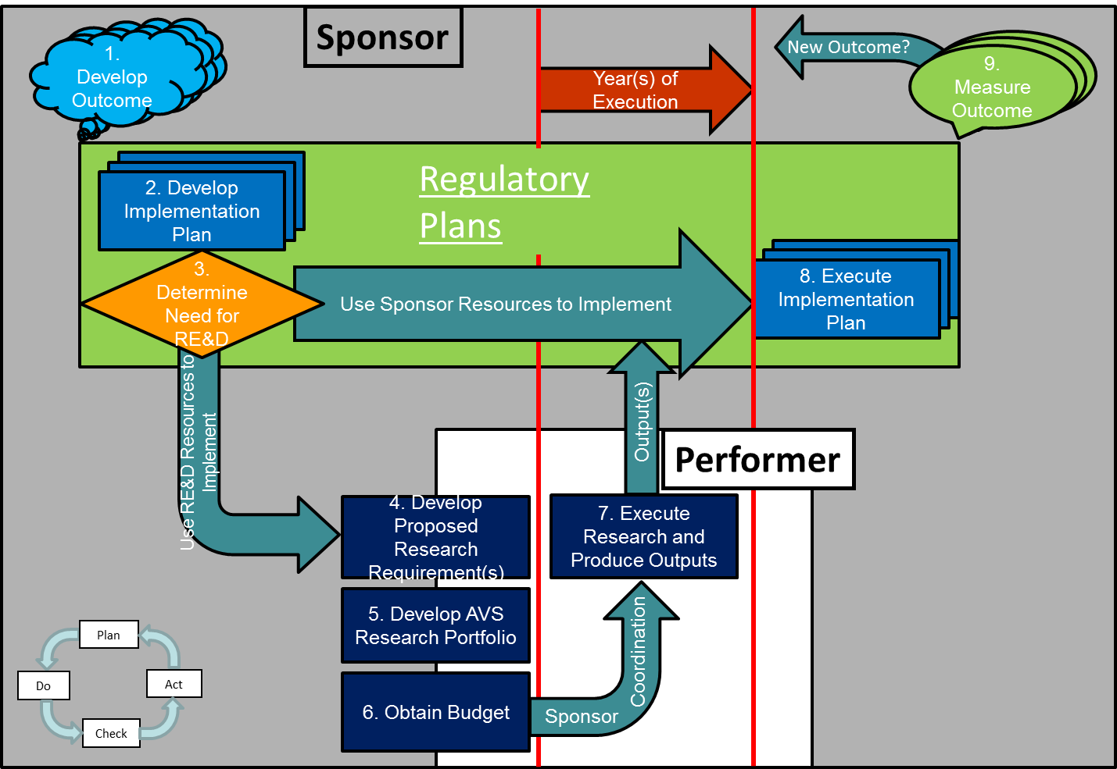
AVS R&D Life-cycle Model
Notes:
Main Point: The generic AVS R&D Life Cycle Model consists of nine basic steps with the primary purpose to support the AVS organization in the development of regulations, standards, and guidance materials needed to meet the FAA safety goals and objectives.
In the AVS R&D Program, there are two basic roles; sponsor and performer, defined as follows:
Sponsor – The AVS organizations/individuals responsible for the regulations and policy that affect the safety in the NAS.
Performer – The FAA research organizations/individuals (i.e. CAMI & ANG) that provide the program management and research execution to produce the research outputs needed by the sponsors to execute their implementation plans and achieve the desired outcomes.
This is reflective as the Sponsor activities/roles touch the grey background and the Performer/provider’s are White
1. Develop Outcome
The outcome is the future state desired by the sponsoring organization in a given area under that organization’s responsibility. For organizations in AVS, these are predominantly in terms of safety in the NAS. In the context of the Prioritization Process, this future state is on the order of five to ten years from the initiation of any research requirements. These outcomes should be reflected in the regulatory plans of the organization and provide the basis for developing implementation plans and research requirements.
2. Develop Implementation Plan
The implementation plan details what the sponsoring organization is going to do with the research outputs (reports, databases, expertise, etc.). These plans could include rulemaking, publishing policy and guidance, deploying training, publishing industry standards, etc.
3. Determine the Need for Research
The need for research flows from the sponsoring organization’s regulatory plans and the implementation plan. The sponsoring organization determines what resources (data, personnel, expertise, budget, time, etc.) are needed to execute the implementation plan. The management of the organization must make the deliberate decision to propose research requirements and to actively engage in the research process along with the performers to ensure the outputs meet their needs.
4. Develop Proposed Research Requirements
Research proposals are developed in groups of FAA-only Subject Matter Experts (SMEs) called Technical Community Representative Groups (TCRG). These groups are populated with representatives from across the sponsor and performer organizations that work together from the project inception through the end of the research as projects are prioritized and funded. Currently, there are 16 different TCRGs covering technical areas from Aeromedical to UAS.
5. Develop AVS R&D Portfolio
The AVS portfolio and associated budget proposal for each year follows the same basic steps starting up to 29 months before the year of execution for the research in support of the OST/OMB/Congressional budget cycle.
Release Strategic Guidance (high level, updated annually, May FY-3)
Collect proposals (Sept FY-3)
Determine technical rank order (Oct FY-2)
Program to projected funding target from ABP-330 per rank order list (set the Mendoza Line, Jan FY-2)
Management reviews, changes & approvals (Apr FY-2)
6. Obtain Budget
Once the proposed AVS portfolio is approved by AVS-1, the sponsors and performers collaborate to write the budget narratives (white sheets) that are submitted to OST at the beginning of June FY-2.
7. Execute Research and Produce Research Outputs
In the year the budget is released for the research (the year of execution, FY-0), the performers and the sponsors coordinate to execute planned research and monitor the progress.
The process has provisions for introducing previously unbudgeted research (i.e. pop-up) in the year-of-execution that follows the same technical ranking, budgeting, and management approval steps as in step 5 above, with a much shorter turn-around. One difference at this point is that the budget is already set making this a zero-sum event where in order to fund something new at this point requires something else in the portfolio to not be funded.
8. Execute Implementation Plan Using Research Outputs
Once the research outputs are available, the sponsoring organization can execute the implementation plans.
9. Determine If Outcome Was Achieved
The life cycle is completed when the sponsoring organization measures the outcome resulting from executing the implementation plan and determines if the desired outcome was achieved as defined in step 1 of the life cycle.

