Slide 1
Project 25: General Aviation 2030 Exploratory Analysis
Presented by Dr. William Crossley
Professor, School of Aeronautics and Astronautics, Purdue University
PEGASAS team: Dr. Simon Briceno, Zhenyu Gao, Thomas Po-Nien Lin (Georgia Tech)
Arpan Chakraborty (Purdue)

Slide 2
Project 25 Executive Summary
Workshop 0: Academia Centric at Georgia Tech
PEGASAS team will generate a report to document strategic general aviation research topics that can help the FAA and other GA stakeholders better prepare for general aviation issues in 2030
Perform benchmarking/review of GA topics (technologies, methods, etc.) of current and future concepts and operations
Conduct industry/government workshops to collect input from experts and stakeholders
Develop a report that documents research and workshop output and lists important, strategic topics in need of further research
GA 2030 Exploratory Analysis
Benchmarking:
Literature Review
Articles, Blogs and Online Forums
Workshop 1:
Industry Centric
at Georgia Tech
Workshop 2:
Government Centric
at Purdue (in planning)
Products:
An interim report on August 31, 2017
A final technical report on November 30, 2017

Slide 3
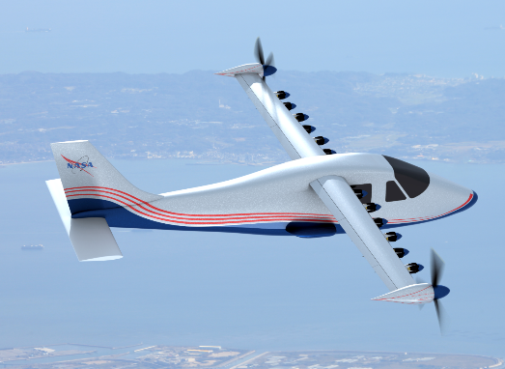
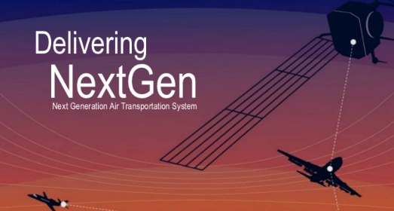
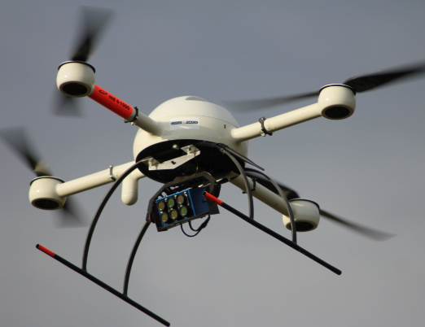
Future Trends for General Aviation
Key transformational changes - will impact airspace, airports and aircraft
Urban Mobility may emerge as a major transformational concept. Urban air taxi service is most likely to happen first in the Dallas-Ft. Worth area
Transformational propulsion architectures will be powered by new energy, such as electric, hybrid-electric and fuel cell
Enabling technologies will be used to enhance GA safety, including Ballistic Recovery Systems, NextGen, pilot aids, runway incursion prevention system, and real time weather
Automation level will be raised – increased autonomous operations – trajectory automation/planning – information sharing, leverage big data
UAS activity will increase substantially and will impact the shared airspace
Trends for all GA stakeholders; not just FAA

Slide 4
Key Challenges Identified
Top 4 Challenges in Future GA
New Technology Investigation
Certification
How to make the certification process more efficient for new types of aircraft and technologies
Airspace Management
How to plan the airspace in urban and suburban areas in order to accommodate more urban VTOL concepts and UAS
Infrastructure
How to accommodate alternative GA energy beyond 100LL - electric, MoGas, and other future sources; Maintenance stations and Vertiports for urban VTOL
Cost
Initialization of new technologies may be expensive for GA operators, owners, users and GA supporting airports
New Technology analysis under the following considerations:
New technology that can influence GA
Current technology that has not been adopted by GA
A combination of two metrics was used to evaluate a given technology:
Technology Readiness Level (TRL)
Estimated Technology Adoption (ETA)
Over 30 new technologies had been investigated using the two metrics above

Slide 5
Workshop Objectives/Expected Outcomes
Develop and prioritize themes and scenarios to stimulate participant thinking about what GA might look like in the 2030 timeframe. These can focus on GA vehicle concepts, operations, regulations, etc.
Some of the driving questions may include:
Where will GA be in 2030?
What dimensions of GA (cultural changes, regulation, guidance, certification cost and basis, training, safety) will be impacted?
What might be the potential benefits of GA 2030?
What will be the future of urban mobility?
What role will rotorcraft, V(S)TOL play?
What does the FAA need to “learn” about these “things” to be prepared in 2030?
Establish the template that the participants will use to talk about these top X items.
What are key considerations and issues?
What dimensions of GA does it affect?
Use safety, accessibility, sustainability to “seed” this aspect of the discussion
What are the potential consequences if the FAA is well prepared / NOT well prepared?
What are the FAA’s research needs?
How could the work to satisfy these needs be conducted?

Slide 6
Workshop 0: Academia Centric
Georgia Tech in Atlanta
June 2016
Academia-centric
Duration: 1.5 days
20 participants
Experts from the PEGASAS core universities, invited consultants and government participants
Consultant
Government
Florida Tech
Iowa State
Ohio State
Georgia Tech
Texas A&M
Purdue

Slide 7
Workshop 1: Industry Centric
Georgia Tech in Atlanta
June 2017
Industry-centric
Duration: 1.5 days
15 participants
Experts in the GA community from industry, PEGASAS Advisory Board, and directors and executives of several companies
Airframe
Academia
Airport
Operator
Engine
Government
Simulation
Consultant

Slide 8
Workshop 2: Government Centric
Purdue University in West Lafayette
November 2017
Government-centric
Duration: 1.5 days
15-20 participants
Experts in the government agencies, including experts from FAA, NASA, AFRL and some experts from industry and academia
Anticipated Invitees
Academia
FAA
Industry
AFRL
NASA

Slide 9
Project Progress
Tasks Completed:
Workshop 0 and Workshop 1
Benchmarking based on Workshop 0 results
On-going Tasks
Analysis of Workshop 1 results and comparison with Workshop 0.
Interim Report creation.
Future Tasks:
Benchmarking based on Workshop 1 results.
Preparation for Workshop 2
Analysis of Workshop 2 results and comparison.
Final report with recommendations.
Workshop 0: Academia Centric at Georgia Tech
GA 2030 Exploratory Analysis
Benchmarking:
Literature Review
Articles, Blogs and Online Forums
Workshop 1:
Industry Centric
at Georgia Tech
Workshop 2:
Government Centric
at Purdue (in planning)
Products:
An interim report on August 31, 2017
A final technical report on November 30, 2017

Slide 10
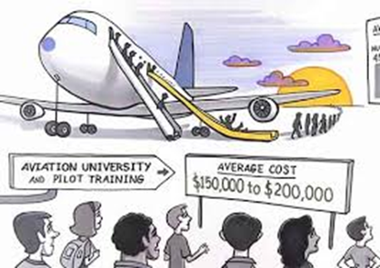
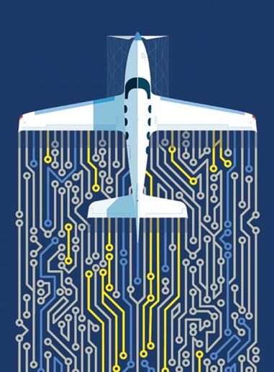
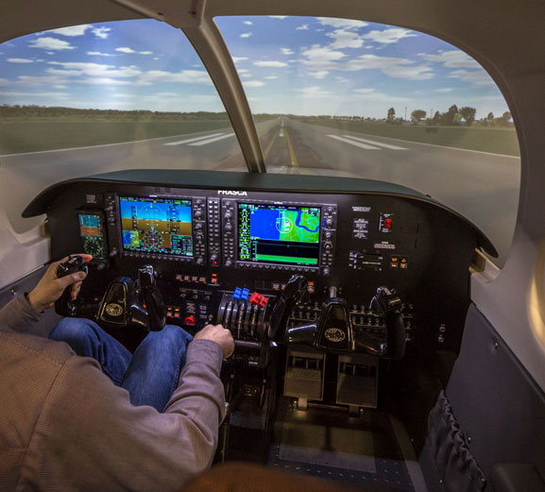
Theme 1: Pilot Training and Proficiency
Pilot shortage in several areas of aviation to 2030
GA as entry path for new pilots
Current training is higher cost / longer time than desired
Automation / autonomy to reduce pilot workload
Utilize improved simulator technology

Slide 11
Theme 1: Pilot Training and Proficiency
Facts / Observations:
Pilot shortage: It is difficult to attract new pilots to fly GA
GA viewed as entry point for many pilots for commercial aviation
GA aircraft still require pilots unless full automation is available
Pilot Training currently requires too much time and money commitments
Current pilot training standards have not kept up with simulator technology
Pilot’s trust in autonomy still need to grow
Potential Research Needs:
Need to make learning how to fly easier, cheaper and more streamlined. Can introduce more high-fidelity flight simulators training in the future, but retain basic flying skills. Need to investigate redundancies in existing private pilot training requirements. The target should be $1,500 and within 20 hours for instrument rated PPL.
Need research on the current state of simulator technology and what is its roadmap in 20 years
Need market analysis of the new age pilots and their motivations, to tweak the curriculum to better suit them
Need to encourage the use of technologies to reduce pilot’s workload. Think of what can be added to the aircraft and brought on board (e.g., a tablet or smartphone).
Need roadmap from simplified operations for current pilot to no pilot (fully autonomous) is to be identified
Need substantially streamlined and simplified VFR and IFR training curriculum
Need to raise the accessibility to quality GA training (geographically)
Need more cockpit/interface designs to prevent information overload

Slide 12
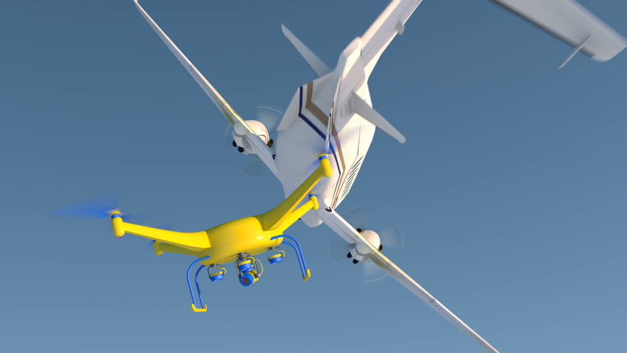
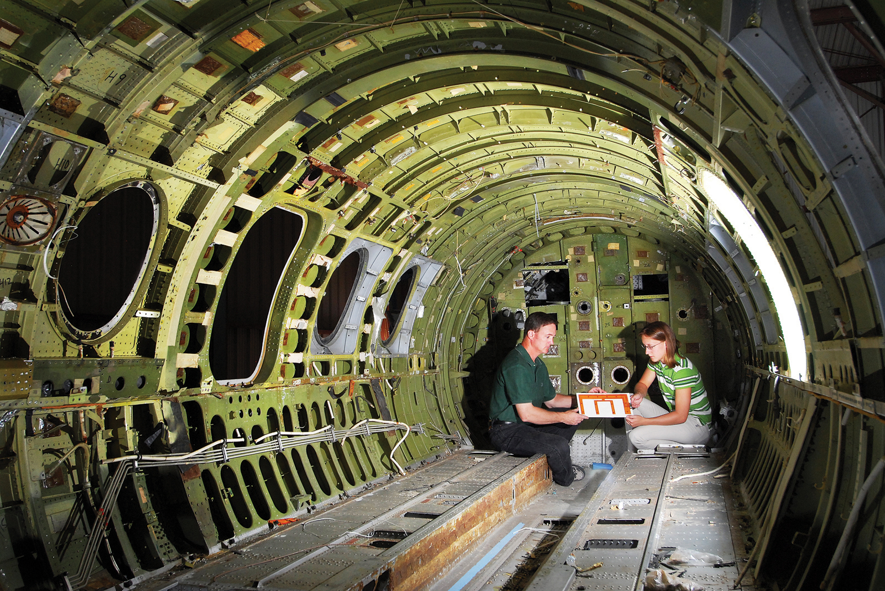
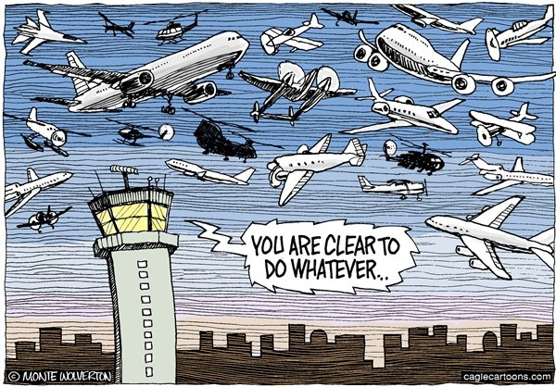
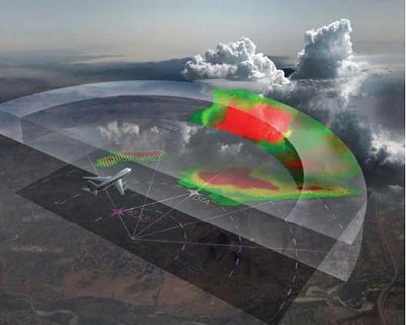
Theme 2: Autonomy and Automation
Automated technologies from commercial and UAS can help bring down the cost of GA
Need to make people trust automation
New certification for autonomous operations and autonomous systems
Tasks that can be automated
Avoidance
ATC Communication
Weather
Decision making
Structural diagnostic

Slide 13
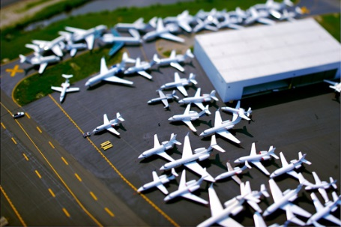
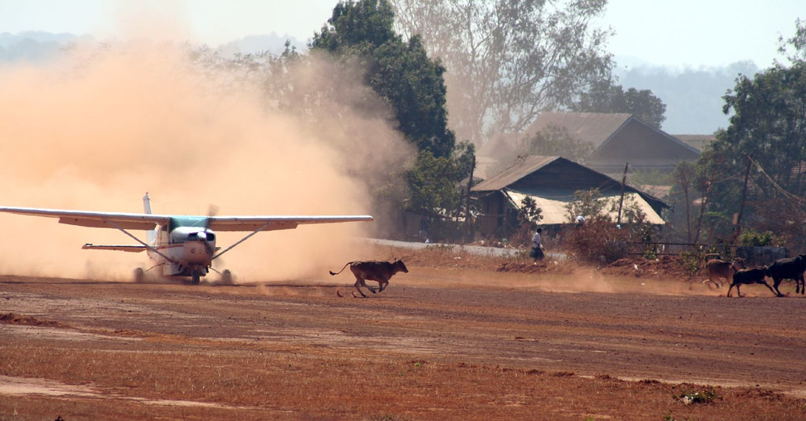
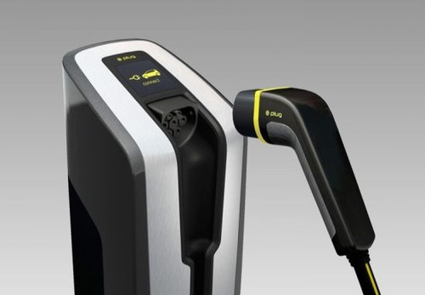
Theme 3: Airport and Infrastructure
Runway incursion issues (towered and non-towered airports)
Infrastructure issues:
Pavement quality and maintenance
Terminal capacity
Infrastructure to provide new energy sources (charging stations, etc.)
Find suitable landing sites/emergency sites for intra-urban air taxi
Impacts for new energy aircraft on infrastructure
Future high density airspace’s impact on airport infrastructures

Slide 14
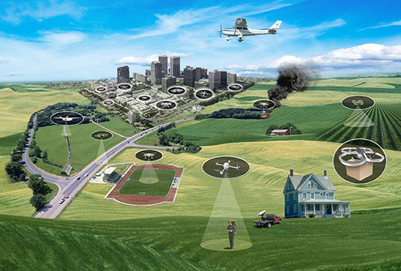
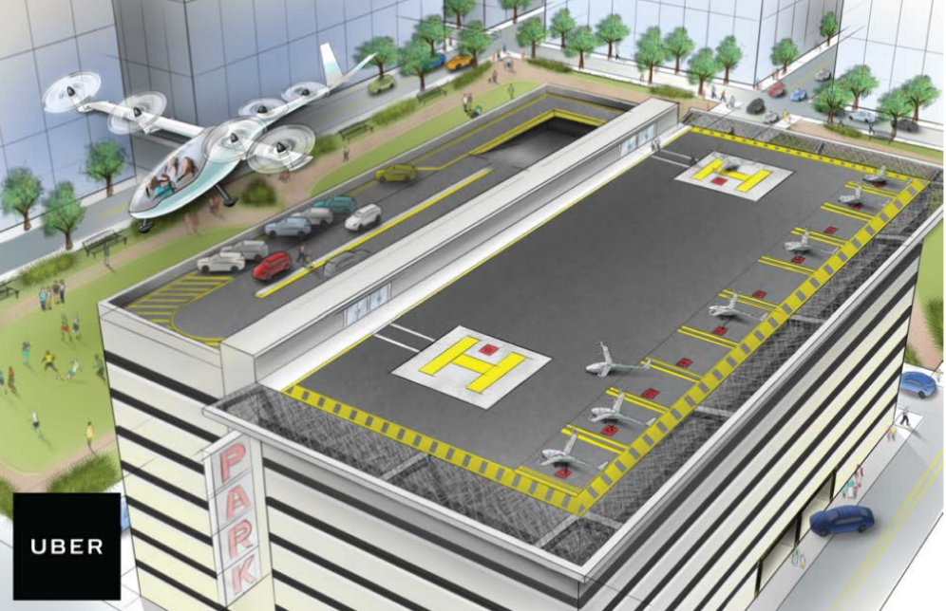
Theme 4: GA in the Future Airspace
Automation in airspace management Dedicated airways for UAVs or (fully) autonomous aircraft
How airspace can be shared between commercial, GA, and UAS in high density airspace
Cyber security for autonomously controlled vehicle and airspace
Artificial intelligence on airspace management

Slide 15
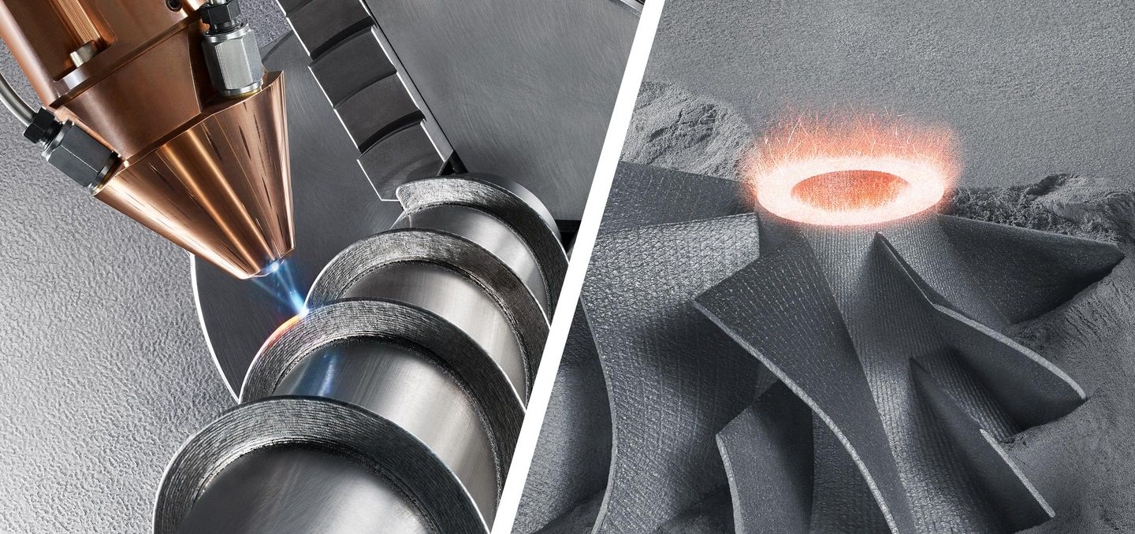
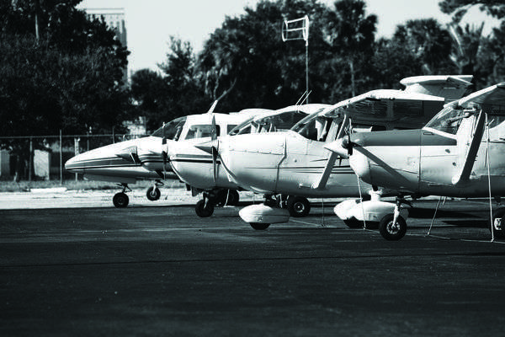
Theme 5: Airframe, Legacy Fleet and Maintenance
Sustainability of legacy GA still needed
Incorporating new technologies to legacy fleet
New predictive technologies to assist maintenance works
Additive manufacturing is available and may have some impacts
Certification of 3-D printing parts, additive manufacturing methods, or process

Slide 16
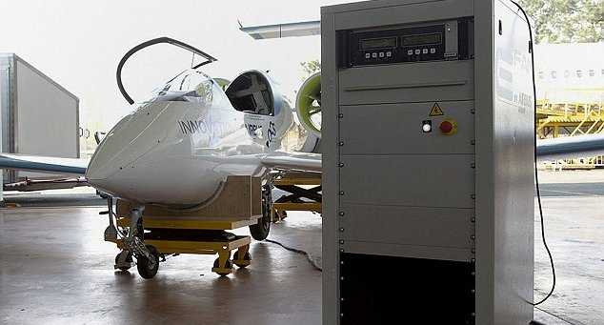
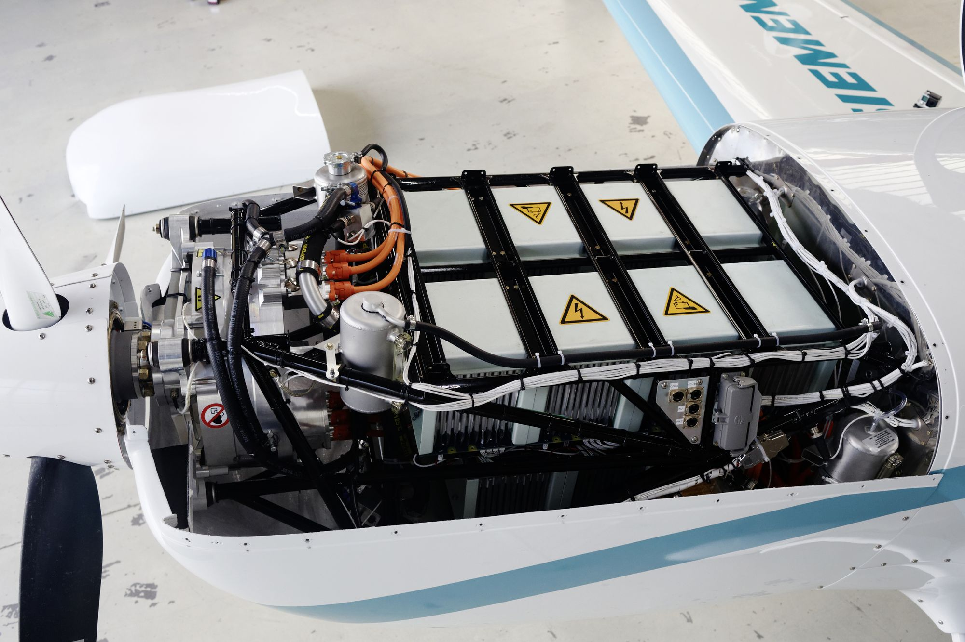
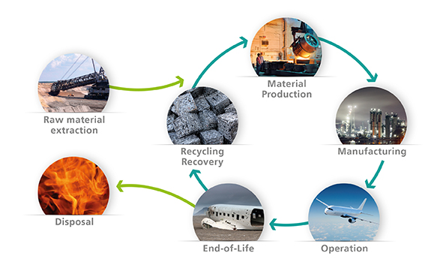
Theme 6: Future Propulsion Technology/New Energy Sources
Infrastructure, maintenance, and training for new energy sources needed
Novel energy storage and transmission components will be available and affordable
Certification framework for electric propulsion system or alternative/non-fossil fuels
Impact of full life-cycle, environmental issues, reliability, and level of safety on electric propulsion technologies

Slide 17
Word Counts from Workshops 0 and 1
Key words selected from benchmarking and workshop notes
Counts show how often words are mentioned in workshop notes, but does not directly relate to importance
Helps team ensure we have not missed something in the theme discussions

Slide 18
Word Count Comparisons of Workshops 0 and 1
Workshops had different set of participants
Counts show where keywords mentioned
More often in Workshop 1 (industry centric)
About the same in both workshops
More often in Workshop 0 (academic centric)
Understanding context of word use important
WORKSHOP 1
W1$≅$ W0
WORKSHOP 0

Slide 19
Comparisons of Workshop 0 and 1
Workshop 0
Workshop 1
Refers to the training for aircraft maintenance in particular.
Training
Refers to the training of pilots and operators of aircraft
Modification in training procedure
Identifies the importance to GA and areas of improvement required.
Certification
Positive on new Part 23. Finding possible solutions. COTS a good option.
Movement in ‘swarm’ of drones.
Drone strike capabilities (like bird strike).
UAS/Drones
Movement in crowded airspace.
Leveraging UAS technology.
Operator
Focused on performance and responsibilities of the operator.
Requirements for transition from conventional pilots to operators.

Slide 20
Project Next Steps
Interim report with comparison of the last two workshops
Another stage of benchmarking tasks based on Workshop 1 results
Preparation for Workshop 2 (Government-centric):
November 2017
Planned to be at Purdue in West Lafayette, IN
Analysis of Workshop 2 results and comparison:
Organizing workshop 2 notes
Comparison among workshop 0, 1 and 2
Final report with research recommendations
Tentatively available in December 2017
Includes suggested priority for research themes
Potential for themes to turn into individual workshops

Slide 21
Detail theme discussion
Backup slides

Slide 22
Theme 1: Pilot Training and Proficiency
Facts / Observations:
Pilot shortage: It is difficult to attract new pilots to fly GA
GA viewed as entry point for many pilots for commercial aviation
GA aircraft still require pilots unless full automation is available
Pilot Training currently requires too much time and money commitments
Current pilot training standards have not kept up with simulator technology
Pilot’s trust in autonomy still need to grow
Potential Research Needs:
Need to make learning how to fly easier, cheaper and more streamlined. Can introduce more high-fidelity flight simulators training in the future, but retain basic flying skills. Need to investigate redundancies in existing private pilot training requirements. The target should be $1,500 and within 20 hours for instrument rated PPL.
Need research on the current state of simulator technology and what is its roadmap in 20 years
Need market analysis of the new age pilots and their motivations, to tweak the curriculum to better suit them
Need to encourage the use of technologies to reduce pilot’s workload. Think of what can be added to the aircraft and brought on board (e.g., a tablet or smartphone).
Need roadmap from simplified operations for current pilot to no pilot (fully autonomous) is to be identified
Need substantially streamlined and simplified VFR and IFR training curriculum
Need to raise the accessibility to quality GA training (geographically)
Need more cockpit/interface designs to prevent information overload

Slide 23
Theme 2: Autonomy and Automation
Facts / Observations:
Automation can improve current product and possibly increase market share
Lot of accidents happen in the transition between not using a tech at all and using it pervasively
Investment is restricted due to small market and low ROI
Accessibility of GA pilots to automated tools may be limited by cost, but technology flowing down from commercial aviation and UAS can help bring costs down for automation
Tasks that can be automated: Avoidance (traffic collision, terrain, airspace), ATC Communication, Weather (adjust course automatically), Critical air vehicle, decision making, structural diagnostic
Autonomy can make flying easier, safer and thereby training easier
Future ImagineAir or Uber-type models will be with ‘driver/operator’ instead of pilot
Potential Research Needs:
Need certification of automation software for smaller GA aircraft (potentially come from UAV or commercial aircraft side)
Need to make people trust automation system (e.g. fully-autonomous vehicles) and willing to use them
Need research on what autonomy technologies are viable for small GA
Need research on what sensors are required on board the airplane for autonomy
Need roadmap from simplified operations for current pilot to no pilot (fully autonomous)
Possibly need new certificate for autonomous operations
Need to focus on progression of software aimed at decision-support /decision-authority
Need to think of what tasks can be automated
Need infrastructural changes required for more autonomous vehicles (markings, lights)
Need human-in-the-loop for automation system

Slide 24
Theme 3: Airport and Infrastructure
Facts / Observations:
Some airports already have large traffic volumes, but others are nowhere close to the capacity they can fulfill
Still have runway incursion issues (towered and non-towered airports)
Issues on oversight and ownership of runways and airports (large roads, grass fields, etc.)
Have Infrastructure issues (pavement, terminals)
Need more supporting infrastructure (charging stations, local electric grid, etc.)
Potential Research Needs:
Need research on suitable landing sites/emergency sites (especially for intra-urban air taxi)
Need research on the drone ports integration into current airport infrastructure
Need research on integrating UAS in the vicinity of airports
Need better Noise management around airports
Need infrastructural changes required for more autonomous vehicles (markings, lights)
Need infrastructures required to control and manage large number of UAS and different configurations of general aviation aircraft
Need infrastructural changes for new energy aircraft
Difference in infrastructure between differently owned airports to be investigated

Slide 25
Theme 4: GA in the Future Airspace
Facts / Observations:
With growing UAS and future urban VTOL air taxi, the voice and transponder bandwidths will get overloaded. Airspace management would soon be needed to be automated.
Higher volume of vehicles in airspace
Tighter arrival spacing and mixed aircraft fleet (e.g. drones, personal air vehicles, and on-demand mobility) are expected
Configuration of airspace today its primarily commercial airline driven
There will be Interaction with UAS and automated cargo operations or package delivery operations
There is the potential for dedicated airways for UAVs or (fully) autonomous aircraft
ADS-B mandate requirement exists in only certain areas and aircraft and not all
Current GA will be heavily influenced with Uber Elevate type concepts in the future, which may have the capability to and land at any place
Potential Research Needs:
Need to think of how is the airspace shared between commercial, GA, and UAS
Need research on expandability of ADS-B (UAS)
Need to think of UAV’s interaction with structures and obstacles. Intra-city operations (for example would 500 ft clearance be applicable in urban areas for UAS?)
Need new methods for NextGen surface management, de-conflicting surface operation
Need research on cyber Security for autonomously controlled vehicle and airspace
Need research on artificial intelligence acting as a service provider for airspace management
Need research on the evolution of airspace restrictions
Need more simulations of high density airspace with various aircraft type and modes of operation

Slide 26
Theme 5: Airframe, Legacy Fleet and Maintenance
Facts / Observations:
Sustainability of legacy GA will be required, while renovating an old aircraft with completely new equipment is very costly
In attracting new customers and introducing new aircraft, it is also important to make sure that older aircraft are able to operate safely in the same airspace
The expectations would be that a general aviation aircraft operate at the same reliability of a car
Current engines are from the 1930s era without really major upgrade to the basic technology. Hesitation to develop a completely new engine specifically for GA, in part because of small market
New Aircraft Technologies out there: Propulsion Technologies, Advanced Control Systems, New Materials and Airframes, Human-machine Interface
Smart airframe/engine systems and new predictive/preventative maintenance technologies can find the problems
Testing different fuels (e.g., unleaded) on existing platforms is underway now
Additive manufacturing is available and accessible, and it allow people to make their own parts even the parts that no longer produced
Potential Research Needs:
Need to incorporate technologies into legacy fleet to increase capability, improve life cycle and drive down cost
Need better aerodynamic and aircraft design strategies to be used to make aircraft safer
Need methods to certify the airworthy of airframes
Need implementations for anti-icing or de-icing mechanisms, particularly heating elements, on composite structure
Need methods to inspect and repair the advanced airframes/materials
Need research on issues about the certification of 3-D printing parts or additive manufacturing methods/process
Need to develop algorithms and sensors used for maintenance works
Need to study differences between certified and home-built aircraft

Slide 27
Theme 6: Future Propulsion Technology/New Energy Sources
Facts / Observations:
For new energy sources (like electric, diesel, MoGas), new airport infrastructure, changes in maintenance, training, fuel providers, and “fuel” storage needs to be present and merged
Electrical propulsion system will not have tail pipe emissions. Opportunities for low carbon if integrated with “green energy” sources.
Future propulsion technology can significantly reduced cost to individual pilot/operator
In future, regulatory framework will accommodate electric propulsion, alternative/non-fossil fuels
For future electric propulsion, question of range capability are resolved, state of the art is well understood, and novel energy storage and transmission components are available and affordable
New propulsion technology should be comparable to AVgas and have comparable aircraft mission performance
Potential Research Needs:
Need research on the certification framework for electric propulsion system or alternative/non-fossil fuels
Need infrastructure associated with maintaining, repairing, and disposing electric propulsion components
Need further studies on electric propulsion as ofwhat’s the impact of full life-cycle, system disposal, environmental issues, cooling requirement, airport infrastructure, mission performance, reliability (the meaning of one engine operation), and level of safety?
Need new inspection and maintenance workforce/training. Also, how to do we retrofit older aircraft to electric/hybrid or alternative fuels propulsion? Can it be done? Additional ARFF capabilities/training are required?
Need to further research on the different sources/architectures of electric/hybrid/alternative fuels propulsion

Slide 28
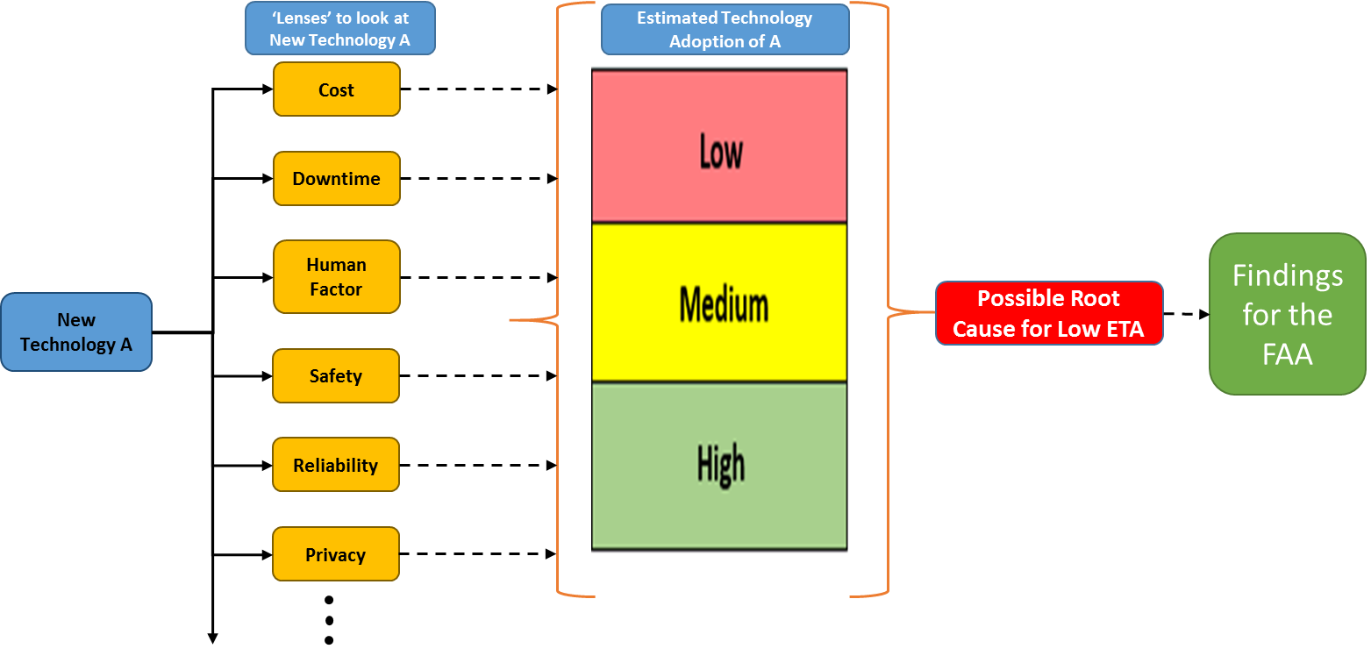
Discussion of Estimated Technology Adoption (ETA) Rating
ETA developed by the project team to complement TRL.
If a high TRL technology seems relevant to GA, but it is not widely adopted, this could illuminate a research need
Low: < 30% technology adoption (30% of the aircraft that could use, do use)
Medium: 30% to 60% technology adoption.
High: 60% technology adoption.

