Slide 1
FAA Aircraft Certification Service (AIR) Transformation
Presented to: Research, Engineering, and Development Advisory Committee (REDAC)
Subcommittee on Aircraft Safety (SAS)
By: Chris Carter, Acting Deputy Executive Director
Date: September 6, 2017
Notes:
Key Messages

Slide 2
Drivers of Change
Industry growth
Industry expands and contracts much faster than the FAA in its current structure can manage
Globalization of aviation
Industry is made up of an international web of networks and complex business arrangements that are challenging our traditional regulatory model
Heightened expectations
The public, industry and government entities continue to increase their expectations of us to do things faster and without error
Velocity of change
Technological advances and business model changes are precipitating higher rates of change and increasing the need for organizational agility and adaptability as our environment changes
Notes:
The AIR vision addresses four external drivers that are challenging our current way of doing business. We’ve found these current challenges in the aviation system to be dynamic and universal “drivers of change.”
The first is industry growth; industry expands and contracts faster than we can keep pace. The second is globalization; the aviation industry’s international networks and complex business arrangements are challenging our traditional regulatory model. Third is heightened expectations; the public, industry and government entities continue to increase their expectations of us to do things faster and without error. Finally, there is the velocity of change; technological advances and business model changes are precipitating higher rates of change and increasing the need for organizational agility and adaptability.
Our system needs to be able to adapt to these changes in the system without reducing the overall level of safety within the system.

Slide 3
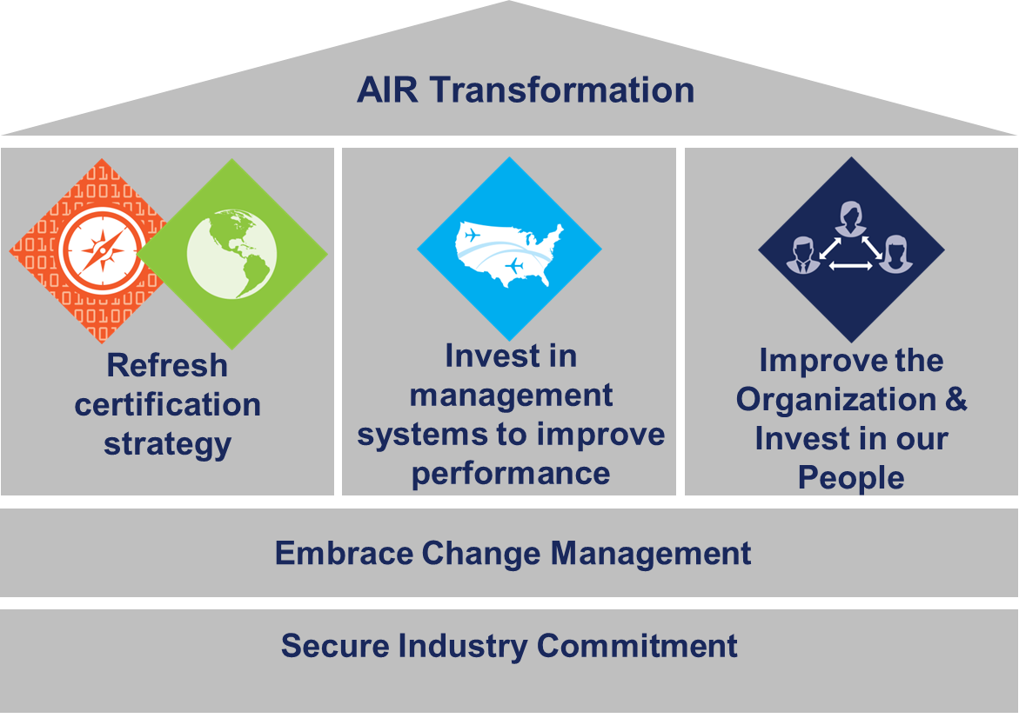
AIR Transformation Improving Efficiency and Effectiveness
Additional information can be found on the AIR Transformation website: www.faa.gov/go/AIRTransformation.
Notes:
What we’ve realized is that, in order to truly transform how we do business and become more efficient and effective, we first needed to take a deep look into how our organization is structured and how we conduct our regulatory oversight responsibilities.
AIR transformation is the culmination of years of deliberation, analyses, and proposals that stretch back well over a decade. We have made tremendous progress in improving the certification process through the introduction of new policies and rules such as the part 23 change, applicant showing only, and NORSEE
Now we are moving forward into the next phase, AIR Transformation, a comprehensive approach to becoming more efficient and effective.
Today we’re going to talk specifically about what we’re doing under the third pillar… to improve our organization.
AIR had lots of great ideas, and collaborated with Industry on many of them, striving for continuous improvement.
However, the initiatives were often ad-hoc, independent and incremental…Section 312 etc.

Slide 4
Benefits of AIR Transformation
Encourages early industry engagement and risk-based system surveillance to eliminate barriers from unnecessary FAA involvement during certification
Improves consistency and standardization by establishing single functional lines for 1) certification, 2) standards and 3) system oversight
Fosters innovation by engaging industry applicants early to understand new concepts and ensure viable path to compliance
Provides agility and adaptability to meet the challenges of the dynamic global aviation industry
Establishes business practices for utilizing metrics for determining efficacy of Industry/FAA associated with compliance/safety and time to market
AIR’s Past Focus
Systems Oversight
Compliance
Standards
AIR’s Current Focus
Systems Oversight
Compliance
Standards
Notes:
Let’s talk about the benefits of AIR Transformation… what can you expect?
(Go through the slide info and give concrete examples)
So, how do we get there?

Slide 5
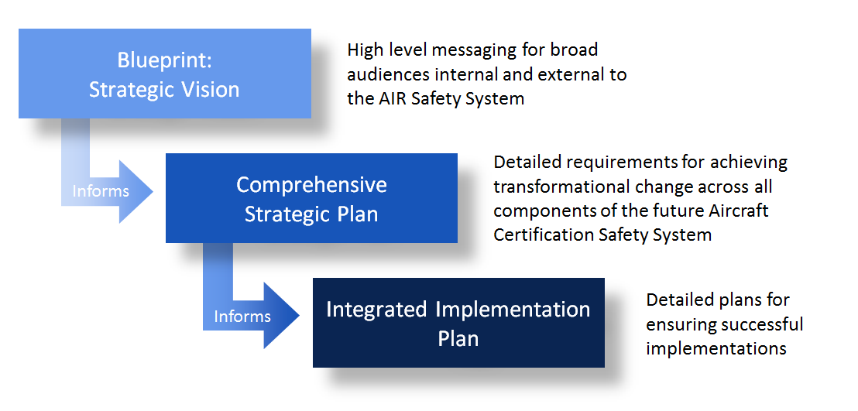
Strategy for AIR Transformation
Collaboration with stakeholders to identify requirements,
including actions & timeframes
Notes:
Building a competent network of cooperative partners helps ensure a consistent level of safety and the seamless transfer of products and approvals globally.
Successfully building this network requires that we improve clarity and transparency for all of our stakeholders… this is key to a successful AIR Transformation!
The Blueprint leverages, integrates and expands on previous efforts and existing strategies
Considers full transformation of the entire system
Identifies and leverages the key drivers of change in realizing mission outcomes
Considers activities from near to mid and far-term
Is informed by AIR SMEs (and stakeholders)
Applies best practices of systems engineering and operational transition and integration
The focus of this slide is that the Blueprint:
Is publically available
Is meant to communicate our strategy to all audiences
Has been developed with all of the other strategic documents in mind
Including COB, CMT, GLI
Animated call out box to identify collaboration w/stakeholders at the CSP level
AIR Safety System: The set of interconnected, functions, processes, and entities (both public and private) that collectively ensure the safe design and production of aerospace products. The system encompasses AIR’s activities related to design, manufacturing, airworthiness approvals and oversight, standards and policy development, and, continued operational safety (COS); Industry’s role in ensuring compliance to regulations; and the public’s active participation in the regulatory process.
This is a new method of business planning for AIR:
Strategic & Long Term Planning instead of “effort du jour”
Holistic Directed Planning instead of ad-hoc

Slide 6
Improve Our Organization
AIR realigned the organization in July 2017 to begin to institutionalize the process improvements that are currently in progress.
Realignment moved AIR’s existing local offices (ACOs, MIDOs, etc.) to align with AIR’s functional divisions.
During realignment AIR’s existing POCs were retained to ensure seamless relationship management and to facilitate contact with the appropriate AIR employee.
AIR will continue to brief bilateral partners and industry stakeholders on implementation status and to solicit feedback.
As an outcome of realignment, AIR’s directorate structure no longer exists.
Notes:
AIR is undergoing a phased implementation of the functional organization with realignment the first visible step, which will have a measurable impact on bilateral partners and industry.

Slide 7
Improving Our Organization Former State
Aircraft Certification Service
AIR-1, Director
AIR-2, Deputy Director
Executive Support Staff
(AIR-10)
Fuels Program Staff
(AIR-20)
Design, Manufacturing & Airworthiness Division
(AIR-100)
International Division
(AIR-400)
Planning & Program Management Division
(AIR-500)
Transport Directorate
(ANM-100)
Small Airplane Directorate
(ACE-100)
Engine and Propeller Directorate
(ANE-100)
Rotorcraft Directorate
(ASW-100)
Policy
Admin
Policy
Foreign Affairs
Technical Training
Budget
Staffing
Policy
ACO’s
MIDO’s
Admin
Policy
ACO’s
MIDO’s
Admin
Policy
ACO’s
MIDO’s
Admin
Policy
ACO’s
MIDO’s
Admin

Slide 8
Improving our Organization Realignment (As of July 23)
Aircraft Certification Service
AIR-1, Executive Director
Dorenda Baker
Executive Technical Support Staff
(AIR-10)
Brian Morris
AIR-2, Deputy Executive Director, Regulatory Operations
David Hempe
AIR-3, Deputy Executive Director, Strategic Initiatives
Chris Carter, Acting
Alternative Fuels Program Staff
(AIR-20)
Peter White
Organizational Performance Division (AIR-300)
Colleen D’Alessandro
International Division
(AIR-400)
Sarbhpreet Sawhney, Acting
Policy & Innovation Division (AIR-600)
Mike Kaszycki, Acting
Compliance & Airworthiness Division (AIR-700)
Lance Gant
System Oversight Division (AIR-800)
Jeff Duven
Enterprise Operations Division (AIR-900)
Mike Linegang, Acting
AIR-300 Staff (Stood up on October 30, 2016)
Policy
Foreign Affairs
Policy
ACOs
DSCO
MIDOs
MIOs
BASOO
Enterprise-wide Technical and Administrative Support
Notes:
First step: Realign existing local offices (e.g. ACO’s, MIDO’s, etc.) to functional divisions.

Slide 9
AIR Transformation: Industry’s Role
Engage EARLY and OFTEN about new technologies
Upfront involvement will help the FAA determine the certification basis and get out of the critical path to certification
Applicant conducts R&D on new technologies that will be used in upcoming products by engaging with FAA standards staff through the Innovation Center; collaboratively defining new standards and MOCs
Research, development, implementation and transition must be a collaborative effort; no one can do this alone
Notes:
Let’s talk about Industry’s role and how R&D can play a role in transformation… what can you expect?

Slide 10
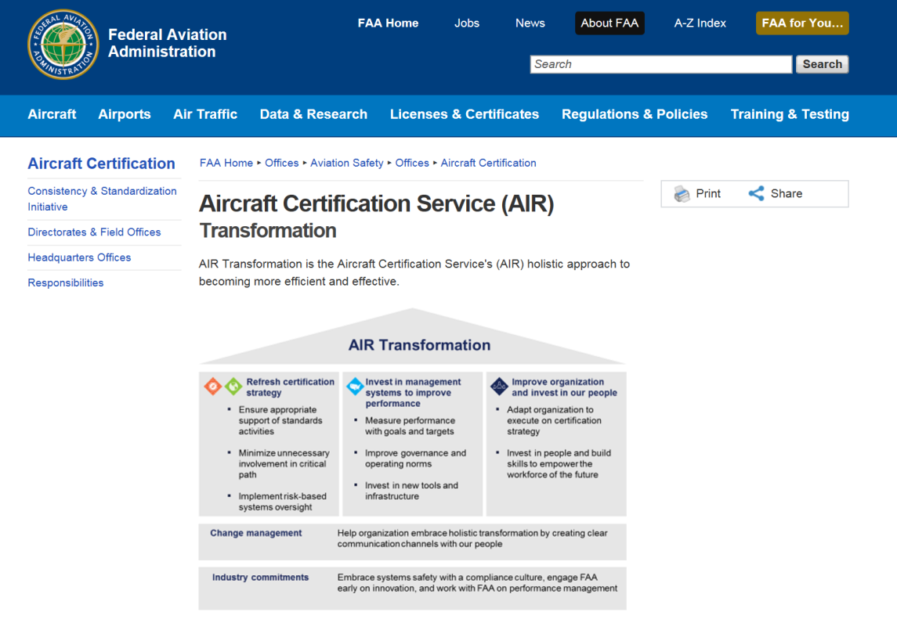
Find More Information
Learn more on the public AIR Transformation website:
www.faa.gov/go/AIRTransformation
Notes:
We recognize that change management is essential, and as such, it is one of the foundational elements of the AIR Transformation. AIR is also reaching out and engaging both INTERNALLY and EXTERNALLY to share our progress and get feedback as we move forward.
To find out more about our strategy for increasing efficiency and effectiveness, visit our external webpage! From there, you can also subscribe to our monthly newsletter and access dynamic video content.

Slide 11
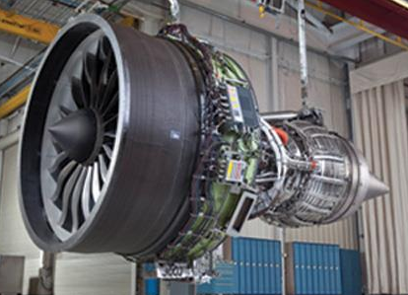
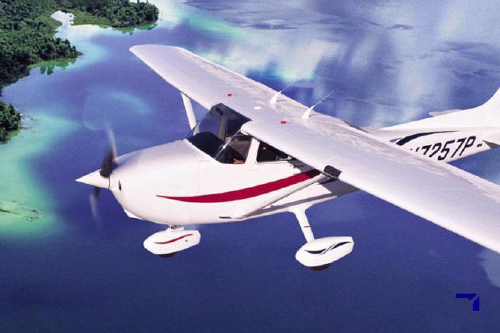
Questions?

