Slide 1
Computing and Analytics Shared Services Integrated Environment (CASSIE) General Overview
Tony Gurcsik, ANG-E272
Chris Malitsky, ANG-E13
Tom Tessitore, ANG-E272
September, 2017

Slide 2
CASSIE Description (Overall Project)
Description
A collaborative environment for conducting research, developing and testing across all research programs, sponsors and WJHTC organizations
CASSIE enables a flexible environment to conduct research by bringing all FAA organizations, partners and sponsors together in a shared services environment consisting of DATA, COMPUTE POWER and ANALYTICAL TOOLS
Provides Big Data Platform along with FAA NAS data sources to support programs in the development of new capabilities and transition of capabilities.

Slide 3
CASSIE Description (Conceptual Overview)

Slide 4
CASSIE Description (Architecture Overview)
https://www.nist.gov/el/cyber-physical-systems/big-data-pwg

Slide 5
CASSIE Description (Architecture Overview)
https://www.nist.gov/el/cyber-physical-systems/big-data-pwg

Slide 6
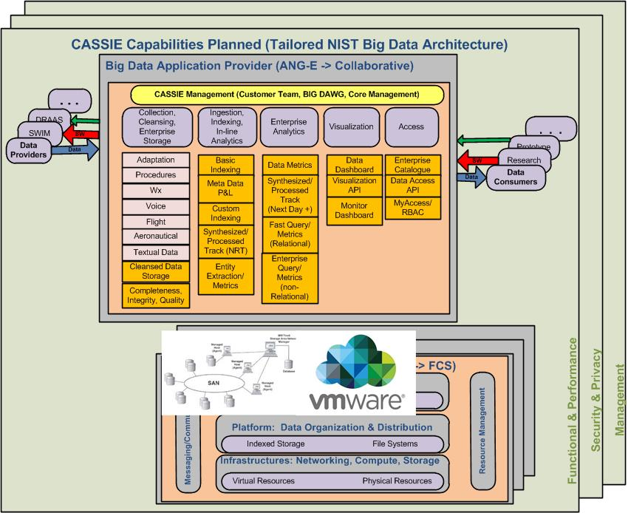
CASSIE Description (Architecture Overview)
https://www.nist.gov/el/cyber-physical-systems/big-data-pwg

Slide 7
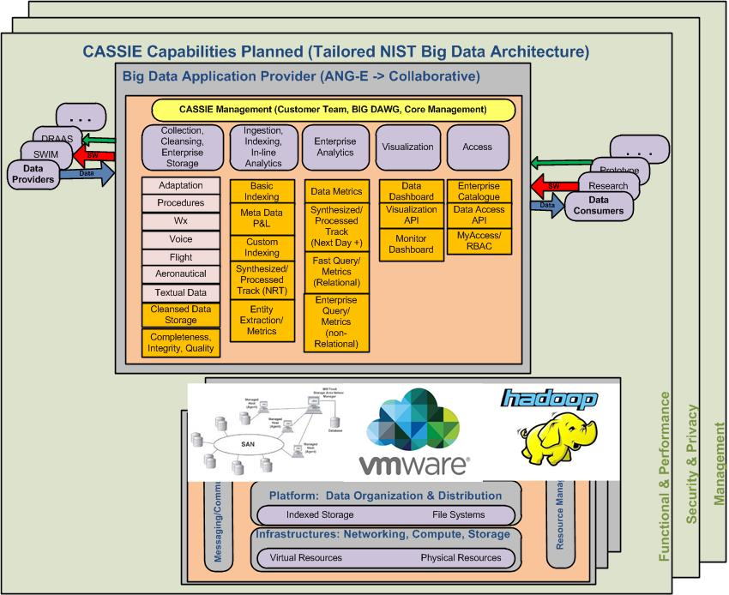
CASSIE Description (Architecture Overview)
https://www.nist.gov/el/cyber-physical-systems/big-data-pwg

Slide 8
CASSIE Description (Architecture Overview)
https://www.nist.gov/el/cyber-physical-systems/big-data-pwg

Slide 9
CASSIE Description (Architecture Overview)
https://www.nist.gov/el/cyber-physical-systems/big-data-pwg

Slide 10
CASSIE Description (Platform Overview)
Description
Data Storage (NetApp Storage Area Network) Approximately 600TB
VMware virtualization (UNIX and Windows) 12 hosts, 300 cores, 256GBx12 RAM, storage on SAN
Big Data Hortonworks Development Platform (HDP) 13 physical Data nodes and virtual sandbox with 3 nodes.
High Performance Compute (HPC) 2 head nodes and 13 compute nodes approx. 300 cores
ORACLE cluster
Data sources SWIM (All feeds), ASDE-X, Voice, SBSS, METAR, CIWS VIL/Echo, NOP RH …

Slide 11
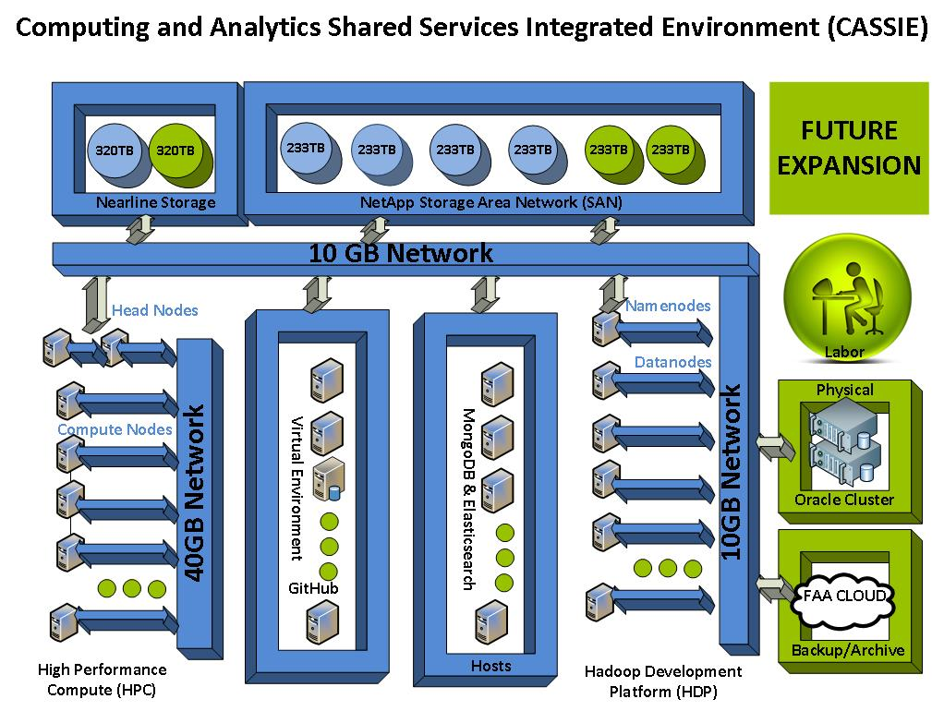
CASSIE Description (Overall)

Slide 12
Current Customers
CASSIE currently providing support to:
Fire & structures research to perform modeling and data analytics
Software and Systems Branch programs for prototyping of research capabilities & transfer safety data and tools throughout the FAA
Aviation Research Division (ANG-E2) sponsors (i.e. AJI, AVP, AFS) in support of development and use of analytics to support safety procedures
Several other WJHTC organizations (ANG-C Weather, ANG-C Modeling & Simulation, ANG-E TGF, TechOps) to obtain data and develop new capabilities
OKC Academy and Flight Standards
NASA RTT programs for access to threaded track and deployment of safety and performance modeling (i.e. MKAD & RACE)
NextGen Enterprise Repository (NER) in the development of enterprise ingestion in conjunction with FAA’s Chief Data Officer
AVS SSMT hosting ASAIC viewer vs deploying physical machines and data sources
etc…

Slide 13
Sample Use CASES
Weather Information Management (WIM) system utilized CASSIE storage, virtualization and ORACLE to save on infrastructure & labor.
TGF enhancing analytical capabilities to help with the development of scenarios and refine decent profile metrics.
Multiple R&D programs leveraging High Performance Compute (HPC) vs. running individual HPC clusters
AJI performing machine learning was able to utilize CASSIE to run multiple R machine learning algorithms that could not be run locally.
ANG-C Modeling & Simulation Branch moving lab infrastructure (ORACLE, Compute etc.) to CASSIE to save maintenance and operations cost
Multiple users using CASSIE SWIM feeds vs on-ramping themselves
Airport using CASSIE to develop and enhance pavement wear
Shared knowledge and collaboration. Invaluable!

Slide 14
CASSIE Funding Model
CASSIE started with initial work under FAA ASIAS program
WJH FAA Tech Center enhanced infrastructure to support new capabilities and kick-off maintenance and allow WJHTC organizations to on-ramp within CASSIE
Non-core funding provided by organizations that utilize and benefit from CASSIE.
Goal is to become totally user funded over time.
Most users see immediate financial benefits using CASSIE vs current operations
Eventually move to FCS within R&D Domain

Slide 15
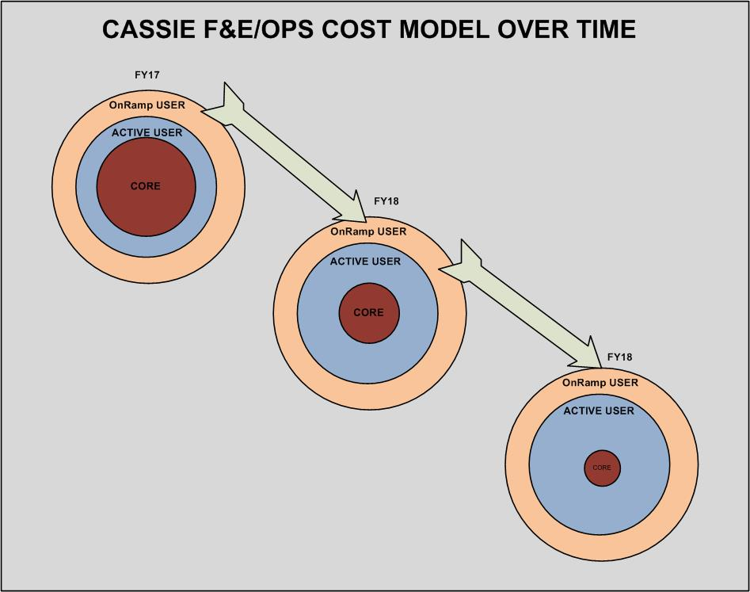
CASSIE Funding Model
User-supported model
Notional

Slide 16
BIG DAWG [Data Analytics Working Group]
BIG DATA
Mission: empower WJHTC workforce to utilize big data analytics technology to improve safety and efficiency of the NAS
How
Form a cross organizational team
Acquire skills and knowledge
Prototype solutions
Build on experience leveraging on CASSIE
Expand and iterate…

Slide 17
Contact Data:
Tom Tessitore Systems Safety Section,
CASSIE Program Lead
609-485-4166
tom.tessitore@faa.gov
Tony Gurcsik Systems Safety Section,
CASSIE Implementation Lead
609-485-5622
tony.gurcsik@faa.gov

