Slide 1
Data Link
Oakland Center
ISPACG/33
FIT/26
March 19^{th -} 20th, 2019
Prepared by: Julia Fuller

Slide 2
Welcome Message
Starting on July 31st, 2018, Oakland Center introduced the Welcome Message as a method to confirm Current Data Authority(CDA).
  THIS IS AN AUTOMATED MESSAGE TO CONFIRM DATALINK CONNECTION TO KZAK. PILOTS MUST INFORM ATC EACH TIME THE MACH NUMBER VARIES OR IS EXPECTED TO VARY BY EQUAL TO OR GREATER THAN 0.02 MACH.
The Welcome Message was changed on February 27th, 2019 to the following-
  THIS IS AN AUTOMATED MESSAGE TO CONFIRM CPDLC CONNECTION TO KZAK. REPORT SPEED CHANGES TO ATC.

Slide 3
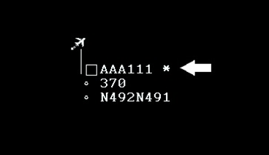
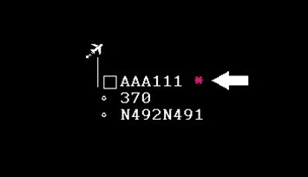
Welcome Message
CPDLC connection indicator and CDA status on the datablock
Datablock connection indicator will indicate whether a connection exists and whether or ATOP is the CDA
Connection Indicator is data block color = CDA
Magenta Connection Indicator = Not CDA

Slide 4
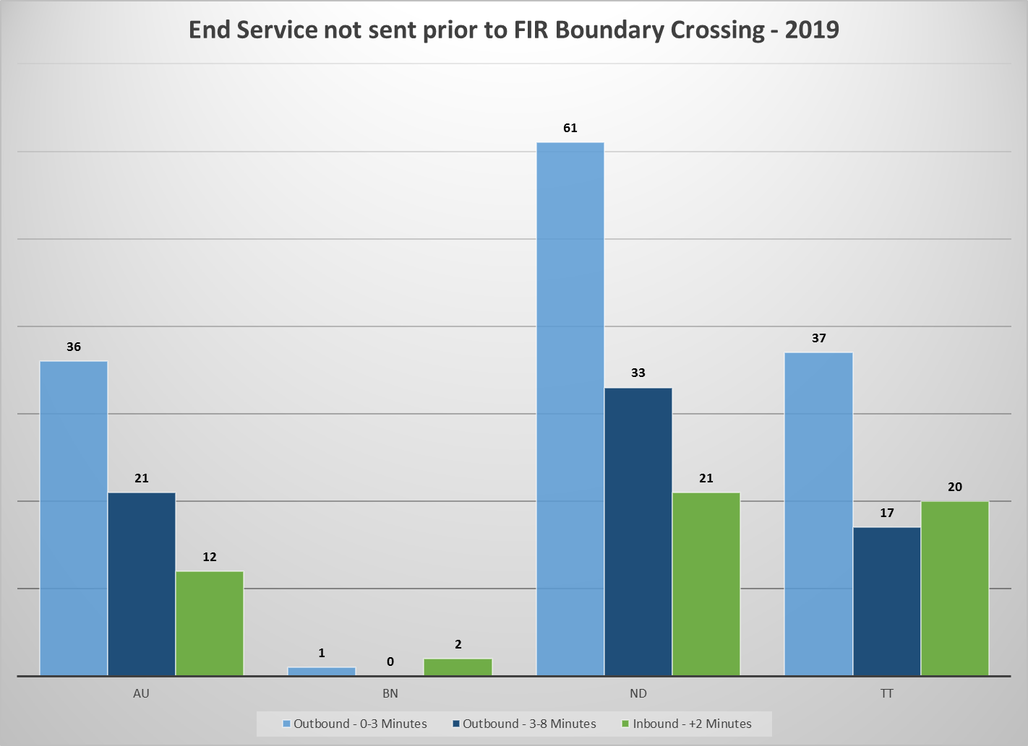
Welcome Message
Confirming CDA

Slide 5
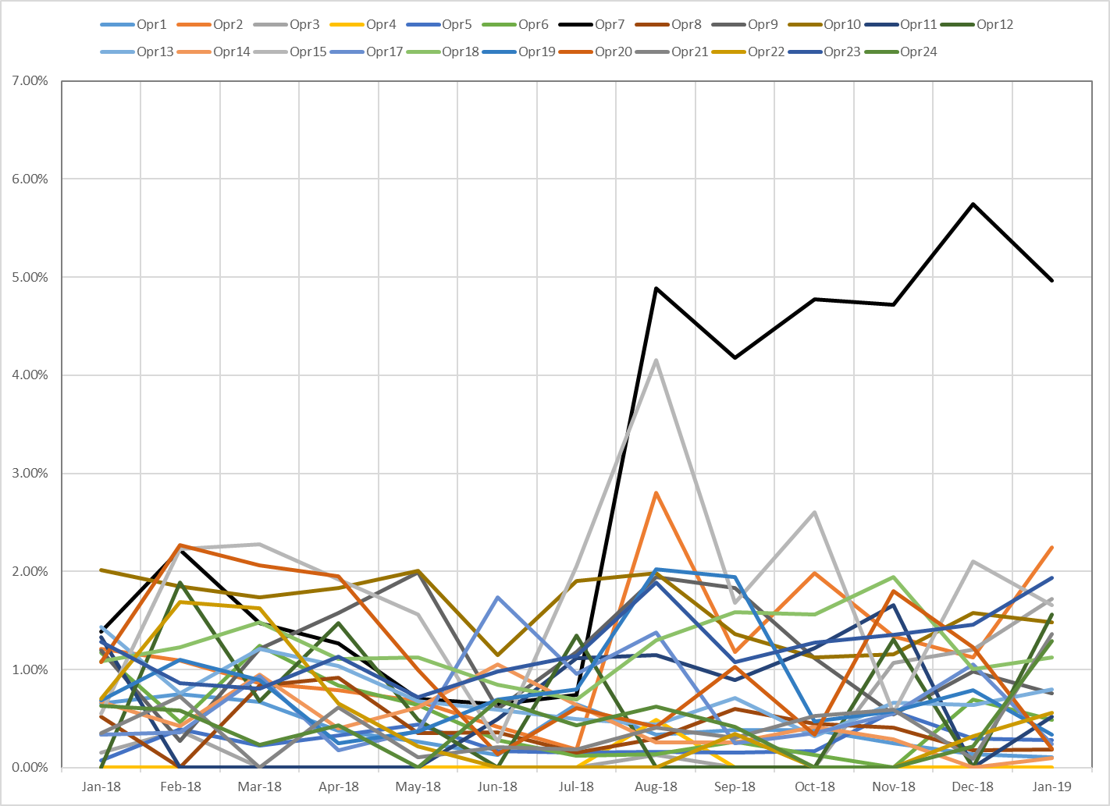
Welcome Message
PR 2793-SH: No Response to Climb Clearance
Starting in August, 2019 an increase in the number of clearances that did not receive a response via CPDLC was observed with one operator.
Percentage of altitude clearances that did not receive a response via CPDLC - includes all aircraft types

Slide 6
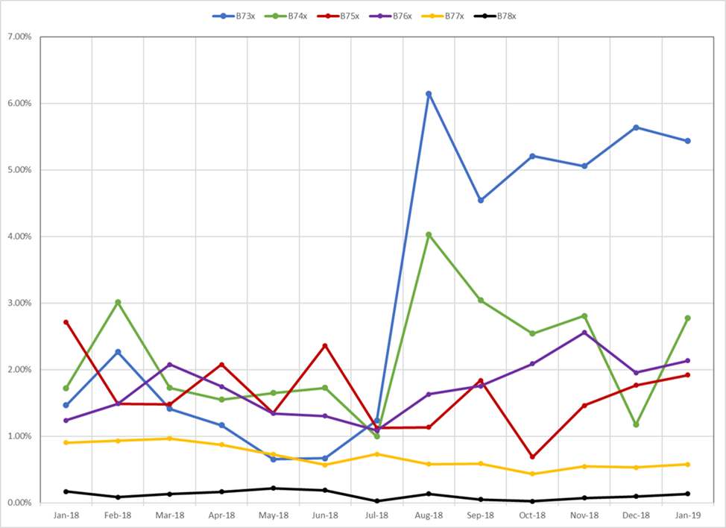
Welcome Message
PR 2793-SH: No Response to Climb Clearance

Slide 7
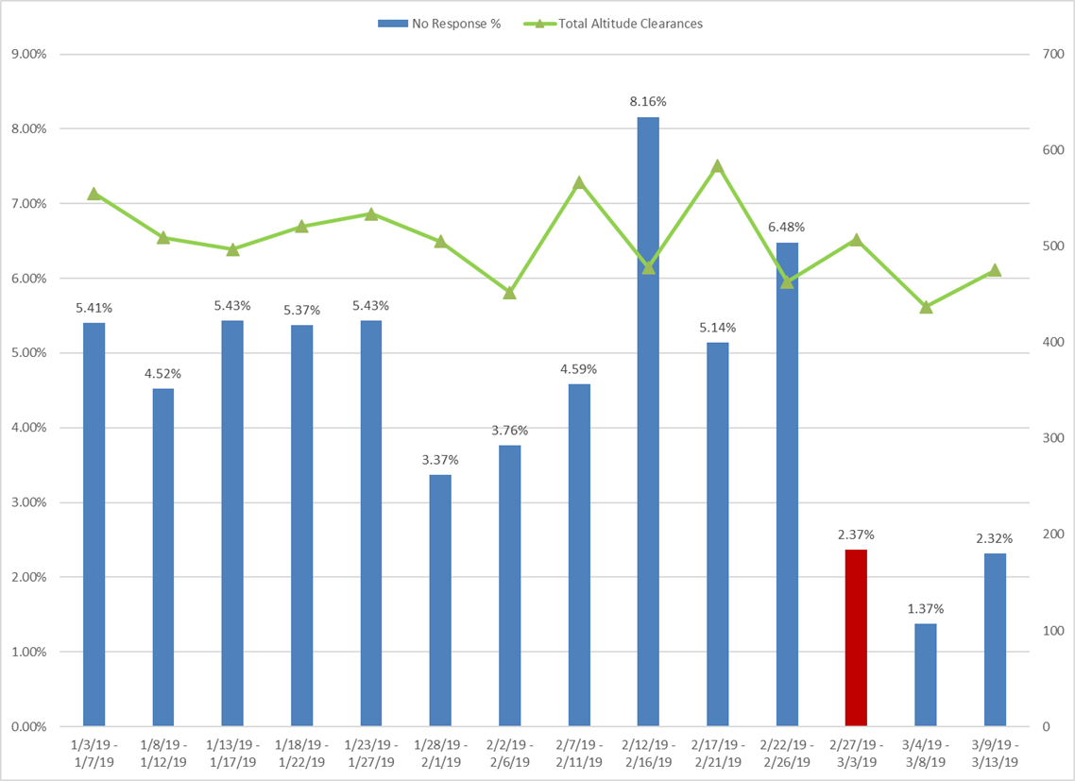
Welcome Message
PR 2793-SH: No Response to Climb Clearance
The New Welcome Message was designed such that it fit within one uplink block. This change was implemented on February 27th, 2019.

Slide 8
AFN Logon Filtering
VDL Only Flights
AFN Logons by VDL-only flights causes an increase in controller workload.
  Numerous Sector Queue Messages are generated informing the controllers that uplinks could not be delivered and ADS-C position reports were not received as expected.
With a recent software release, new functionality was introduced to allow for AFN Logons to be automatically rejected(reason code 5) if the equipage in Field10a does not contain a J-code indicating SATCOM capability.
  CPDLC FANS 1/A SATCOM J5(Inmarsat),J6(MTSAT),J7(Iridium)
  New York and Anchorage are currently using this functionality.
When this happens a Messages is sent to the Supervisor Queue reporting:
  Aircraft <ACID> attempted AFN Logon without the acceptable datalink media J-code

Slide 9
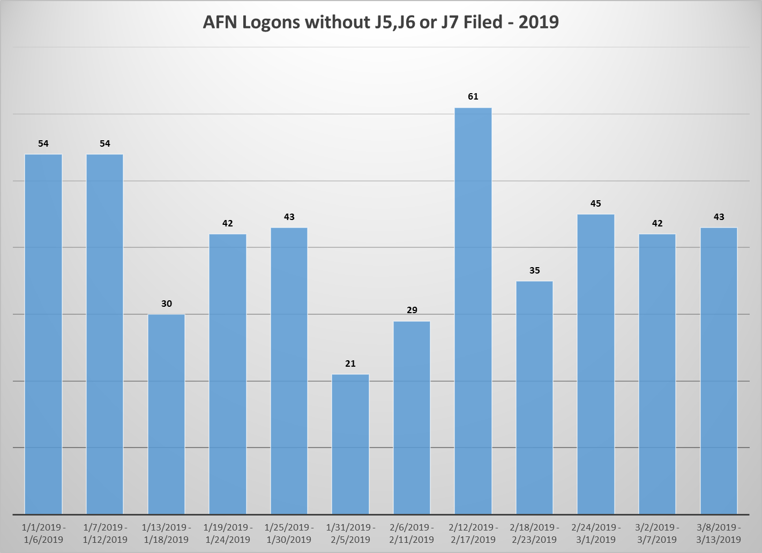
AFN Logon Filtering
VDL Only Flights
Logon by VDL-only flight
March 7th, 2019
  Field10a SDE3FGHIRWZ
  111 Sector Queue Messages generated between 1858z – 2254z.

Slide 10
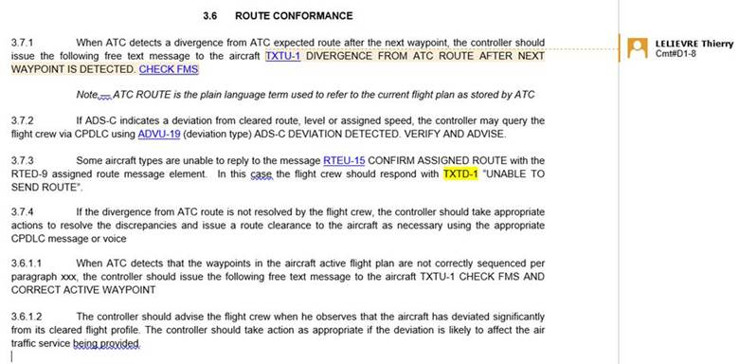
Flights on Deviations
ADS-C waypoints out of sequence
On February 27th, 2019, Oakland replaced the preformatted freetext –
  “RESEQUENCE ADS WAYPOINTS” with
  “CHECK FMS AND CORRECT ACTIVE WAYPOINT”

Slide 11
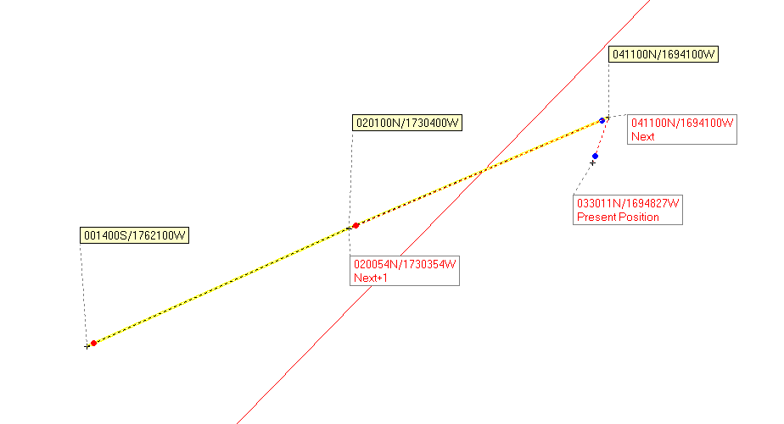
Flights on Deviations
ADS-C waypoints out of sequence
2019-03-12 12:53:57 CPU CLEARED TO DEVIATE UP TO L or R 030 NM OF ROUTE,REPORT BACK ON ROUTE
2019-03-12 13:10:12 Sector Queue Message Report REJECTED: Position report and next estimate are not correctly sequenced.
2019-03-12 13:11:33 CPU CHECK FMS AND CORRECT ACTIVE WAYPOINT
2019-03-12 13:13:34 CPD REQUEST DIRECT TO 0201N17304W

Slide 12
Flights on Deviations
ADS-C waypoints out of sequence
From the GOLD –
  2.1.2.7.3 If the aircraft is in heading select mode and the aircraft passes abeam an ATC waypoint by more than a defined distance, the FMS will not sequence this or subsequent waypoints. Consequently, the aircraft will not send an ADS-C waypoint change event report. However, if the aircraft sends an ADS-C periodic report with a predicted route group, the NEXT waypoint data in the report will continue to indicate the waypoint that was passed. As a result, the ground system could use invalid data for display of the aircraft position or extrapolating the correct route for the aircraft.

Slide 13
ARINC424 Format & DARPs
2018-11-23 13:58:25.250 CPD
  REQUEST Destination Airport: PHNL
  27E70 26E80 25N175W 24N70 DOGIF
  Approach Procedure: APPROACH ILS08L BOOKE
  Arrival Procedure: ARRIVAL BOOKE8 CANON
  Arrival Runway: 08 LEFT
2018-11-23 14:00:12.676 CPU
  UNABLE,
  INCORRECT FORMAT FOR THE UPLINK
2018-11-23 14:05:52.573 CPD
  AFTER N27E170 REQUEST N26E180 N25W175 N24W170 DOGIF CANON BOOKE8
2018-11-23 14:07:30.410 CPU
  YOUR FORMAT IS OFF SIR...SORRY. WE HAVE OUTAGES AND WEATHER THAT HAVE PRIORITY,
  SEND CORRECT FORMAT DOWNLINK PLS
2018-11-23 14:10:24.373 CPU
  GIVE ME A FEW MINUTES...ILL SEND IT UP...STANDBY PLS
2018-11-23 14:15:17.310 CPU
  CLEARD Destination Airport: PHNL
  27N170E 26N180E 25N175W 24N170W DOGIF CANON
  Arrival Procedure: ARRIVAL BOOKE8 CANON,
  THE PORTION OF YOUR FORMAT THAT WAS INCORRECT WAS LAT LONG,
  SYSTEM WONT ACCEPT N27E170. LAT LONGS NEED TO BE 27N170E FOR EXAMPLE...CHEERS

Slide 14
Detecting Outages
Following the fifth meeting of the TIG in April 2018, an informal sub-group of data analysts began meeting to coordinate on standardization of PBCS monitoring conducted in support of safety oversight for data link-dependent operations in the NAT region.

Slide 15
Detecting Outages
3.28 The Group agreed that the analysts should continue coordination on the following items:
develop a standard method for identifying outage periods based on data;
determine additional metrics to be tracked relevant to PBCS monitoring, e.g. CPDLC uplink failure rate, ACP of all uplink messages, even those filtered out of the aggregate metrics; and
revise the existing performance data template to enable combining the data more easily into a merged NAT report for all categories.

Slide 16
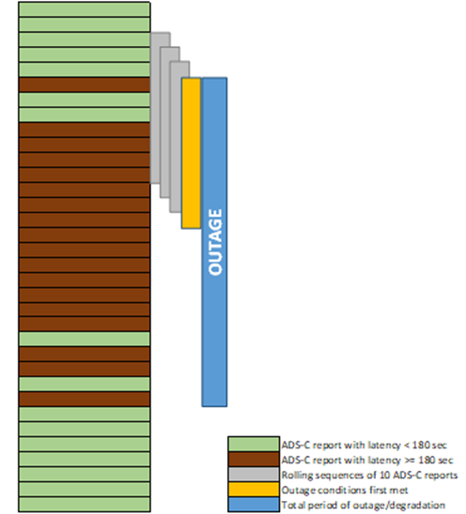
Detecting Outages
FAA Method
This method looks for time periods in which a majority of flights and position reports are impacted.
Both system outages and system degradations are tracked using this method.

Slide 17
Detecting Outages
FAA Method
Xmt_Time | Rcv_Time | Delay(Sec) | Acid | Reg | Pos | Type | GES
2018-08-27 16:34:29 | 2018-08-27 16:42:26 | 477 | CFG226 | DABUI | 305759N0514742W | BAS | IGW1
2018-08-27 16:36:43 | 2018-08-27 16:38:45 | 121 | DAL220 | N195DN | 220518N0343232W | BAS | IGW1
2018-08-27 16:37:13 | 2018-08-27 16:40:06 | 172 | JBU509 | N955JB | 281117N0694826W | BAS | IGW1
2018-08-27 16:37:32 | 2018-08-27 16:54:56 | 1044 | TCX2618 | OYVKF | 282323N0672825W | BAS | IGW1
2018-08-27 16:37:35 | 2018-08-27 16:53:05 | 930 | MMZ611 | CSTKR | 365022N0462120W | BAS | IGW1
2018-08-27 16:37:43 | 2018-08-27 16:40:58 | 194 | JBU1537 | N913JB | 245926N0690639W | WPC | IGW1
2018-08-27 16:38:00 | 2018-08-27 16:55:09 | 1029 | TCX2618 | OYVKF | 282133N0673157W | WPC | IGW1
2018-08-27 16:38:48 | 2018-08-27 16:39:55 | 66 | TFL311 | PHOYI | 415009N0373430W | BAS | IGW1
2018-08-27 16:39:24 | 2018-08-27 16:50:55 | 690 | JBU1537 | N913JB | 244700N0690334W | BAS | IGW1
2018-08-27 16:40:17 | 2018-08-27 16:51:16 | 659 | JBU1537 | N913JB | 244019N0690156W | WPC | IGW1
2018-08-27 16:40:18 | 2018-08-27 16:52:20 | 721 | JBU949 | N956JT | 255425N0655956W | BAS | IGW1
2018-08-27 16:40:20 | 2018-08-27 16:54:39 | 858 | JBU1669 | N949JT | 283306N0695311W | BAS | IGW1
2018-08-27 16:40:42 | 2018-08-27 16:53:29 | 767 | JBU509 | N955JB | 274441N0694238W | WPC | IGW1
2018-08-27 16:44:01 | 2018-08-27 16:56:26 | 744 | DAL273 | N711ZX | 430201N0493556W | BAS | IGW1
2018-08-27 16:44:04 | 2018-08-27 16:52:47 | 523 | CFG226 | DABUI | 301535N0525836W | BAS | IGW1
2018-08-27 16:46:18 | 2018-08-27 16:47:30 | 72 | DAL220 | N195DN | 224459N0354321W | BAS | IGW1
2018-08-27 16:46:41 | 2018-08-27 16:58:59 | 737 | DAL273 | N711ZX | 430104N0500014W | WPC | IGW1
2018-08-27 16:46:48 | 2018-08-27 16:53:53 | 425 | JBU509 | N955JB | 265754N0693235W | BAS | IGW1
2018-08-27 16:46:53 | 2018-08-27 16:54:55 | 481 | JBU1669 | N949JT | 274445N0694240W | WPC | IGW1
2018-08-27 16:47:10 | 2018-08-27 16:55:48 | 517 | TCX2618 | OYVKF | 274619N0683908W | BAS | IGW1
2018-08-27 16:47:12 | 2018-08-27 16:56:02 | 529 | MMZ611 | CSTKR | 363025N0475200W | BAS | IGW1
2018-08-27 16:47:57 | 2018-08-27 16:52:46 | 288 | JBU949 | N956JT | 245515N0654920W | WPC | IGW1
2018-08-27 16:48:25 | 2018-08-27 16:48:34 | 8 | TFL311 | PHOYI | 411922N0390517W | BAS | IGW1
2018-08-27 16:48:48 | 2018-08-27 16:54:13 | 324 | JBU509 | N955JB | 264243N0692922W | WPC | IGW1
2018-08-27 16:49:55 | 2018-08-27 16:53:22 | 206 | JBU949 | N956JT | 243959N0654639W | BAS | IGW1
2018-08-27 16:49:56 | 2018-08-27 16:55:14 | 317 | JBU1669 | N949JT | 272203N0693745W | BAS | IGW1
2018-08-27 16:50:17 | 2018-08-27 16:55:36 | 319 | JBU1669 | N949JT | 271922N0693710W | BAS | IGW1
2018-08-27 16:50:24 | 2018-08-27 16:53:06 | 161 | DAL2571 | N822DX | 364243N0710107W | BAS | IGW1
2018-08-27 16:52:47 | 2018-08-27 16:55:58 | 191 | JBU1669 | N949JT | 270039N0693309W | BAS | IGW1
2018-08-27 16:53:00 | 2018-08-27 16:54:47 | 107 | JBU509 | N955JB | 261104N0692241W | BAS | IGW1
2018-08-27 16:53:17 | 2018-08-27 16:56:22 | 185 | JBU1669 | N949JT | 265655N0693222W | BAS | IGW1
2018-08-27 16:53:34 | 2018-08-27 16:56:37 | 182 | JBU1669 | N949JT | 265447N0693154W | BAS | IGW1
2018-08-27 16:53:38 | 2018-08-27 17:01:39 | 480 | DAL273 | N711ZX | 430332N0510455W | BAS | IGW1

Slide 18
Detecting Outages
ACARS Identifiers | # unplanned outages affecting path > 10 min | Sum of unplanned outages affecting path > 10 min (min) | Estimated availability for path | Sum of minutes with observed impact KZAK | Sum of minutes with observed impact KZNY | Sum of minutes with observed impact PAZA
IG1 | 5 | 690 | 99.87% | 1525 | 970 | 1164
IGW1 | 13 | 1424 | 99.73% | 1492 | 1316 | 1464
XXN | 0 | 0 | 100.00% | 0 | 0 | 0
AOE2* | 3 | 801 | 99.85% | 0 | 0 | 0
AOE6* | 1 | 10 | 100.00% | 0 | 23 | 0
XXF | 4 | 1709 | 99.67% | 0 | 0 | 0
EUA1 | 7 | 1799 | 99.66% | 0 | 0 | 0
XXI | 0 | 0 | 100.00% | 0 | 0 | 0
EUA2 | 0 | 0 | 100.00% | 0 | 0 | 0
IOR1* | 0 | 0 | 100.00% | 0 | 0 | 0
IOR6* | 0 | 0 | 100.00% | 0 | 0 | 0
XXB | 3 | 502 | 99.90% | 0 | 0 | 0
EUA9 | 0 | 0 | 100.00% | 0 | 0 | 0
EME9 | 3 | 215 | 99.96% | 0 | 0 | 0
XXA | 5 | 1665 | 99.68% | 33 | 0 | 0
APK1 | 9 | 993 | 99.81% | 88 | 0 | 0
XXP | 2 | 217 | 99.96% | 33 | 0 | 0
APK2 | 6 | 510 | 99.90% | 23 | 0 | 0
POR1 | 2 | 163 | 99.97% | 33 | 0 | 0
XXS | 2 | 386 | 99.93% | 0 | 0 | 0
APK9* | 0 | 0 | 100.00% | 0 | 0 | 0
PAC9 | 3 | 173 | 99.97% | 0 | 0 | 0
XXH | 1 | 38 | 99.99% | 32 | 0 | 0
AME1 | 4 | 361 | 99.93% | 77 | 72 | 0
XXW | 1 | 58 | 99.99% | 11 | 41 | 0
AME2 | 6 | 971 | 99.82% | 49 | 11 | 0
AOW2 | 4 | 983 | 99.81% | 0 | 205 | 0
XXU | 2 | 386 | 99.93% | 31 | 0 | 0
AME9* | 0 | 0 | 100.00% | 0 | 0 | 0
AMR9 | 3 | 173 | 99.97% | 0 | 0 | 0
XXM | 1 | 79 | 99.98% | 0 | 0 | 0
MEA9 | 3 | 153 | 99.97% | 0 | 0 | 0
MTS1 | 2 | 163 | 99.97% | 52 | 0 | 0

