Slide 1



Agenda Item #2
NZZO Brief
ISPACG FIT 27
Virtual meeting
2200 UTC, 30 June 2020

Slide 2
CRA Website
2
| ISPACG FIT 27 2020

Slide 3
CRA website
  We now have 1981 active accounts on the CRA website.
    Manufacturer: 17
    CSP:13
    ANSP & CAA: 57
    Aircraft Operator: 1894
  PBCS Charter membership is 1442
  A website upgrade is in progress to overcome the occasional query timeout. This upgrade will be made available to the CRA for final testing by the end of July and should be rolled out by September. This upgrade involves some minor changes to the look of the user interface.
3
| ISPACG FIT 27 2020

Slide 4
PBCS
4
| ISPACG FIT 27 2020

Slide 5
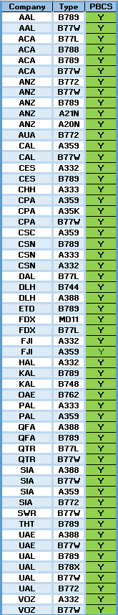
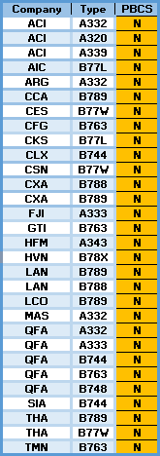
PBCS status
  65% of Airlines are indicating PBCS status in their FPL.
  Monthly performance monitoring and reporting program implemented. Detail of this is briefed in our IP NZ1.
5
| ISPACG FIT 27 2020

Slide 6
Latency Monitor
Implemented latency monitor uplink 21 June 2018.
    Supports PBCS safety requirement #15 on aircraft - mitigating late message receipt.
    Message is sent by CPDLC free text when NZZO is confirmed CDA requesting aircraft set 300”.
    Implementation incorporates 2” delay in timestamp to mitigate timing issue in some Airbus fleets which has now been fixed.
    NZZO was sending 4600/month pre-pandemic, now around 1100/month.
    Latency reject messages from Airbus aircraft are running at 1 in 1152 uplinks or 0.09%.
    More detail on the latency monitor is contained in our IP NZ2.
6
| ISPACG FIT 27 2020

Slide 7
Performance
7
| ISPACG FIT 27 2020

Slide 8
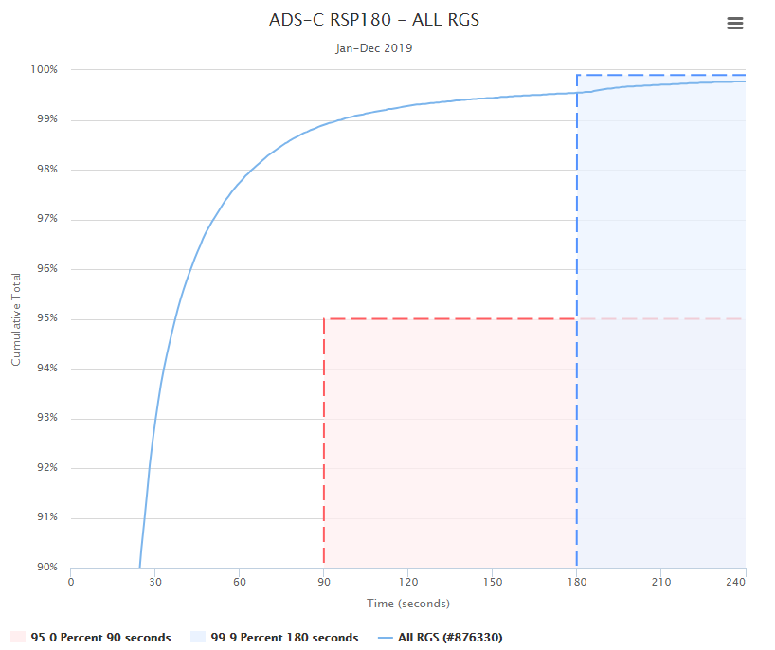
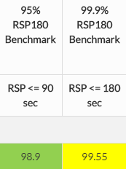
ADS-C RSP180 – All RGS 2019
No significant change observed from 2018 year.
8
| ISPACG FIT 27 2020

Slide 9
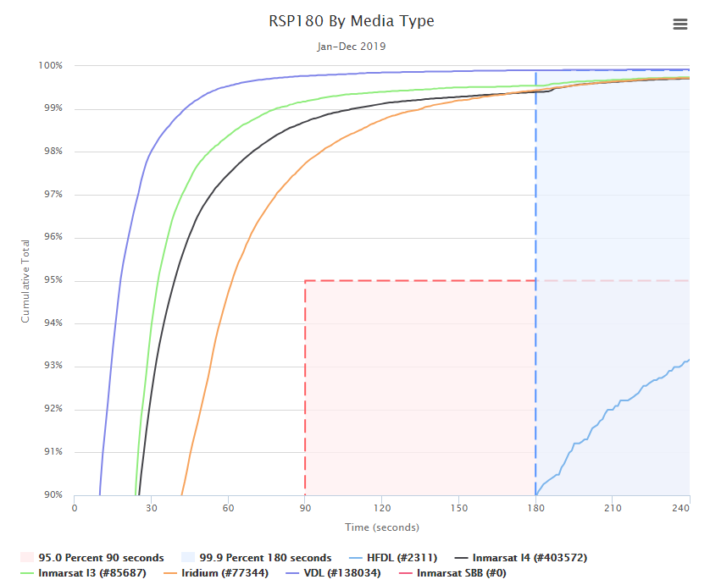
ADS-C RSP180 – By Media Type 2019
9
| ISPACG FIT 27 2020

Slide 10
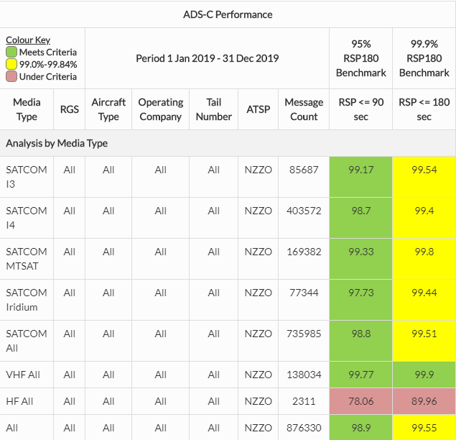
ADS-C RSP180 – By Media Type 2019
10
| ISPACG FIT 27 2020

Slide 11
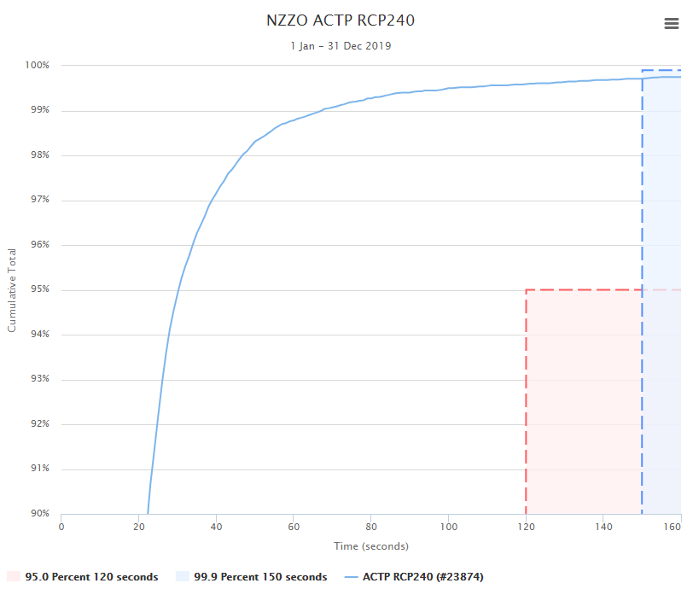
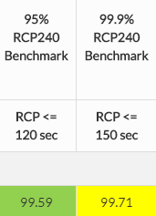
CPDLC RCP240 – Actual Communications Technical Performance (ACTP) – All RGS 2019
No significant change observed from 2018 year.
11
| ISPACG FIT 27 2020

Slide 12
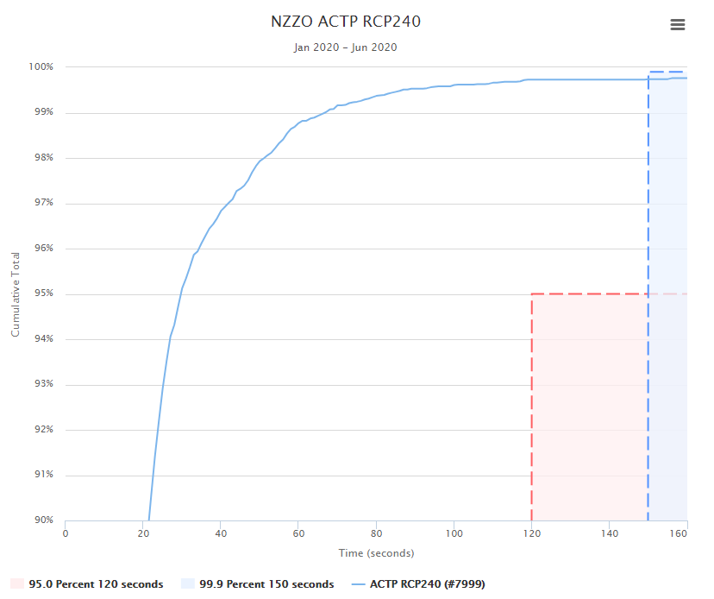
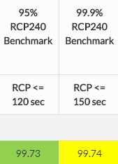
CPDLC RCP240 – Actual Communications Technical Performance (ACTP) – All RGS 2020
Slight improvement observed on 2019 year.
12
| ISPACG FIT 27 2020

Slide 13
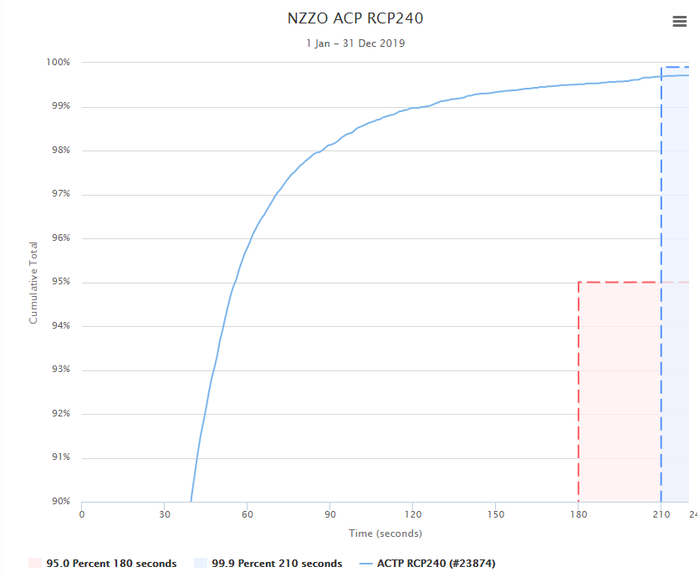
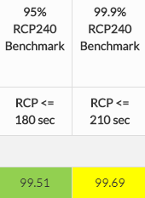
CPDLC RCP240 – Actual Communications Performance (ACP) – All RGS 2019
No significant change observed from 2018 year.
13
| ISPACG FIT 27 2020

Slide 14
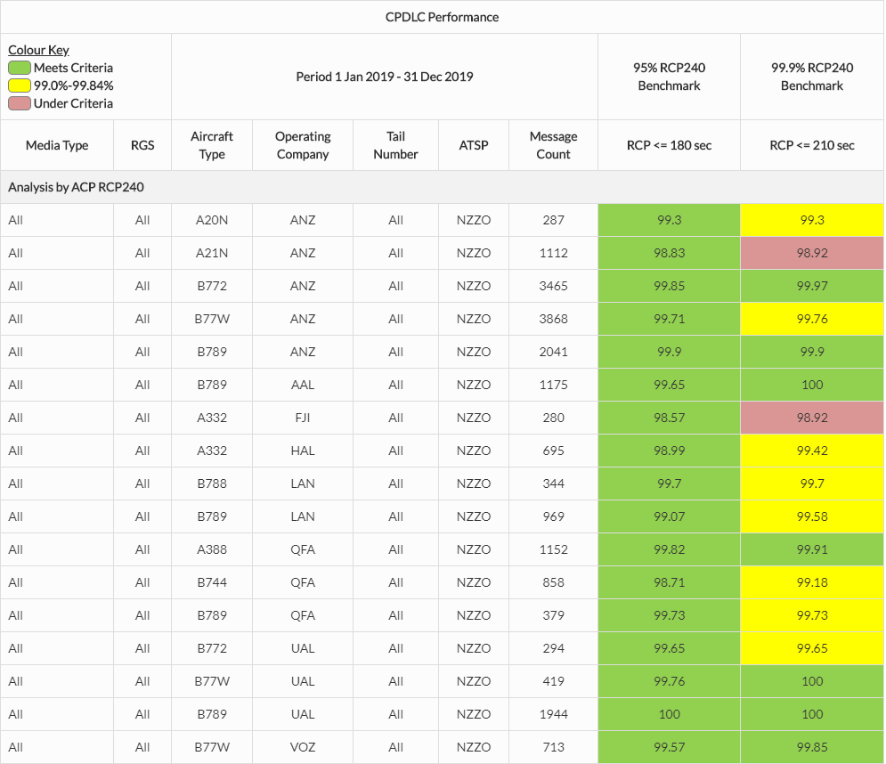
CPDLC RCP240 – Actual Communications Performance – By Operator and Type 2019 (top 17)
14
| ISPACG FIT 27 2020

Slide 15
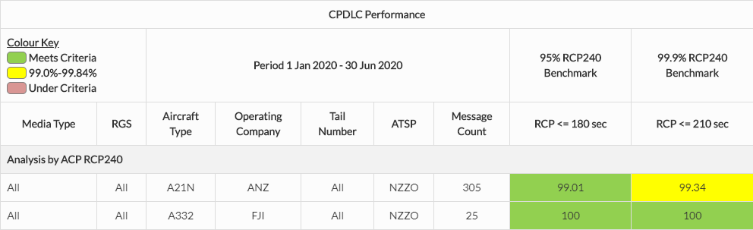
CPDLC RCP240 – Actual Communications Performance – Performance Improvements
FJI A332 have operated as PBCS qualified since mid 2019 and have stopped using HFDL in the “next-on-busy” mode.
ANZ A21N improved performance late 2019 following crew training initiatives by the airline.
15
| ISPACG FIT 27 2020

Slide 16
Iridium Performance
16
| ISPACG FIT 27 2020

Slide 17
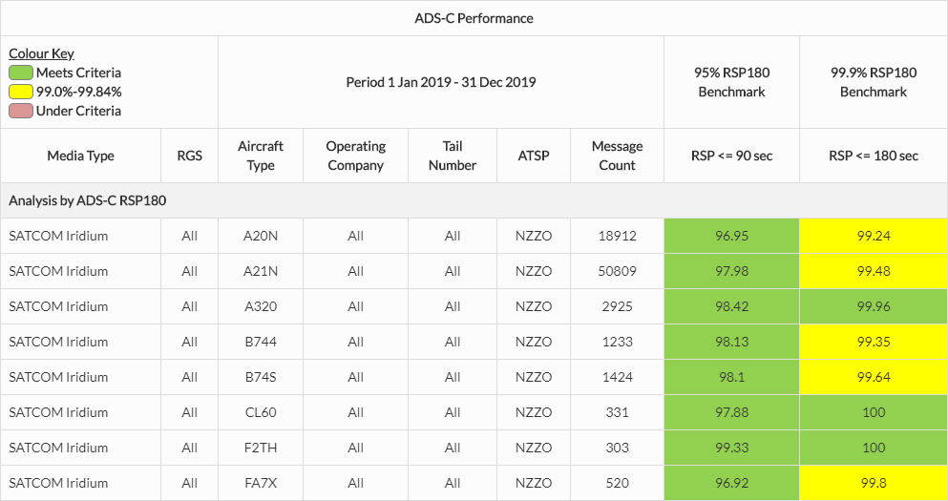
Significant performance improvement observed since April 2018 continues.
8.8% of ADS-C downlinks via Iridium.
ADS-C RSP180 – Iridium Performance– All RGS
17
| ISPACG FIT 27 2020

Slide 18
HFDL Performance
18
| ISPACG FIT 27 2020

Slide 19
HFDL Performance
Performance when used in “next on busy” mode does not cause significant performance deterioration.
Performance when used as primary media in event of SATCOM failure does NOT meet RSP180 performance requirements.
Dispatching with no SATCOM will not meet PBCS in oceanic.
0.3% of ADS-C reports are using HFDL, 0.1% of CPDLC RCP240 monitored transactions are using HFDL
FANS1/A problem solution tracker has a recommended solution to HFDL performance issues …………..
19
| ISPACG FIT 27 2020

Slide 20
ADS-C RSP180 – HFDL Performance – FANS1/A problem solution tracker resolution
2) HF datalink – next-on-busy Certain Airbus ATSU and Rockwell Collins CMU-900 software versions implement a feature called “next-on-busy” by which those avionics send a new downlink via HF datalink when outside of VHF coverage and SATCOM is busy sending a previous downlink, instead of waiting for SATCOM to finish sending the previous downlink and then sending the new downlink via SATCOM. This feature reduces datalink performance because the avionics can actually deliver the new downlink more quickly if they wait for SATCOM to finish sending the previous downlink and then send the new downlink via SATCOM.
 | Option Work with Airbus and Rockwell Collins to install avionics software versions that disable the next-on-busy feature.
3) HF datalink – general HF datalink performance has not been demonstrated to meet the RCP240 and RSP180 specifications, although for various reasons avionics may send FANS downlink messages via HF datalink.
 | a) Option – Manually prevent HF datalink use Prevent HF datalink use manually by implementing flight crew procedures to disable HF datalink (usually by placing the HF radio used for HF datalink into voice mode).
 | b) Option – Automatically prevent HF datalink use Prevent HF datalink use automatically with capable avionics (for example, by deselecting HF datalink as an allowed subnetwork for FANS downlink messages in the 777 DCMF AMI or 787 CMF AMI).
20
| ISPACG FIT 27 2020

Slide 21
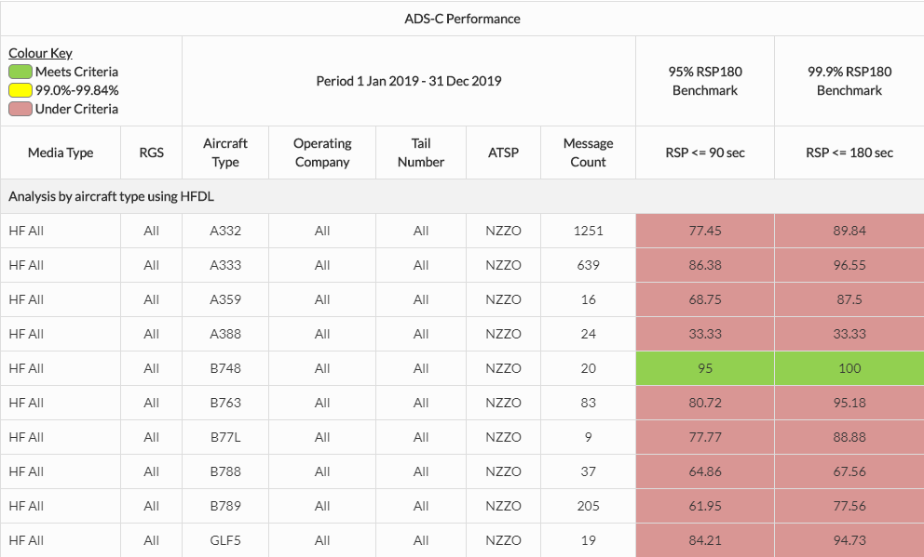
ADS-C RSP180 – HFDL Users
21
| ISPACG FIT 27 2020

Slide 22
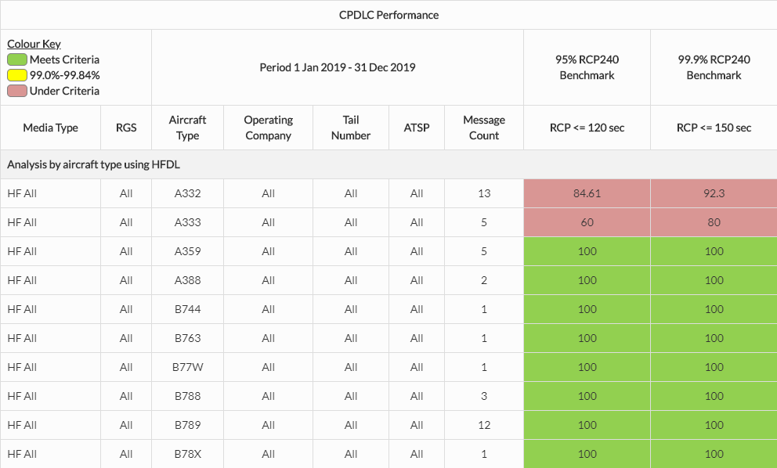
CPDLC RCP240 – HFDL Users
22
| ISPACG FIT 27 2020

Slide 23
Availability
23
| ISPACG FIT 27 2020

Slide 24
Availability
RCP240/RSP180 specifications call for a safety availability of 0.999. This equates to:
  A maximum of 48 unplanned outages
  A maximum accumulated outage of 520 minutes
  Unplanned outage notification within 5 minutes
In 2019 an assessment based on reported outages to NZZO that could have operational impact in NZZO shows :
  28 unplanned outages
  The accumulated outage was 1549 minutes
  Notification delay variable. Very few were under 10 minutes with the best 7 minutes and the worst 4 days (please refer FANS PR 2802-MM)
A review of the 2019 outages where an operational impact was seen in NZZO shows:
  10 unplanned outages had operational impact
  The accumulated outage time where there was operational impact was 515 minutes (approximately 8½ hours).
24
| ISPACG FIT 27 2020

Slide 25
Availability
A review of the January-June 2020 outages and assessing if an operational impact was seen in NZZO shows:
  4 notified unplanned outages had an operational impact with an accumulated outage time of 550 minutes.
  SITA advisories were not received by Airways between 13 Jan and 7 April. During this we detected 1 Iridium outage of 30 minutes on 11 Feb between 1830 and 1900.
  The accumulated outage time is 580 minutes (approximately 9½ hours).
25
| ISPACG FIT 27 2020

Slide 26

Thank you

