Slide 1



Agenda Item #6 – IP NZ2
Latency Monitor
ISPACG FIT 27
Virtual meeting
2200 UTC, 30 June 2020

Slide 2
Latency Monitor
Implemented latency monitor uplink 21 June 2018.
    Supports PBCS safety requirement #15 on aircraft - mitigating late message receipt.
    Message is sent by CPDLC free text when NZZO is confirmed CDA requesting aircraft set 300”.
    Implementation incorporates 2” delay in timestamp to mitigate timing issue in some Airbus fleets which has now been fixed.
    NZZO was averaging 4627/month pre-pandemic, now 1115/month.
    Latency reject messages from Airbus aircraft are running at 1 in 1152 uplinks or 0.09%.
    Observing an average 7 rejects/month pre-pandemic but during reduced traffic levels since March 2020 have observed none.
2
| ISPACG FIT 27 2020

Slide 3
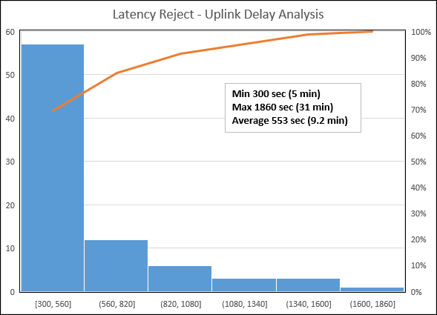
Latency Monitor rejected uplink delay analysis
3
| ISPACG FIT 27 2020

Slide 4
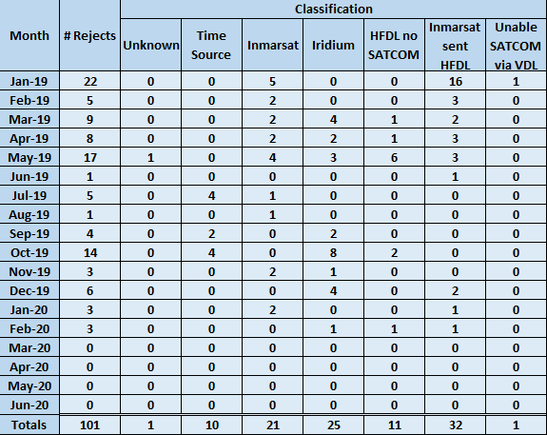
Latency Monitor rejects by month and classification
4
| ISPACG FIT 27 2020

Slide 5
Latency Monitor
During review period 345,049 CPDLC uplinks initiated
116,377 uplinks to Airbus aircraft
101 rejects – failure rate of 1 in 1152 or 0.09%
Of the 101 rejected uplinks:
  43% sent by HFDL
    32% when operating Inmarsat
    11% when operating no satcom
  25% sent by Inmarsat satcom
  21% sent by Iridium satcom
  10% attributed to aircraft time source error
5
| ISPACG FIT 27 2020

Slide 6
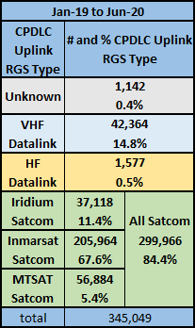
Latency Monitor – reject rates in NZZO by RGS type
Latency reject message rate:
  Via HFDL = 4%
  Via Iridium = 0.07%
  Via Inmarsat = 0.03%
6
| ISPACG FIT 27 2020

Slide 7
Latency Monitor
A review of uplink rejects is now included in monthly PBCS monitoring.
Please refer to the attachment to the IP for a summary of all rejects observed during the review period.
7
| ISPACG FIT 27 2020

Slide 8

Thank you

