Slide 1
Performance-based Communication and Surveillance (PBCS)
Monitoring Report:
FAA – Oakland Oceanic Airspace
ISPACG35 / FIT27
Virtual
28-29 July 2020

Slide 2
Overview
Data link performance – airspace level evaluation
  Summary for aggregate airspace and by media type
  By path identifier
  FANS over Iridium
  FANS over SwiftBroadband
Data link performance – aircraft level evaluation

Slide 3
Performance by media type

Slide 4
Performance by Media Type
81,362
data link flights
January – June 2020
Oakland
Media Type | ADS-C |  |  | CPDLC
 | Count of ADS-C Downlink Messages | ADS-C 95% | ADS-C 99.9% | Count of CPDLC Transactions | ACTP 95% | ACTP 99.9% | ACP 95% | ACP 99.9%
Performance Criteria |  | RSP 180 |  |  | RCP 240
Aggregate | 3,177,308 | 98.9% | 99.6% | 306,146 | 99.3% | 99.6% | 99.2% | 99.5%
SAT | 2,776,704 | 98.9% | 99.6% | 283,954 | 99.5% | 99.7% | 99.4% | 99.6%
VHF | 393,275 | 98.9% | 99.6% | 16,731 | 99.9% | 99.9% | 99.7% | 99.8%
HF | 7,290 | 63.2% | 76.6% | 158 | 59.5% | 67.7% | 67.1% | 71.5%
SAT-VHF |  |  |  | 1,836 | 94.1% | 95.8% | 89.9% | 90.8%
VHF-SAT |  |  |  | 1,364 | 95.7% | 97.9% | 96.7% | 97.9%
SAT-HF |  |  |  | 984 | 82.5% | 86.8% | 85.4% | 87.9%
HF-SAT |  |  |  | 987 | 97.6% | 98.6% | 97.5% | 98.7%
VHF-HF |  |  |  | 61 | 80.3% | 88.5% | 85.3% | 85.3%
HF-VHF |  |  |  | 71 | 90.1% | 94.4% | 94.4% | 94.4%

Slide 5
Performance by path

Slide 6
Satellite Service Provider (SSP) | Satellite | Service | Ground Station Location | ARINC ACARS Identifiers | SITA ACARS Identifiers
Iridium | All | Short Burst Data | Primary: Tempe, Arizona, US Secondary: None | IG1 | IGW1
Inmarsat | AORE (3F5 at 54°W) | Classic Aero | Burum, Netherlands | XXN | AOE6
 |  | Swift Broadband-Safety | N/A | N/A | N/A
 | EMEA (AF1 at 25°E) | Classic Aero over I-4 | Primary: Fucino, Italy Secondary: Burum, Netherlands | XXF | EUA1
 |  | Classic Aero over I-4 (virtual I-3 IOR) | Burum, Netherlands | XXI | EUA2
 |  | Swift Broadband-Safety | Primary: Burum, Netherlands Secondary: Fucino, Italy | XXB | EUA9
 | APAC (4F1 at 143.5°E) | Classic Aero over I-4 | Primary: Paumalu, Hawaii, US Secondary: Auckland, New Zealand | XXA | APK1
 |  | Classic Aero over I-4 (virtual I-3 POR) | Perth, Australia | XXP | APK2
 |  | Swift Broadband-Safety | Primary: Paumalu, Hawaii, US Secondary: Auckland, New Zealand | XXS | APK9
 | AMER (4F3 at 98°W) | Classic Aero over I-4 | Primary: Paumalu, Hawaii, US Secondary: Auckland, New Zealand | XXH | AME1
 |  | Classic Aero over I-4 (virtual I-3 AORW) | Laurentides, Canada | XXW | AME2
 |  | Swift Broadband-Safety | Primary: Paumalu, Hawaii, US Secondary: Laurentides, Canada | XXU | AMR9
 | MEAS (4F2 at 64°E) | Swift Broadband-Safety | Primary: Burum, Netherlands Secondary: Fucino, Italy | XXM | MEA9
MTSAT |  |  | Kobe and Hitachiota, Japan | N/A | MTS1

Slide 7
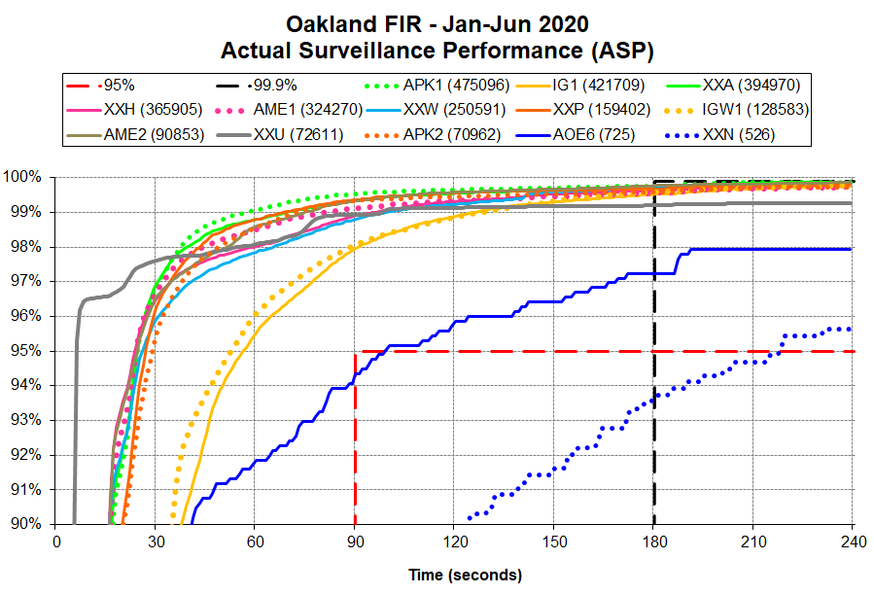

Slide 8
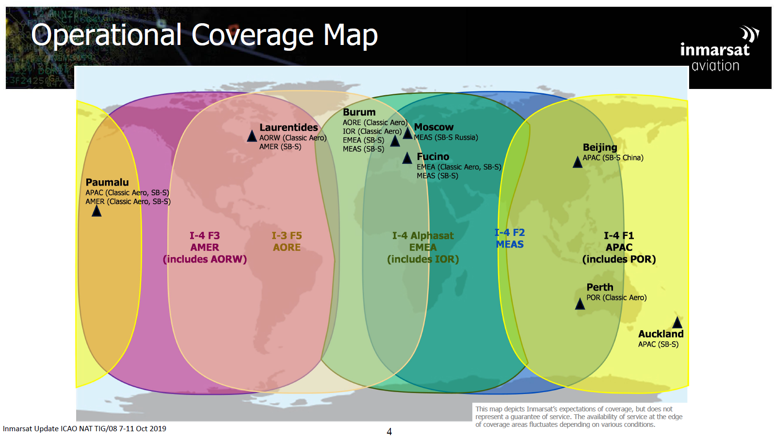

Slide 9
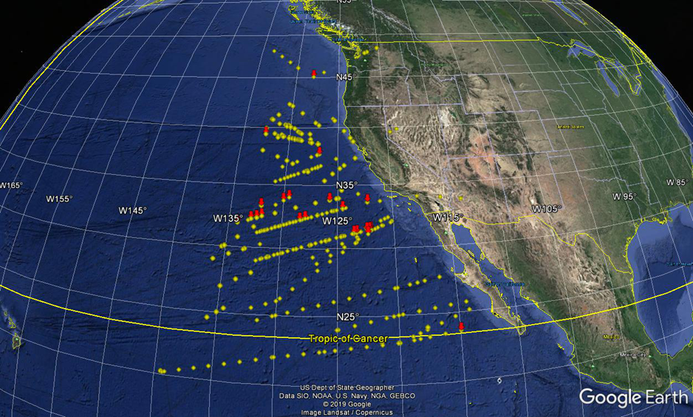
AOE6/XXN ADS-C position reports – Dec 2019
SSP | Satellite | Service | Ground Station Location | ARINC | SITA
Inmarsat | AORE (3F5 at 54°W) | Classic Aero | Burum, Netherlands | XXN | AOE6

Slide 10
FANS Over iridium

Slide 11
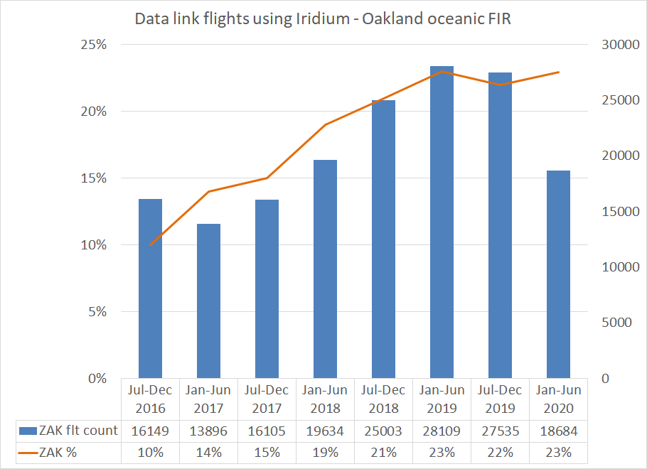

Slide 12
FANS Over swift broadband

Slide 13
FANS over SBB Data Link Usage
Jan-Jun 2020 | KZAK
FANS data link airframes using SBB | 23
Total flights observed | 2418

Slide 14
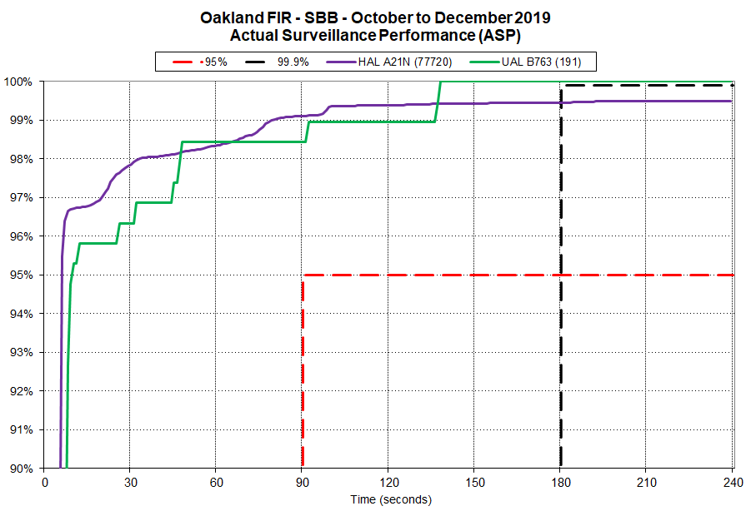

Slide 15
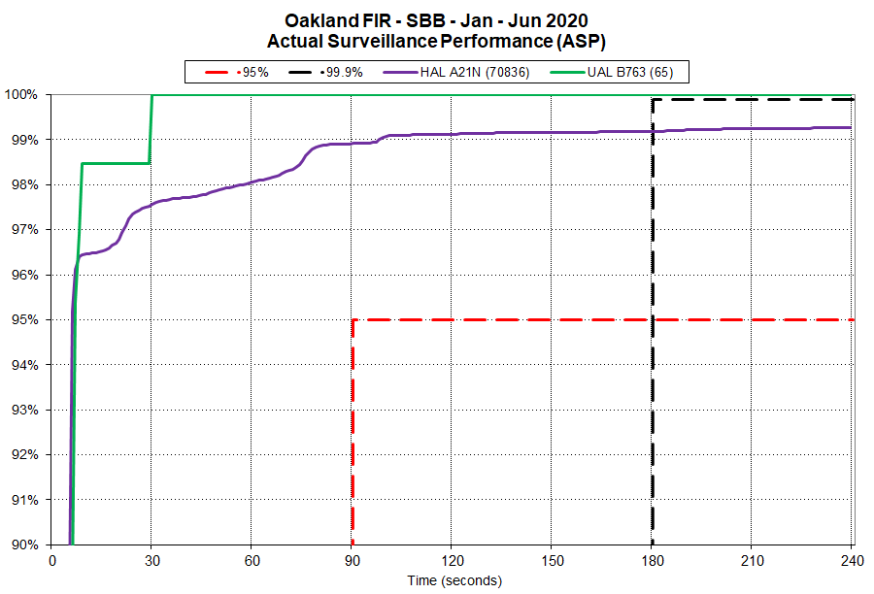

Slide 16
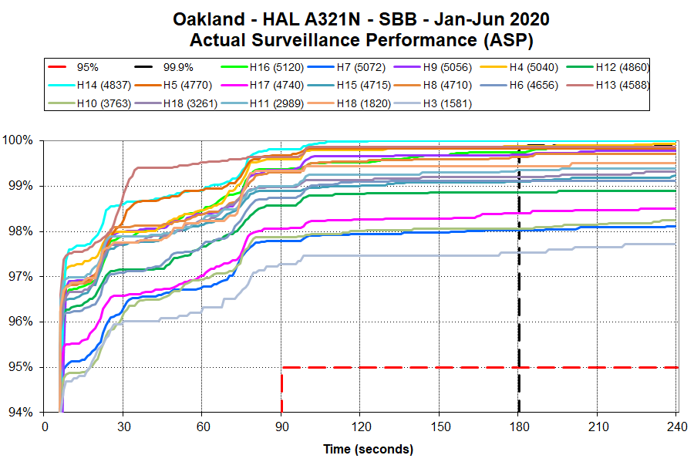

Slide 17
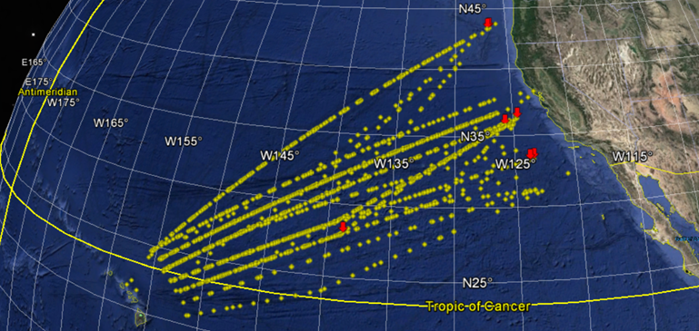
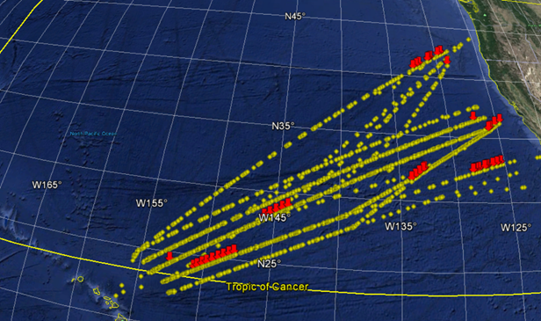
Airframe N214HA – Dec 2019
99.8% within 90 sec
100% within 180 sec
Airframe N227HA – Dec 2019
97.9% within 90 sec
98.2% within 180 sec

Slide 18

Case study: Disable HF Next-on-busy
 | ADS-C Actual Surveillance Performance (ASP) |  |  |  |  |  | CPDLC Actual Communication Performance (ACP)
Fleet | Before: Sep-19 |  |  | After: Nov-19 |  |  | Before: Sep-19 |  |  | After: Nov-19
 | ADS-C downlink count | Latency < 90 sec | Latency > 180 sec | ADS-C downlink count | Latency < 90 sec | Latency > 180 sec | CPDLC transaction count | Round trip time < 180 sec | Round trip time < 210 sec | CPDLC transaction count | Round trip time < 180 sec | Round trip time < 210 sec
B738 fleet | 36,161 | 94.5% | 97.9% | 57,723 | 97.3% | 99.4% | 2,852 | 96.0% | 96.6% | 4,902 | 98.4% | 98.9%
B739 fleet | 18,209 | 95.0% | 98.4% | 13,376 | 97.2% | 99.3% | 1,306 | 97.2% | 98.2% | 1,037 | 98.5% | 98.8%

Slide 19
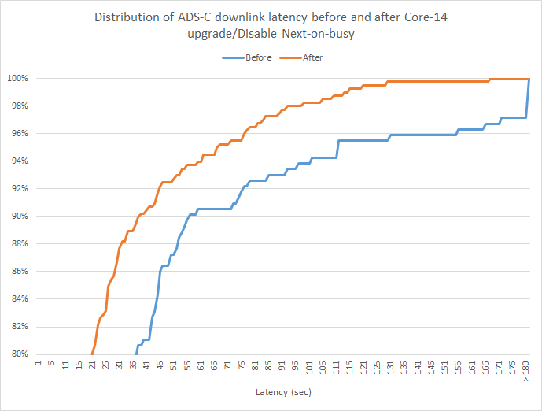
Upgrade 10/15/2019
 | Before | After
Total ADS-C downlink reports | 243.0 | 398.0
% > 90 sec | 93.0% | 97.5%
% > 180 sec | 97.1% | 100.0%
Avg | 31.9 | 18.9
Max | 746.0 | 167.0

Slide 20
