Slide 1
Performance-based Communication and Surveillance (PBCS)
Non-compliance Reporting Updates
ISPACG35 / FIT27
Virtual
28-29 July 2020

Slide 2
Overview
PBCS monitoring requirements
PBCS aircraft performance monitoring programs
  Combined regional reporting
  Monthly reporting
Extra slides: PBCS resources
  FANS-CRA website
  NAT Ops Bulletin – data link performance improvement options
  ICAO website

Slide 3
ICAO PBCS monitoring requirements
Annex 11, Air Traffic Services
3.3.5.2 Where RCP/RSP specifications are applied, programmes shall be instituted for monitoring the performance of the infrastructure and the participating aircraft against the appropriate RCP and/or RSP specifications, to ensure that operations in the applicable airspace continue to meet safety objectives. The scope of monitoring programmes shall be adequate to evaluate communication and/or surveillance performance, as applicable.
Annex 6, Operation of Aircraft, Part I
7.1.5 The State of the Operator shall ensure that, in respect of those aeroplanes mentioned in 7.1.3, adequate provisions exist for:
  receiving the reports of observed communication performance issued by monitoring programmes established in accordance with Annex 11, Chapter 3, 3.3.5.2; and
  taking immediate corrective action for individual aircraft, aircraft types or operators, identified in such reports as not complying with the RCP specification(s).
Note: corresponding requirements in Part I, paragraph 7.3.4, and Part II, paragraphs 2.5.1.9 and 2.5.3.5

Slide 4
PBCS Aircraft Performance Monitoring Programs
Combined regional reporting
1 of 2
Semi-annual reports posted on www.FANS-CRA.com for:
  North Atlantic - Gander, New York, Santa Maria, Shanwick, Reykjavik
  Pacific - Anchorage, Auckland, Fukuoka, Nadi, Oakland, Tahiti
When “red” performance is observed, operators should consult applicable regulatory document, e.g. AC 90-117, and contact relevant monitoring PoC(s) for more details

Slide 5
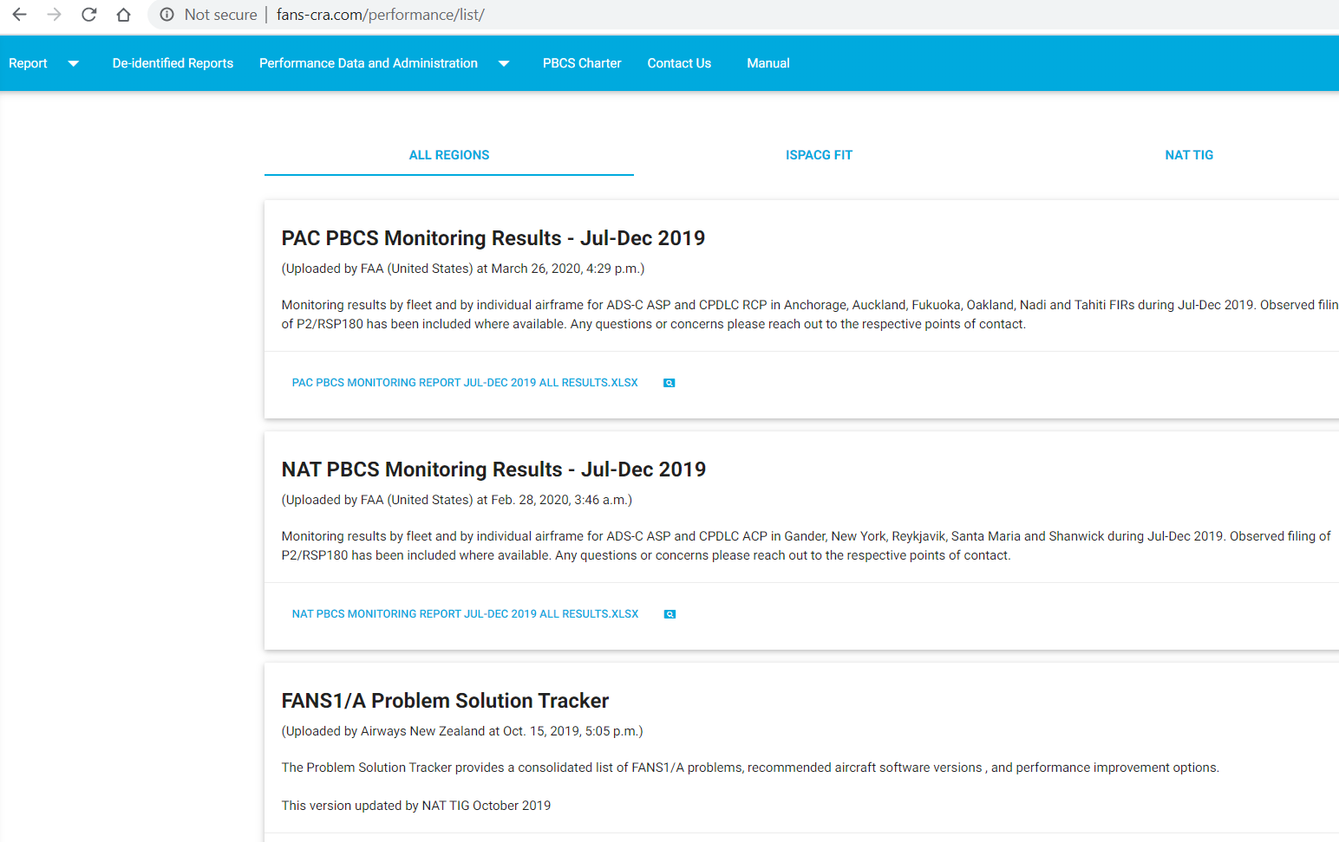
PBCS Monitoring Results – Fleet/Airframe

Slide 6
PBCS Aircraft Performance Monitoring Programs
Combined regional reporting
2 of 2
Annual reports for Asia-Pacific
  Data compiled through and reported to the FANS Interoperability Team – Asia (FIT-Asia) group
Reporting FIRS
State | FIR
United States | Oakland Oceanic
Fiji | Nadi
French Polynesia | Tahiti
New Zealand | Auckland Oceanic
Sri Lanka | Colombo
India | Chennai
Viet Nam | Ho-Chi-Minh
Myanmar | Yangon
Malaysia | Kota Kinabalu
 | Kuala Lumpur
Singapore | Singapore
Australia | Brisbane
 | Melbourne
China | Lanzhou
 | Urumqi

Slide 7
PBCS Aircraft Performance Monitoring Programs Monthly reporting
New process being coordinated globally for ATSPs to compile and send reports for cases of airframe non-compliance to the relevant Regional Monitoring Agencies (RMAs)
Reporting started in late 2019 from Singapore South East Asia Safety Monitoring Agency (SEASMA)
Reporting started by North Atlantic Central Monitoring Agency (NAT CMA) mid-July 2020
Other RMAs starting end of July 2020

Slide 8
PBCS monthly monitoring process
Compile data
Identify airframes below 95% for RSP180 and/or RCP240
Check if these aircraft filed P2/RSP180 during the past month
Investigate further
Assess scope using data from other periods and other FIRS (if applicable)
Determine if a known issue
If aircraft DID file P2/RSP180:Submit non-compliance report to relevant RMA
If aircraft DID NOT file P2/RSP180: Contact operator if possible, or Submit problem report to FANS-CRA (DLMA) for further investigation

Slide 9
ATSP Investigate further…
Check performance in 2 previous months
  Helps identify ongoing vs. new problems, scope of problem
Check locations of reports > 90 seconds
  Helps identify if delays occur in VHF/SAT or SAT/SAT transition areas, FIR boundaries
Check media types of reports > 90 seconds (and reports before and after)
  Helps identify or confirm HF data link problems, media transition problems, specific media/path problem
Check estimated PORT if ACP < 95%
  *May* help identify abnormal pilot response behavior
Check if issue occurred on one leg and was subsequently resolved

Slide 10
FAA PBCS Analysis Tool
Platforms used
  Front end: Tableau
  Data processing: Python
    Input data: PBCS-formatted ACP and ASP files
Used to support investigations of non-compliant aircraft to determine if a report should be generated

Slide 11
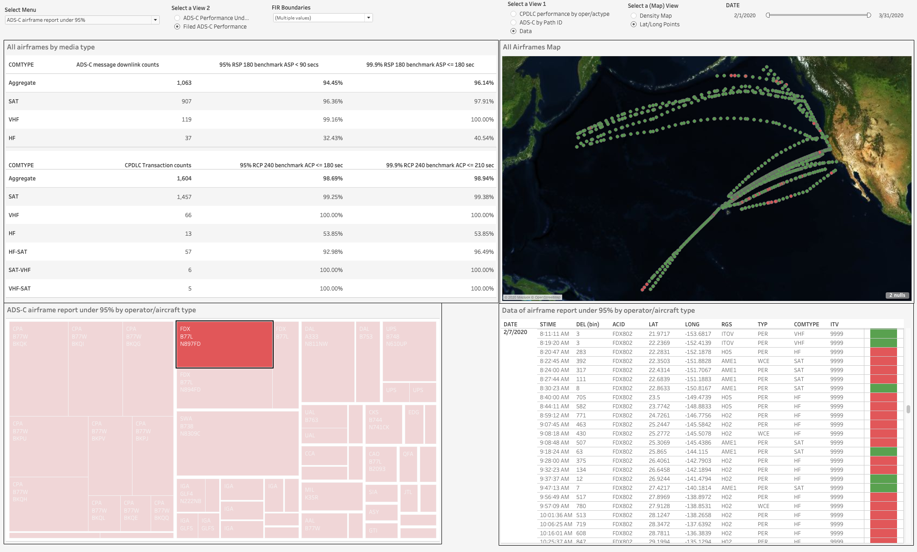

Slide 12
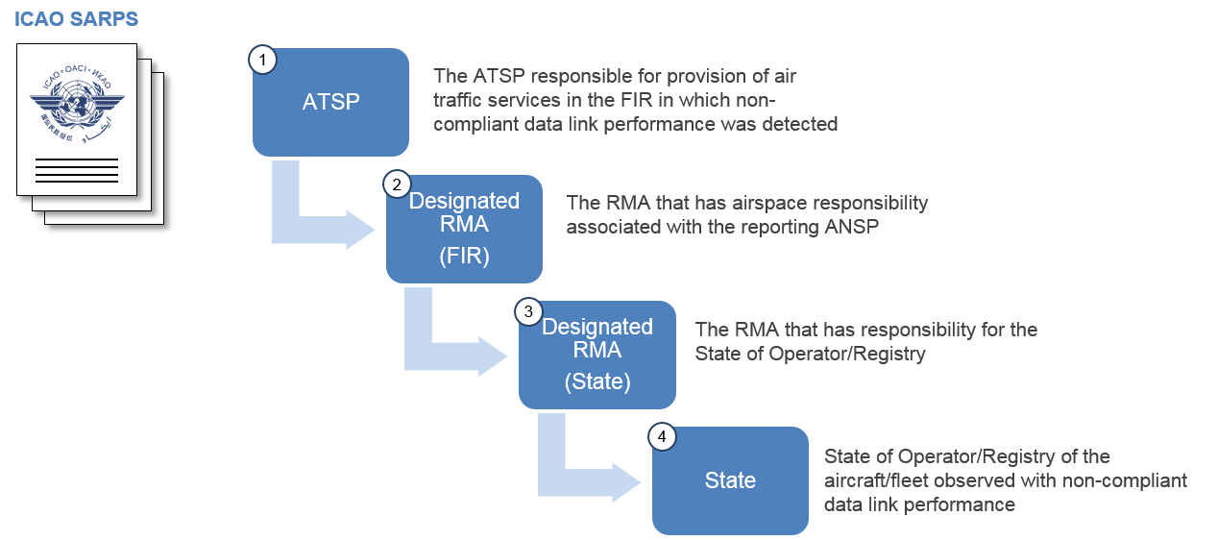
Non-compliance reporting
RMA: regional monitoring agency

Slide 13

ICAO Endorsed Regional Monitoring Agencies (RMAs)
Eurasia RMA
NAT CMA
NAARMO
Eur RMA
China RMA
PARMO
Mid RMA
Japan RMA
ARMA
MAAR
AAMA | Australian Airspace Monitoring Agency
ARMA | African and Indian Ocean (AFI) Regional Monitoring Agency
CARSAMMA | Caribbean and South American Monitoring Agency
China RMA | China Regional Monitoring Agency
EurAsia RMA | Regional Monitoring Agency Eurasia
Eur RMA | European Regional Monitoring Agency
Japan RMA | Japan Regional Monitoring Agency
MAAR | Monitoring Agency for Asia Region
Mid RMA | Middle East Regional Monitoring Agency
NAARMO | North American Approvals Registry and Monitoring Org
NAT CMA | North Atlantic Central Monitoring Agency
PARMO | Pacific Approvals Registry and Monitoring Organization
SATMA | South Atlantic Monitoring Agency
CARSAMMA
SATMA
AAMA

Slide 14
PBCS ATSP Non-compliance Report Form
Report Date: |  |  | 7/27/2020
Period of observed non-compliance: |  |  | Jan-Mar 2020
Reporting Air Traffic Service Provider (ATSP): |  |  | FAA - Oakland
Contact email address(es) at Reporting ATSP: |  |  | FAAPBCSmonitoring@faa.gov
Reporting to Regional Monitoring Agency (RMA): |  |  | PARMO
ICAO CODE: |  |  | XXX
Airline Operator: |  |  | XXX Inc.
State of Operator/Registry: |  |  | United States
PBCS Data
FIR | 4-letter ICAO Aircraft Type | Registration | ADS-C downlink Message Counts | 95% RSP 180 Benchmark | CPDLC Transaction Counts | 95% RCP 240 benchmark | Issue code
 |  |  |  | ASP |  | ACP
 |  |  |  | <=90 sec |  | <=180 sec
KZAK | B772 | Reg 1 | 410 | 93.41% | 25 | 96.00% | (*1)(*3)
KZAK | B772 | Reg 2 | 290 | 94.48% | 21 | 95.24% | (*1)

Slide 15
Issue code | Explanation | Recommendation(s)
(*1) Delayed reports around VHF/SAT transitions. | This note is used when ADS-C or CPDLC reports are observed with delays when there is mixed media usage in the sequence of reports before, at or after the delayed reports (ex.: VHF/VHF/SAT/VHF/SAT). | - Review "NAT OPS Bulletin 2019_003: Data Link Performance Improvement Options" and recommended solutions/actions (Problem/Issue #2).
(*2) Delayed reports via HF media. | This note is used when delayed ADS-C or CPDLC reports are observed to be delivered via HF data link (HFDL) or near reports delivered via HFDL. Check whether this appears to be a SATCOM failure with one flight or a period during the flight, or more continuous, intermittent use of HFDL. Potential issue with aircraft media priority settings. | - Review "NAT OPS Bulletin 2019_003: Data Link Performance Improvement Options" and recommended solutions/actions (Problem/Issue #1, #4, #9). - Review all Service Information Letters (SILs) and Software Bulletins (SBs) released from Satcom avionics manufacturers, particularly advice on Operator Requirement Table (ORT) set-up. - Operator should be aware that HFDL DOES NOT meet the RCP/RSP criterias for PBCS operations.
(*3) Delayed reports due to Inmarsat satellite to satellite transition (aircraft) or satellite problems (network). | This note is used when ADS-C or CPDLC reports are observed with delays and its noticed that there is a switch sequence between different or same Inmarsat satellite paths (Ex.: XXF/XXH/XXF/XXH). One known area where this occurs in the NAT is at 30W longitude. If multiple aircraft observed with same issue around same time, may be a network-related issue and ATSP may want to report to FANS-CRA/DLMA. | - Review all Service Information Letters (SILs) and Software Bulletins (SBs) released from Satcom avionics manufacturers, particularly advice on Operator Requirement Table (ORT) set-up. - Check with contracted Data Link Service Provider and Satellite Service Provider for possible coverage problems.
(*4) Delayed reports due to Iridium avionics (aircraft) or satellite problems (network). | This note is used when ADS-C or CPDLC reports are observed with delays via Iridium satellite paths (IG1, IGW1). If multiple aircraft observed with same issue around same time, may be a network-related issue and ATSP may want to report to FANS-CRA/DLMA. | - Check for SATCOM radio/unit problems.
(*5) Reported only on VHF and/or HF. | This note is used when delayed ADS-C reports or CPDLC messages are observed via VHF and/or HF only (no SATCOM). This might indicate that SATCOM unit is defective or became unavailable during flight. Check if this issue is observed during one flight or part of one flight only, or whether it is an ongoing problem. If not observed on subsequent flights, the issue may have been addressed. | - Operator should not declare PBCS if SATCOM not available. - Check for SATCOM radio/unit problems. - Flight crew should inform ATC if SATCOM becomes unavailable during flight.
(*6) Poor ACP due to high PORT. | This note is used when its found that the delayed CPDLC transactions are caused by high pilot operational response time (PORT). | - Review "NAT OPS Bulletin 2019_003: Data Link Performance Improvement Options" and recommended solutions/actions (Problem/Issue #6). - Review procedures to reduce pilot operational response time (PORT) to CPDLC messages.
(*7) Aircraft data link connection problems detected. | This note is used when we can identify that delays happened on periods that disconnections and reconnections have been performed. Check whether this appears to be a problem with one flight or a period during one flight, or whether it is an ongoing problem. If problem is not observed on later flights, the issue may have been addressed. | - Review "NAT OPS Bulletin 2019_003: Data Link Performance Improvement Options" and recommended solutions/actions (Problem/Issue #8 unknown cause).
(*8) Delays related to specific VHF station. | This note is used when the delayed ADS-C reports and CPDLC messages are observed via a specific VHF ground station. If multiple aircraft observed with same issue, ATSP may want to report to FANS-CRA/DLMA as a VHF station issue. | - Review "NAT OPS Bulletin 2019_003: Data Link Performance Improvement Options" and recommended solutions/actions (Problem/Issue #2).
(*9) FMS time before ATC uplink time. Clock setting not syncronized with GPS. | This note is used when its found that the FMS response time is earlier than the ATC uplink time. According to aircraft manufacturers this happens when clock is set manually and not being set by synchronization with GPS source. | - Review procedures for clock settings to be set to GPS clock instead of manual set of clock.

Slide 16
Monthly non-compliance monitoring
Monitoring period: Jan-Mar 2020
Airspace: | Oakland
Total aircraft observed using data link | 2418
Have 100 or more ADS-C downlink reports and/or CPDLC transactions | 1955
Observed below 95% for RSP180 and/or RCP240 | 46
Filed P2/RSP180 | 25

Slide 17
Top cause for non-compliance:
SAT/VHF transition areas
Do the areas where higher concentrations of delays greater than 90 sec correlate to areas where
  Performance-based separations are applied?
  Controllers experience issues connecting to or getting timely surveillance and com responses from aircraft in those areas?
If no impacts to controllers should we filter the data used for PBCS monitoring for those high concentration areas? (Then aircraft that currently fail the 95% requirements because of VHF/SAT issues will not be flagged)
OR
If there are impacts to controllers in those areas, can the airspace be considered compliant with RCP240/RSP180? How do we assess and mitigate the impacts of VHF/SAT transition areas on controller workload/aircraft performance?

Slide 18
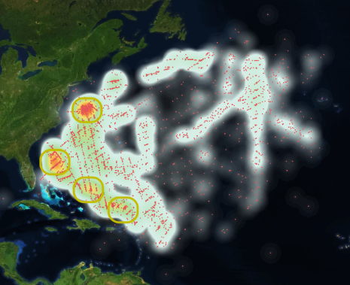

Slide 19
Questions

Slide 20
Extra Slides

Slide 21
Central location for PBCS tools and information www.FANS-CRA.com
Hosts the Central Reporting Agency (CRA)
  AKA Data Link Monitoring Agency (DLMA) in the NAT
Must register for account to obtain secure access
  Available to any FANS data link stakeholder
  Only 1 account per company/organization (if multiple users, expected to share common username and password)
Users can:
  Log data link problem reports
  View common data link problems, solutions, and recommended software versions in the “FANS Problem Solution Tracker”
  Sign up for the PBCS Charter
  View semi-annual regional monitoring results provided by fleet and by registration numbers for contributing FIRs

Slide 22
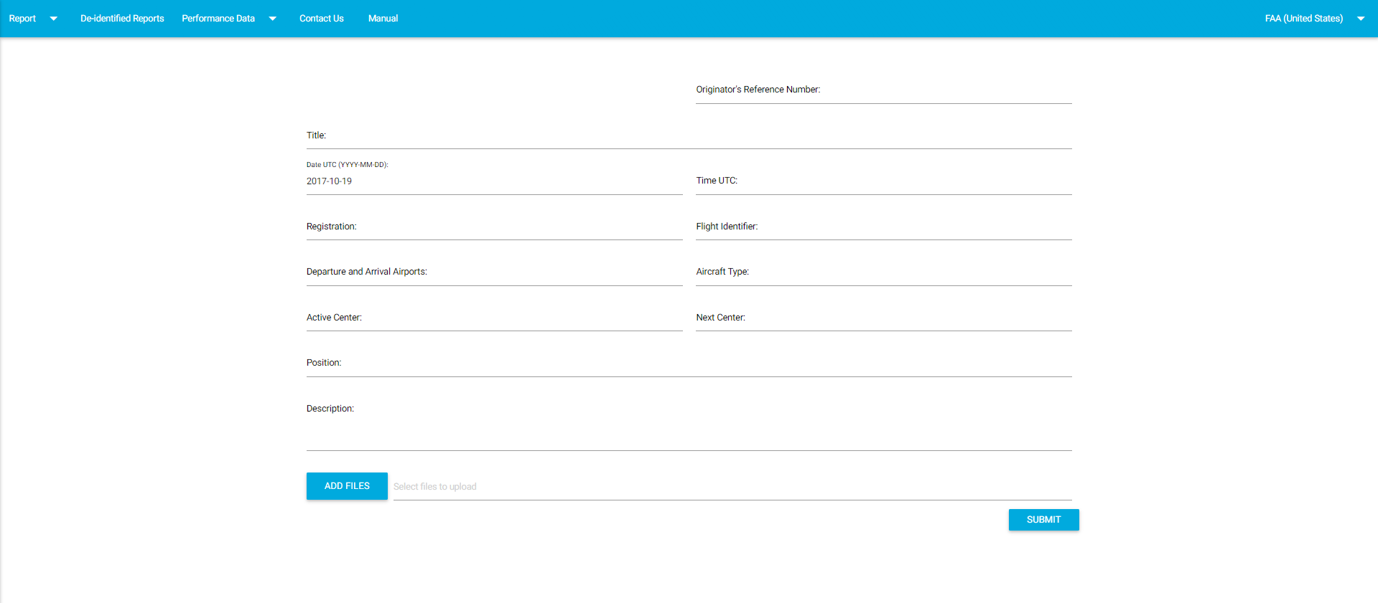
www.FANS-CRA.com
Problem report form

Slide 23
Problem investigation and resolution
Data collection typically involves obtaining logs from involved parties
May include:
  aircraft maintenance system logs
  built-in test equipment data dumps for some aircraft systems
  SATCOM activity logs
  logs/printouts from the flight crew and recordings/logs from the ANSPs involved in the problem
It is crucial that events are reported shortly after event so that the entity collecting data for the analysis task can request and obtain necessary data in a timely manner, as much of it is subject to limited retention

Slide 24
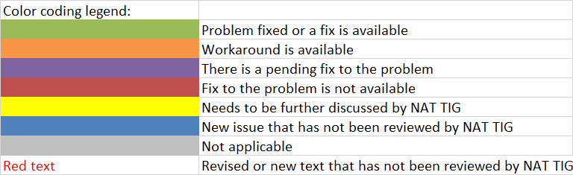
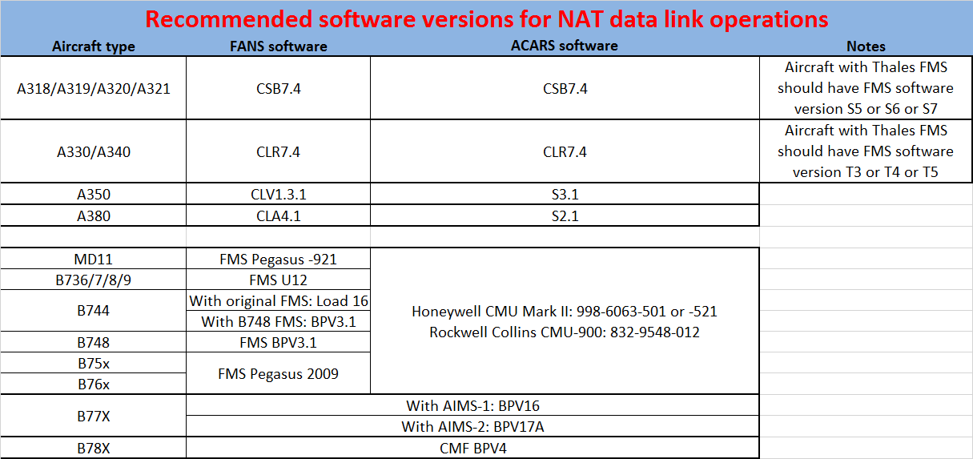
FANS Problem Solution Tracker
Record of current FANS1/A problems and status (Aircraft, Ground, Network)
Workarounds and proposed solutions
Recommended software versions for data link operations

Slide 25
Data link improvement options
https://www.icao.int/EURNAT/Pages/EUR-and-NAT-Document.aspx
NAT Documents
  NAT OPS Bulletins
    NAT OPS Bulletin 2019_003 Data Link performance improvement options

Slide 26

ICAO PBCS website
https://www.icao.int/airnavigation/pbcs/Pages/default.aspx

Slide 27
Monitoring Contacts
Flight Information Region | Email Address
NAT
Gander | PBCS@navcanada.ca
New York | FAAPBCSMonitoring@faa.gov
Reykjavik | PBCS@isavia.is
Santa Maria | Jose.Cabral@nav.pt
Shanwick | tim.murphy@nats.co.uk; fiona.roche@nats.co.uk
PAC
Anchorage, Oakland | FAAPBCSMonitoring@faa.gov
Auckland | Paul.Radford@airways.co.nz
Fukuoka | hqt-cra-jasma@ml.mlit.go.jp
Tahiti | seac-pf-sna-tiare-ld@aviation-civile.gouv.fr
Nadi | IvanW@fijiairports.com.fj

