Slide 1
AIDC
Oakland Center
ISPACG/33
Planning Team
March 18th, 2019
Prepared by: Julia Fuller

Slide 2
Honolulu/OFDPS Planned System Update
There is a known issue with the coordination of flights that originate out of Honolulu or Guam
  Field15 Speed and Level change data is added to Field18 as part of RMK/. The corresponding increase in the size of Field18 can cause AIDC messages sent to Brisbane to get LRMd. This data will be included in every Honolulu Flight Plan that has Speed and Level change data in Field15.
  On occasion incomplete Field10a/10b data is sent in AIDC Coordination Messages for flights originating out of HCF or Guam. Currently Field10a/10b data is not included in the coordination data from OFDPS. Consequently when ATOP does not have an FPL on file, the coordinated Field10a/10b data will not be complete. This happens to ~1-3 southbound flights per month.
Recent Example
  2018-11-29 16:28:22z, LN51GJ
  (CPL-LN51GJ/A2466-IN
  -LJ35/M-VGDWOL/C
  -PHNL-ELLMS/1743F400F380A/W20E
  -N0436F400 EBEBE G457 TUT
  -NSTU
  -STS/MEDEVAC HOSP PBN/A1B2C2D2L1O2 EET/KZAK0038 NZZO0400 OPR/GLOBAL
  JETCARE RMK/ICAO EGKEL N0435F380 EBEBE N0425F430)

Slide 3
Honolulu/OFDPS Planned System Update
Field10a/10b data will soon be included in coordination messages from OFDPS.
Field15 Speed and Level change data will no longer be added to the remarks of the coordination messages from OFDPS
This change is scheduled to be implemented in 2019.
Once this change is implemented, we will monitor the AIDC data and report back on the results at ISPACG/34.

Slide 4
AIDC with Ujung Pandang
Manual coordination is currently used between Oakland and Ujung Pandang.
~0-3 flights are coordinated between Oakland and Ujung Pandang per day.
AIDC testing was performed between Ujung Pandang and the FAA Technical Center in October 2018(2nd,3rd,4th) and December 2018(11th,12th).
Based on that testing the current planned message set will include - ABI, EST, ACP, REJ, MAC, LAM and LRM.
AIDC between Oakland and Ujung Pandang is planned for implementation in 2019.

Slide 5
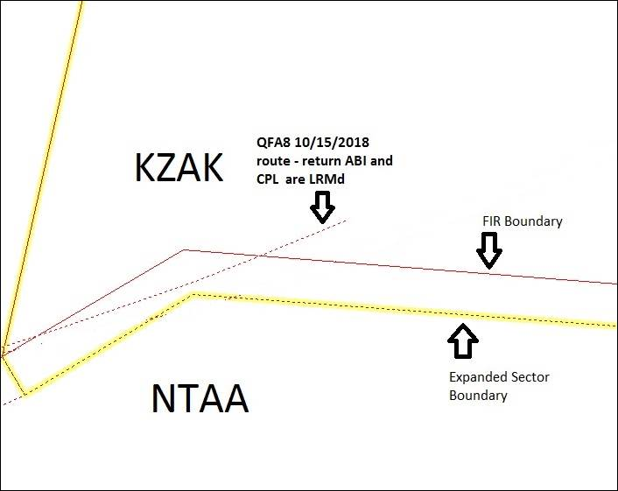
Hemstitching Flights
KZAK⬄NTAA
2018-09-19 UAL101
2018-09-28 UAL101
2018-10-12 UAL101 and QFA8
2018-10-13 UAL101 and QFA8
2018-10-15 QFA8

Slide 6
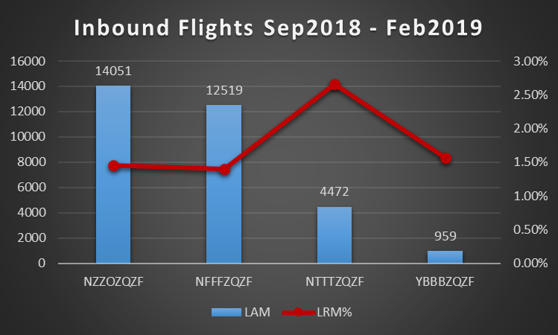
AIDC Messaging
Inbound Flights
FIR/LRM Text | Total
NFFFZQZF | 175
RMK/65/INVALID MESSAGE SEQUENCE | 173
RMK/6/INVALID ACID | 2
NTTTZQZF | 119
RMK/65/INVALID MESSAGE SEQUENCE | 118
RMK/61/0/INVALID CRC | 1
NZZOZQZF | 205
RMK/65/INVALID MESSAGE SEQUENCE | 198
RMK/6/INVALID ACID | 4
RMK/34/14/INVALID CROSSING CONDITION | 3
YBBBZQZF | 15
RMK/65/INVALID MESSAGE SEQUENCE | 14
RMK/61/0/INVALID CRC | 1

Slide 7
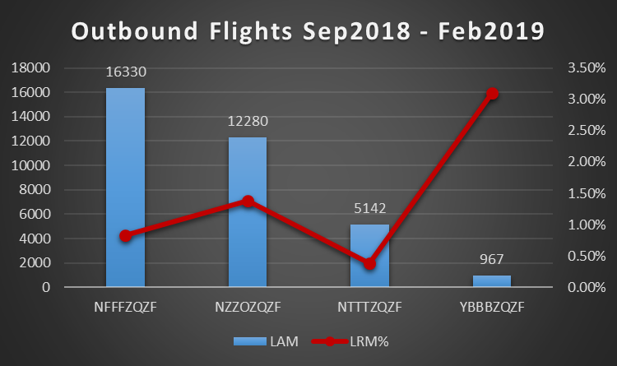
AIDC Messaging
Outbound Flights
FIR/LRM Text | Total
NFFFZQZF | 135
RMK/65/INVALID MESSAGE SEQUENCE | 123
RMK/26/14,15/INVALID ENROUTE POINT | 9
RMK/6/INVALID ACID | 3
NTTTZQZF | 20
RMK/62/7/SYNTAX ERROR : CANNOT DETERMINE TIME | 16
RMK/62/7/SPACE IS MISSING OR FIELD SYNTAX ERROR | 4
NZZOZQZF | 170
RMK/65/INVALID MESSAGE SEQUENCE | 85
RMK/57//SYNTAX ERROR | 85
YBBBZQZF | 30
RMK/62/22/8/IG | 13
RMK/62/22/8/IS | 9
RMK/62/22/8/IM | 3
RMK/62/18/NOT FLIGHT PLAN INFORMATION. | 2
RMK/62/22/8/IN | 2
RMK/4/HEADER ?(FPL | 1

Slide 8
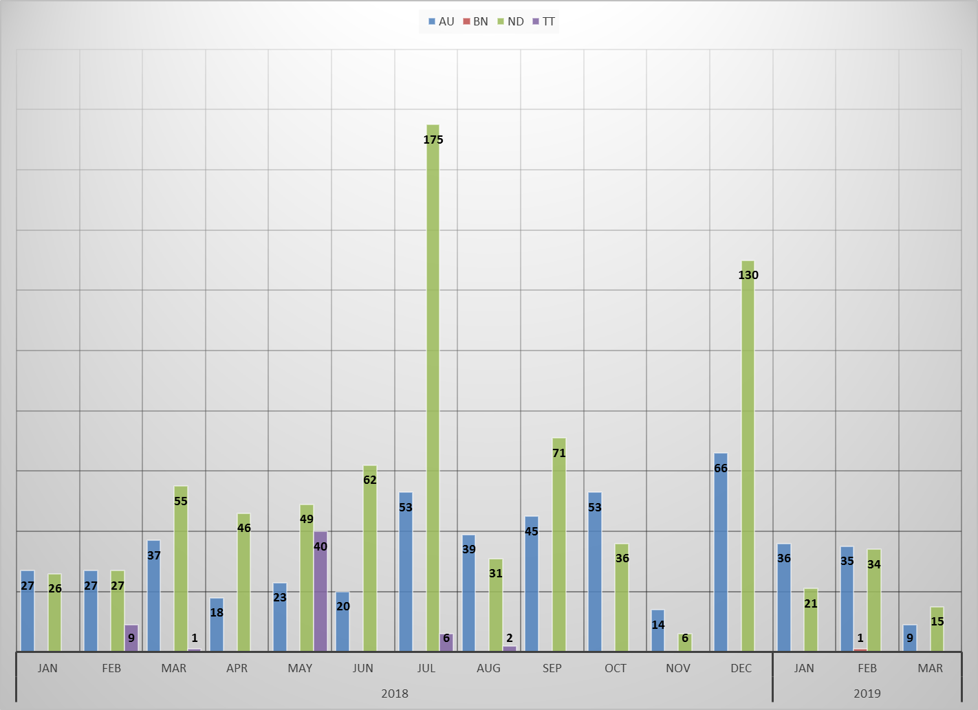
AIDC Messaging
LAM Timeouts

Slide 9
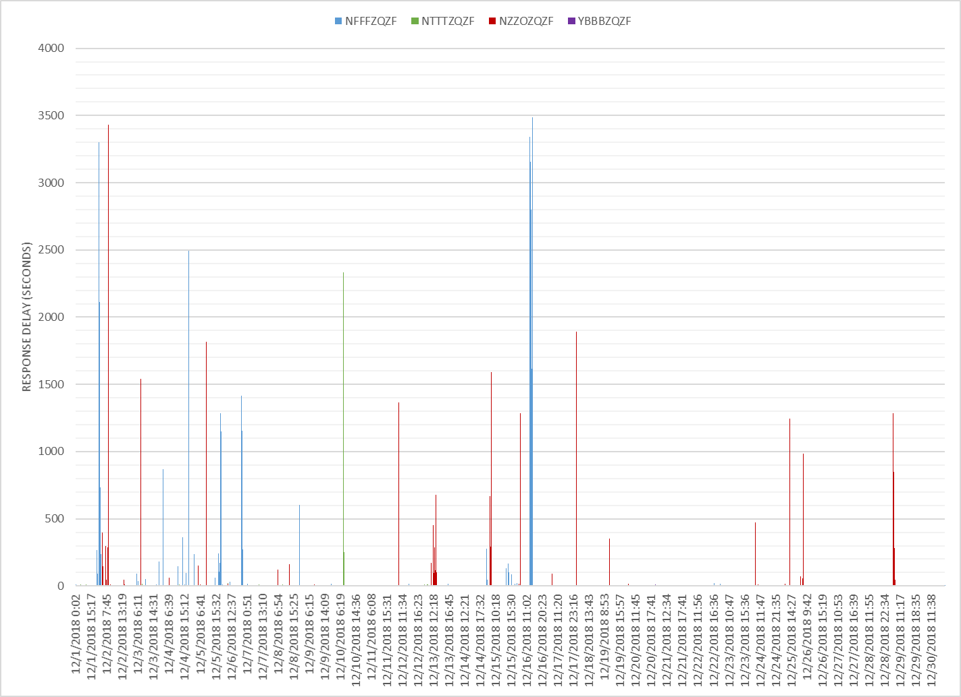
AIDC Messaging
LAM Timeouts – December, 2018

