Slide 1

ASPIRE Status
18 March 2019
Braks Etta - FAA

Slide 2
2018 Annual Coordinator’s Meeting
Hosted by FAA at Southern California TRACON
Chaired by Tim Boyle of Airways New Zealand
ANSPs in attendance:
  AEROTHAI, Airways New Zealand, CAAS, JANS, FAA
Airlines in attendance:
  Hawaiian, Japan, Singapore, United

Slide 3
ASPIRE Future Plans
Attendees agreed unanimously to declare project success and share ASPIRE processes/methodologies with any other interested parties
CANSO Environment Working Group and ISPACG were identified as possible recipients of ASPIRE products
  CANSO EWG declined at their October 2018 meeting

Slide 4
ASPIRE Best Practices
User-Preferred Routes (UPRs)
Dynamic Airborne Reroute Procedure (DARP)
30-30 Reduced Oceanic Separation
Time-Based Arrivals Management
Arrivals Optimisation
Departure Optimisation
Surface Movement Optimisation
Network Optimisation
City-pairs are given * ratings based on number of best practices available

Slide 5
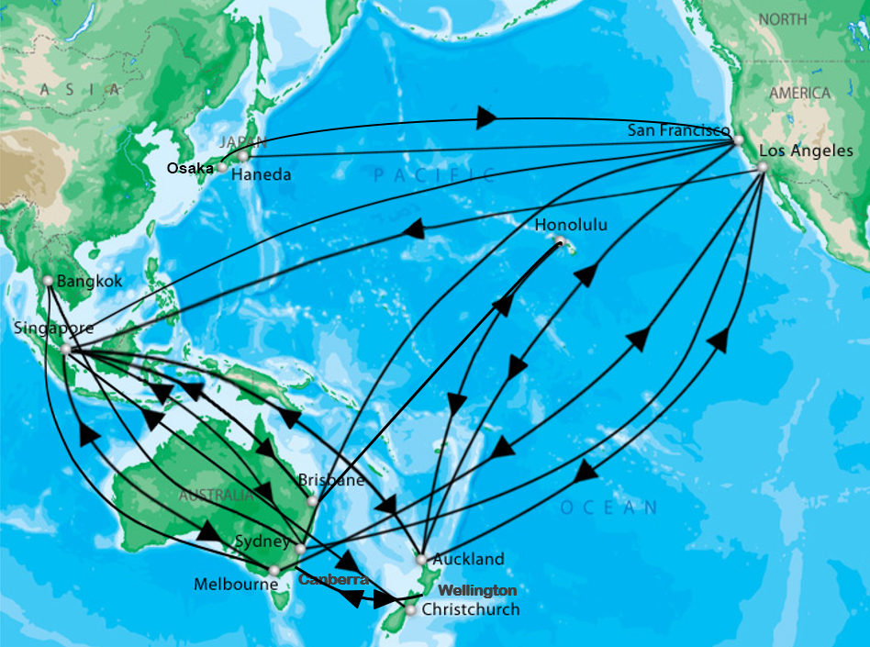
ASPIRE-Daily City-Pairs

