Slide 1
OCP Routes
ISPACG 33

Slide 2
OCP Routes
September 26, 2014 at 5:20am a contractor entered the basement of Chicago ARTCC and using gas soaked rags set fire to computer equipment and communications gear.
Chicago ARTCC handles over 6000 flights per day.

Slide 3
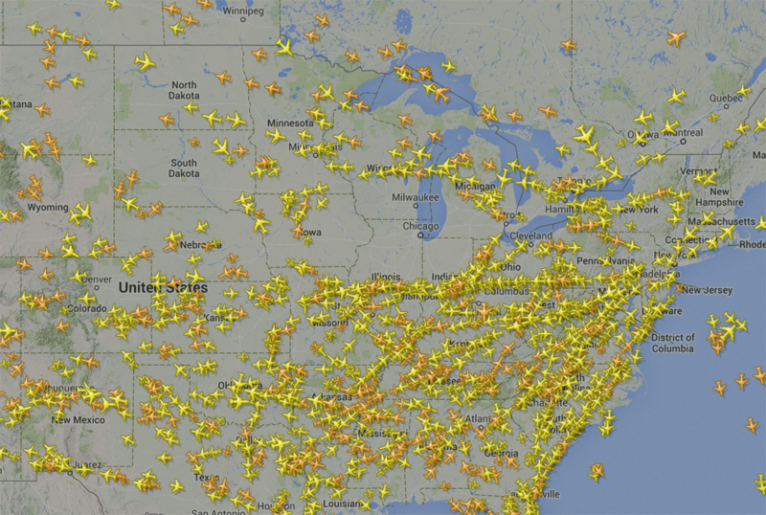

Slide 4
OCP Routes
Because of the Chicago ARTCC fire Contingency plans at FAA facilities have become a priority.
The route structure to be discussed is in the event that Oakland Oceanic is no longer able to provide ATC services for an extended period of time. (hour 4 to hour 10)
This route structure is conceptual and in need of feedback from the surrounding ANSP’s

Slide 5
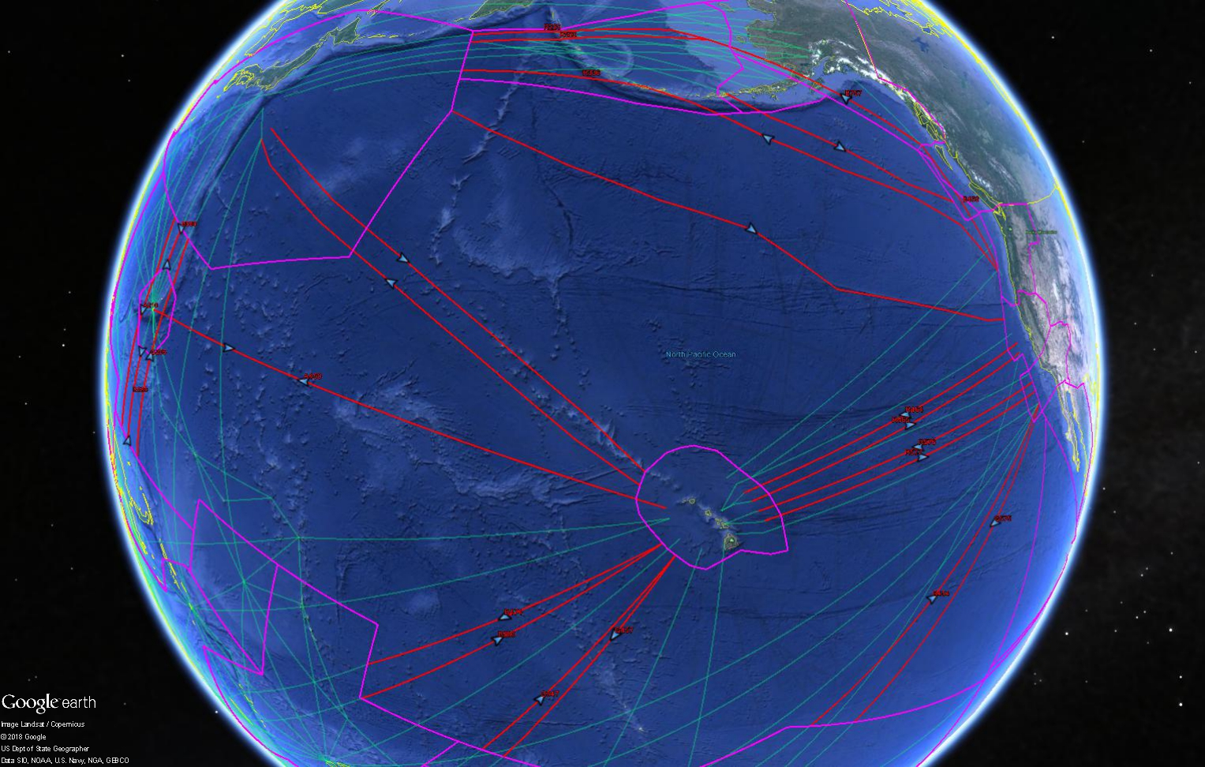

Slide 6
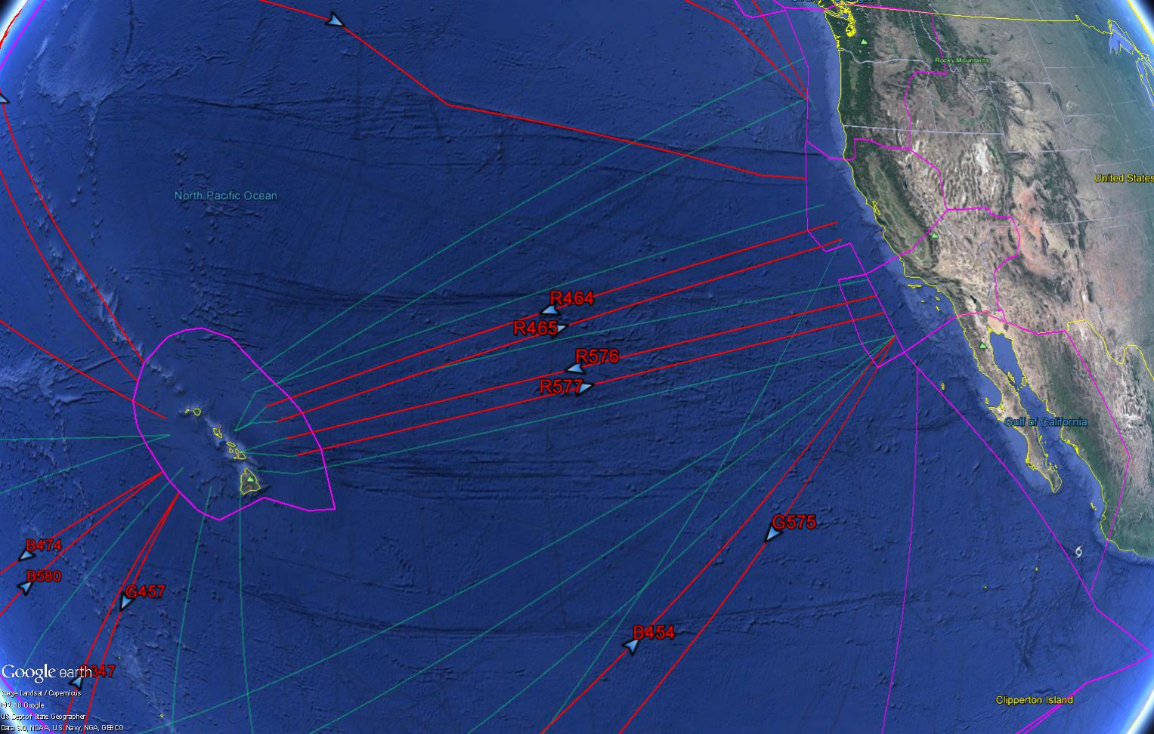
West Coast/Hawaii

Slide 7
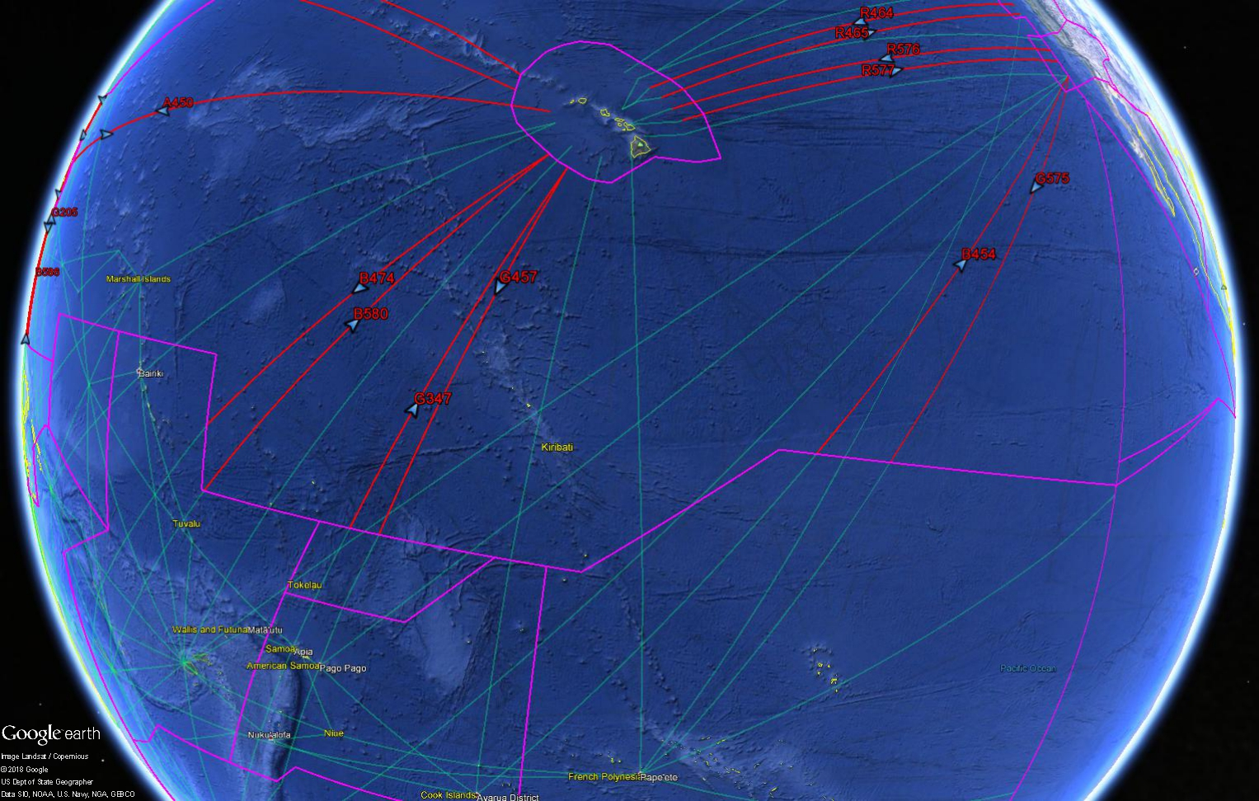
West Coast/Tahiti/Auckland/Sydney

Slide 8
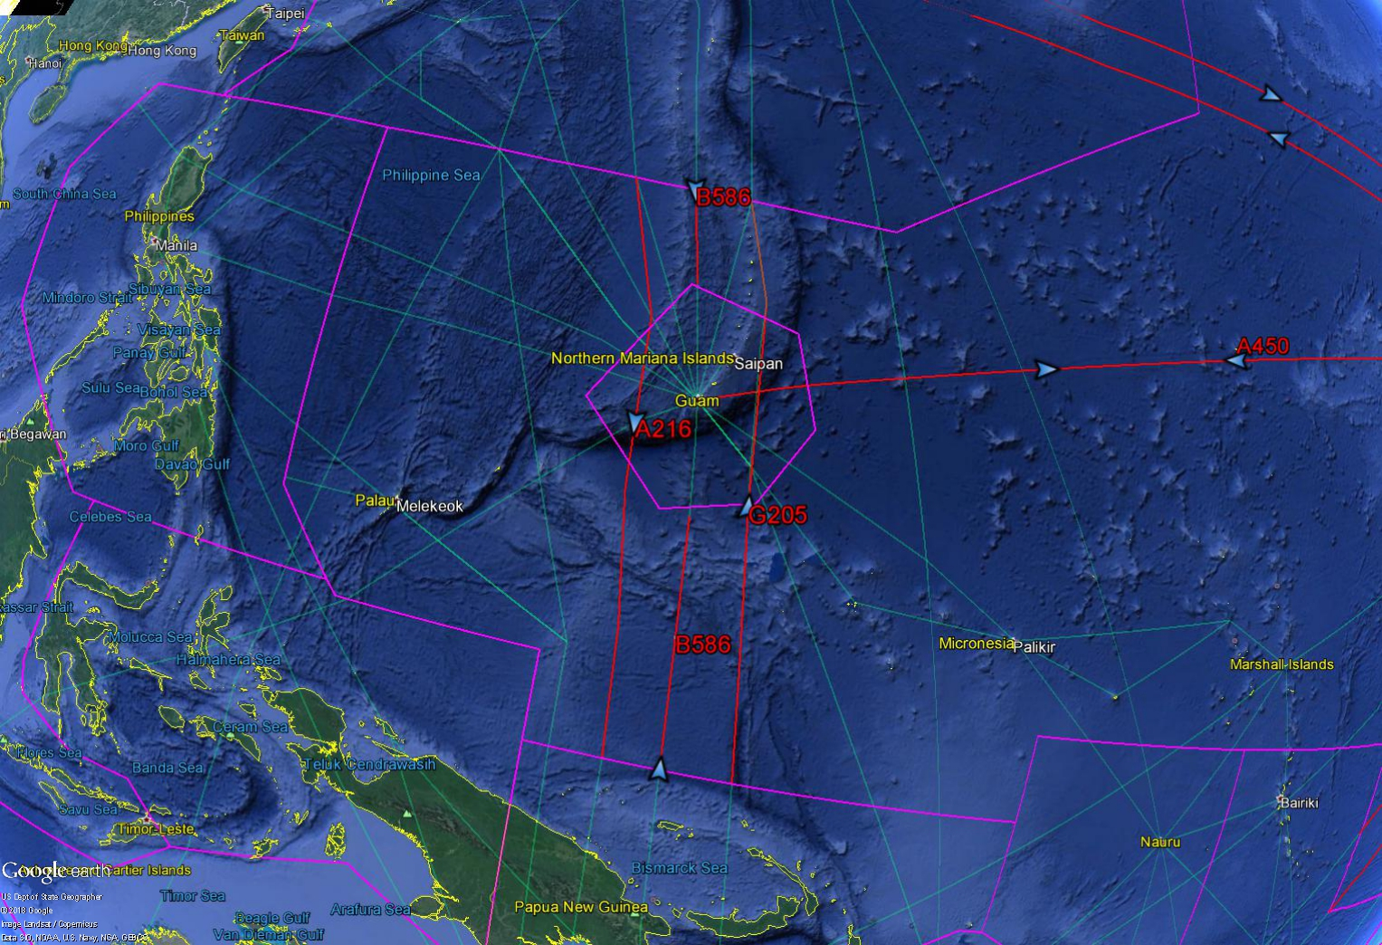

Slide 9
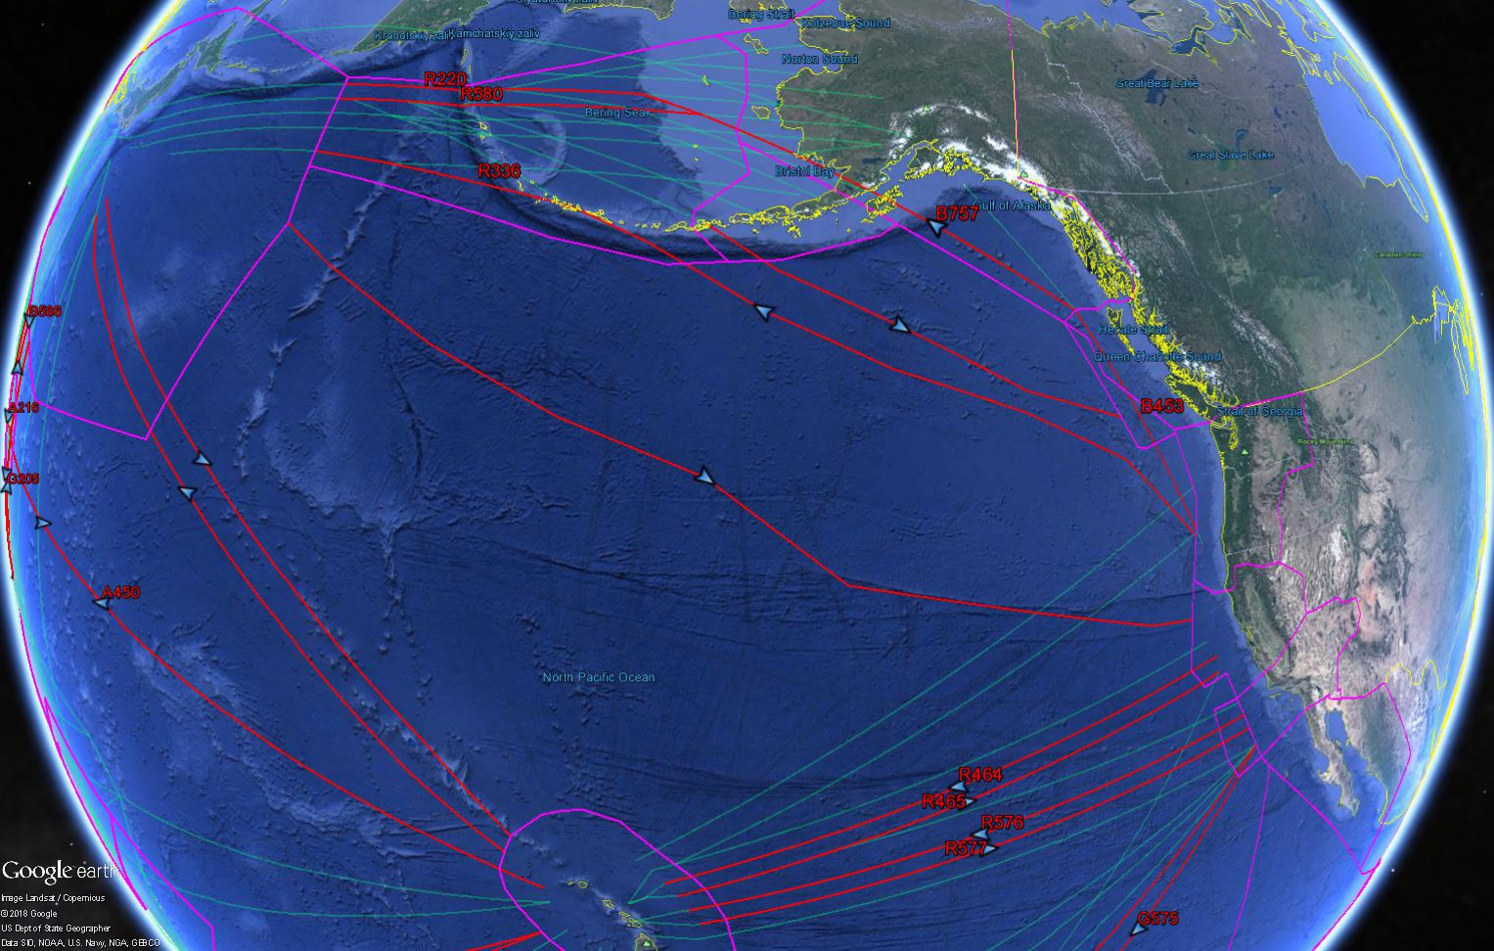
West Coast/Japan/Alaska

Slide 10
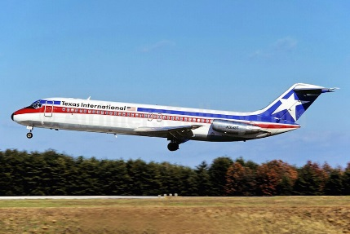
Questions

