Slide 1
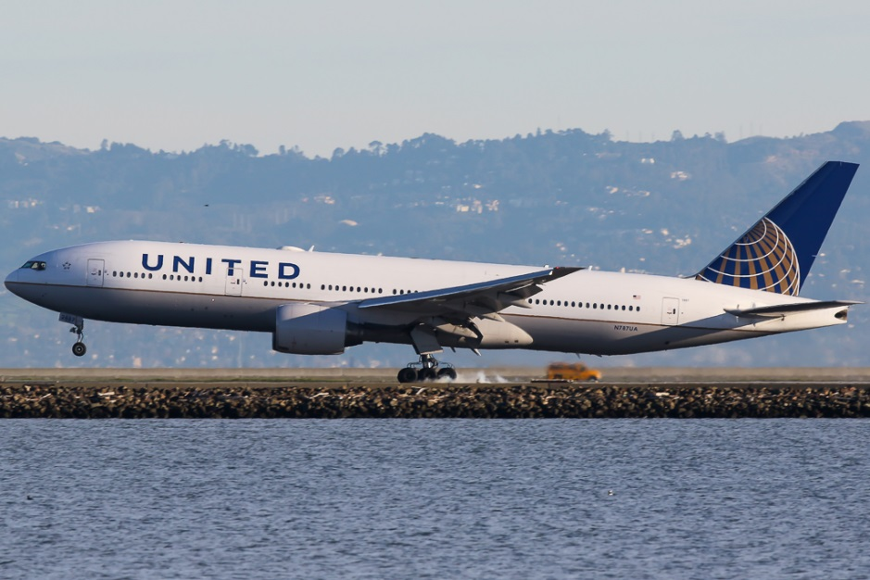
SATVOICE TRIAL

Slide 2
SATVOICE TRIAL
The primary objective is to accrue operational experience at San Francisco Radio and collect data using SATVOICE as a primary means of voice communications, via radio operator, for ATM functions and safety services in lieu of HF. Measure all clearances delivered in terms of the FAA-determined time budget of 3 minutes, and for all clearance delivery communications transactions that exceed 3 minutes, measure the communications transactions with respect to RCP400. Secondary objectives are to assess operational validity of the SATVOICE Callback Check, and to facilitate policy changes recognizing SATVOICE services provided by New York Radio and San Francisco RADIO as sufficiently comparable to HF voice services so as to allow operators to use SATVOICE as their sole voice communication system.

Slide 3
Participating Organizations
United Airlines
Collins (ARINC)
FAA Flight Standards Flight Technologies and Procedures Division, Flight Operations Group (AFS-410)
FAA Oakland ARTCC
Inmarsat

Slide 4
Participating Aircraft
United Airlines will utilize Boeing B777 and B787 aircraft equipped with Aero H+ Inmarsat capable units: B777-200s use Collins SDU-906, B777-300ERs use Collins SDU-2200, and the B787s use Collins SRT-2100. All units are safety service capable as detailed in AC20-150B.

Slide 5
SATVOICE TRIAL
The trial began February 25, 2019.
Deliver 2000 clearances via SATVOICE
The trial can be extended if all stakeholders agree

Slide 6
SATVOICE TRIAL
Pacific Area SatVoice Trial
Week | ATC Clearances |  |  |  |  |  |  | All Timed Messages
 | # of ATC Clearances | Transaction Time < 3 Min (AMCS target > 95%) |  | Transaction Time < 320 sec (RCP-400 target > 95%) |  | Transaction Time < 370 sec (RCP-400 target > 99.9%) |  | Total SatVoice Messages | All Time Measured Messages | Transaction Time < 320 sec (RCP-400 target >95%) |  | Transaction Time < 370 sec (RCP-400 target >99.9%)
25Feb-3Mar | 132 | 112 | 84.85% | 125 | 94.70% | 126 | 95.45% | 997 | 197 | 180 | 91.37% | 184 | 93.40%
4Mar-10Mar | 88 | 84 | 95.45% | 87 | 98.86% | 87 | 98.86% | 925 | 139 | 131 | 94.24% | 131 | 94.24%
11Mar-17 Mar | 84 | 70 | 83.33% | 79 | 94.05% | 79 | 94.05% | 1050 | 133 | 124 | 93.23% | 124 | 93.23%
Cumulative | 304 | 266 | 87.50% | 291 | 95.72% | 292 | 96.05% | 2972 | 469 | 435 | 92.75% | 439 | 93.60%

Slide 7

Discussion
Questions
Dustin Byerly
Dustin.M.Byerly@FAA.Gov
Oakland ARTCC
510-745-3543
Dustin Byerly
Dustin.M.Byerly@FAA.gov
510-745-3543

