Slide 1
Surveillance & Broadcast Services
Advanced Surveillance Enhanced Procedural Separation (SBS ASEPS)
Status Update
ISPACG Planning Team
FAA PMO
18 March 2019
Notes:
The FAA is exploring the use of Space-Based ADS-B (SBA) in oceanic environments as part of the Advanced Surveillance Enhanced Procedural Separation (ASEPS) Program.
SBS = Surveillance & Broadcast Services

Slide 2
Purpose
Provide a status update on the current SBS ASEPS program strategy, including the following:
  High Level Initiative Overview
  Initiative Detail
  Next Steps
Notes:
This briefing will describe the plans for five program components, called “initiatives”.

Slide 3

SBS ASEPS Program Concept
FUTURE STATE
LONG-TERM (5+ years)
ZAN
Anchorage
ZAN
New York
ZOA
Oakland
ZNY
NEAR-TERM (1-3 years)
MID-TERM (3-5 years)
Miami Center
New York Oceanic
40
58
60
63
Miami Oceanic
Havana
62
4
6
Port au Prince
2
Santo Domingo
San Juan CERAP
3
Notes:
The Program is currently exploring near-, mid- and long-term surveillance enhancements to support reduced separation and contingency operations in U.S.-managed airspace.

Slide 4
Strategy Overview
Initiative | 2019 | 2020 | 2021 | 2022 - beyond | Outcome
NEAR-TERM
(1-3 years)
ATOP Reduced Separation
23/20 reduced oceanic separation for suitably equipped aircraft pairs
IOC*
Full Capability
*2021 IOC dependent upon implementation of Wx Deviation solution
SBA Operational Evaluation
IOC
Recommendations
Near-term benefits of SBA with the ability to prove out the technology
SBA in the Caribbean 5NM separation in ERAM | Expanded ADS-B Coverage Evaluate Route Structure Optimization
MID-TERM
(3-5 years)
Define operational scenarios where SBA can be used to support air traffic when surveillance services are interrupted
Identify additional automation upgrades (MEARTS, STARS) required to support SBA within the NAS
Identify changes to support SBA use under the current contract and future ADS-B recomplete contract
Surveillance on-demand when ground surveillance infrastructure is unavailable
Contingency Operations using SBA
Documentation of Oceanic Environment
  Data-driven analysis of UPR usage in the ocean
  Assess potential safety hazard mitigations
  Requirements for future automation system
Support development of future oceanic concept
LONG-TERM
(5+ years)
Future Oceanic Concepts
Further reduction in oceanic separation supported by enhanced Communications
ConOps Enhanced Communications Route Structure | Automation (ATOP/Other) Weather
Milestone
Dependency
Notes:
Overview of the five intiatives (1 through 5, from top to bottom)
INITIATIVE 1: ATOP Reduced Separation will use ADS-C to reduce separation in oceanic airspace based on the ICAO approved 23 Nautical Miles (NM) Lateral Separation standard and a 20 NM Longitudinal Separation standard anticipated to be approved by ICAO (currently under assessment).

Slide 5
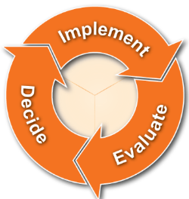
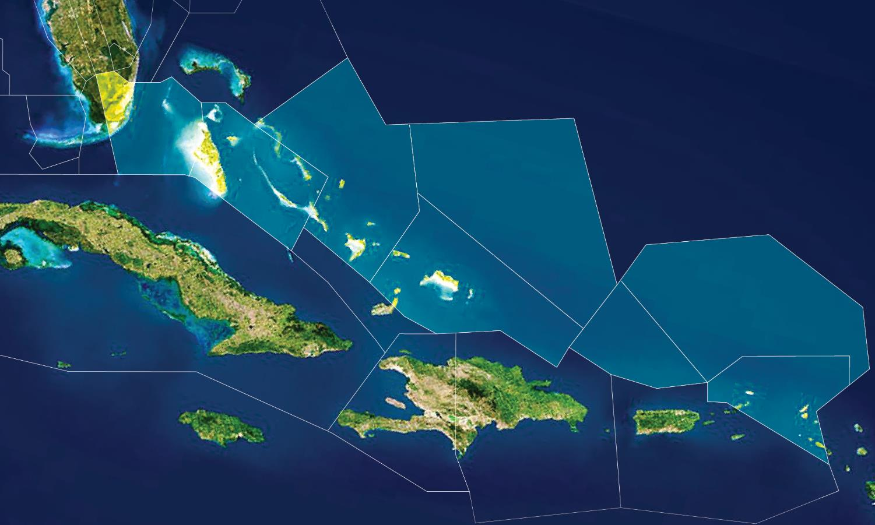




SBA Operational Evaluation (Near-term)
1
SBA in Caribbean in an operational context
Short term, 1 year
Miami Center
1
2
Operations and ATC acceptance
Route structure (e.g., ops for optimization)
SBA tech performance
Benefits
3
2
40
58
3
Continued use in Caribbean
Expansion to other geographic areas
60
63
62
4
6
Miami ARTCC (ZMA)
2
Example
Port au Prince
Santo Domingo
San Juan CERAP
Sectors 62 & 63
5
Notes:
INITIATIVE 2: A Caribbean SBA operational evaluation is planned on the En Route Automation Modernization (ERAM) automation platform

Slide 6
SBA Operational Evaluation (Near-term)
Scope:
  Conduct an Operational Evaluation of SBA using ERAM in the Caribbean to assess technical performance and operational benefits (e.g., Grand Turk airspace)
    Focused on current operational environment where VHF communication exists
    Evaluate route structure optimization (shortcut between CARPX and RENAH) including additional communication site
Stakeholder input:
  Miami ARTCC (ZMA) involvement in design and implementation
  Industry engagement on metrics to evaluate and benefits mechanisms
Anticipated outcomes:
  Completed Safety Risk Management (SRM) process for SBA use in ERAM under 5 NM separation standard
  Recommendations for airspace management with 1090 MHz SBA operations
6
Notes:
More on INITIATIVE 2

Slide 7
SBA Operational Evaluation (cont.)
Anticipated outcomes (cont.):
  Requirements for potential automation changes based on technical performance evaluation
  Potential opportunities for continued use of SBA in the Caribbean and SBA expansion to other geographic areas
  Requirements for SBS recompete: notional goal is to leverage the SBS recompete to the extent possible to deploy SBA in the NAS
  Quantified benefits seen by airlines from SBA enhanced surveillance
Status:
  ZMA Kick-off meeting held on December 18, 2018
    Need to negotiate updates to existing Letters of Agreement (LOA) with adjacent ANSPs identified as a key dependency
  Safety Panel scheduled on April 23-25
  Separation standards analysis is planned to complete in March 2019
    Outcomes TBD (e.g., 5NM separation with SBA determined to be equivalent to/better than 5NM separation with just radar)
  Antenna diversity analysis
    MITRE provided initial result on antenna diversity vs update interval and latency
    Initial results indicate aircraft with bottom mounted antennas meet update and latency requirements
    Additional analysis needed since current data set was bandwidth limited and was not the full satellite constellation
Notes:
More on INITIATIVE 2
3rd bullet under Status: eparation standards analysis expected to be completed by the end of this month (March)

Slide 8



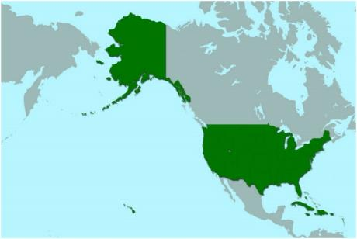







Contingency Capability (Mid-term)
Disaster Recovery
Terrestrial Augmentation
Alaska
All U.S. Airspace
Hurricanes
CONUS
Hawaii
Guam
Caribbean
Floods
Wildfires
Notes:
INITIATIVE 3 – focuses on contingency operations

Slide 9
Contingency Capability (Mid-term)
Scope:
  Explore potential for SBA to provide a partial disaster recovery and operational contingency capability across the NAS for a range of disaster events, such as hurricanes, floods, etc.
Anticipated outcomes:
  Evaluation and scenario development of using SBA to achieve an operational contingency and partial disaster recovery capability
  Safety work in support of a new investment decision for SBA contingency operations
  Explore possibilities for upgrading avionics on universal access transceiver (UAT) equipped aircraft in the Gulf of Mexico to support contingency operations through SBA services
  Explore possibilities for upgrading avionics on UAT equipped aircraft in Alaska to support surveillance expansion through SBA services
Status:
  A draft CONOPS for using SBA to support disaster recovery operations has been developed and is currently being refined
  Discussions are underway with En Route and Terminal facilities regarding use of SBA to augment existing surveillance and constraints from single link/UAT traffic
Notes:
More on INITIATIVE 3
Last 2 bullets under Anticipated Outcomes: may need to upgrade UAT avionics in order to support Space-Based ADS-B

Slide 10
Operational Environment (Mid-term)
Scope:
  Review and document oceanic operational environment
    Review and validate current operational shortfalls, including the availability of User Preferred Routes (UPRs)
  Assess potential mitigations for existing oceanic safety hazards
Anticipated outcomes:
  Support for the new CONOPS for oceanic operations in the long-term
    Improved understanding of UPRs in oceanic airspace
    Input into requirements for decisions on the oceanic automation system of the future
Status:
  The FAA is in the process of documenting current operations with shortfalls and developing a plan to evaluate them further
  Initial planning discussions are ongoing regarding the plan to evaluate UPRs
Notes:
INITIATIVE 4: Documentation of the Oceanic Environment
Continuing analysis activities to prepare for future oceanic operations (INITIATIVE 5), including developing requirements for our automation systems

Slide 11
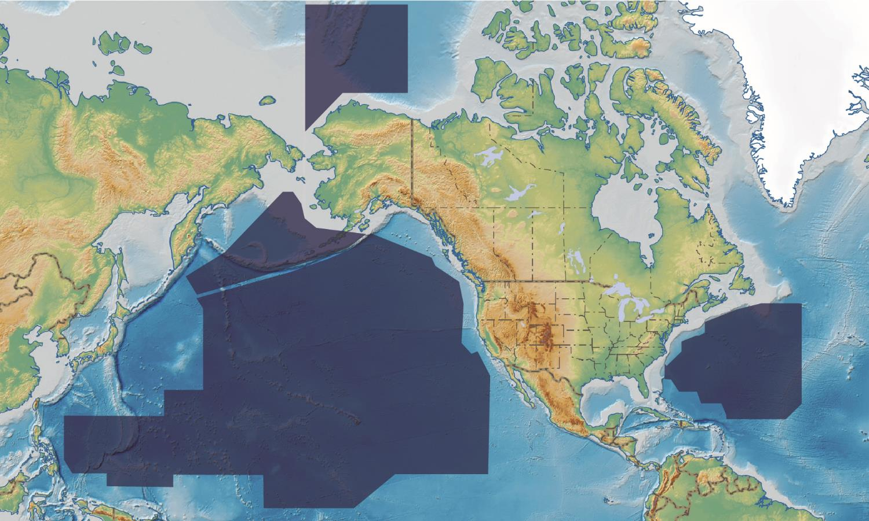
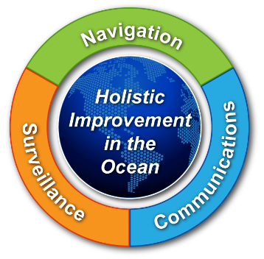
Future Oceanic Concepts (Long-term)
Core Elements
ZAN
Anchorage Arctic FIR
1
Enhanced Communications equivalent to VHF
2
Enhanced Surveillance similar to terrestrial ADS-B
3
Use of weather products
4
Route structure optimization
5
ANSP harmonization
Anchorage
ZAN
Anchorage Oceanic FIR
New York
ZOA
Oakland Oceanic FIR
Oakland
ZNY
New York Oceanic FIR
Work We Do
Develop
Concept
Evolve Solution/ Technology
Improve Oceanic Operations
11
Notes:
INITIATIVE 5: Developing a new concept for oceanic operations for the future that assumes the availability of Space-Based ADS-B and VHF-like communication in the ocean

Slide 12
Future Oceanic Concepts (Long-term)
Scope:
  Develop a new concept for oceanic operations that assumes the availability of SBA and enhanced communication in the ocean
  Explore strategies to accelerate the implementation of enhanced communications (similar to terrestrial communication) that, when combined with enhanced surveillance, could deliver the operational capability required to enhance Air Traffic Services in oceanic airspace
  Conduct Industry engagement activities to solicit feedback on the concept for future operations in the ocean
Anticipated outcomes:
  Industry engagement for a new oceanic operational concept
  Networking and information exchange between ASEPS and potential vendors
  New concept of oceanic operations that includes more than just enhanced surveillance (e.g., enhanced communication, weather, route structure changes, and ANSP coordination)
Notes:
Regarding industry engagement, our program office has had several productive discussions with Airlines for America and member airlines to explore what these future oceanic concepts may look like.

Slide 13
Future Oceanic Concepts (cont.)
Anticipated outcomes (cont.):
  Support for acceleration of enhanced communications capability
  Revalidation of oceanic shortfalls - current environment and approved changes in the pipeline
  Recommendations to be presented to the JRC in November 2021
Status:
  Initial planning is underway for industry engagement activities mid-2020
    The goal of the engaging with industry is to solicit feedback on the concept for future operations in the ocean
    Outcomes will be used to inform recommendations to be presented to the JRC in November 2021, along with findings from near and mid-term initiatives

Slide 14
Strategy Implementation Plan
Initiative
FY 2019 | FY 2020 | FY 2021 | FY 2022 – Beyond
NEAR-TERM (1-3 yrs)
JRC Decision
23 Lat Procedures Completed
IOC—Initial Functionality
IOC—Full Functionality
ATOP Reduced Separation
Safety Panel
20 Long Standard Approved by ICAO for Operational Use (MAR 20)
20 Long Procedures Completed
Last Site Operational
SBA Operational Evaluation
Harris Contracts Definitized
Harris SAT
Commence Op Eval/IOC
Op Eval Completed
Recommendations for Future SBA Use (NOV 2021)
Safety Panel
FINAL REPORT
Continue SBA services in Caribbean (TBD)
SBS Recompete Planning
Test Plan Developed
LOAs Negotiated
Investment Decision (TBD – 2023)
SBS Recompete Planning
ATC Procedures & Automation Updates
MID-TERM (3-5 yrs)
CONOPS &
Sep Standards Analysis
Safety Analysis
Recommendations
Contingency Operations using SBA
Avionics Upgraded
Proceed based on JRC Approval
Documentation of Oceanic Environment
UPRs Evaluated
Other Shortfalls/Safety Hazards/Comms Assessed
Recommendations
Analysis Complete
LONG-TERM (5+ yrs)
Industry Day Plan Developed
RFI Issued
Recommendations
CONOPS Development (Comms, Weather, ANSP Coordination, etc.)
Business Case Analysis
Investment Decision (TBD – 2025)
Future Oceanic Concepts
Begin Investigating Enhanced Comms
Industry Day
Evaluation & Award
NAVCANADA SBA Operational Trial Commences (MAR 19)
JRC Milestones
SEPT 2018
Approval to Proceed
APR 2019
Strategy Meeting
SEPT 2019
Status & request to spend FY20 funds
SEPT 2020
Status & request funding for remaining work
NOV 2021
Obtain concurrence on next steps
Duration
FAA Milestone
External Milestone
Dependency
Notional plans contingent on Nov 2021 JRC
Notes:
Analysis on future phases is being done in parallel, resulting in recommendations for executive decision in Nov 2021 – this will determine which of the potential medium & long-term capabilities are implemented

Slide 15
Program Next Steps
Continue refinements on scope for mid- and long-term initiatives – Ongoing
Complete Final Operational Assessment and Benefits Plan for the Operational Evaluation – September 2019
Present Strategy Briefing to JRC – September 2019
Notes:
Regarding last bullet, the program office is giving a strategy briefing to our executives every year

Slide 16
Back-up

Slide 17
Target Caribbean Airspace
Figure 1: Caribbean Airspace Sectors*
*Source: Report of the Eastern Regional Task Group (ERTG) of the RTCA Tactical Operations Committee (TOC), July 2015

Slide 18
Target Caribbean Airspace (cont.)
Figure 2: Grand Turk Surveillance Gap*
Figure 3: Potential shortcut between CARPX and RENAH (cut through)*
*Source: Report of the Eastern Regional Task Group (ERTG) of the RTCA Tactical Operations Committee (TOC), July 2015
Notes:
Area between blue shapes on left is surveillance gap when radar goes out
Yellow line on right is the CARPX-RENAH shortcut, which goes outside Miami Center sectors 62 and 63

