Slide 1
Airservices Update
ISPACG/33 2019
Chris McCormack & Tony Smith

Slide 2
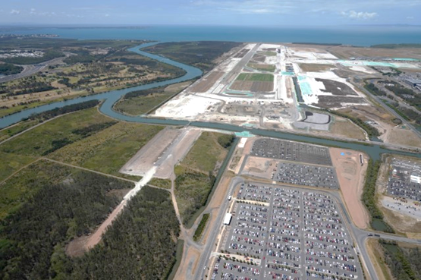
What’s been happening?
OneSKY – CMATS; Building demolition and construction underway in Brisbane and Melbourne
New Voice Communication System commissioned
VCS Benefits
YBBN NPR
Gold Coast ILS in operation
FMC Waypoint Reporting
AIDC Trial with PNG ASL
PBCS

Slide 3

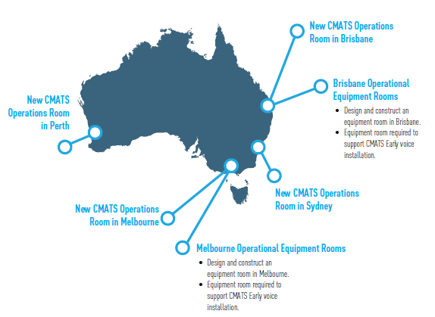
Dependent Projects

Slide 4

VCS Commissioning
New voice Communication System deployed in Perth, Melbourne, Sydney and Brisbane.

Slide 5

VCS Benefits
Improved Frequency management> Efficient Airspace Management.

Slide 6
Brisbane New Parallel Runway 2020
Upgrades to ATM systems, airfield infrastructure such as an ILS, augmented Surface Movement Radar and new VHF frequencies.
Stakeholder engagement leading to design and implementation of new airspace and flight paths.
Training of over 150 air traffic controllers
New ARFF station
Notes:
Significant bodies of work grouped into three main areas:
Airfield; New Nav Aids, Expanding ASMGCS, New Frequencies,
Systems: New INTAS and Eurocat consoles as well as software adaptation and integration
Airspace: Airspace design for new flight paths, community consultation, nose abatement and ATC training

Slide 7
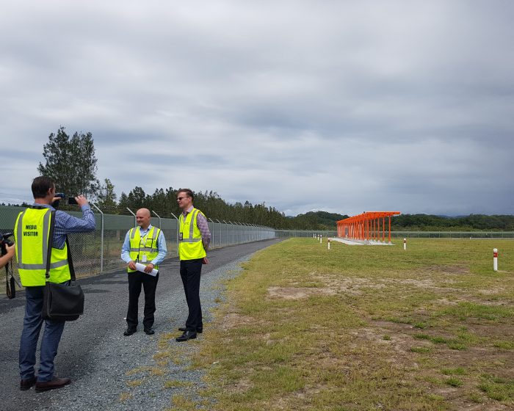
Gold Coast ILS
YBCG ILS commissioned
28 February 2019

Slide 8
Expanded FMC WPR in YBBB
FMC Waypoint reporting now in use within entire YBBB, ANAU and AGGH FIR’s with Air New Zealand A320’s in accordance with Letter of Agreement
Negotiations underway with Virgin Australia with a view to implementation later in the year

Slide 9
AIDC with AYPM
AIDC message testing – April 2019
AIDC message operational trial - ongoing

Slide 10
PBCS
Planning underway to introduce PBCS standards (23NM and 5 minutes) into Australian airspace in 2019
Intent to retain 30/50NM RNP standards for the near future and phase these out as PBCS approvals increase

Slide 11
For more information
Chris McCormack
Airservices Australia
christopher.mccormack@airservicesaustralia.com

