Slide 1

Airbus FANS Problem Reports - Debrief
ISPACG33 / FIT26 – New-Zealand
Jean-François BOUSQUIE / Clement SELLES
March 2019

Slide 2
PR 2635 | MATSC017 | A332 – Connection Fail
Description
An unexpected receipt of DM62 (Error Msg) “UNRECOGNIZED MESSAGE REFERENCE NUMBER” was triggered by an A330 following a CPDLC uplink clearance
Analysis
Air-Ground traces exhibited the following sequence:
  1528z: DM6 – REQUEST FL390 (MIN = 3)
  1535z: UM1 – STAND BY (MRN = 3)
  1537z: UM20 – CLIMB TO AND MAINTAIN FL390 (MRN = 3)
  1538z: DM62 – ERROR UNRECOGNIZED MSG REFERENCE NUMBER
Current Airbus A320/A330/A340 FANS avionics implement a 5 minutes timer triggered after a DM is sent. Once the timer has expired, only one message is accepted for this on-going transaction. In this case, the STBY message was received after the timer expiration which closed the transaction on-board. When the clearance was then received it was rejected.
This known issue is already tracked by PR 811, and is followed in the NAT “FANS Problem Solution Tracker” file as Aircraft Item A9.
It is fixed in the available FANS avionics software version CSB9 / CLR9
PR status proposed: CLOSED

Slide 3
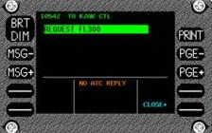
PR 2697 | Reported by Air Tahiti Nui | A343 – Loss of information during CPDLC transfer
Description
After requesting to climb to FL400 to KZAK, the flight crew reported flying on that level to RJJJ (next ATC) based on a clearance they presumably received from KZAK, whereas controllers never sent it.
Analysis
Air-Ground traces exhibited the following sequence:
  KZAK (CDA) sends UM160 identifying RJJJ as NDA
  Crew sends a DM9 – REQUEST CLIMB TO FL400
  Due to the existence of this on-going transaction, automatic transmission of UM161 – END SERVICE is inhibited at ground level.
  ATCo followed one of the available KZAK procedures for this situation and uplinked a UM169 – SELECT ATC COM OFF AND MANUALLY LOG ON TO RJJJ. MAKE REQUEST WITH THEM.
  Once connected to RJJJ, crew reported flying at FL400 following a previous clearance although no such clearance had been received.
No avionics misbehavior was identified and no clearance to climb to FL400 was indeed emitted.
After discussions with the operator, 2 items are suspected as having caused flight crew confusion:
  The “MAKE REQUEST WITH THEM” instruction, part of the UM169.
  The “NO ATC REPLY” displayed on the DCDU after the DM9 request was sent by the crew.
PR status proposed: CLOSED

Slide 4
PR 2703 PR 2704 PR 2708 | ASA FIT PR 2018-02 ASA FIT PR 2018-04 ASA FIT PR 2018-08 | A330 – Loss of ADS-C capability
Description
YBBB reported multiple occurrences of ADS-C communications loss, on various airframes/flights, while CPDLC remained serviceable.
Analysis
Air-Ground traces exhibited, for each of the three reported occurrences, the same kind of pattern:
  ADS-C contract requests are sent by the ground at the edge of VHF coverage
  As the A/C is leaving VHF coverage, some of these uplinks are received by the A/C but the corresponding MAS/S are not received by the CSP, leading to additional repetitions of the same uplinks via VHF, and then via SATCOM.
  On the avionics side, multiple “duplicate” ADS-C contract requests were then successively received on both media.
Due to an existing FANS software anomaly on Airbus A320/A330/A340 airframes, the avionics did not correctly identify and handle these duplicate ADS-C contract requests. The first contract is correctly accepted, but the successive requests are rejected with a N-ACK instead of being simply discarded. As per ED-100A/DO-236A, after 3 consecutive N-ACKs, all ADS-C contracts with YBBB were terminated by the avionics.
This known issue is already tracked by PR 1627, and is followed in the NAT “FANS Problem Solution Tracker” file as Aircraft Item A38.
A fix is available in the FANS avionics software version CSB9 / CLR9
PR status proposed: CLOSED

Slide 5
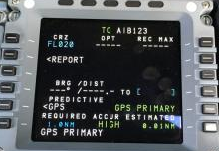
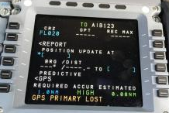
PR 2743 | ACNZ_2018_13 | Incorrect ADS-C reported position
Description
Aircraft is approaching PEBLU in Tasman Sea aircraft sends Waypoint Event at 1131:00 251049S1305816E which places aircraft in the middle of Australia, a lateral deviation report at 1130:51 251024S1305823E also in the middle of Australia, and an accurate periodic report at 1130:38 381215S1694818E which reports actual aircraft position.
Suspect this is caused by crew manipulation of the FMS which shouldn't be happening in an ADS-C environment.
Analysis
DFDR data could not be retrieved, below analysis cannot be 100% confirmed but is deemed very highly probable
3 “faulty” reports were received: LDE at 11:30:59, WCE at 11:31:10, On-Demand at 11:31:28, with:
  An A/C position around 25°S10’/130°E58’
  A FoM that was degraded from 6 (nominal precision <0,25NM) in the periodic report of 11:30:49, to 1 (precision around 30NM)
As suspected by the ATCo, behavior is consistent with the use by the crew of the POSITION UPDATE AT function in the FMS
In more recent FMS standards, this function has been inhibited when navigation is based on GPS, but this A/C is still fitted with an old FMS.
The MCDU design is such that crew errors were regularly reported in-service with this function being inadvertently used instead of the “Bearing/Distance To” function, leading to large undue FMS position offsets.

Slide 6
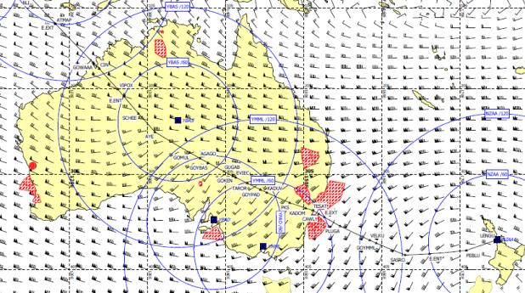
PR 2743 | ACNZ_2018_13 | Incorrect ADS-C reported position
Analysis
This hypothesis is validated by:
  The location of the position jump: on navaid AYE (in the F-PLN)
  The immediate degradation of the FOM between 2 reports separated by only 10 seconds
  The immediate return to a normal situation in the WCE report of 11:33:51 once crew corrected the error (saw their ownship position slewed on ND and took quick action), except for the FOM that takes a bit longer to go back to better values
PR status proposed: CLOSED

Slide 7
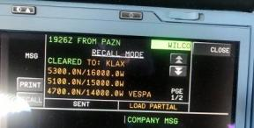
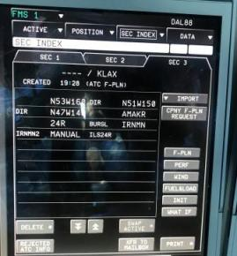
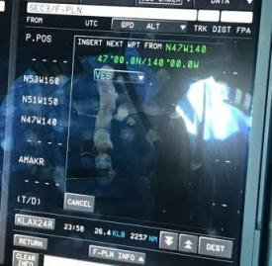
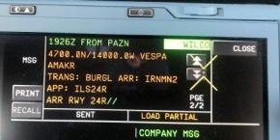
PR 2747 | DAL-2018-006 | CPDLC Route Clearance Uplink Issue
Description
Report was made following application of a DARP procedure
Dispatcher sent revised route via ACARS. Crew manually entered revised routing into SEC 3 to include STAR and Arrival/ILS. SEC 3 revised routing transferred to CPDLC mailbox and sent to PAZN. PAZN uplinked a CPDLC clearance for the revised routing which was in all GREEN along with a WILCO prompt. Crew WILCO'd CPDLC clearance
Crew selected "Load in SEC 3" CPDLC prompt. When new CPDLC clearance transferred to SEC 3 got ATC F-PLN INSERTED IN SEC 3 REJECTED INFO SEE SEC INDEX
Noticed 2 discontinuities...one after 140W deleting VESPA...the other after AMAKR... Mailbox cleared routing turned AMBER along with LOAD PARTIAL
Two questions: Why were discontinuities generated? What caused the LOAD PARTIAL?

Slide 8
PR 2747 | DAL-2018-006 | CPDLC Route Clearance Uplink Issue
Analysis
The 1st Discontinuity corresponds to the rejection of WPT VESPA contained in the uplinked UM80 route clearance
  This WPT is a duplicate in the Navigation DataBase (NDB): one occurrence in Sweden, and one at the Oakland Oceanic/Domestic boundary
  Per Airbus FMS design, when a WPT is part of a Route Clearance, if it has duplicates in the NDB and the Optional Lat/Long values are NOT provided in the uplink, then the fix is discarded¹, a DISCO is strung instead and a LOAD PARTIAL feedback is provided to the pilots.
  Airbus suggested the FAA to look into the possibility of systematically including the optional Lat/Long associated to fixes in a Route Clearance in the ATOP system (as done for the US Domestic DataComm program).
The 2nd Discontinuity corresponds to the “hole” between the last EnRoute WPT (AMAKR) and the Arrival procedure (IRMN2.BURGL) in the UM80
  Per Airbus FMS design, a search is performed in the RouteInformation part of the clearance for the 1st Arrival procedure fix (in this case BURGL), if no match is found, then a DISCO is strung between the last Route WPT and the 1st Arrival procedure fix.
  Airbus suggested the FAA to look into the possibility of repeating the 1st Arrival procedure fix (STAR or STAR Transition) as the last WPT of the RouteInformation part of a UM80 (or UM83) clearance, when a continuous path to the Arrival procedure is desired.
No AVNCS misbehavior identified
¹: Except if the fix is the intersection point between 2 Airways contained in the uplink, in this case the FMS can “solve the duplicate” without Lat/Long provided
PR status proposed: transfer to PAZN

Slide 9
Thank you
© AIRBUS S.A.S. 2019. ALL RIGHTS RESERVED. PROPRIETARY DOCUMENT

