Slide 1
Performance-based Communication and Surveillance (PBCS)
Monitoring Report

Slide 2
Overview
Summary of data link performance by media type
CPDLC uplink analysis
Data link performance by operator
  Impact of UPS fleet improvement
FANS over Iridium
FANS over SwiftBroadband
Availability
  Reported outages
  Unreported outages

Slide 3
Performance by media type

Slide 4
Performance by Media Type
119,555
data link flights
July – December 2018
Oakland
Media Type | ADS-C |  |  | CPDLC
 | Count of ADS-C Downlink Messages | ADS-C 95% | ADS-C 99.9% | Count of CPDLC Transactions | ACTP 95% | ACTP 99.9% | ACP 95% | ACP 99.9% | PORT 95%
Performance Criteria |  | RSP 180 |  |  | RCP 240
Aggregate | 4,790,151 | 98.3% | 99.4% | 285,728 | 99.5% | 99.6% | 99.0% | 99.3% | 97.9%
SAT | 4,230,323 | 98.5% | 99.5% | 265,626 | 99.6% | 99.7% | 99.2% | 99.4% | 98.0%
VHF | 525,096 | 98.9% | 99.7% | 14,887 | 99.8% | 99.9% | 99.3% | 99.4% | 97.8%
HF | 34,684 | 68.3% | 82.4% | 84 | 0.0% | 0.0% | 0.0% | 0.0%
SAT-VHF |  |  |  | 1,581 | 94.8% | 96.1% | 86.9% | 88.4%
VHF-SAT |  |  |  | 1,321 | 95.0% | 97.4% | 93.6% | 95.0%
SAT-HF |  |  |  | 1,426 | 84.4% | 88.0% | 86.3% | 88.6%
HF-SAT |  |  |  | 697 | 98.1% | 98.6% | 96.8% | 98.1%
VHF-HF |  |  |  | 69 | 63.8% | 75.4% | 78.3% | 82.6%
HF-VHF |  |  |  | 37 | 89.2% | 89.2% | 86.5% | 89.2%

Slide 5
Performance by Media Type
40,146
data link flights
July – December 2018
Anchorage
Media Type | ADS-C |  |  | CPDLC
 | Count of ADS-C Downlink Messages | ADS-C 95% | ADS-C 99.9% | Count of CPDLC Transactions | ACTP 95% | ACTP 99.9% | ACP 95% | ACP 99.9% | PORT 95%
Performance Criteria |  | RSP 180 |  |  | RCP 240
Aggregate | 1,268,647 | 98.3% | 99.4% | 84,588 | 99.20% | 99.40% | 98.90% | 99.19% | 97.36%
SAT | 841,632 | 98.0% | 99.4% | 59,948 | 99.20% | 99.40% | 98.89% | 99.21% | 97.17%
VHF | 421,066 | 99.6% | 99.8% | 22,633 | 99.89% | 99.92% | 99.69% | 99.76% | 98.58%
HF | 5,937 | 49.9% | 66.8% | 72 | 0.00% | 0.00% | 0.00% | 0.00% | 80.56%
SAT-VHF |  |  |  | 776 | 97.29% | 97.94% | 92.91% | 94.07% | 89.43%
VHF-SAT |  |  |  | 737 | 95.93% | 97.69% | 95.52% | 96.74% | 90.77%
SAT-HF |  |  |  | 142 | 61.27% | 69.72% | 71.13% | 76.06% | 97.18%
HF-SAT |  |  |  | 244 | 87.70% | 91.39% | 88.52% | 92.21% | 82.38%
VHF-HF |  |  |  | 24 | 91.67% | 95.83% | 95.83% | 95.83% | 100.00%
HF-VHF |  |  |  | 12 | 91.67% | 100.00% | 91.67% | 91.67% | 75.00%

Slide 6
Performance by Media Type
82,756
data link flights
July – December 2018
New York
Media Type | ADS-C |  |  | CPDLC
 | Count of ADS-C Downlink Messages | ASP 95% | ASP 99.9% | Count of CPDLC Transactions | ACTP 95% | ACTP 99.9% | ACP 95% | ACP 99.9% | PORT 95%
Performance Criteria |  | RSP 180 |  |  | RCP 240
Aggregate | 2,654,907 | 98.0% | 99.2% | 168,359 | 99.25% | 99.44% | 98.82% | 99.13% | 97.52%
SAT | 2,043,448 | 97.9% | 99.2% | 134,503 | 99.34% | 99.50% | 98.98% | 99.29% | 97.66%
VHF | 600,796 | 99.3% | 99.6% | 28,525 | 99.86% | 99.91% | 99.41% | 99.51% | 97.96%
HF | 10,602 | 57.8% | 74.5% | 22 | 0.00% | 0.00% | 0.00% | 0.00% | 90.91%
SAT-VHF |  |  |  | 2,372 | 95.53% | 96.67% | 91.06% | 91.95% | 88.28%
VHF-SAT |  |  |  | 1,988 | 97.18% | 98.59% | 95.17% | 96.13% | 94.47%
SAT-HF |  |  |  | 633 | 73.93% | 79.94% | 81.04% | 84.99% | 98.42%
HF-SAT |  |  |  | 283 | 99.29% | 99.65% | 97.17% | 98.94% | 87.28%
VHF-HF |  |  |  | 11 | 54.55% | 63.64% | 72.73% | 72.73% | 100.00%
HF-VHF |  |  |  | 22 | 90.91% | 95.45% | 90.91% | 90.91% | 59.09%

Slide 7
CPDLC Uplink Analysis
Actual communication performance (ACP) captures performance for completed transactions
Sometimes uplinks are sent and do not make it to the aircraft or have a significant delay
There is no timestamp for when the uplink actually reaches the aircraft
There is a message assurance (MAS) feature that can be requested by the air navigation service provider (ANSP) for the communication service provider (CSP) to send a message indicating the uplink was delivered to the aircraft

Slide 8
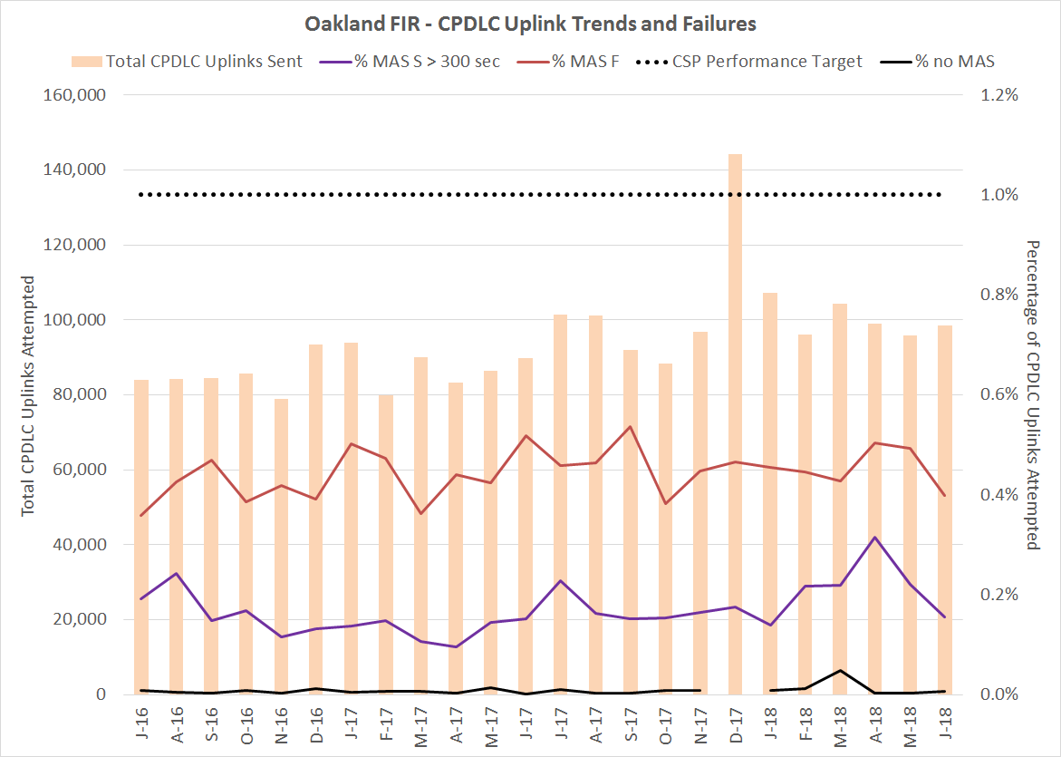

Slide 9
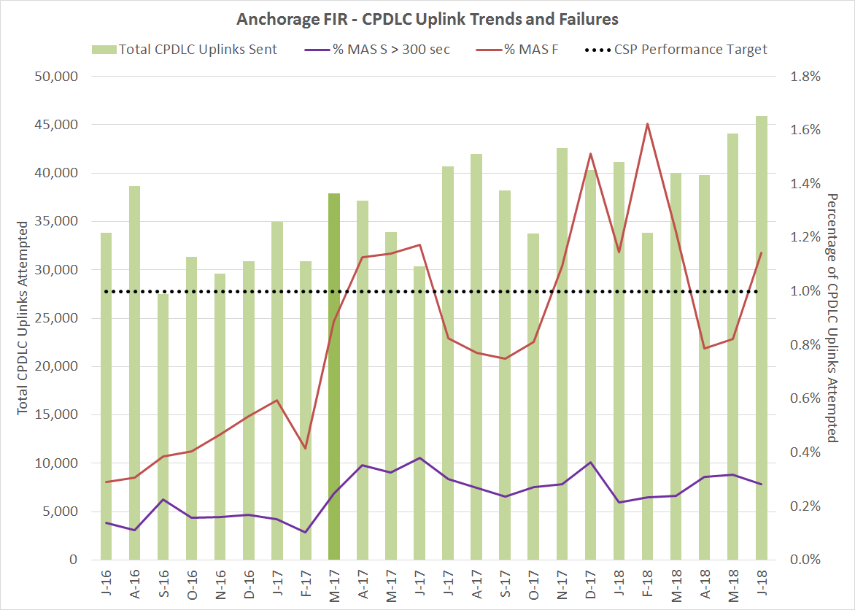

Slide 10
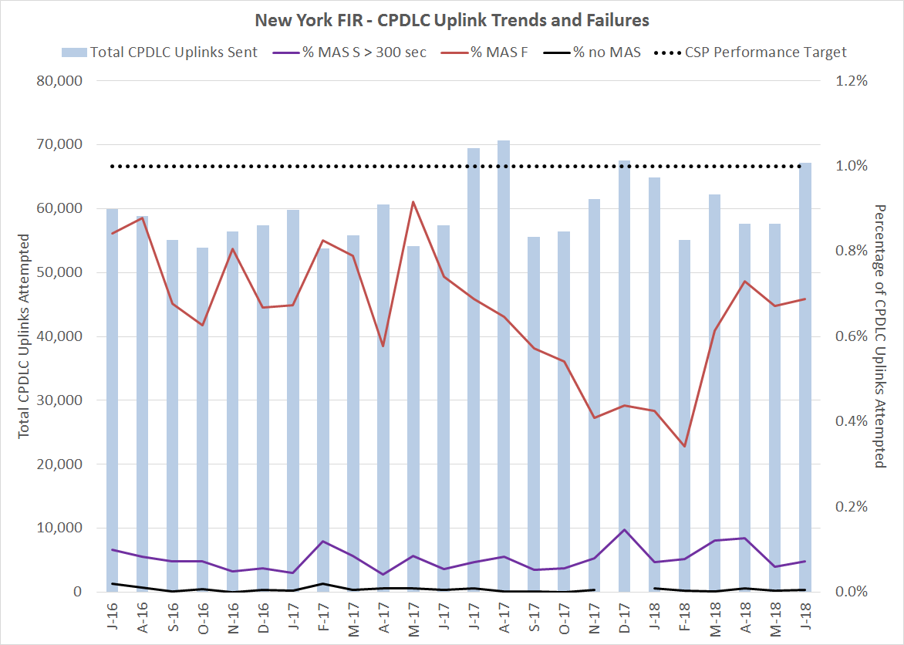

Slide 11
Performance by fleet

Slide 12
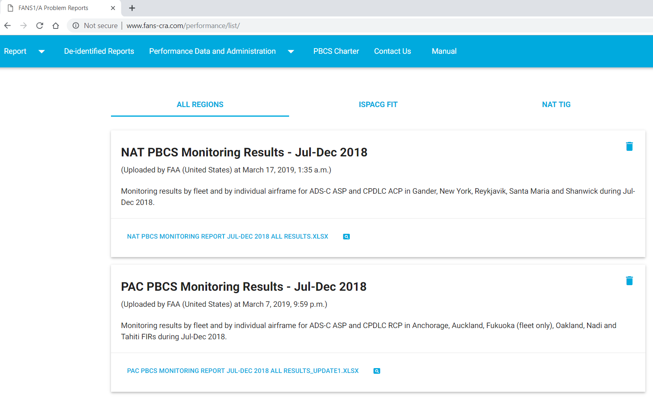
PBCS Monitoring Results

Slide 13
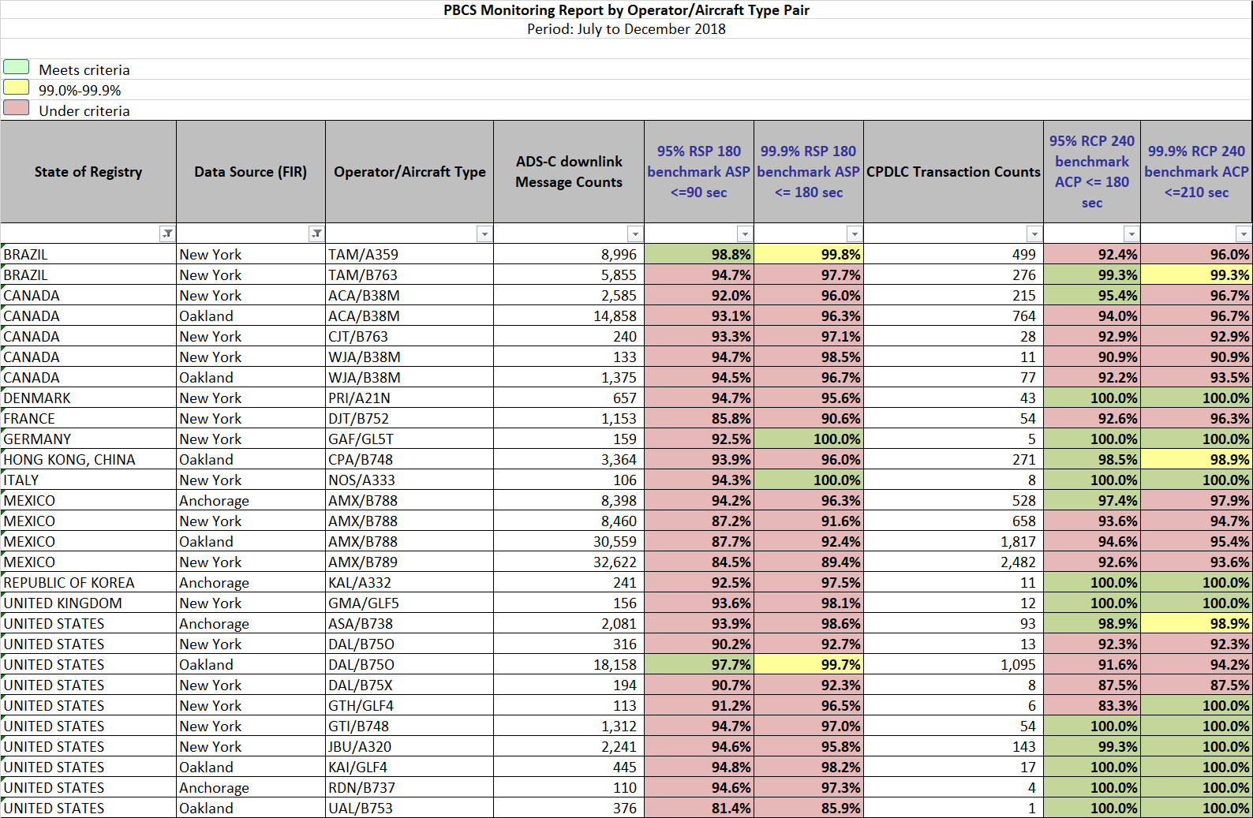

Slide 14
AMX B788
Performance deterioration occurred between May and June 2018
  Notable increase in HFDL messaging
Feedback from CRA to modify subnetwork order of preferences for ATC (FANS CPDLC and ADS-C) downlink messages
  order should be (1) VHF, then (2) SATCOM, and then (3) HF because those subnetworks generally provide successively poorer performance
Note: Boeing’s statement that the 787 meets the RCP240 and RSP180 specifications is based on HF being the last preference (or even not a preference at all) for ATC downlink messages in the CMF AMI
Performance notably improved in October 2018

Slide 15
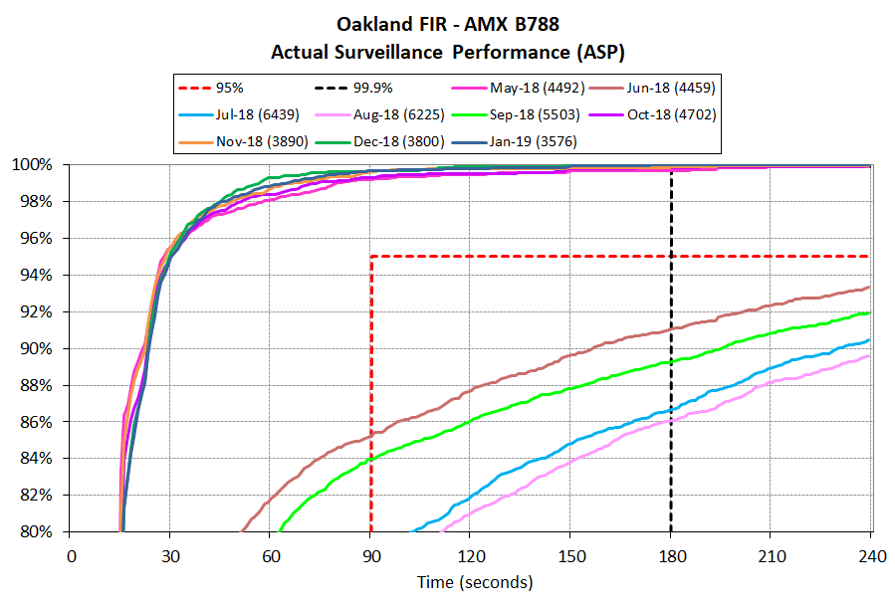

Slide 16
UPS Fleet improvements
Overall Iridium improvements impacted performance
Disabling HFDL
  B747 fleets – end of May
Software upgrades

Slide 17
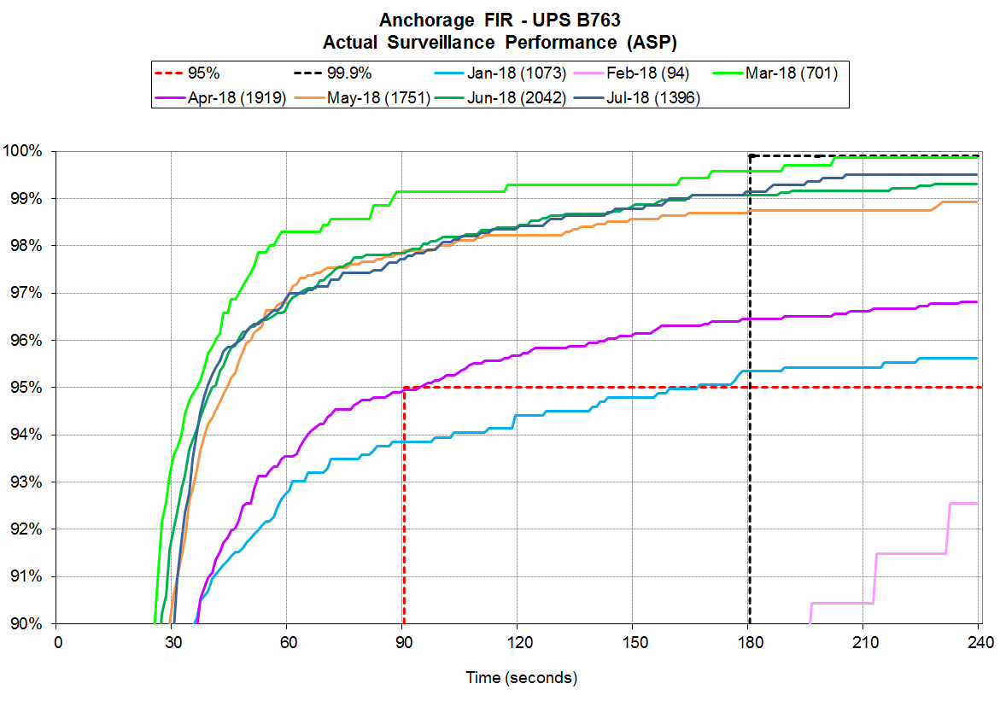

Slide 18
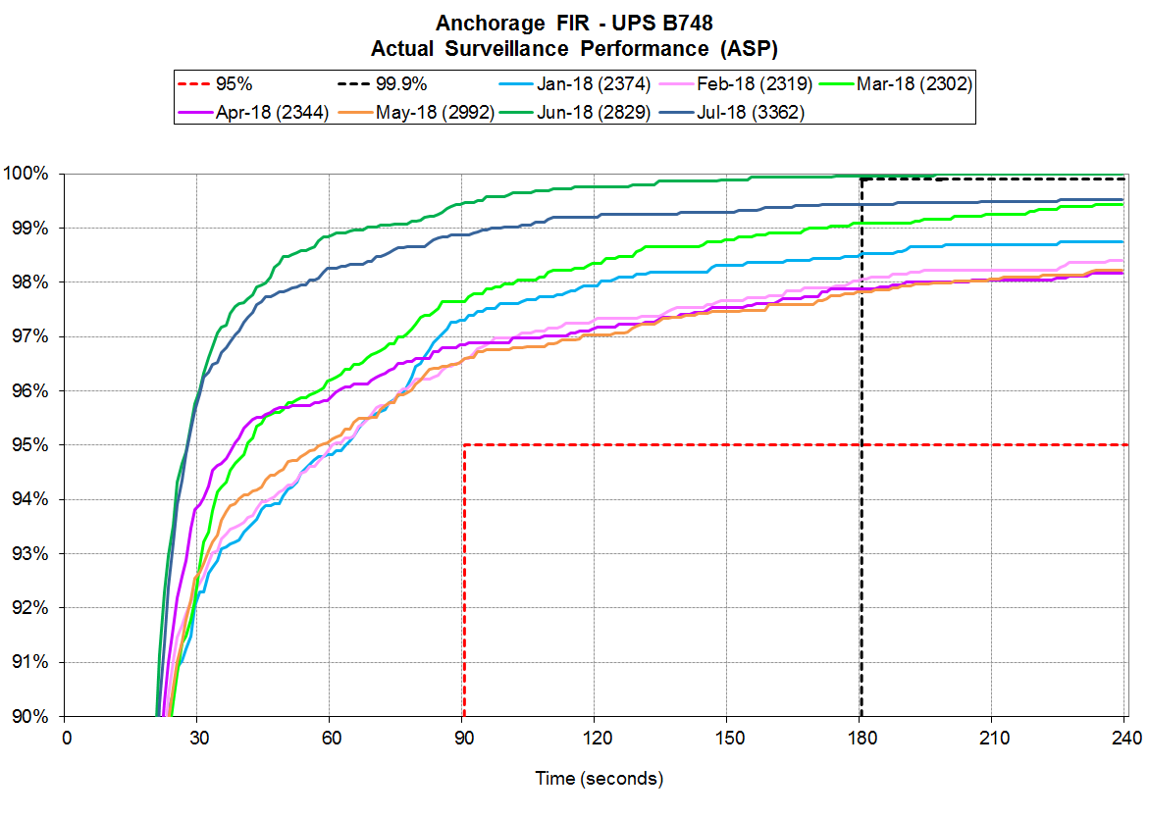

Slide 19
FANS Over iridium

Slide 20
FANS over Iridium Data Link Usage
Jul-Dec 2018 | KZNY | KZAK | PAZA
% FANS data link flights using Iridium | 17% | 21% | 12%
Average flights/day using Iridium | 77 | 135 | 26
% FANS data link airframes using Iridium | 15% | 18% | 16%

Slide 21
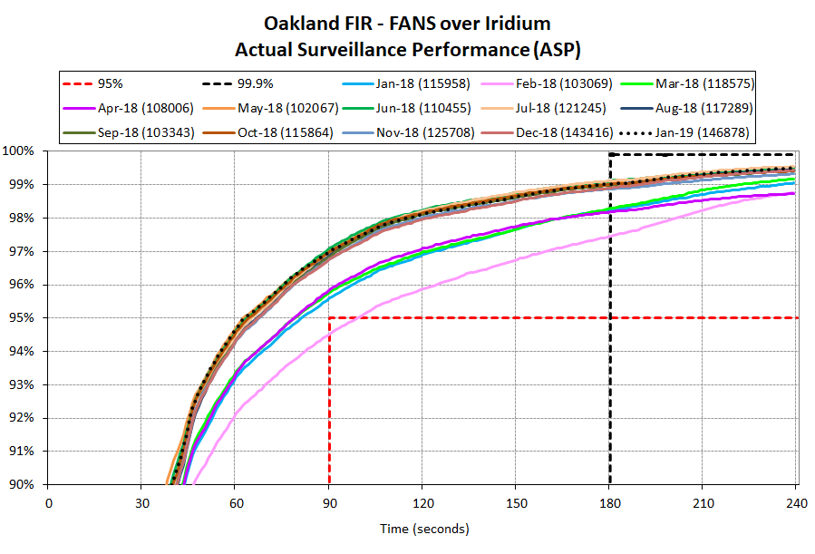

Slide 22
FANS Over swift broadband

Slide 23
FANS over SBB Data Link Usage
Jan-Jun 2018 | KZNY | KZAK | PAZA
FANS data link airframes using SBB | 4 | 15 | -
Jul-Dec 2018 | KZNY | KZAK | PAZA
FANS data link airframes using SBB | 4 | 20 | -

Slide 24
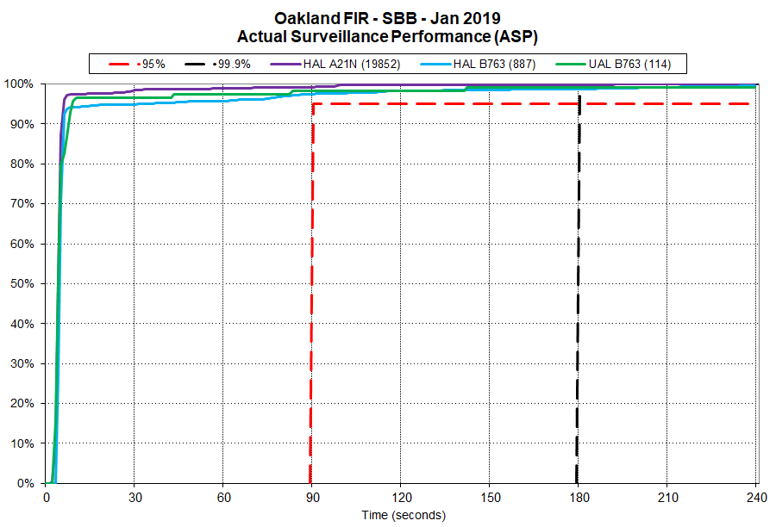
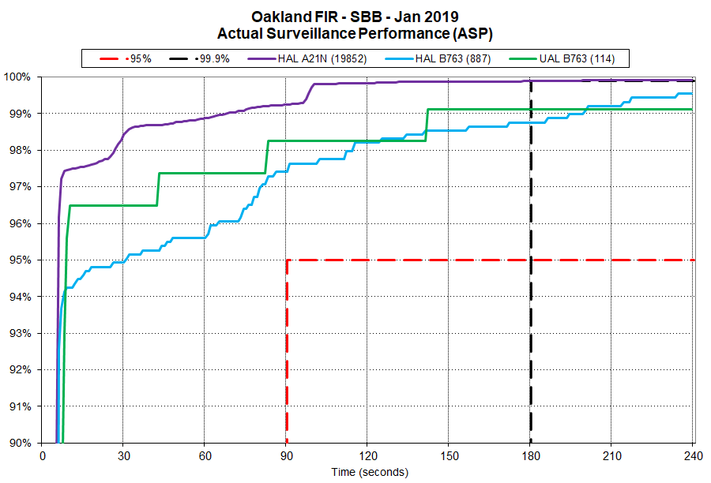

Slide 25
availability

Slide 26
Outage impacts
Detected by observations of:
  Increase in delays of ADS-C Reports (>180 seconds)
  Increase in delays of CPDLC uplinks/ downlinks(>180 seconds)
  Increase in MAS Failures
  Increase in reversions to HFRO for communication and position reporting
  Increase is use of alternative forms of separation
  Increase in controller sector queue workload

Slide 27
ACARS Identifiers | # unplanned outages affecting path > 10 min | Sum of unplanned outages affecting path > 10 min (min) | Estimated availability for path | Sum of minutes with observed impact KZAK | Sum of minutes with observed impact KZNY | Sum of minutes with observed impact PAZA
IG1 | 5 | 690 | 99.87% | 1525 | 970 | 1164
IGW1 | 13 | 1424 | 99.73% | 1492 | 1316 | 1464
XXN | 0 | 0 | 100.00% | 0 | 0 | 0
AOE2* | 3 | 801 | 99.85% | 0 | 0 | 0
AOE6* | 1 | 10 | 100.00% | 0 | 23 | 0
XXF | 4 | 1709 | 99.67% | 0 | 0 | 0
EUA1 | 7 | 1799 | 99.66% | 0 | 0 | 0
XXI | 0 | 0 | 100.00% | 0 | 0 | 0
EUA2 | 0 | 0 | 100.00% | 0 | 0 | 0
IOR1* | 0 | 0 | 100.00% | 0 | 0 | 0
IOR6* | 0 | 0 | 100.00% | 0 | 0 | 0
XXB | 3 | 502 | 99.90% | 0 | 0 | 0
EUA9 | 0 | 0 | 100.00% | 0 | 0 | 0
EME9 | 3 | 215 | 99.96% | 0 | 0 | 0
XXA | 5 | 1665 | 99.68% | 33 | 0 | 0
APK1 | 9 | 993 | 99.81% | 88 | 0 | 0
XXP | 2 | 217 | 99.96% | 33 | 0 | 0
APK2 | 6 | 510 | 99.90% | 23 | 0 | 0
POR1 | 2 | 163 | 99.97% | 33 | 0 | 0
XXS | 2 | 386 | 99.93% | 0 | 0 | 0
APK9* | 0 | 0 | 100.00% | 0 | 0 | 0
PAC9 | 3 | 173 | 99.97% | 0 | 0 | 0
XXH | 1 | 38 | 99.99% | 32 | 0 | 0
AME1 | 4 | 361 | 99.93% | 77 | 72 | 0
XXW | 1 | 58 | 99.99% | 11 | 41 | 0
AME2 | 6 | 971 | 99.82% | 49 | 11 | 0
AOW2 | 4 | 983 | 99.81% | 0 | 205 | 0
XXU | 2 | 386 | 99.93% | 31 | 0 | 0
AME9* | 0 | 0 | 100.00% | 0 | 0 | 0
AMR9 | 3 | 173 | 99.97% | 0 | 0 | 0
XXM | 1 | 79 | 99.98% | 0 | 0 | 0
MEA9 | 3 | 153 | 99.97% | 0 | 0 | 0
MTS1 | 2 | 163 | 99.97% | 52 | 0 | 0

