Slide 1
Long Range Air Traffic Flow Management (LR-ATFM)
18 – 22 March 2019
ISPACG 33
Chris McCormack
ATC Line Manager

Slide 2
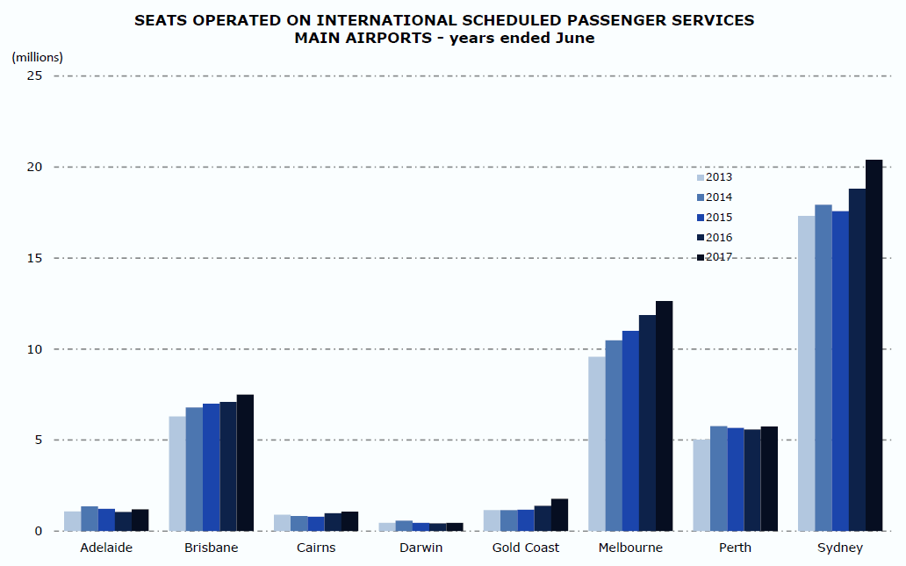
The case for change
Long Range Air Traffic Flow Management
Current network challenges
  Strong growth of international demand at peak periods for Australia’s major airports
  Pre-tactical demand and capacity management applies to domestic operations only
  International flights often arrive without a reserved priority spot
  = Disruption of tactical arrivals management, low predictability and delays for all flights
A unique opportunity in Australia
  Large airspace
  Single system across all ATC domains (oceanic and continental)
  Mature ATFM implementation
  Towards regional ATFM
Integration of international flights into air flow traffic management processes through new network control lever = Long Range ATFM

Slide 3





How it works – from the west
Long Range Air Traffic Flow Management
Identification of delay requirement based on
demand and capacity at the destination airport
LR-ATFM delay is communicated to the flight
crew as an AF CTO for ARBEY
Aircraft accepts AF CTO for
ARBEY and advises ATC of
revised cruise speed
Entering into the terminal arrivals airspace, LR-ATFM delay absorbed enroute is credited and offset against any airborne delay
ARBEY

Slide 4
How it works – from the east
Long Range Air Traffic Flow Management
Flight is assigned an arrival slot by Harmony with potential delay required based on demand
and capacity at the destination airport
AOCs (if agreeable) can see allocated AF CTO via a Harmony web browser and can pass on to their aircraft
via datalink
Once in the Australian FIR, ATC advises AF CTO for MARLN
Aircraft accepts AF CTO for
BOREE and advises ATC of
revised cruise speed
Entering into the terminal arrivals airspace, LR-ATFM delay absorbed enroute is credited and offset against any airborne delay
BOREE

Slide 5



Anticipated benefits
Long Range Air Traffic Flow Management
Capability
Service Improvement
Outcome
Benefit
Predictability of operations
Reduced
fuel burn
Efficiency
Environment
Early provision
of anticipated
landing time
Orderly flow into tactical arrival management environment
Reduced controller workload
Safety
Efficiency
Long Range ATFM
Expanded demand and capacity management
Improved network performance
Reduced
tactical delay
Efficiency
Equity in allocating network delay
Reduced
GDP delay
Efficiency

Slide 6
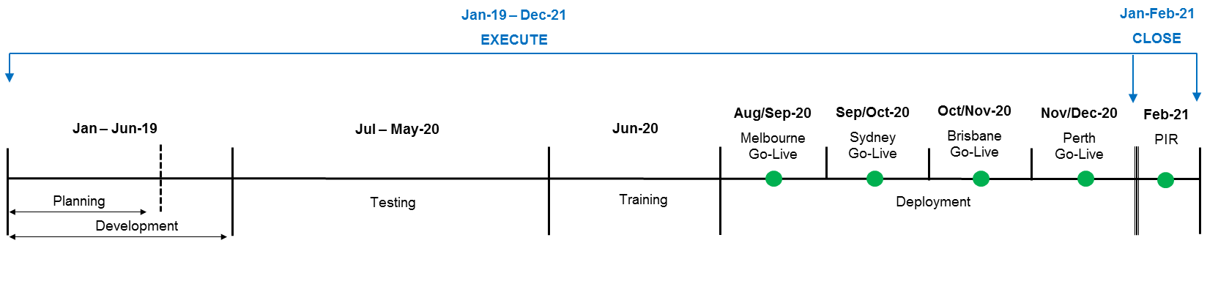
Timeline & next steps
Long Range Air Traffic Flow Management
Business Case approved by the Airservices Board – December 2018
Detailed design underway based on Concept of Operations
Project team in place & implementation planning underway

