Slide 1
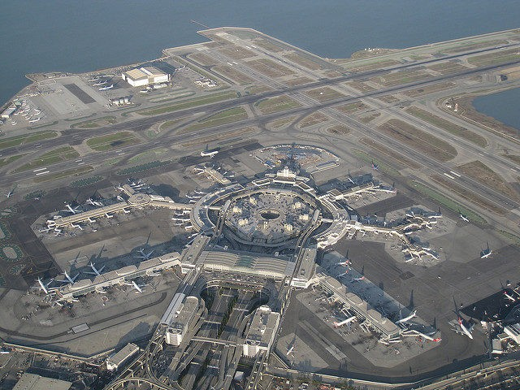
Oakland Center Update
ISPACG
Dustin Byerly
3/20/19

Slide 2
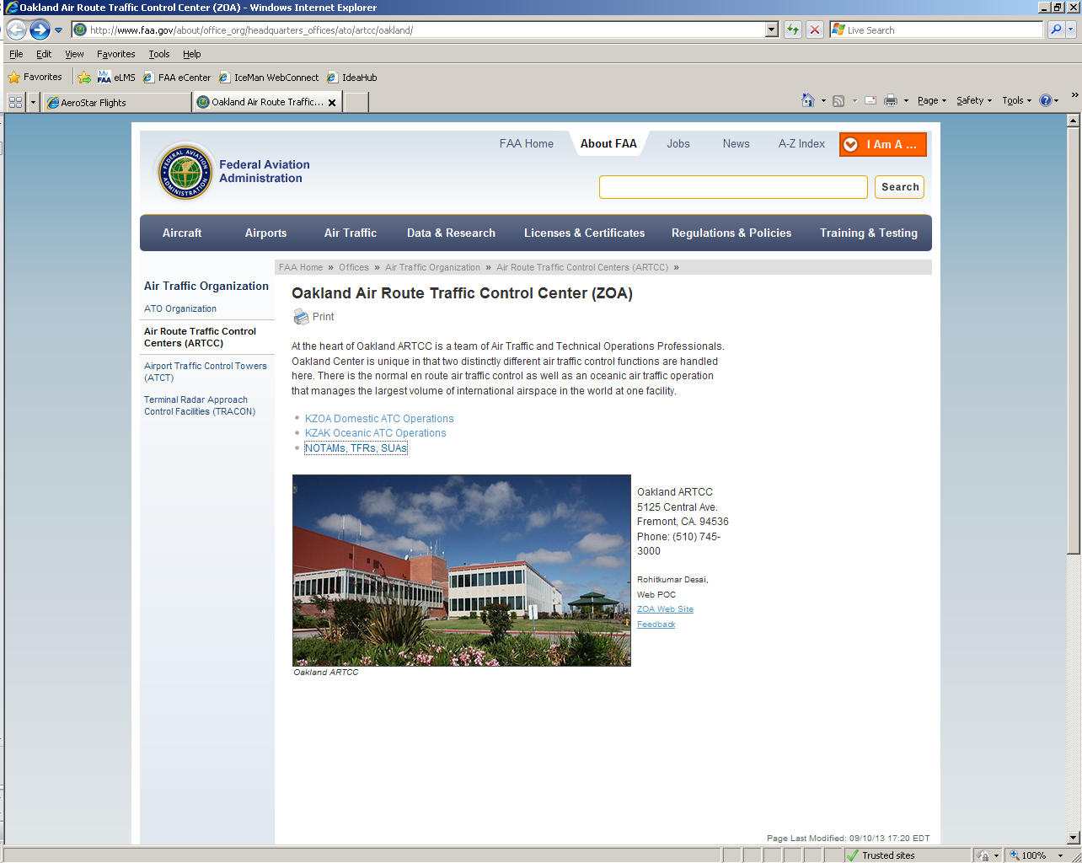
Oakland ARTCC Webpage
http://www.faa.gov/about/office_org/headquarters_offices/ato/service_units/air_traffic_services/artcc/oakland/
2

Slide 3
Oceanic Equipage

Slide 5
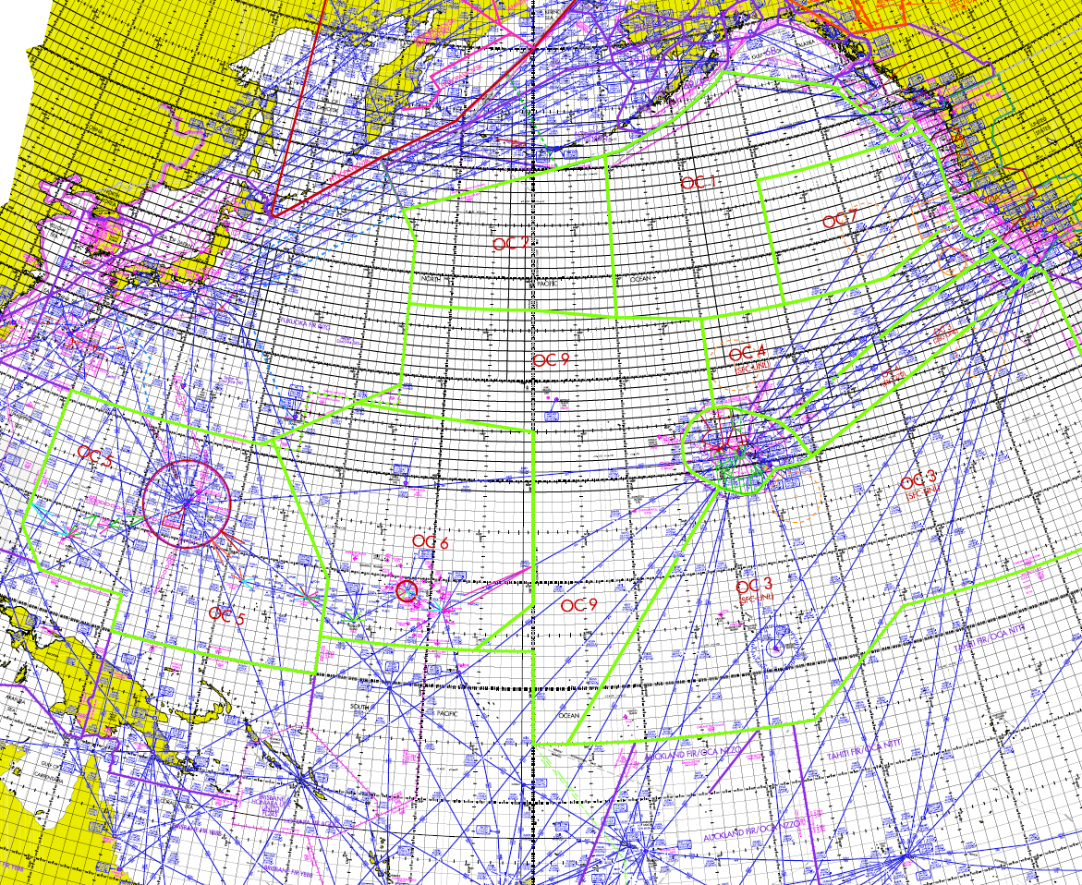
Flow %KZAK % FANS AUNZJP 5.9% 95.5% JP-Guam 7.9% 27.2% CEP 37.8% 56.5% JP – HI 7.0% 96.8% CENPAC 27.8% 97.8% SOPAC 9.0% 94.6%

Slide 7
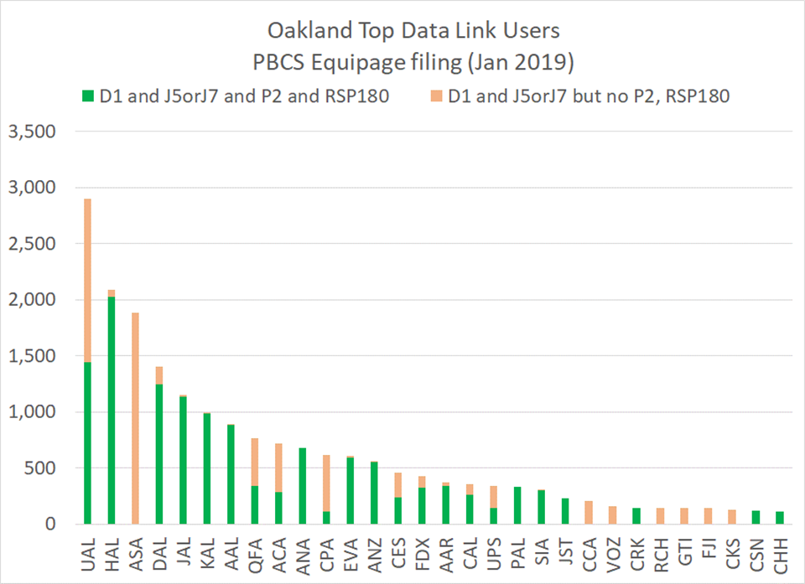

Slide 10
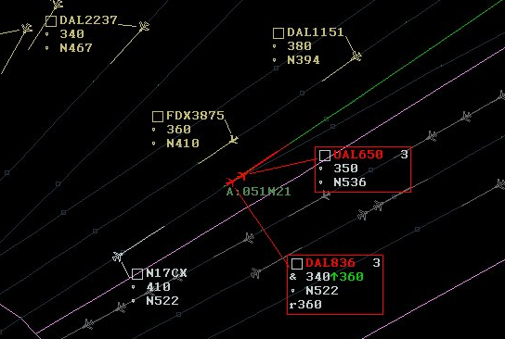
RNP4, FANS1A, and PBCS Certs Improves efficiency
FANS RNP10
FANS RNP4
Non FANS RNP10
10

Slide 11
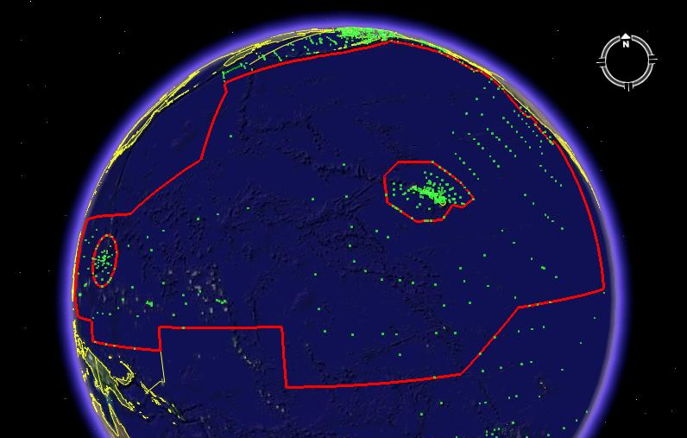
PACOTS vs UPRs
Overall 19 of 22 PACOTS Tracks have been replaced with UPRs
11

Slide 12

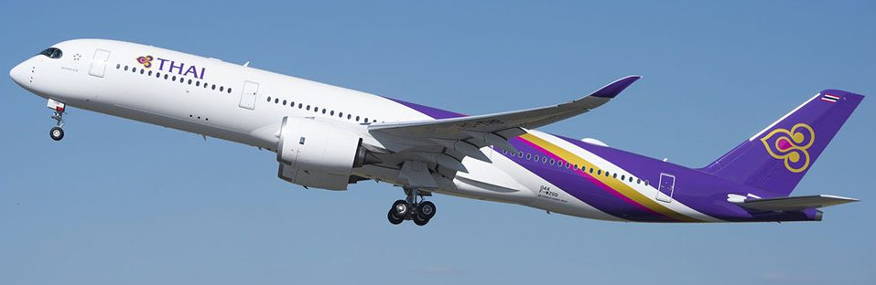
High Altitude UPR’s

Slide 13
Tailored Arrival/PIRAT ONE Arrival
On February 28 the Tailored arrival was permanently turned off.
The PIRAT ONE arrival will now be the preferred arrival into KSFO & KOAK
The PIRAT ONE will be NA until a crossing restriction at PIRAT is added.

Slide 14
DARP

Slide 15
DARP

Slide 16
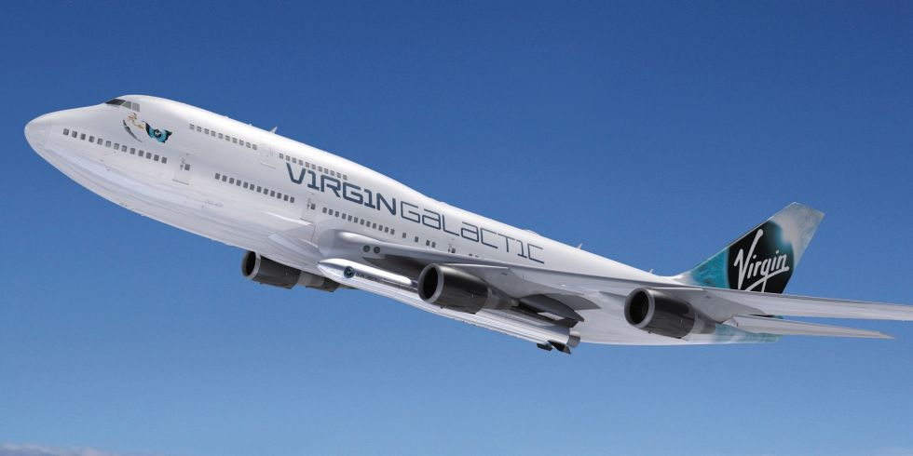


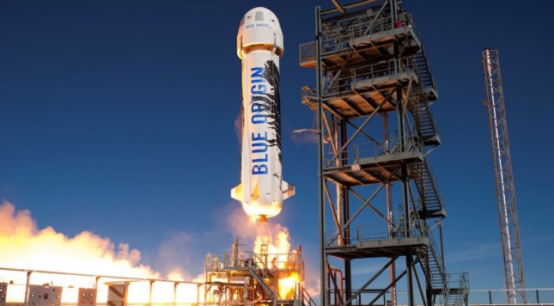
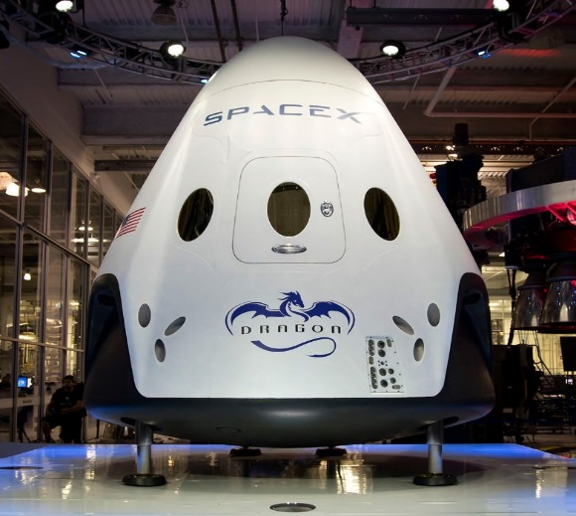


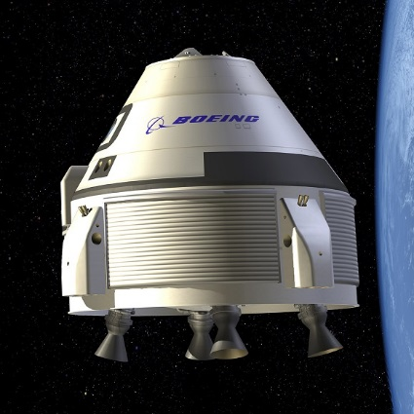

Slide 17
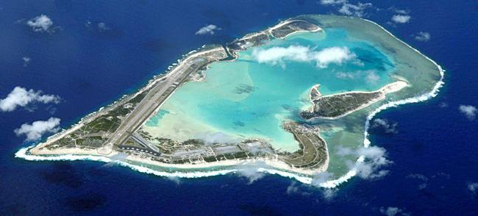
Wake Island

Slide 18
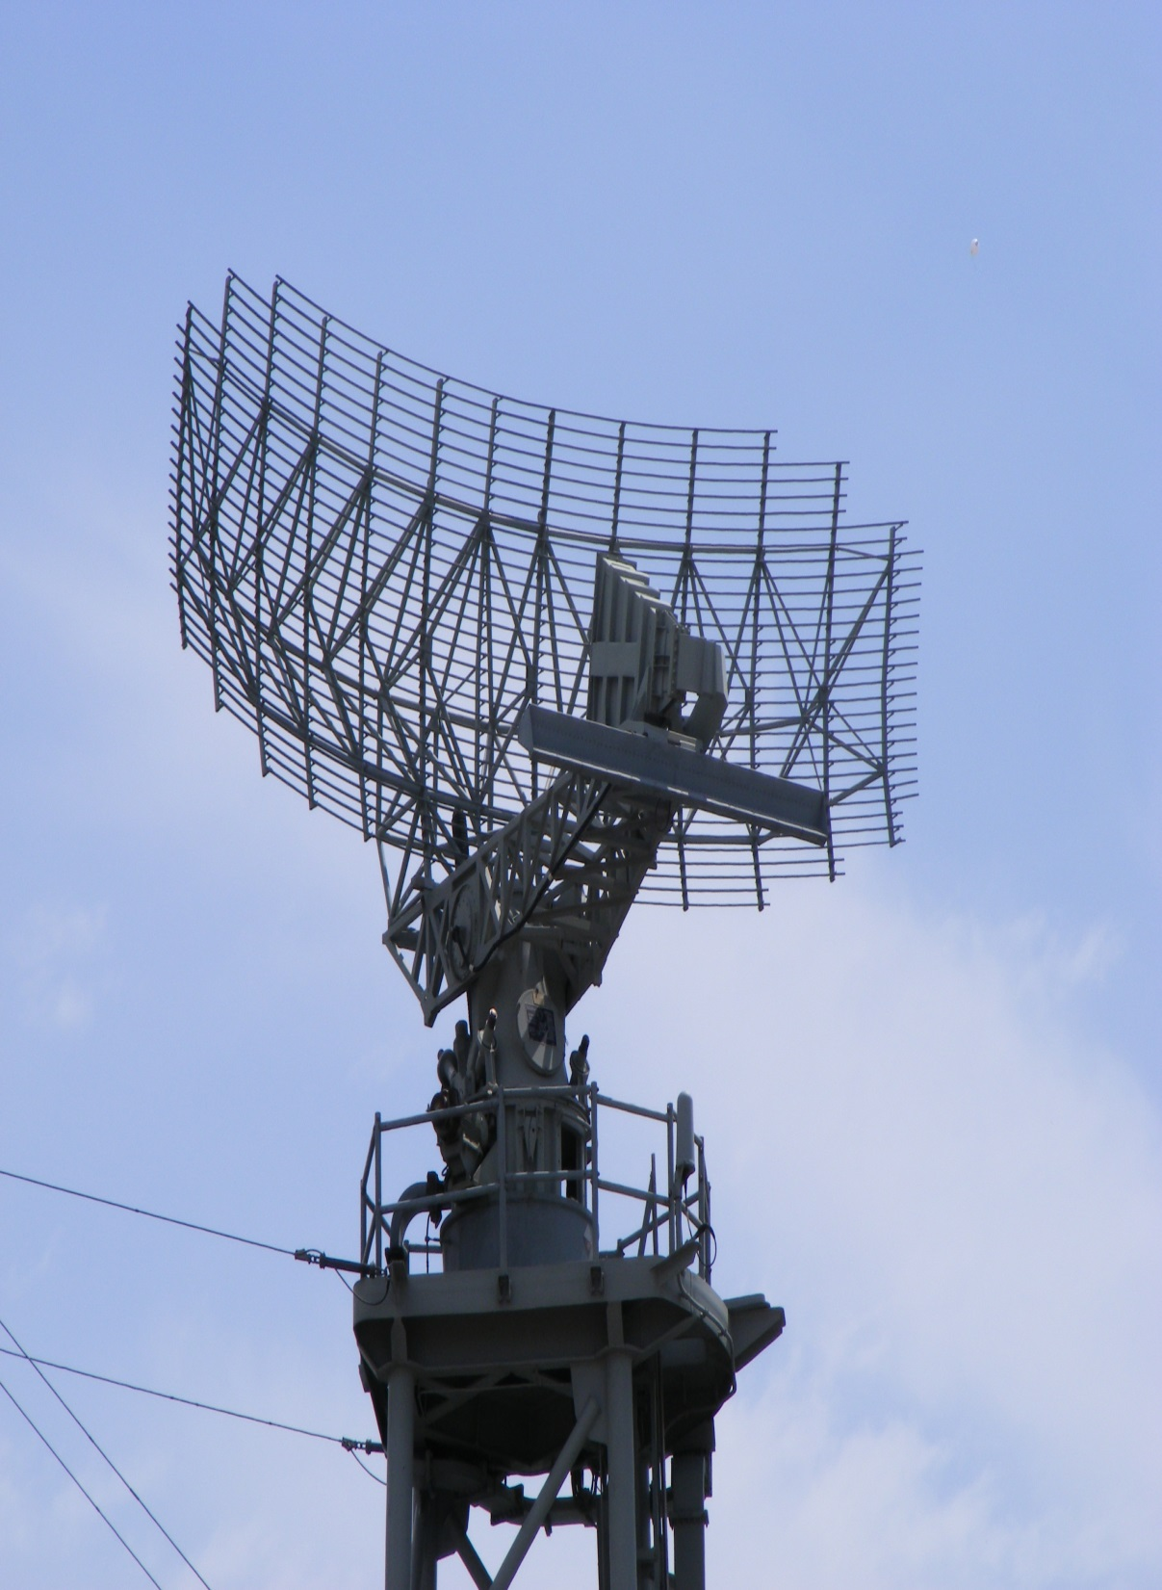
HCF Radar into ATOP
Status Update

Slide 19
Radar into ATOP
Mill Valley (Operational)
HNL Radars (Operational)
Remainder of the West Coast Radars ???
Data will be used for conformance monitoring only.
Other benefits in contingency situations.

Slide 20
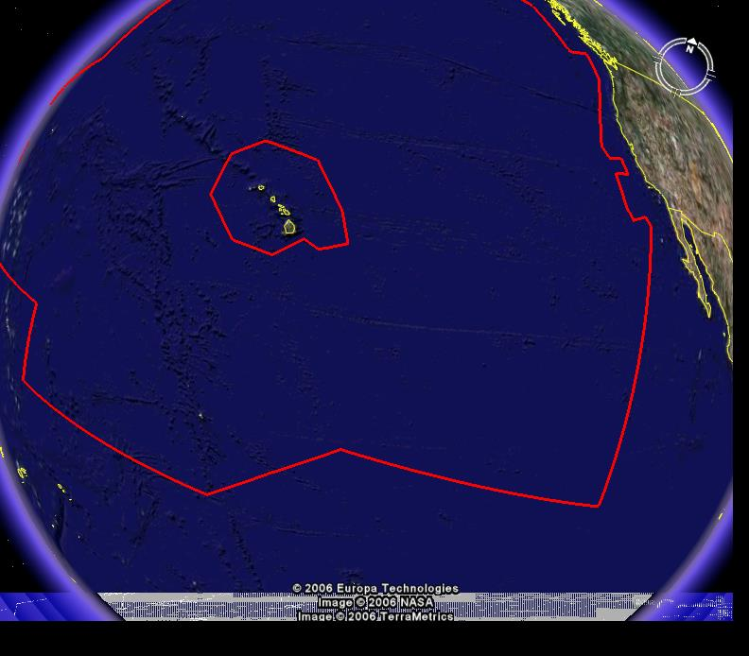
Space Based ADS-B Surveillance
ZOA
The FAA has no plans at this time for Space Based ADS-B in the Pacific. They are looking at parts of the Caribbean to use SB ADS-B.
20

Slide 21
23 Lateral Separation 20 Longitudinal
SRM Panel was conducted December 2018 in Dallas TX.
Working with the ATOP program office on details.
Implementation in January 2021
20 Longitudinal proposed for 2022

Slide 22
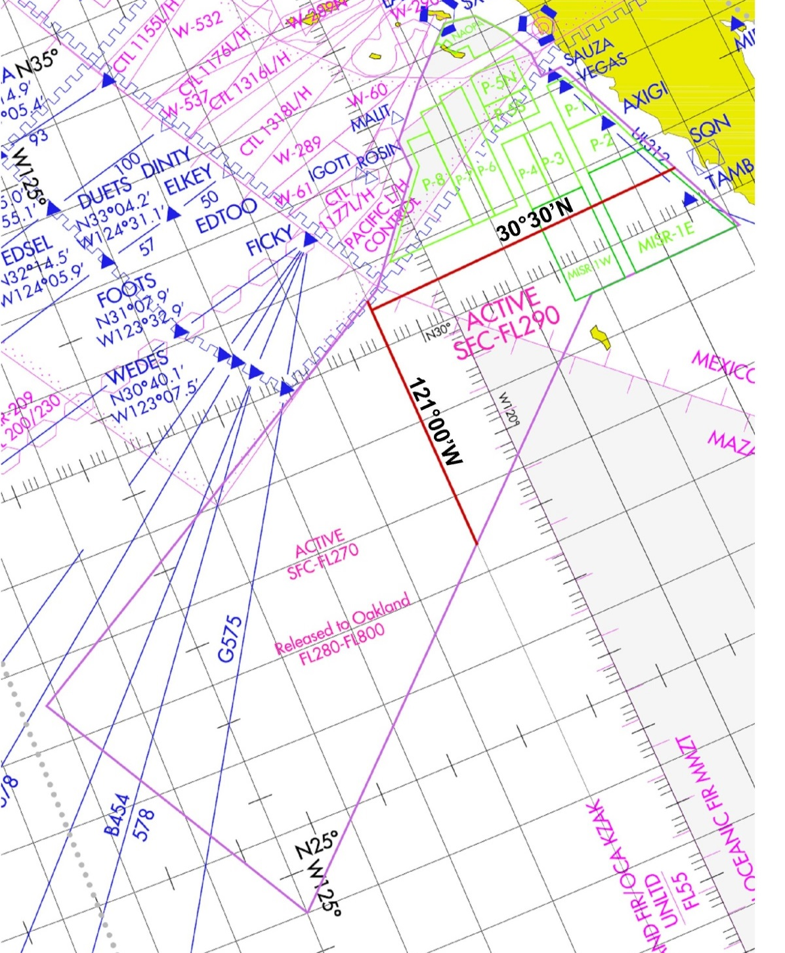
SENEAM
An AIDC connection between Oakland and Mazatlan was established March 2015
Mazatlan is working on a capability to apply ATC services in their oceanic FIR
Date TBD

Slide 23


Slide 24

Questions

Slide 25
BACK UP SLIDES

Slide 26
High Level UPR Trial
Newer Composite aircraft climb above most traffic on PACOTS routes.
Anchorage ARTCC started a High Level UPR Trial allowing aircraft at or above F380 by 180E can UPR up to NIPPI or OMOTO.
Oakland has published the guidelines for a High Level UPR Trial as an alternative to westbound PACOTS to NOPAC
Trial will have an indefinite lifespan.
26

