Slide 1
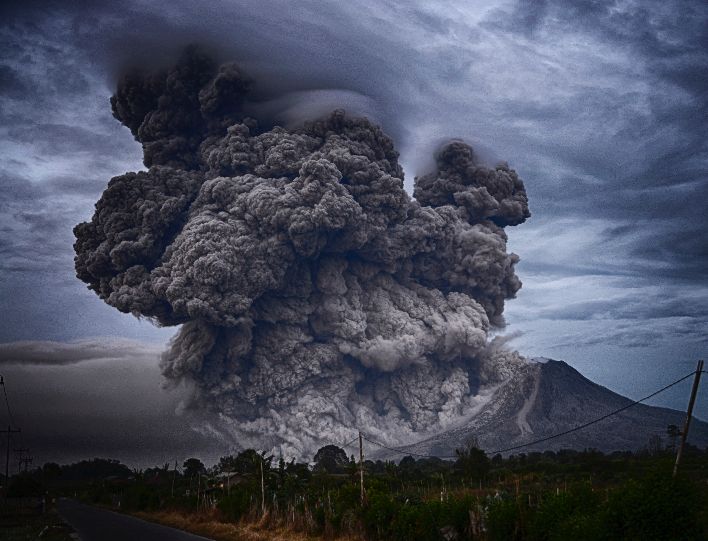
APAC VOLCEX 19/01
South Pacific Volcanic Ash Exercise
Raoul Island

Slide 2
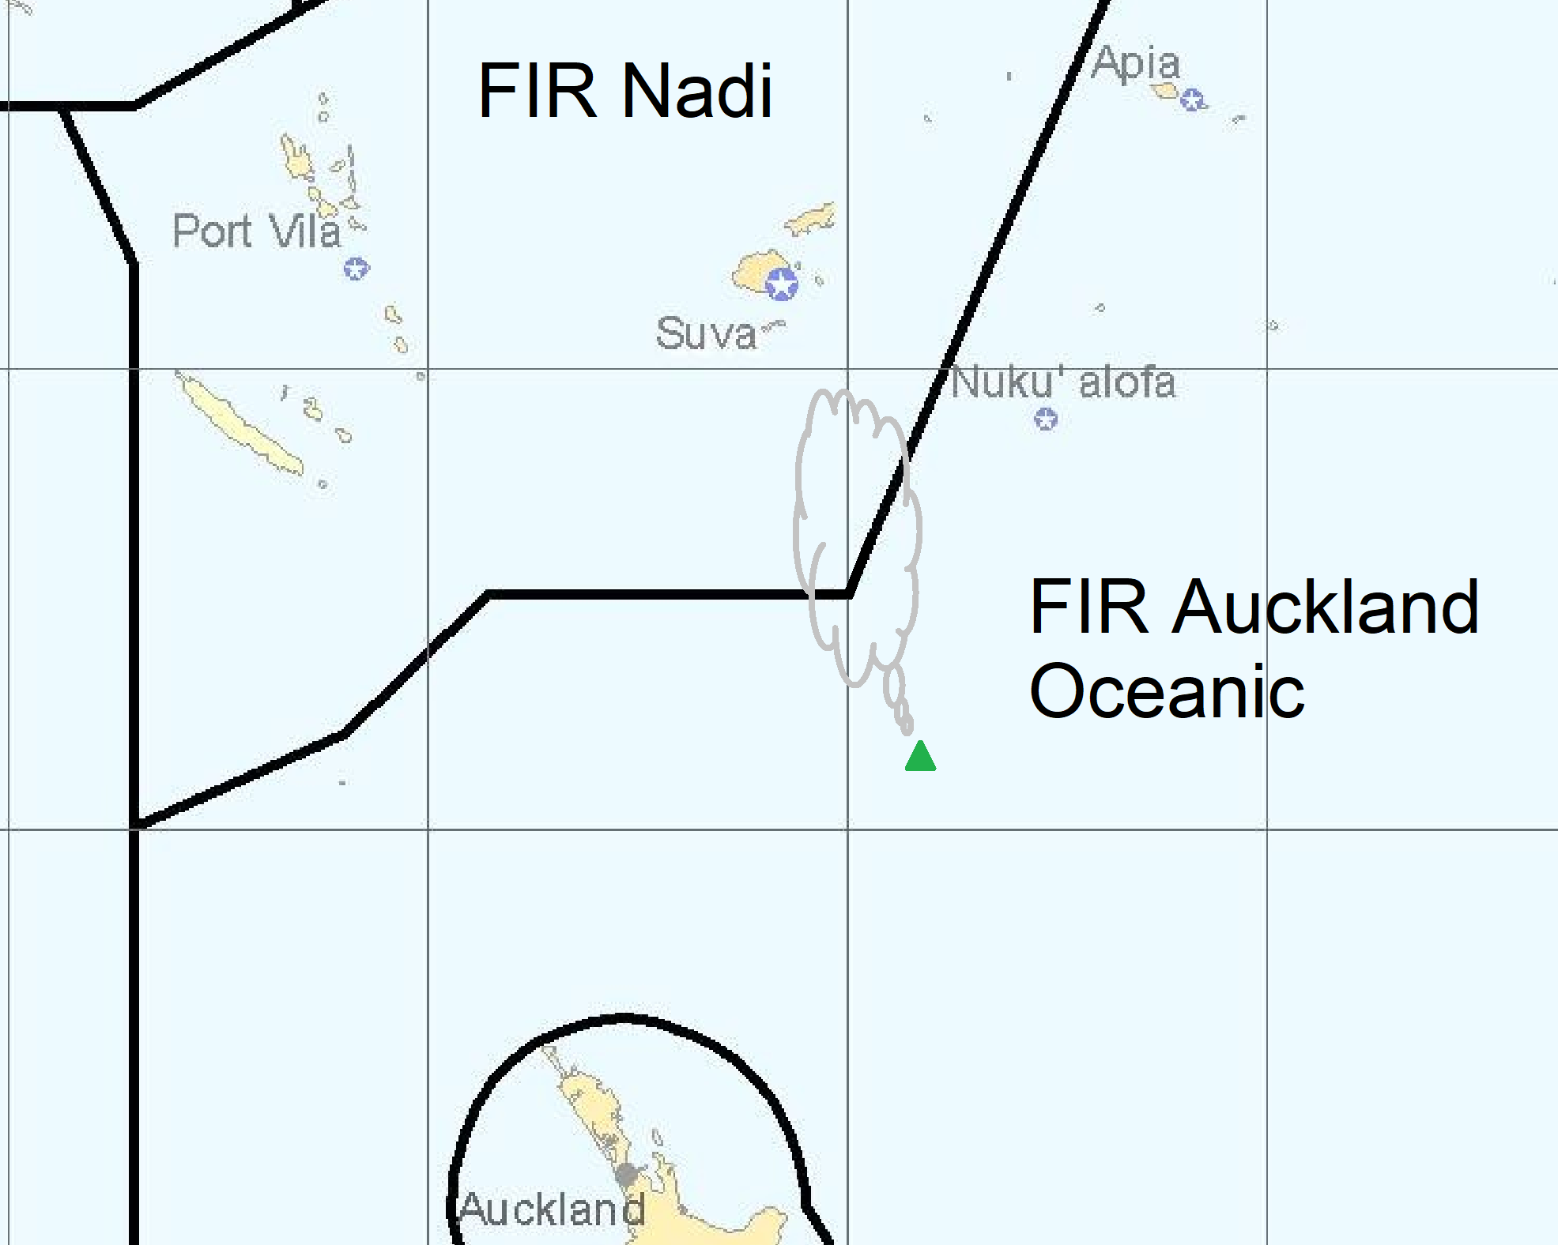

Slide 3
Scenario
Raoul Island erupts to high levels, with ash moving north.
Ash moves through NZZO/NFFF FIR border, but remains within the Wellington VAAC Area of Responsibility.
Ash contaminates Nadi and Nausori International Airports
Exercise planned for Tuesday 7th May 2019, with backup date 9th May 2019 (dates TBC).

Slide 4
Exercise
“Desktop” exercise – normal operations not to be affected
Using “usual channels” for message delivery – AFTN, email
All comms and messages to be prefaced/include “EXERCISE” to reduce risk of confusion.
Web conferencing during exercise to enhance communication and collaboration

Slide 5
Expected Benefits
The exercise scenario provides the opportunity for organisations to test their own volcanic ash processes and procedures, as well as practice essential communication with other organisations
  Practicing before an event enables smoother and safer operations during the real thing
  Improve communication and understanding between organisations
  Uncover opportunities for improvement in operational procedures

Slide 6
Participants
GNS Science
MetService NZ/VAAC Wellington, Fiji Meteorological Service
Airways NZ, Airports Fiji Ltd
Air New Zealand, Fiji Airways/Fiji Link
CAA NZ, CAA Fiji
ICAO APAC Regional Office
Plus other observers of the exercise (MCDEM, IATA, CASA, RNZAF, VAACs Darwin and Tokyo, MWOs Brisbane, Melbourne, Tahiti, Honiara, Honolulu & Tonga Met Service …)

