Slide 1
Airservices Update
ISPACG 2018
Chris McCormack

Slide 2
Re-energised Culture since Accelerate
Over an 18 month period, via our Accelerate program, we have moved from an out-dated operating model to become a profitable, sustainable, more customer-focused organisation.
The environment in which we operate is changing substantially. So we must continue to invest and evolve if our national aviation ecosystem is to remain effective and competitive over the coming years.
Airservices is transforming, with new systems and approaches presenting a significant change in how we will provide more flexible, scalable and agile air traffic control services in Australia.
With our re-energised culture, greater discipline, and a focus on beneficial innovation, we will be diligently looking for further savings opportunities and more ways to bring benefits to you, our customers.

Slide 3
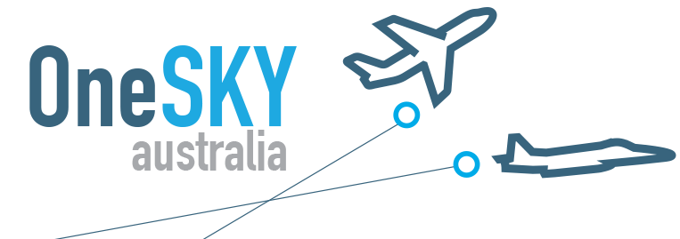
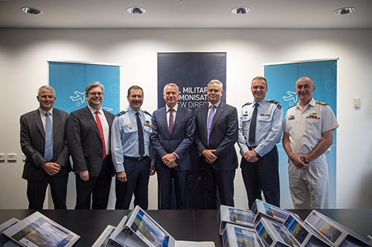
OneSKY announcement
On 22 February 2018, final contracts were signed with Thales Australia to build and deliver the new Civil Military Air Traffic Management System (CMATS).
We now move into implementation phase to deliver a system where for the first time civil and military controllers will share the same fully integrated air traffic management system, and use the same advanced technology and tools to jointly manage Australia’s vast airspace.
“It’s probably the biggest development in the safe management of Australia’s skies since aviation began in this nation.”
Airservices Australia CEO Jason Harfield.
“OneSKY is game-changing. It is transformative, not only for air traffic management in Australia, but world-wide there is nothing like it.”
Airservices Australia CEO Jason Harfield.

Slide 4
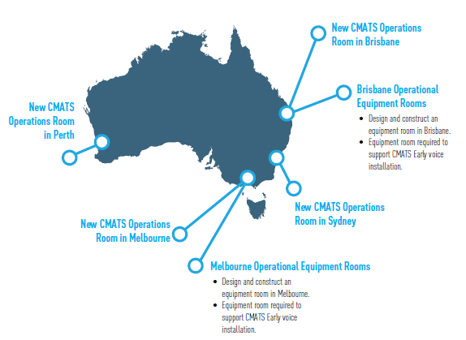
Dependent Projects

Slide 5
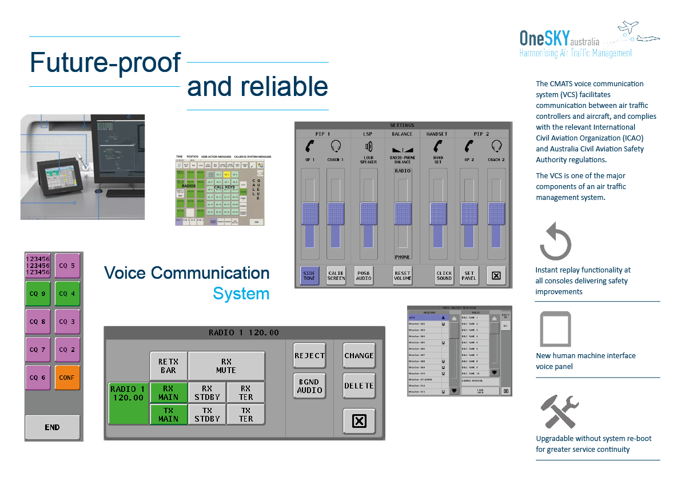

Slide 6
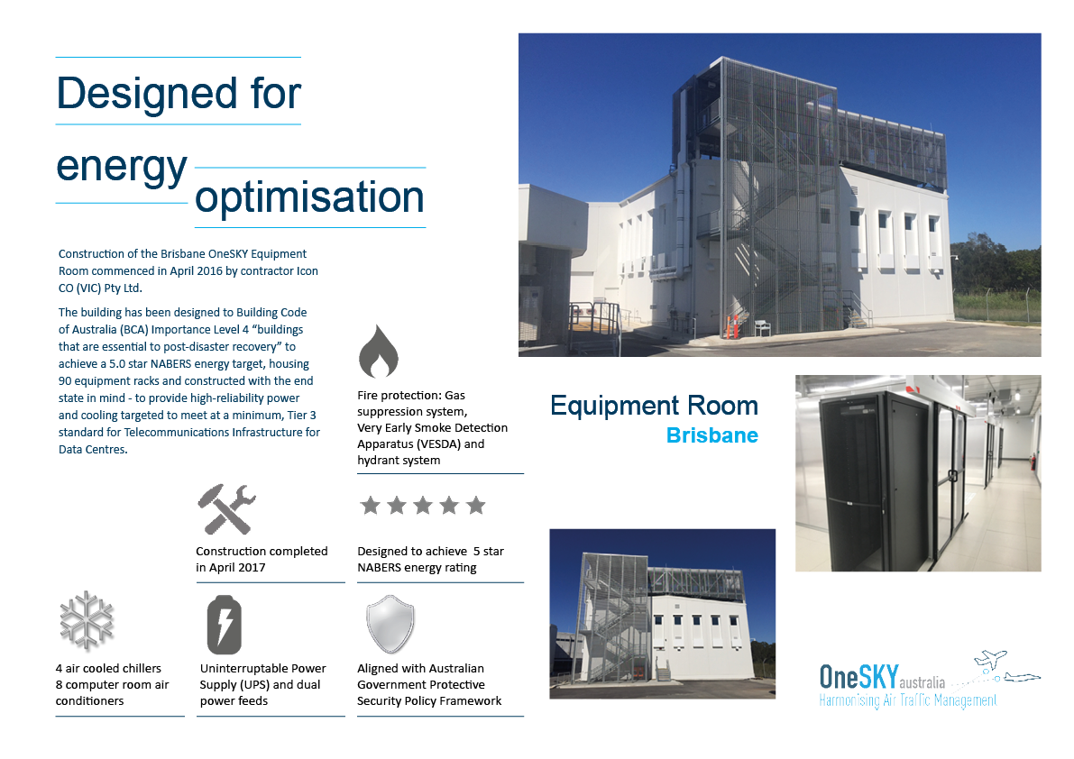
Equipment rooms

Slide 7
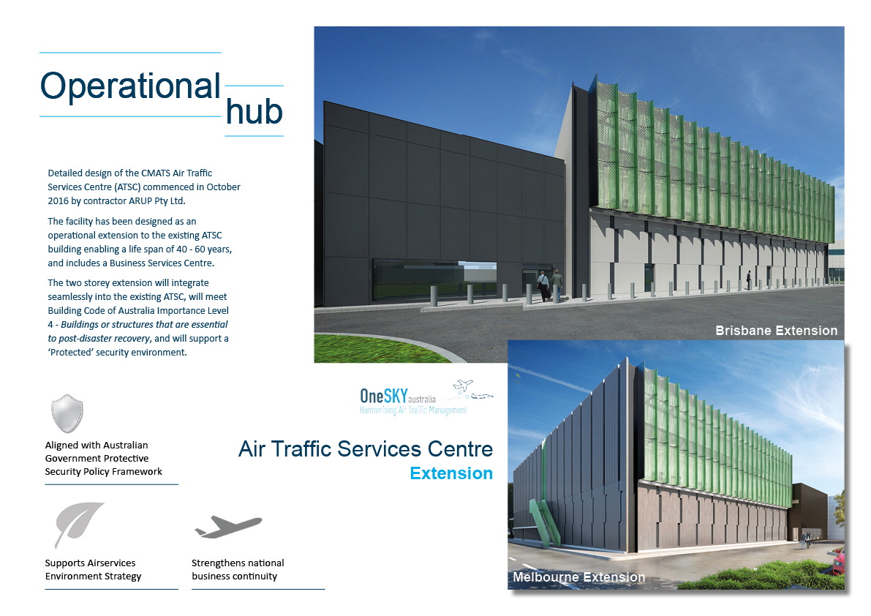

Slide 8
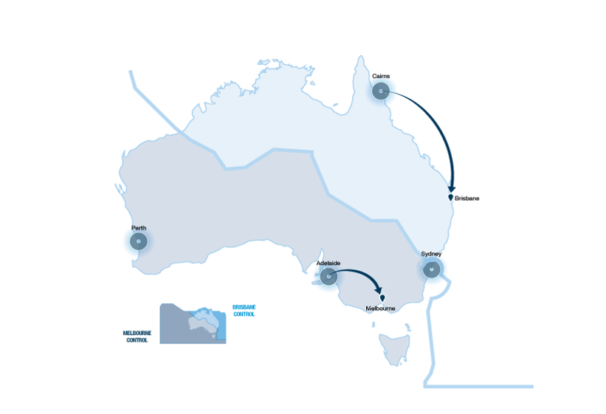
Cairns and Adelaide TCU Integration
Notes:
In August 2011, an independent assessment of the TCU buildings was undertaken and found that the buildings were near the end of their useful life and would require replacement or refurbishment.
The outcome of the review was that cost and operational efficiencies could be gained through integration, that there were minimal technical and logistical impediments and no significant safety impacts.
The Integration involved moving around 25 staff from Adelaide and 15 staff from Cairns.

Slide 9
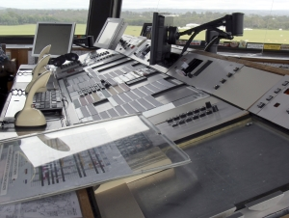
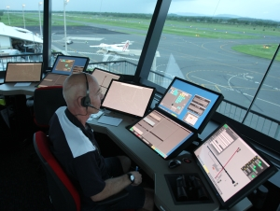
INTAS
Integrated Tower Automation Suite
Notes:
Integrated Tower Automation Suite (INTAS) is a fully harmonized suite of ATC tools that provides Airservices controllers with a common, modern set of key ATC systems and capabilities in a single customizable platform to meet both the current and future demands of aviation and industry users. INTAS is currently operational in our towers in Broome, Rockhampton, Adelaide, Melbourne, Gold Coast, Perth, Cairns and Brisbane. INTAS is based on the NAV CANADA ATM technology, the Harris and Frequentis voice switches and Saab ASMGCS.
INTAS replaces the traditional paper-based console with a number of touch screen monitors. All tower data and communication is accessed via these touch screens. It also integrates electronic flight strips, operational data management, digital automatic terminal information services, voice communication control system and the electronic surveillance system

Slide 10
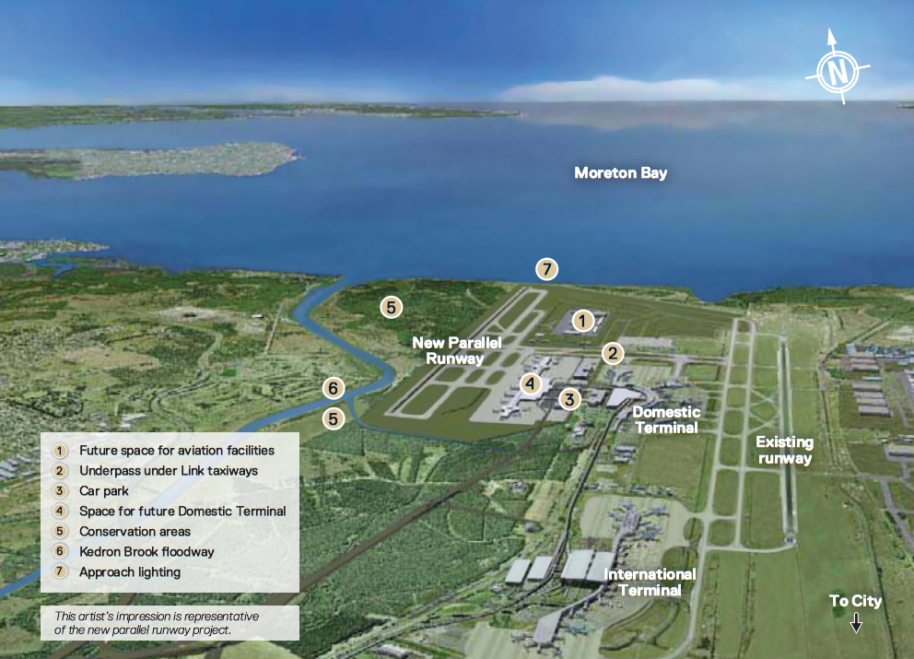
New Parallel Runways
Brisbane 2020
Melbourne 2022
Notes:
Significant bodies of work grouped into three main areas:
Airfield; New Nav Aids, Expanding ASMGCS, New Frequencies,
Systems: New INTAS and Eurocat consoles as well as software adaptation and integration
Airspace: Airspace design for new flight paths, community consultation, nose abatement and ATC training

Slide 11
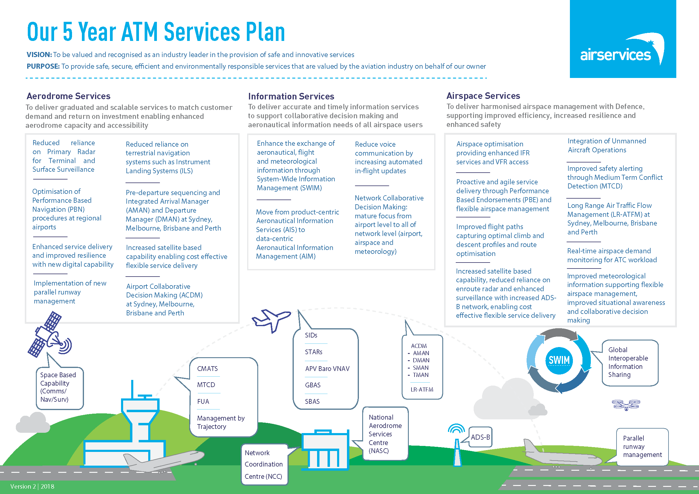

Slide 12
For more information
Chris McCormack
International Programs
Airservices Australia
christopher.mccormack@airservicesaustralia.com

