Slide 1
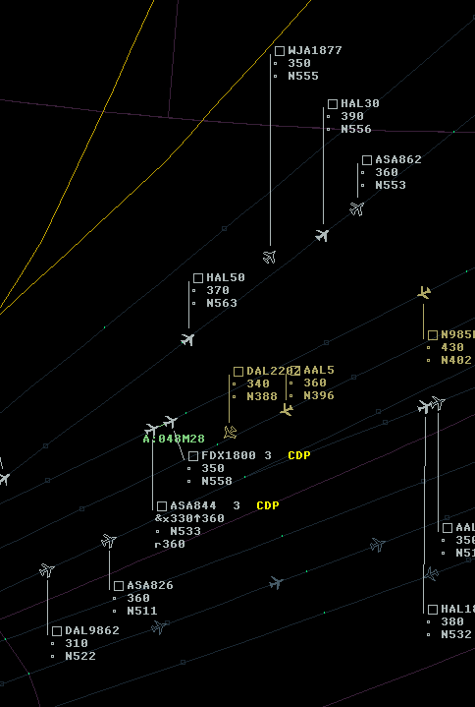
ADS-C CDP & ADS-B ITP
Status Update

Slide 2
ADS-C CDP

Slide 4
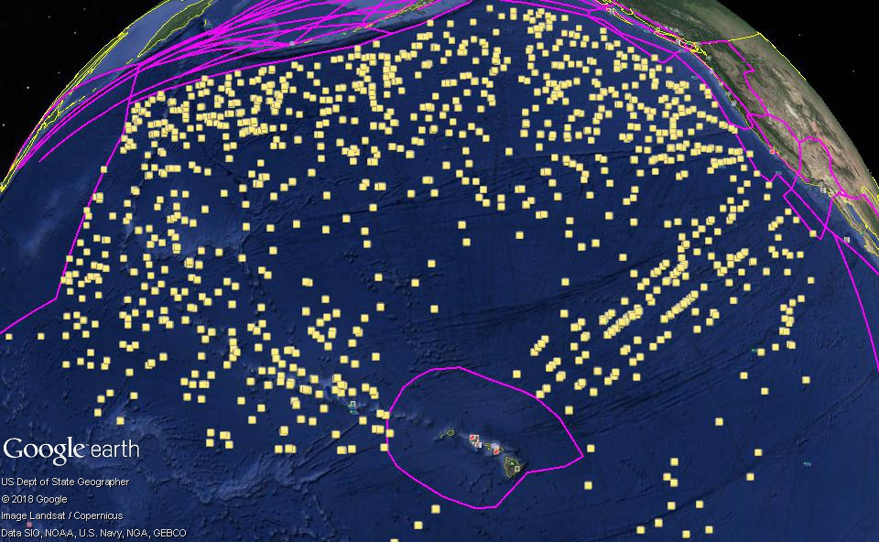

Slide 5
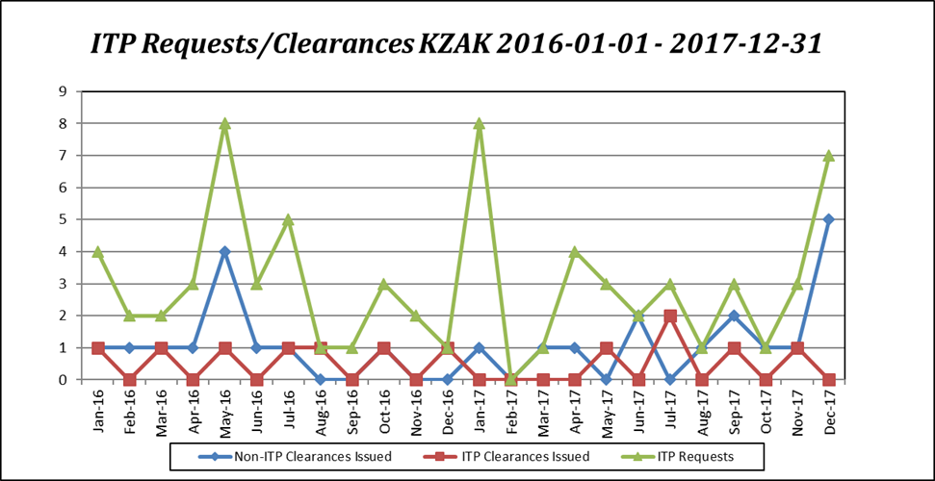

Slide 6

Questions

