Slide 1
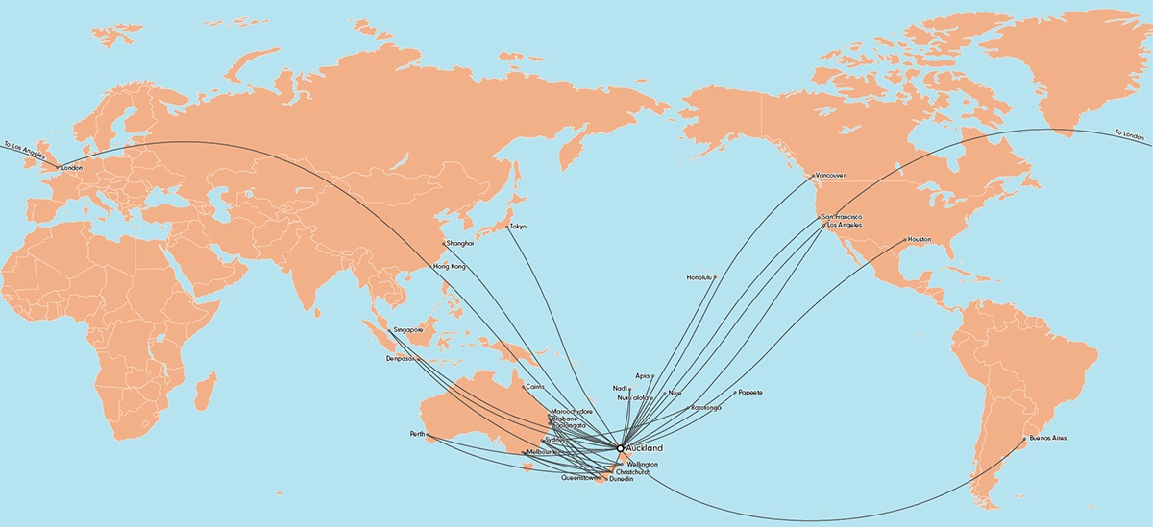
Airways NZ
NZZO NZAIP
UPR EXPANSION

Slide 2
NZZO NZAIP UPR Expansion.
Removal of the restrictions South of A346 and North of L521.
Clarification where publish waypoints must be used and where lat / long positions on the FIR boundary are permitted.
All content copyright Airways NZ ©

Slide 3
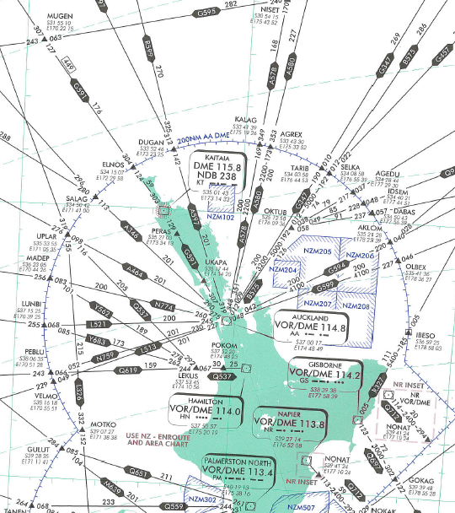
NZZO NZAIP UPR Expansion
All content copyright Airways NZ ©

Slide 4
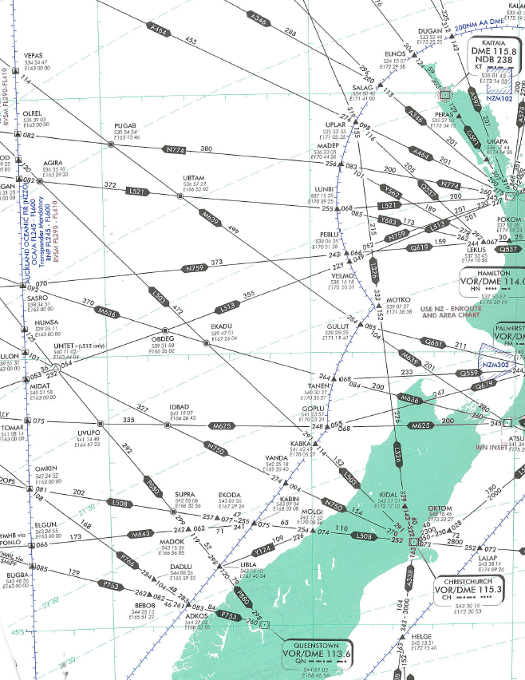
NZZO NZAIP UPR Expansion
All content copyright Airways NZ ©

Slide 5
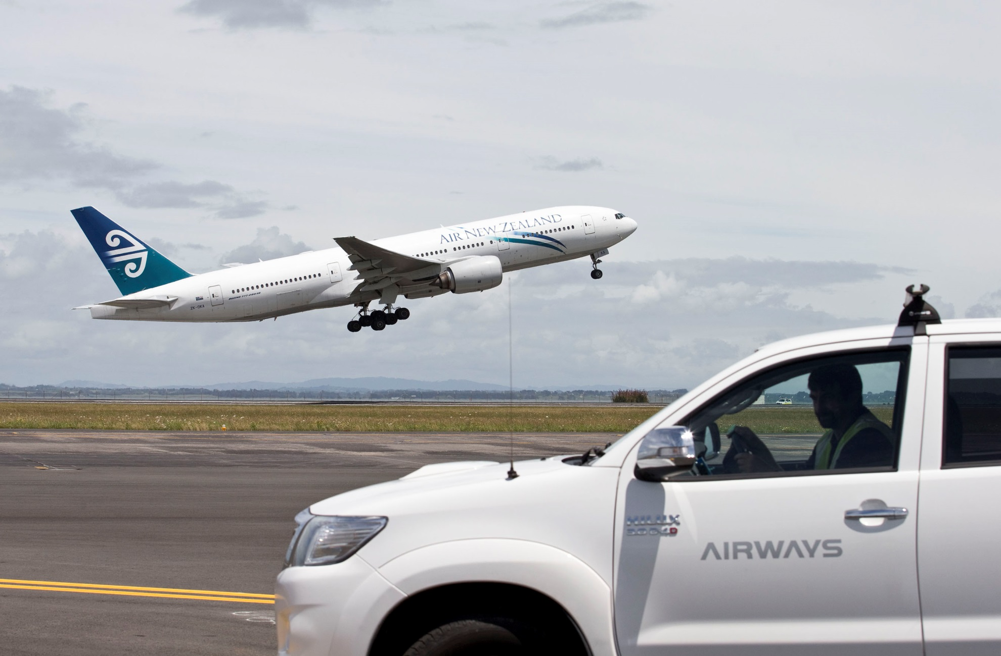

All content copyright Airways NZ ©

