Slide 1
32ND Meeting of the Informal South Pacific Air Traffic Services Coordinating Group (ISPACG/32)
Monitoring Agency Activities in South Pacific Airspace

Slide 2
Overview
Pacific Approvals Registry and Monitoring Organization (PARMO)
PARMO responsibilities related to States
PARMO responsibilities related to airspace
Annual report to RASMAG/22
Latest news and updates
Reminders

Slide 3
Pacific Approvals Registry and Monitoring Organization (PARMO)
Regional Monitoring Agency (RMA)
  Established by APANPIRG to support RVSM implementation and continued safe-use of the RVSM in Pacific Airspace
  https://www.faa.gov/air_traffic/separation_standards/parmo/
Enroute Monitoring Agency (EMA)
  Supports the continued safe-use of reduced horizontal separation minima (30-NM and 50-NM longitudinal, and 30-NM lateral separation minima)
The Australian Airspace Monitoring Agency (AAMA) is also an RMA and EMA for South Pacific Airspace

Slide 4
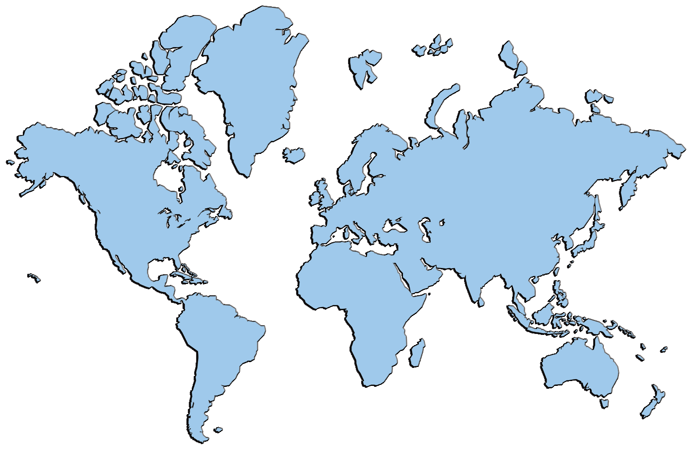
ICAO Endorsed Regional Monitoring Agencies
Eurasia RMA
NAT CMA
NAARMO
Eur RMA
China RMA
Mid RMA
Japan RMA
PARMO
ARMA
MAAR
CARSAMMA
SATMA
AAMA
AAMA | Australian Airspace Monitoring Agency
ARMA | African and Indian Ocean (AFI) Regional Monitoring Agency
CARSAMMA | Caribbean and South American Monitoring Agency
China RMA | China Regional Monitoring Agency
EurAsia RMA | Regional Monitoring Agency Eurasia
Eur RMA | European Regional Monitoring Agency
Japan RMA | Japan Regional Monitoring Agency
MAAR | Monitoring Agency for Asia Region
Mid RMA | Middle East Regional Monitoring Agency
NAARMO | North American Approvals Registry and Monitoring Org
NAT CMA | North Atlantic Central Monitoring Agency
PARMO | Pacific Approvals Registry and Monitoring Organization
SATMA | South Atlantic Monitoring Agency

Slide 5
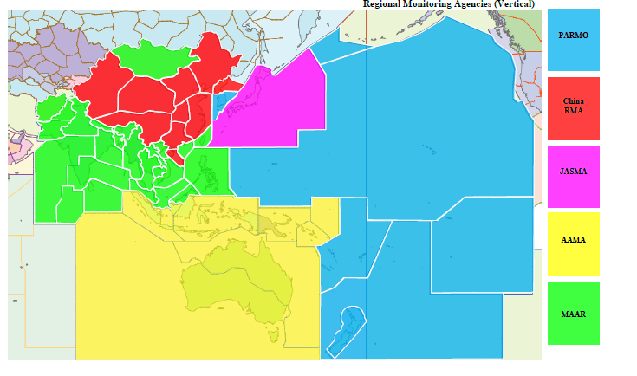
RMAs for the ICAO APAC Region
China RMA
JASMA
PARMO
MAAR
AAMA

Slide 6
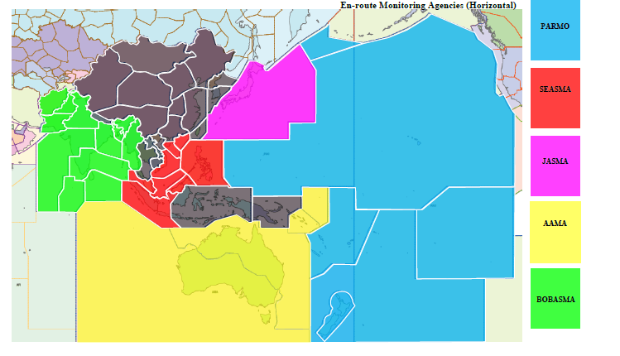
EMAs for the ICAO APAC Region
JASMA
PARMO
BOBASMA
SEASMA
AAMA

Slide 7
PARMO – Designated States & FIRs
State
Airspace
Cook Islands
Federated States of Micronesia
Fiji
Kiribati
Marshall Islands
New Zealand
Palau
Republic of Korea
Samoa
Tonga
Auckland FIR
Nadi FIR
Oakland FIR
Tahiti FIR
* The North American Approvals Registry and Monitoring Organization (NAARMO) is the designated RMA for the following States: Canada, Mexico & U.S.

Slide 8
AAMA – Designated States & FIRs
State
Airspace
Australia
Indonesia
Nauru
Papua New Guinea
Solomon Islands
Vanuatu
Brisbane FIR
Honiara FIR
Jakarta FIR
Melbourne FIR
Nauru FIR
Port Moresby FIR
Ujung Pandang FIR

Slide 9
PARMO Responsibilities Related to States
Maintain a database of RVSM and PBCS approvals
Monitor aircraft altimetry system error (ASE) performance against approval requirements
Annual RVSM Audit using Traffic Sample Data (TSD) and RVSM Approval database
Circulate regular reports of all height deviations to relate the estimated risk to the target level of safety (TLS)

Slide 10
PARMO Activities Related to the Airspace
Collect reports of vertical, lateral and longitudinal incidents
Collect traffic sample data (TSD) from ANSPs (one-month sample for December of each year)
Estimate Collision Risk Model (CRM) parameters from the collected TSD
Circulate regular reports of all height deviations to relate the estimated risk to the target level of safety (TLS)

Slide 11
Annual Reports Provided to RASMAG/22
All the Asia Pacific RMAs and EMAs provide Safety monitoring reports to the Regional Airspace Safety Monitoring Advisory Group (RASMAG)
RASMAG meetings are held annually at the ICAO Asia and Pacific (APAC) Office In Bangkok, Thailand
Reports include
  Summary of received TSD and de-identified reported height deviations, lateral deviations and longitudinal errors
  Annual RVSM audit results using TSD and RVSM approvals database
  Assessment of outstanding long-term height monitoring (operators who have not fulfilled the ongoing RVSM monitoring requirements in Annex 6)
  Annual estimates of collision risk (vertical, lateral and longitudinal)

Slide 12
PARMO RVSM Audit Results Provided to RASMAG/22
Compare ‘W’ provided in Item 10 of FPL against RVSM approvals database
Listing below are results with number of observations > 2
State Authorities have been informed
RMA | State of Op /Registry | AC Type | Dec 2016 Ops Count | TSD
NAARMO | U.S. | SF34 | 13 | ZAK
JASMA | Japan | MRJ9 | 4 | ZAK
NAARMO | U.S. | B734 | 4 | ZAK
NAARMO | U.S. | B763 | 2 | ZAK
NAARMO | U.S. | GLF4 | 2 | ZAK
NAARMO | U.S. | CL35 | 2 | ZAK
NAARMO | U.S. | GLF4 | 2 | NADI
China RMA | China | B789 | 2 | NADI
AAMA | Vanuatu | B738 | 2 | NADI

Slide 13
Management of Non-RVSM Aircraft
RVSM Audits performed by PARMO and other Asia Pacific RMAs and presented to RASMAG/22 led to Conclusion APANPIRG/28/12: Management of Non-RVSM Aircraft
ICAO Bangkok Office issued a survey to all Asia Pacific States (due date was 31 December 2017)
Survey was meant to ensure that States have policies in place to exclude aircraft known to be Non-RVSM from the application of 1,000 ft vertical separation

Slide 14
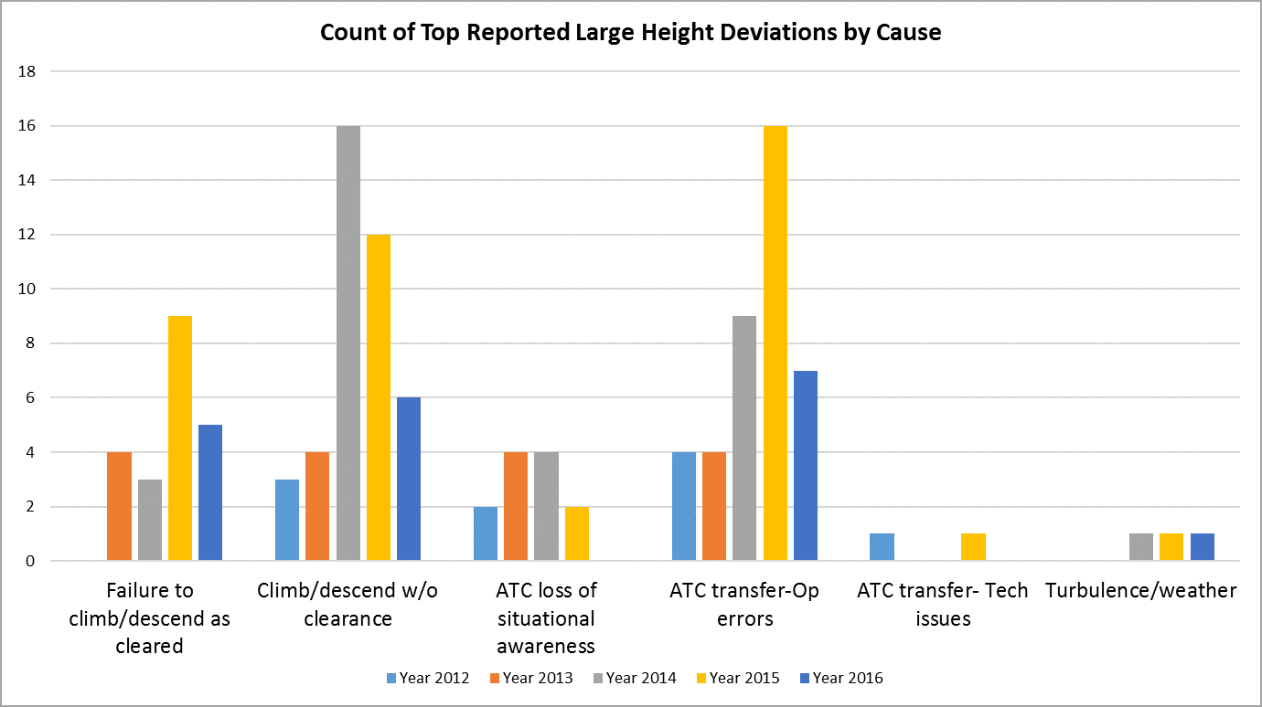
PARMO Summary of Large Height Deviations

Slide 15
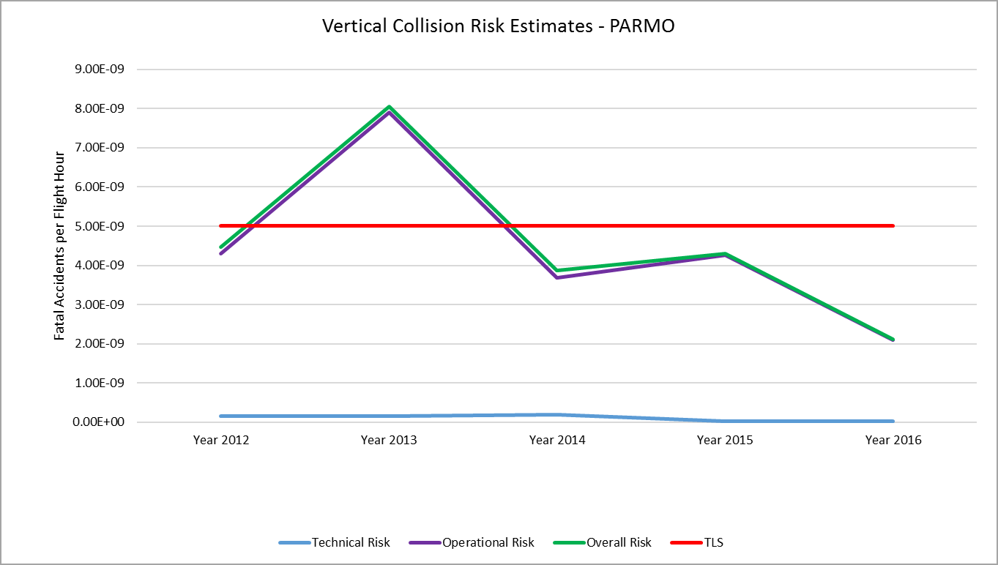
PARMO Summary of Vertical Collision Risk Estimates
Number Minutes 153 239 88 191 149.5
at Incorrect FL

Slide 16
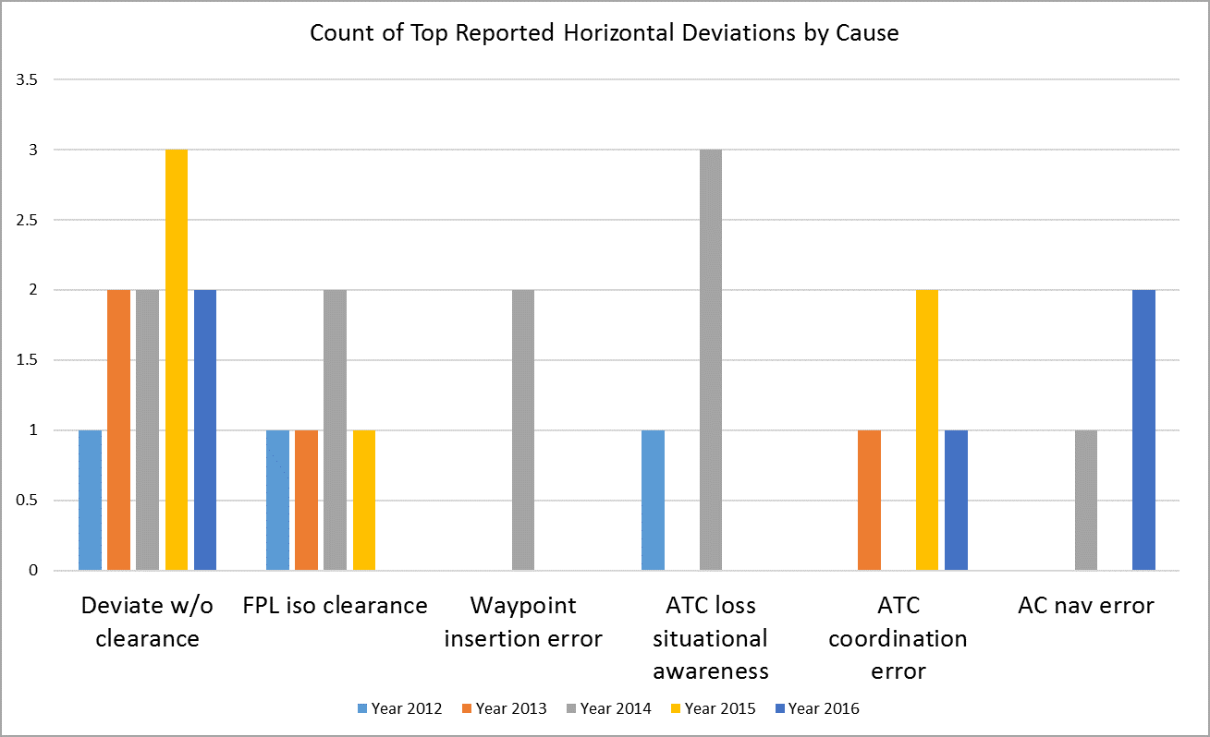
PARMO Summary of Horizontal Error Reports

Slide 17
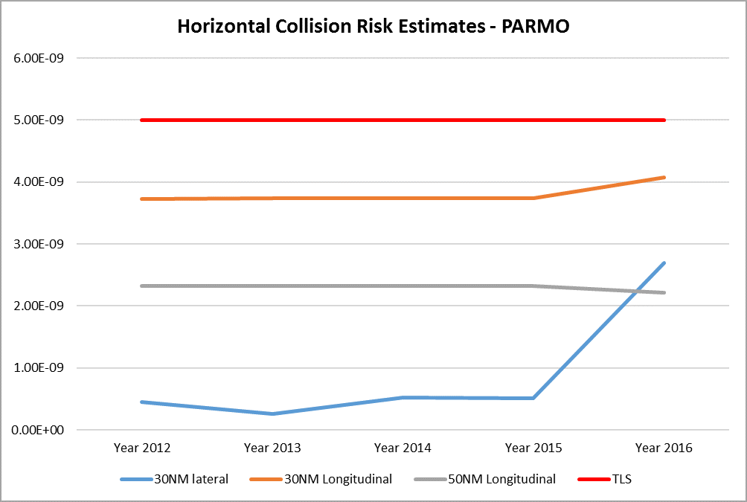
PARMO Summary of Horizontal Collision Risk Estimates

Slide 18
Safety Monitoring Report Summary
Currently, no adverse trends in any event category observed in South Pacific airspace
  Based on the reported events provided to PARMO
Vertical and horizontal collision risk estimates
  Remain below the TLS; however, these estimates are reflective of the operational error reports received
  It is important that ANSPs/Airspace users provide PARMO with reports of events involving deviations from that which was cleared/planned

Slide 19
State Assessment of Airspace Risk
Decision RASMAG/22-11
  States are urged to provide RASMAG a summary of identified airspace risk occurrences as analyzed by the State, and any mitigations introduced
  Objective is to ensure a feedback mechanism between the RMA, State and RASMAG is in place to provide a greater understanding of regional airspace risk and actions being taken by the States
  Interpretation: States are invited to attend RASMAG and provide a presentation/paper discussing procedures/ATC tools/automation changes/etc implemented in their airspace to improve safety

Slide 20
Important Updates
Collection of PBCS approval information
  In addition to RVSM approval information, PARMO will collect and maintain RCP240 & RSP180 State approvals within existing RVSM approval database
Updated event report form
  Recently emailed new form to ANSP contacts
  Allows for vertical, lateral & longitudinal events to be reported using the same form

Slide 21
Important Updates (continued)
Updated event report form
  Just culture reminder: The purpose in collecting this information is NOT to assign blame or liability. The objective is always to help in the understanding of what faltered.
  The information gathered can be used to design and implement procedures which can prevent any recurrence of circumstances leading to previously investigated incidents.
  This culture is supported by ICAO Annex 13 – Aircraft Accident and Incident Investigation

Slide 22
Action for the Meeting
South Pacific States should provide RCP240 and RSP180 approval information to PARMO (or their designated EMA/RMA)
Ensure that the ANSPs
  provide monthly vertical, lateral, and longitudinal incident reports to the PARMO
  provide the December traffic sample data (TSD) to the PARMO, the TSD should include the aircraft callsign, registration mark, filed item 10 information, and aircraft position data including Flight Level (FL). See PARMO website for template or email parmo@faa.gov.

Slide 23
Questions? parmo@faa.gov
Christine Falk Christine.falk@faa.gov

