Slide 1
32nd Meeting of the Informal South Pacific Air Traffic Services Coordinating Group (ISPACG/32)
Acceptable Level of Risk (ALR)
Coleen Hawrysko
April 12, 2018

Slide 2
ALR Background
Increasing Commercial Space activity
FAA Commercial Space Transportation (AST) and the FAA Air Traffic Organization (ATO) use different safety standards
Safety panel concluded existing high hazard
ATO proposed the ALR concept
FAA SMS Executive Council:
  Originally approved ALR for 6 months
  Established ALR Tactical Team
  Approved ALR temporarily
Notes:
Here’s some background information about how ALR came into being
As you know, during a space launch or reentry a lot of airspace has to be blocked to accommodate it. And with the rapidly increasing space activity we’re seeing, blocking huge chunks or airspace is becoming untenable.
The FAA office of commercial space transportation, or AST, and the air traffic organization, ATO, use different measurements to decide what is safe: AST uses 10⁻⁶, and ATO uses 10⁻⁹. But although the probability standard in AST is lower than in ATO, AST is more conservative in other ways. For example, AST uses collisions that produce a casualty, and ATO uses events that produce a fatality. Also, the assumptions used in AST modeling are more conservative: They use a concept known as continuous presence, and they model with larger aircraft and larger debris size. This all means that their 10⁻⁶ is not the same as our 10^{-6.}
Last year, a Safety Risk Management panel was convened, and they were presented with the fact that the ATO is given airspace to block that is computed using 10⁻⁶, while of course the ATO standard is 10⁻⁹. Because of this disparity, the panel concluded there is an existing high hazard in the NAS. But if we were going to have to start blocking aircraft hazard areas - or AHAs - to 10⁻⁹, it would result in massive aircraft delays due to the enormous size of these AHAs
So a group of mathematicians from ATO Safety got together and conceived of a plan to find a way for the 2 varying standards to coexist. Their proposal was ALR, or the Acceptable Level of Risk
This proposal was presented to the FAA Safety Management System Executive Council in January 2017. The Council approved the use of ALR, as proposed, for 6 months, and established a cross-lines-of-business group called the ALR Tactical Team. The team’s mission was to evaluate the ATO’s proposal, and deliver a recommendation regarding whether to continue the use of ALR, and if so, to determine the breadth of commercial space operations that could be covered by it.
The ALR Tactical Team came back with a recommendation to use ALR for all applicable commercial space launch and reentry operations, and in December of 2017, the FAA SMS Executive Council approved the use of ALR “temporarily” while technologies are developed that will enable space launch and reentry operations to conform to the ATO safety standard of 10⁻⁹
There is, however, no defined end date for ALR

Slide 3
ALR: The Specifics
Individual aircraft can be exposed to risk up to 1x10⁻⁷
Introduces Collective Risk
Restrictions allow aircraft to fly up to the 1x10⁻⁶ contour
Notes:
The ALR Specifics:
There are 2 main differences between the ATO SMS safety standard and ALR. The first is that, under ALR, individual aircraft can be exposed to a higher risk: 10⁻⁷ .
The second is that Collective Risk was introduced into the ATO. The collective risk stipulates that, with 95% confidence, there will not be a fatality caused by ALR operations in a typical lifetime; which is described here as 80 years.
Because of the collective risk, the number of aircraft that can be exposed to the higher ALR risk is limited. Once the math was done, it was determined that the maximum number of aircraft that can be exposed to the higher risk is 6412 in any rolling 12 month period
As discussed earlier, AST makes different assumptions when they calculate their safety contours than ATO. In fact, it’s different enough that their 10⁻⁶ is almost the same as our 10⁻⁷ ; but not quite. The fact that AST uses “continuous presence” in their calculations means that if debris were to fall outside the AHA, the assumption is that there would be an aircraft there to be hit by it. But the ATO takes into consideration the fact that if debris falls outside the AHA, there is only a probability that there will be an aircraft there to get hit by it; the ATO gives credit in its mathematical calculation for quickly getting in and out of the AHA. So with a few restrictions to make sure aircraft are not in the AHA for an extended period of time, we can ensure that individual aircraft are not exposed to a risk greater than 10⁻⁷ . These restrictions, which apply to the airspace between the 10⁻⁶ and 10⁻⁷ contours, which we refer to as the Transitional Hazard Area, or THA, are as follows:
Aircraft operations parallel to the flight path of the rocket are not allowed. The mathematicians determined that the angular difference between the rocket and aircraft must be at least 30 degrees
No holding, loitering or helicopter operations are allowed
Finally, no ATC services will be provided to airports that lie within an active THA

Slide 4
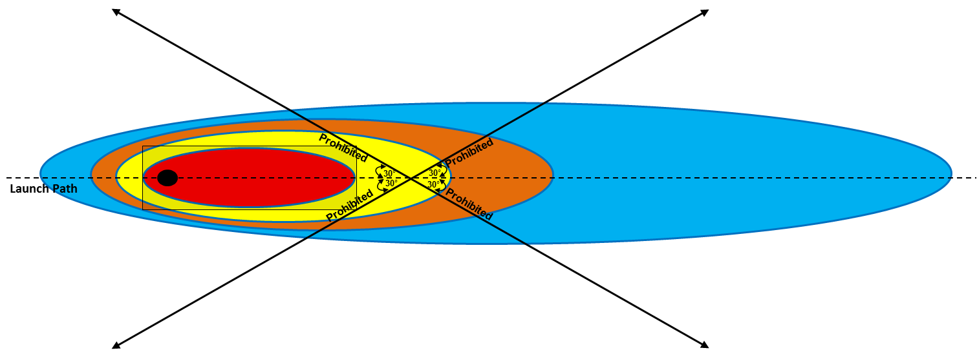
AHA Diagram
Routes with Angular Difference Less Than 30 Degrees from Launch Path Are Closed
Notes:
Here is a diagram to show what this all looks like. The black dot on the left is the launch site, and the red area is the traditional aircraft hazard area, computed to 10⁻⁶ . The yellow area is the transitional hazard area, computed to 10⁻⁷ . No aircraft are allowed inside the red area at any time, and the yellow area is where fixed-wing aircraft are permitted to enter provided they comply with the angular restrictions and don’t loiter. The solid black lines show where routes may and may not be flown.
As you can see here, there is a clearly defined flight path azimuth that allows the required 30 degree angle to be calculated.

Slide 5

Suborbital AHA
Notes:
However, with some launches – for example when the rocket goes straight up and then comes straight back down; like Blue Origin does with their New Shepard vehicle – the hazard area will be more round than linear. In those instances when a flight path azimuth cannot be calculated, (NEXT SLIDE)

Slide 6
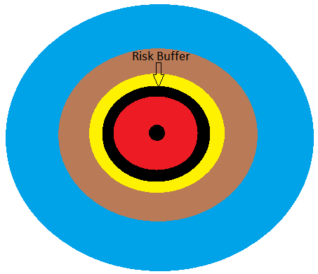
Suborbital AHA
Notes:
A risk buffer will be added onto the hazard area that will ensure no aircraft are exposed to a risk greater than 10⁻⁷ . As you can see, the risk buffer is larger than the AHA, but smaller than the THA. When a risk buffer is added, there is no THA for a controller to manage; it’s simply a larger AHA.
And whether the AHA is oval or round, all aircraft that enter the yellow - 10⁻⁷ - and brown - 10⁻⁸- areas are counted towards the allowed 6412 flights per 12 months

Slide 7
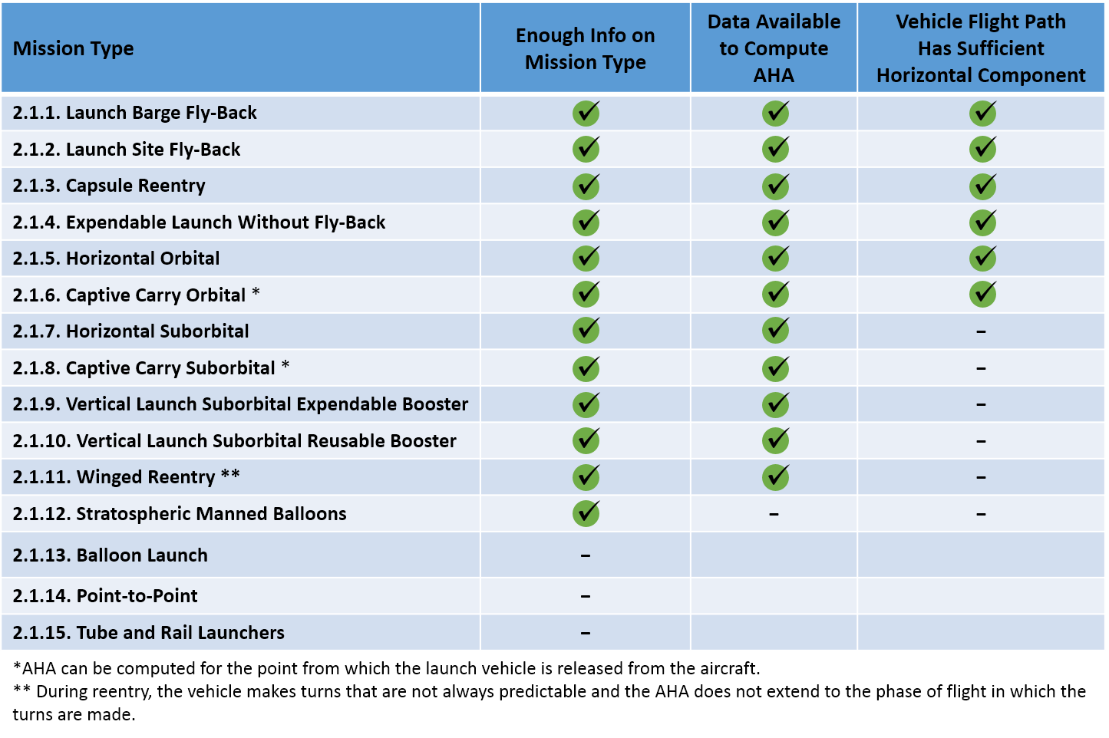
Mission Type Summary
Notes:
I know this slide is a little crowded, but these are the mission types that were considered by the ALR tactical team. Everything from regular vertical launches to concepts like “rail launchers” that are still on somebody’s drawing board.
The 3 criteria that the team considered are:
Can an AHA be calculated?
Can the vehicle launch azimuth be calculated, and
Do we know enough about some of these conceptual launches/or do we believe they will begin operations before ALR expires?

Slide 8
Mission Type Summary
Apply ALR without modification
Notes:
Based on the characteristics of the mission types, the team determined that ALR could be applied to these mission types without modifications:
Launches with first stage Fly-Backs to land and barges
Capsule Reentries
Traditional Launches with expendable first stage boosters
Horizontal Orbital launches, and
Captive Carry with Orbital launches; but with captive carry, ALR can only be applied to the launch phase conducted inside an AHA

Slide 9
Mission Type Summary
Apply ALR with modification (replace 30-degree angular restriction with buffer, provided by AST, in addition to the AHA)
Notes:
On suborbital launches, an AHA can be calculated, but launch path azimuth doesn’t have a long axis; so the AHA is closer to round. Because of this, an angular difference between the rocket and aircraft cannot be computed
In these cases, the 30 degree angular restriction is replaced with a buffer added to the AHA, which enlarges the AHA enough to ensure that aircraft are not exposed to a risk greater than 10⁻⁷

Slide 10
Mission Type Summary
Apply ALR without modification
Notes:
For the last 5 mission types, either an AHA cannot be calculated, or the concept is still in a conceptual stage. For these, the ATO will apply its current safety standard

Slide 11
Post ALR
SDI: Space Data Integrator
  Tracks space vehicles
HRAM: Hazard Risk Assessment and Management
  Present Refined Hazard Areas on scopes
Notes:
As mentioned earlier, ALR was approved temporarily by the Executive Council. Furthermore, there is no expiration date after which the application of ALR must cease. This was done intentionally, to give enough time for the FAA to develop some capabilities that will allow AHAs to be significantly reduced in size, thereby enabling the ATO to return to the traditional SMS policy.
We have two programs in development that we believe will allow a return to normalcy once they come online.
First: The Space Data Integrator – or SDI – is currently going through the acquisition management process with our Program Management Office. SDI will allow ATC to track the health, position and other essential data points of rockets and capsules that go through the NAS.
Next is what is currently being called the Hazard Risk Assessment and Management tool; or HRAM. HRAM is still in development in our NextGen office, and once completed will be able to take the data from SDI and, during an off-nominal event, calculate Refined Hazard Areas that can be put on the controller’s scopes. These refined hazard areas would be much smaller than the current hazard areas, since they will only protect for the actual debris field generated by the off-nominal event. They would also include a count-down timer to inform controllers when the debris is calculated to begin falling through the NAS. This would allow controllers to utilize most of the airspace under launches and reentries, and only move aircraft from the area in case of an off-nominal event. This theory was tested using Human-in-the-Loop simulations at the Tech Center in Atlantic City, New Jersey back in 2014; and it worked very well.

