Slide 1
32nd Meeting of the Informal South Pacific Air Traffic Services Coordinating Group (ISPACG/32)
Overview of the Application of a 23-NM Lateral Separation Standard Concept of Operations
Coleen Hawrysko
April 12, 2018

Slide 2
Planned Areas of Implementation
The 23-NM lateral will be implemented in the:
  New York Oceanic East Control Area (CTA)/Flight Information Region (FIR)
  Anchorage Oceanic CTA/FIR;
  and a portion of the Oakland Oceanic Controlled Airspace (OCA)/FIR.

Slide 3
Benefits
Regional harmonization by effecting efficient and seamless air traffic services and handoff of aircraft transiting between adjacent air traffic control centers.
Provide more opportunities for trans-Pacific operators to fly optimal profiles which will result in flight time reduction, fuel savings, and a reduction in carbon emissions.

Slide 4
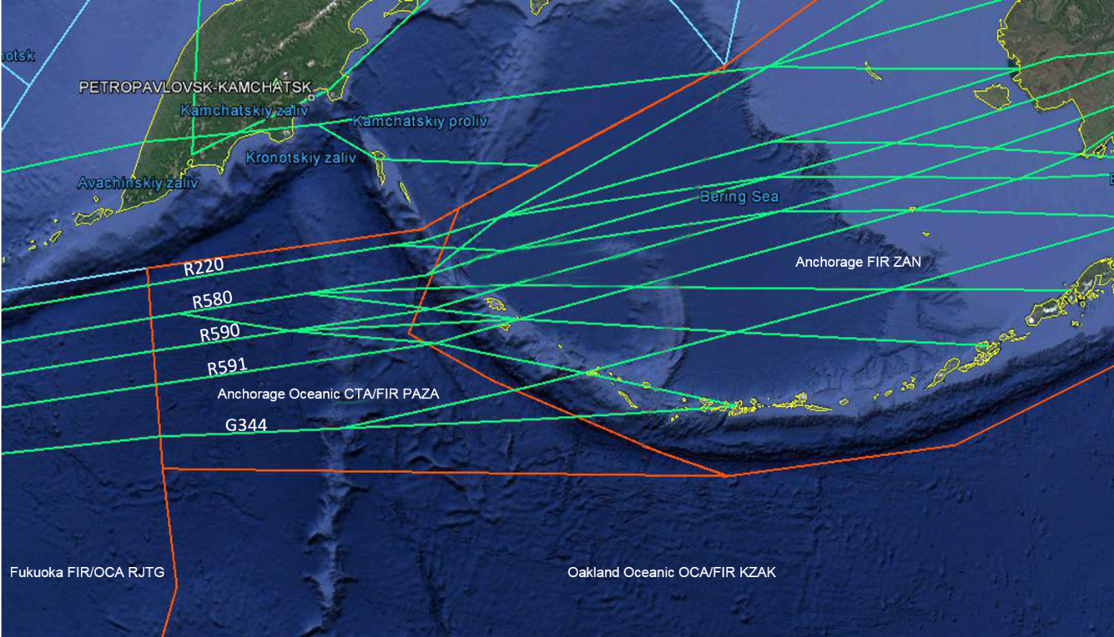
Anchorage Oceanic CTA/FIR
The 23-NM lateral separation standard will be implemented on the Northern Pacific (NOPAC) route system
The NOPAC system will be restructured, with the existing routes remaining parallel and spaced 25 NM laterally.
This spacing includes an additional 2-NM allowance for application of the strategic lateral offset procedure (SLOP).
Operations on the upper route, R220, must satisfy the requirements associated with PBCS authorization.
Non-PBCS operations on the lower routes will be accommodated.

Slide 5
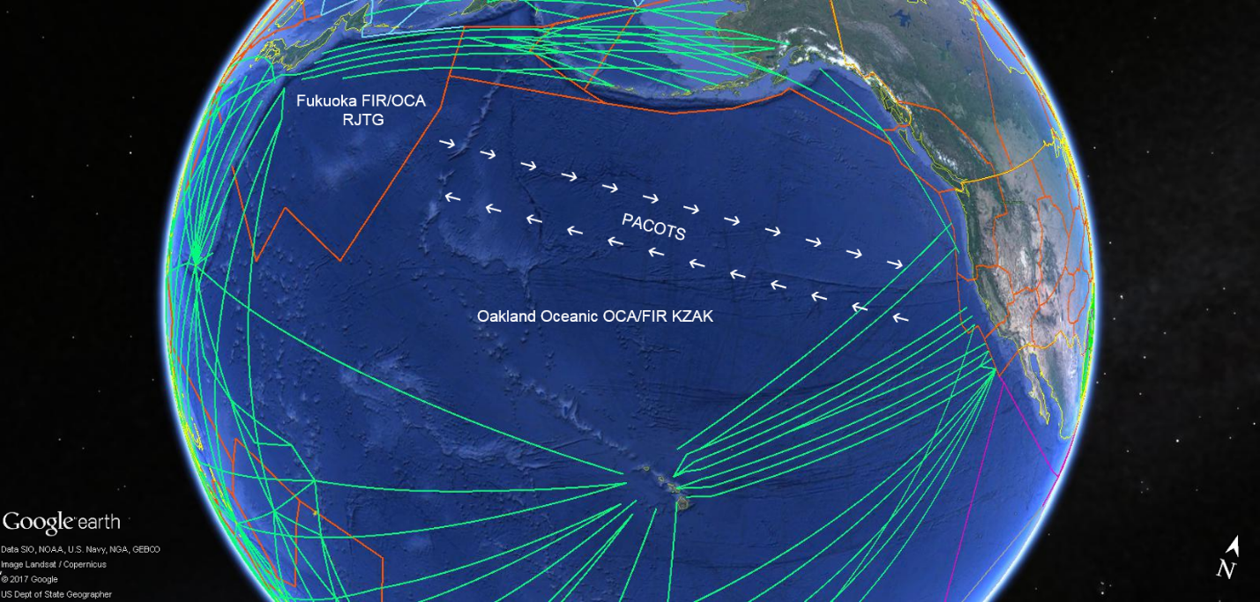
Oakland Oceanic OCA/FIR
The 23-NM lateral separation standard will be applied in the portion of airspace that includes the Pacific Organization Track System (PACOTS).
Currently, PACOTS Tracks are separated laterally by at least 50 NM.
Tracks are moved twice daily in consideration of prevailing winds and are defined using latitude/longitude expressed in whole degrees or using named waypoints, with the possible exception of FIR crossing points.
At this time, there are no plans to restructure the routes.

Slide 6
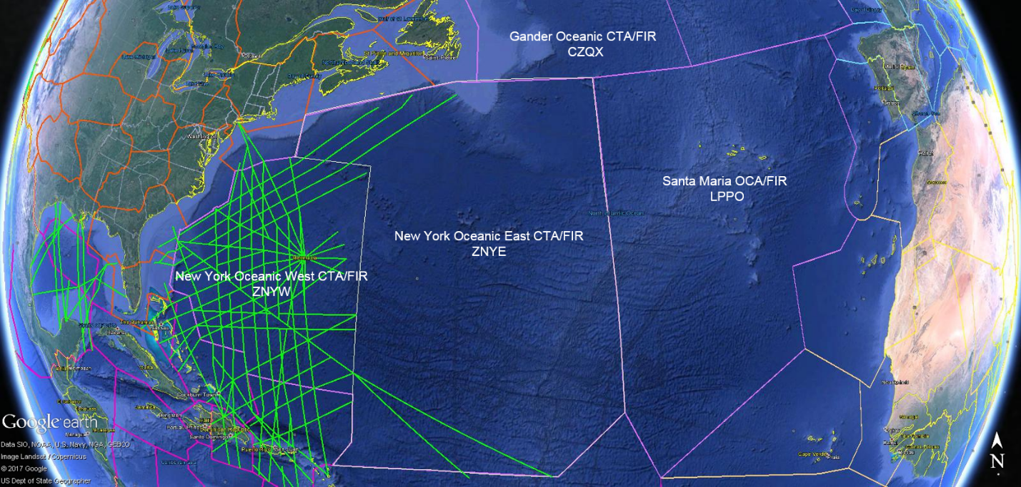
New York Oceanic East CTA/FIR
The 23-NM lateral separation standard will be implemented in all of the New York Oceanic East CTA/FIR.
The standard will primarily be applied to near-boundary operations to facilitate transition of aircraft transiting to and from adjacent FIRs where the standard will be implemented.
The standard will be implemented in the Gander and Santa Maria FIRs.

Slide 7
Application of the Standard
The 23-NM lateral separation standard is a performance-based standard
  Operations eligible for the standard must satisfy PBCS requirements.
  Operators eligible for the standard must have obtained a PBCS approval.
The standard will be applied between aircraft operating at or above the floor of controlled airspace where implemented and:
  Authorized to use ADS-C for surveillance, with an RSP180 approval
  Authorized to use CPDLC for communication, with an RCP240 approval; and
  Approved for RNP2 or RNP4 operations for navigation.

Slide 8
Mission Type Summary
In order to inform ATOP that an aircraft is approved and eligible for application of the standard, operators will be required to include the following information in the ICAO flight plan:
The letter “R” is required in Item 10a of the flight plan along with the performance-based navigation levels that can be met specified in Item 18 following the indicator PBN/.
The appropriate RNP2 or RNP4 designator, “L1” for RNP4
The equipment qualifier J-code must be found within Item 10a of the flight plan.
The equipment qualifier P-code “P2” must be found within Item 10a of the flight plan. The “P2” equipment qualifier indicates the aircraft is certified CPDLC RCP-240.
The text string “RSP180” must appear in Item 18 of the flight plan, following the indicator for surveillance equipment and capabilities (SUR/), which indicates the airframe is certified and compliant.
Notes:
launches/or do we believe they will begin operations before ALR expires?

Slide 9
FANS Logon Requirements and ADS-C Contracts
A logon must be initiated either by the flight crew or automatically following a contact request from another ATS unit in order to establish a CPDLC and/or ADS-C connection.
A logon attempt will be rejected by ATOP if the ICAO flight plan does not contain one of the J-codes indicating satellite communications (SATCOM) capability (J5, J6 or J7).
An additional check will be performed to determine eligibility for application of the 23-NM lateral standard.
  The most recently received ADS position report for the flight must contain a Figure of Merit (FOM) that meets or exceeds the adapted minimum RNP-4 threshold.

Slide 10
Concept for Use of ATOP Oceanic Airspace
The standard will only be applied to appropriately equipped pairs of aircraft that have filed in accordance with flight-plan requirements and are logged on to the communications/ surveillance system through a communications service provider.
The controller will apply the standard on a tactical basis if, and when, appropriate between aircraft pairs.
Conformance monitoring shall be ensured by establishing an ADS-C event contract specifying a lateral deviation change event with a maximum of 5-NM threshold and a waypoint change event.

Slide 11
Concept for Use of ATOP Oceanic Airspace
When two aircraft are eligible for different reduced separation minima, the larger standard shall be applied between the pair.
No changes resulting from this implementation will be required by adjacent air traffic service providers.
No changes resulting from this implementation will be required by aircraft operating in airspace adjacent to the FAA oceanic CTAs.

Slide 12
Provisions for Accommodating Aircraft Not Eligible for 23-NM Lateral Separation
Airspaces where the standard will be implemented will not be exclusionary.
The standard will not be applied between pairs of aircraft not authorized for RCP240 and RSP180, and those not communicating with ADS-C and CPDLC
The standard will not be applied between pairs in which only one aircraft is approved for application of the 23-NM standard.

Slide 13
Concept for Transfer of Control Into Adjacent FIRs not Controlled by the U.S.
The 23-NM lateral separation standard will continue to be provided during transfers with adjacent Air Navigation Service Providers (ANSPs).
For inbound transfers, application of the standard will be allowed when a CPDLC connection has been established in advance. Current data authority is confirmed as soon as practicable upon entry into the airspace.
For outbound transfers to ANSPs supporting CPDLC, application of the standard will be allowed to continue after transfer of communication and control has been successfully completed.

Slide 14
Target Implementation Dates
Implementation in the New York Oceanic East CTA/FIR is planned for March 2020.
  Implementation task list developed (18 critical milestones)
  Initial assessment tasks initiated
Target implementation date for the NOPAC route system is TBD.
Target implementation date for PACOTS is TBD.

