Slide 2


Slide 3

SURVEILLANCE IN FIJI
WHAT ?
WHERE ?
WHEN ?
HOW?

Slide 4
SMART – APPROACH
“Do it well – Do it Once”.

Slide 5
Objective of The FIJIANS Plan
To take a whole system approach to enable the FIJIans Plan.
Manage complex inter-program relationships within the ATM system.
Consider ground infrastructure, aircraft equipage, and importantly the rules framework and equipment mandates need to go hand in hand.
Provide tools to manage varied fleet capability.
Delivering safety, capacity, efficiency.

Slide 6
Stakeholders– Short –Medium-Long Term
EXTERNAL
Ministry of Civil Aviation – Govt. of Fiji
CAAF
Major Domestic Operators
Major International Operators
Telecommunication Companies
Hospitality Industry – Hotels/Tourism
Town/City Councils – Noise abatement./Environment
Unions

Slide 7
Short –Medium-Long Term Priority
SERVICE 2019-2020
Continue Business As Usual BAU
Implement New Surveillance Service
Review, Assess, Act on Feedback,
Operate in Tandem for Consolidation & redundancy.
Cut over to Full Surveillance.
Review, Assess, Act on Feedback,
Determine Point of No Return.
Full surveillance Service in line with ASBU

Slide 8
Benefits – Surveillance, PBN Routes, Separated SIDS/STARS
SAFETY
CIRCULAR FLOW ROUTE STRUCTURE
CONTINUOUS CLIMB
CONTINUOUS DESCENT
PREDICTABLE FLIGHT PATH – Reduced PILOT WORK LOAD
ECONOMIC BENEFIT
ENVIRONMENTAL BENEFIT

Slide 9
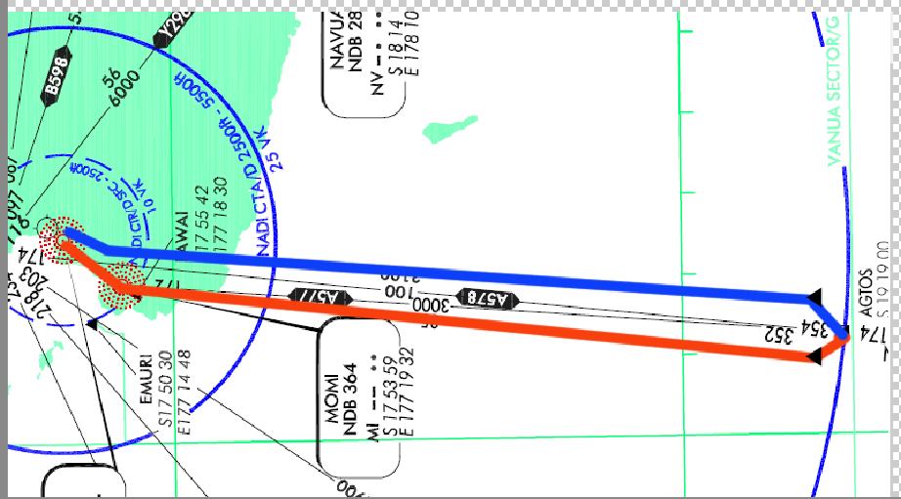

Slide 10
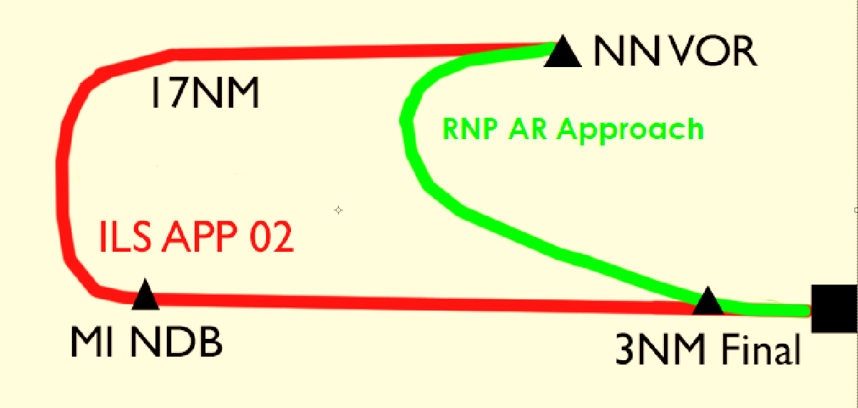

Slide 11
Set Up Work Streams – Short –Medium Term
TECHNICAL
VHF/CPDLC - Domestic DATA LINK
SATELLITE
ADSB Receivers installation/ maintenance
NETWORKS
REDUDANCY
MAINTENANCE
SOFTWARE - Upgrades

Slide 12
Set Up Work Steams – Short –Medium Term
NAV
Design PBN Route Structure
Consult with Operators
Test in SIM – workable – adjust/redesign
Achieve PBN objectives -
NETWORKS
REDUNDANCY
MAINTENANCE
SOFTWARE - Upgrades

Slide 13
Set Up Work Steams – Short –Medium Term
PEOPLE – HR, Finance
Resource, Resource, Resource !! Numbers
Training
Alternative Options
Redundancy/Failure
Counselling

Slide 14
Set Up Work Steams – Short –Medium Term
Projects
Project Management
Reporting to Managers, Executives and Board
Realistic Time lines
Flexibility within reason
Understand the complexities of AIRAC Cycles, requirements for testing and redesigning.
Fit for purpose.
Adhering to time lines

Slide 15
We need to work together to make this happen so everyone can benefit.

Slide 16
Questions

