Slide 1

PNG Air Services Limited
ISPACG Update
April 2018

Slide 2
Modernisation Program
ATM Transition – largely on track
VHF/HF projects – delayed due security and contractor issues
ADS-B reliant on VHF project – partially complete

Slide 3
ATM Transition
Plan disrupted due unrecoverable failure of current FDP
Interim transition of APP/ARR onto new ASDs and processors (limited functionality)

Slide 4
ATM Transition - Timeline
Interim transition – go live on 30 April
Area/Arrivals - mid Q3 2018
Approach/Tower - late Q3 2018 (APEC)
Flight Service post APEC 2018

Slide 5
Communications
First new VHF operational (including redundant links)
Two new VHF sites rendered unusable through local land owner intervention – now sourcing alternate sites
Remaining VHF sites by end 2018?

Slide 6
Communications
HF delayed indefinitely due contractor issues

Slide 7
Surveillance
Second ADS-B site installed - providing data for evaluation and SA (Mt Nauwein) – eventual 5NM standard
Remaining sites to be commissioned early 2019

Slide 8
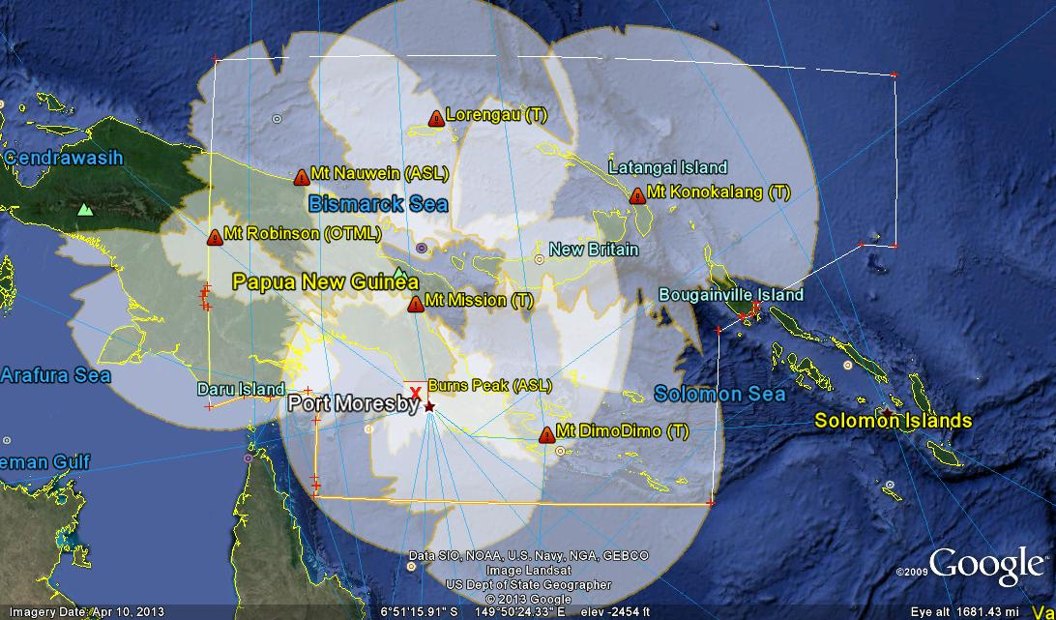
Surveillance

Slide 9
Surveillance
Mode S Radar operational by July 2018

Slide 10
Next Steps
ADS-C/CPDLC Q3 2018
AIDC Testing Q3 2018
ADS-B Data Sharing Q4 2018

Slide 11
Questions?

